Slide 1
Bayesian Neural Networks : An Introduction and Survey
Coopt, 이관희

Slide 2
Contents
Literature Survey
Hybrid Approach – MCMC
Modern BNNs

Slide 3
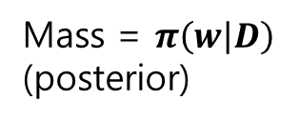
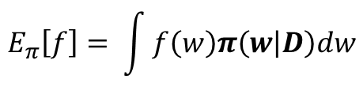
1. Literature Survey - Hybrid Approach : MCMC
To calculate predictions (inference) F, we use expectation of F where,
$$E_{π}\left[f\right]= \int{f\left(w\right)π\left(w | D\right)dw}$$
Mass = $π\left(w | D\right)$
(posterior)
Volume = dw
Relies on accurate approximations of intractable posterior
Recall ) we used approximation methods such as VI (variational Inference) , Laplace
Mass of the distribution may not be the maximum considering the optimization scheme
Because the goal of optimization is to maximize expectation of prediction, presented as product of mass and volume
Goal : maximize mass and also the product of mass and volume -> MCMC

Slide 4
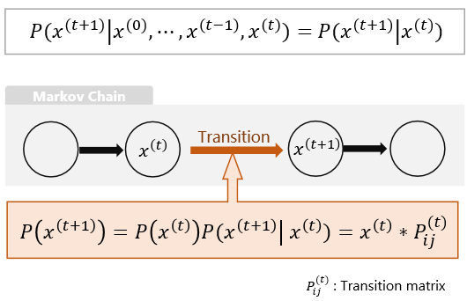
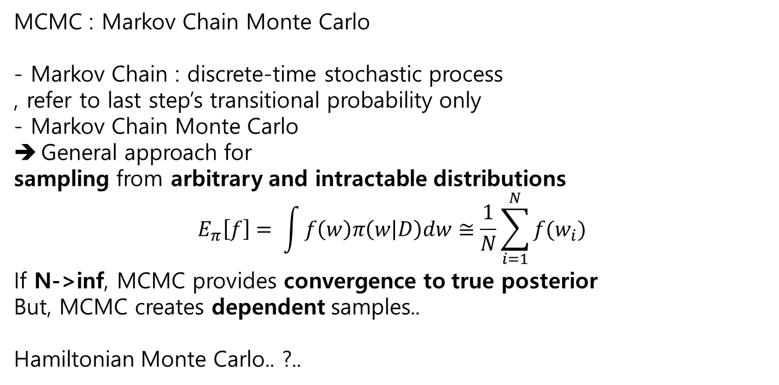
1. Literature Survey - Hybrid Approach : MCMC
Markov chain
MCMC : Markov Chain Monte Carlo
- Markov Chain : discrete-time stochastic process
, refer to last step’s transitional probability only
- Markov Chain Monte Carlo
General approach for
sampling from arbitrary and intractable distributions
$$E_{π}\left[f\right]= \int{f\left(w\right)π\left(w | D\right)dw≅\frac{1}{N}\sum_{i=1}^{N}{f(w_{i})}}$$
If N->inf, MCMC provides convergence to true posterior
But, MCMC creates dependent samples..
Hamiltonian Monte Carlo.. ?..

Slide 5
1. Literature Survey - Modern BNNs
Focused on VI methods using single hidden layer
Network architetures vary -> need of more general approach
Graves -> using factorized Gaussian Approximate posterior to update VI objective parameters
MCMC vs VI (Framework)
ALL DATA vs SGD
Using Stochastic MCMC -> bad
Backprop?
-> Probabilistic Back Propagation,Bayes-by-backprop, dropout..

