Slide 1
Sharpness-Aware Minimization for Efficiently Improving Generalization (SAM)
Pierre Foret et al. (Google research)

Slide 2
목차
1. Introduction
2. Sharpness-Aware Minimization (SAM)
3. Empirical Evaluation
4. Sharpness and Generalization Through the Lens of SAM
5. Related Work
6. Discussion and Future Work
7. Acknowledgements

Slide 3
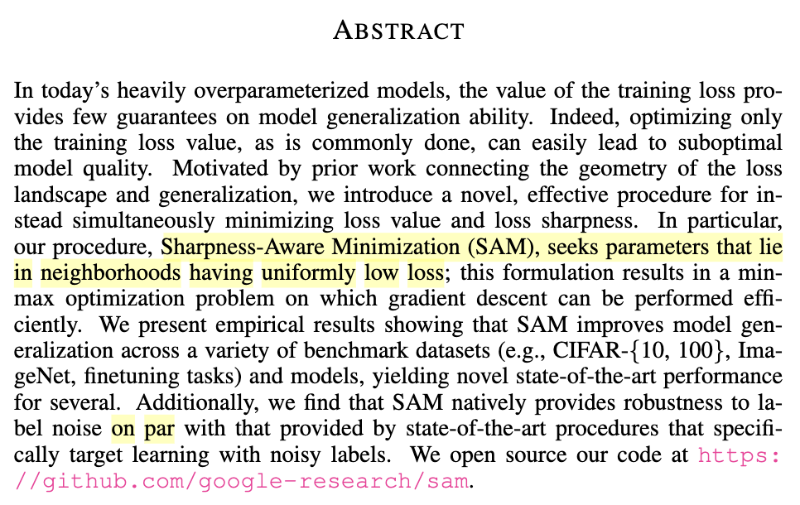
Abstract

Slide 4
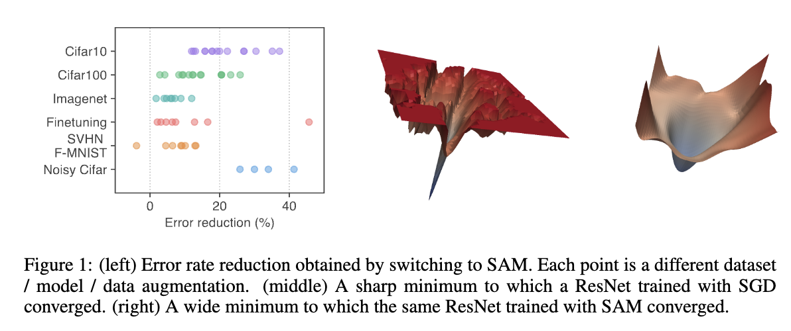
1. Introduction

Slide 5
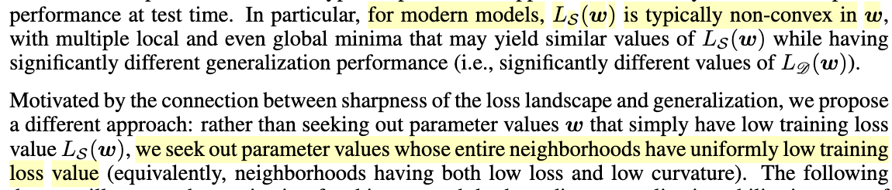
2. Sharpness-Aware Minimization (SAM)

Slide 6
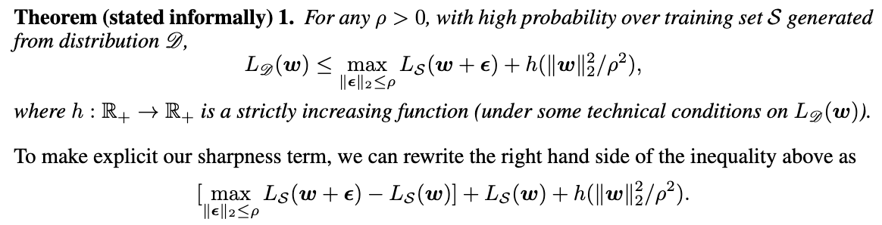
2. Sharpness-Aware Minimization (SAM)

Slide 7
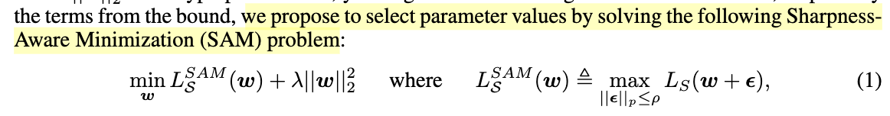
2. Sharpness-Aware Minimization (SAM)

Slide 8
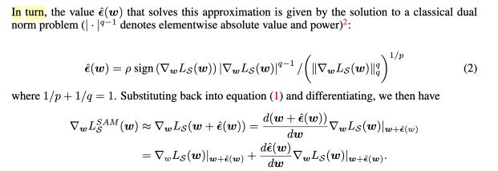

2. Sharpness-Aware Minimization (SAM)

Slide 9
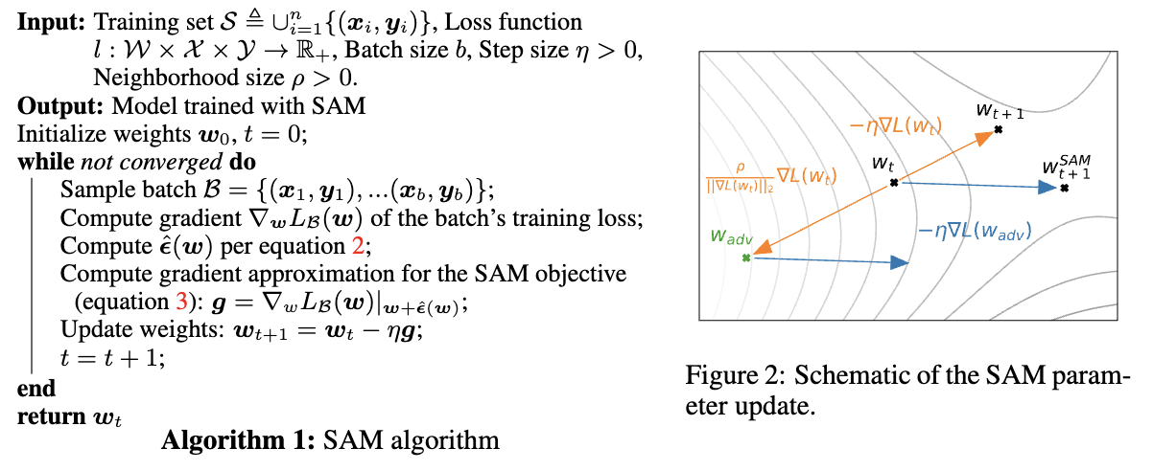
2. Sharpness-Aware Minimization (SAM)

Slide 10
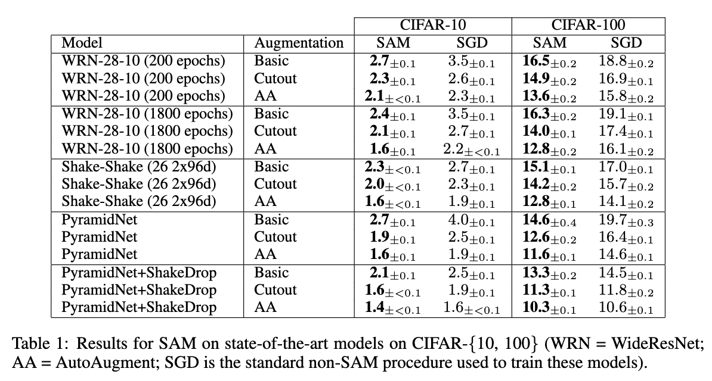
3. Empirical Evaluation - Image Classification from Scratch

Slide 11
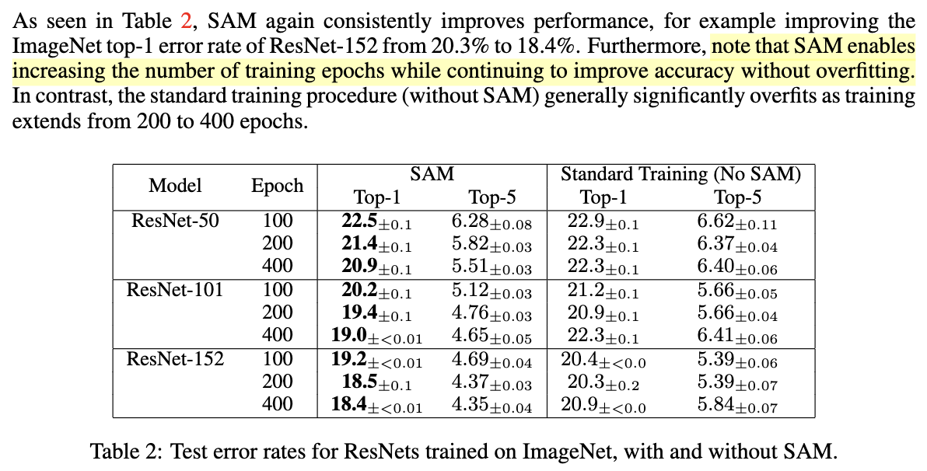
3. Empirical Evaluation - Image Classification from Scratch

Slide 12
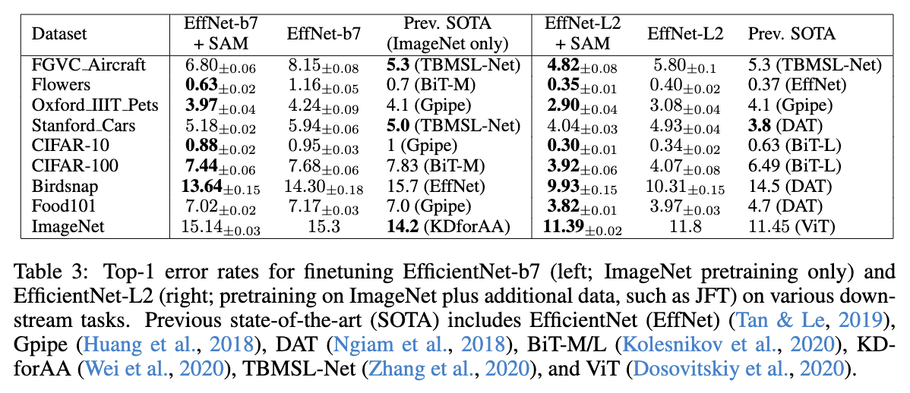
3. Empirical Evaluation - Fine tuning

Slide 13
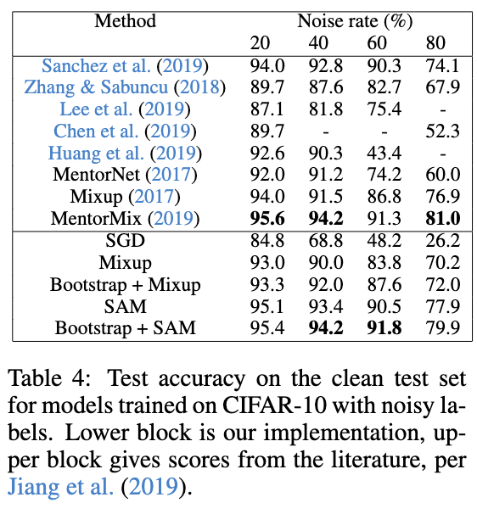
3. Empirical Evaluation - Robustness to Label Noise

Slide 14
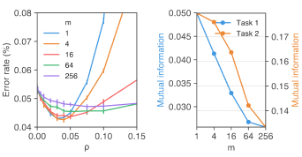

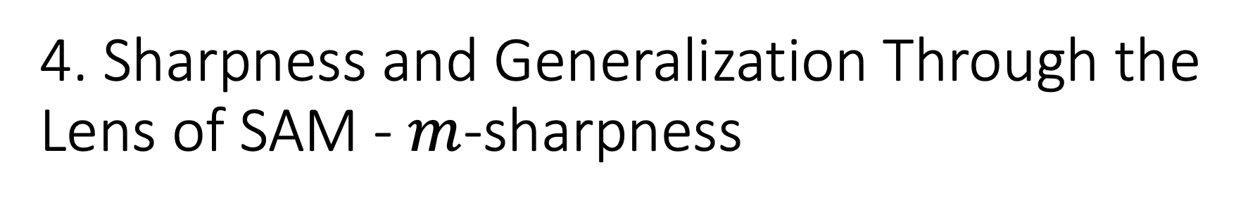
4. Sharpness and Generalization Through the Lens of SAM - $m$-sharpness
Each accelerator receives a subset of size $m$ of a batch.
Smaller values of $m$ tend to yield models having better generalization ability.

Slide 15
4. Sharpness and Generalization Through the Lens of SAM – Hessian Spectra

Slide 16
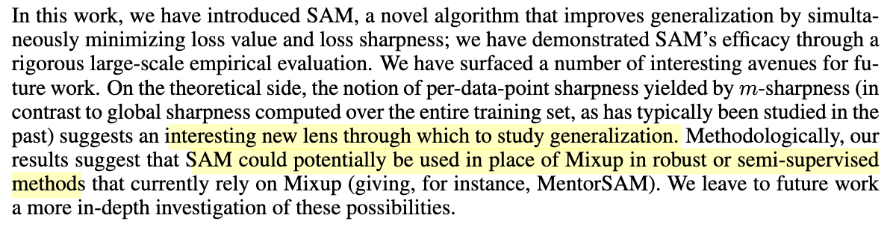
6. Discussion and Future Work

