Slide 1
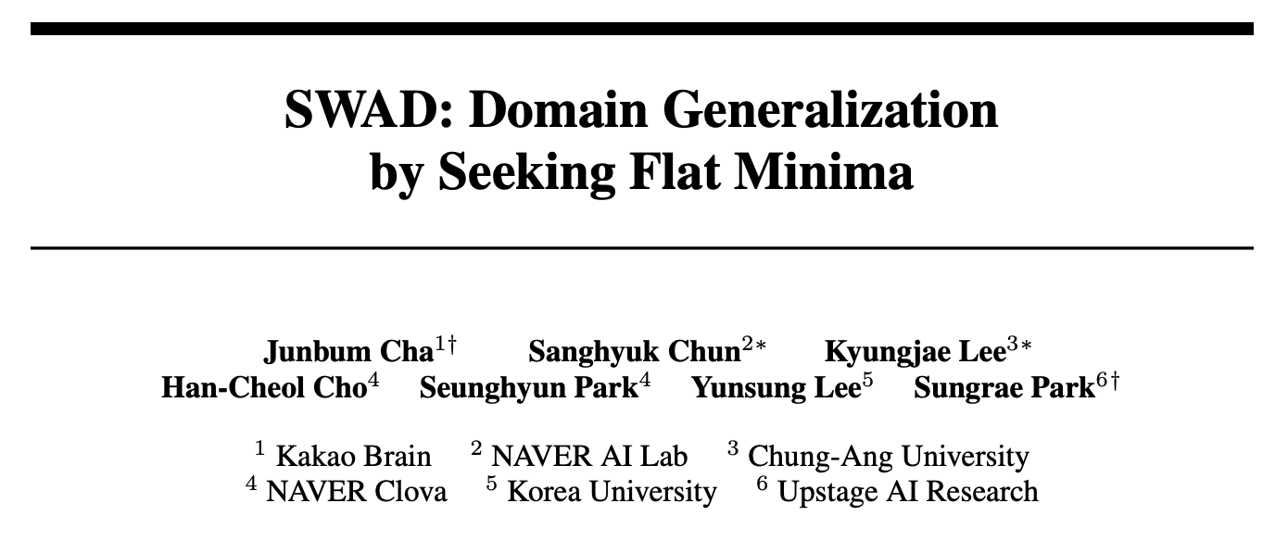
(175 cited. NeurIPS 2021)

Slide 2
주간 보고
Juntang Zhuang et al. (2021). “AdaBelief Optimizer: Adapting Stepsizes by the Belief in Observed Gradients.” NeurIPS.
Peng Mi et al. (2022). “Make Sharpness-Aware Minimization Stronger: A Sparsified Perturbation Approach.” NeurIPS.
Junbum Cha et al. (2021). “SWAD: Domain Generalization by Seeking Flat Minima.” NeurIPS

Slide 3
목차
Abstract
1 Introduction
2 A Theoretical Relationship between Flatness and Domain Generalization
3 SWAD: Domain Generalization by Seeking Minima
4 Experiments
5 Discussion and Limitations
6 Concluding Remarks

Slide 4
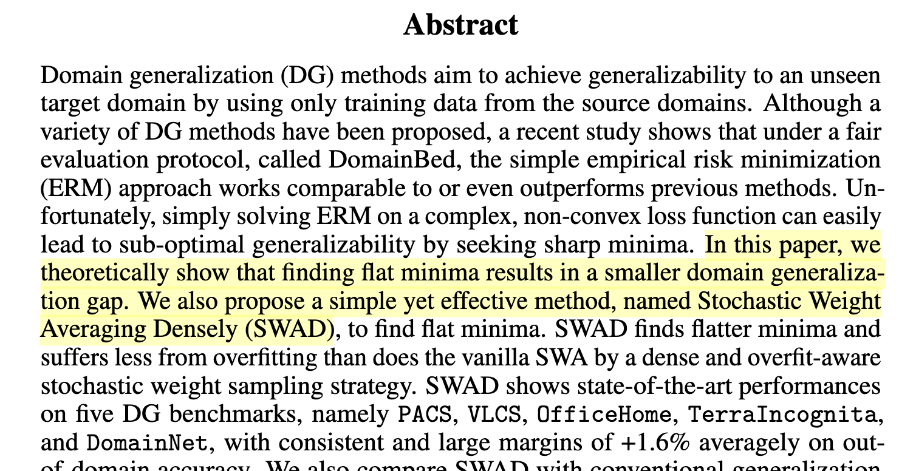
Abstract

Slide 5
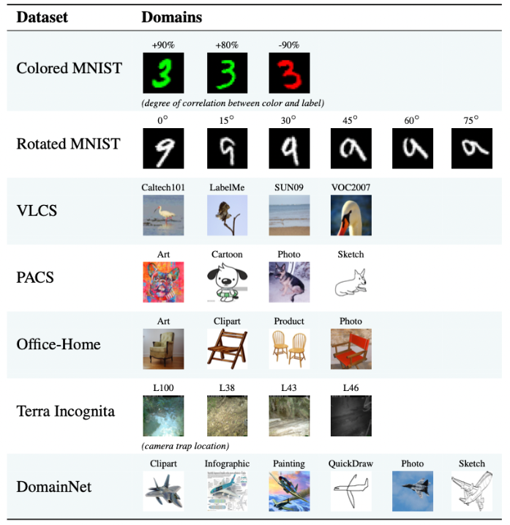
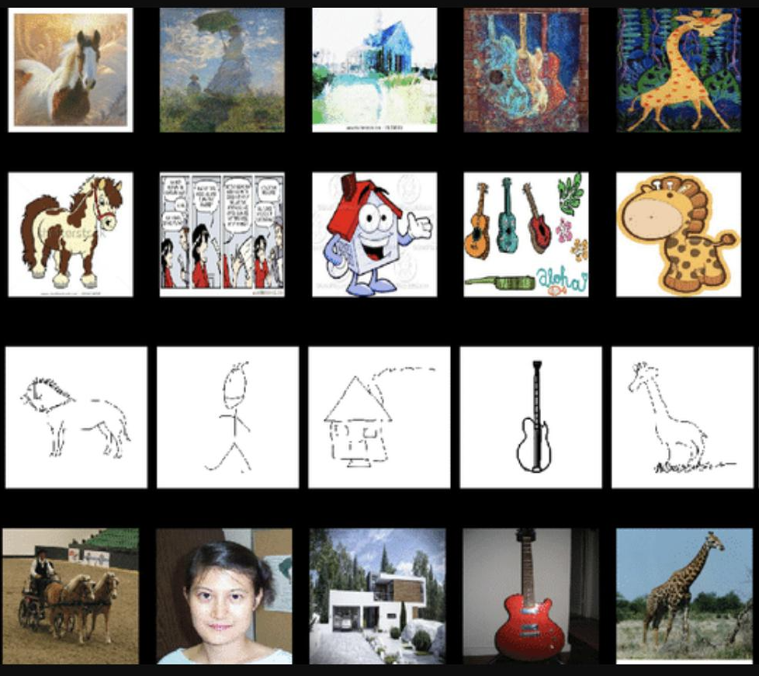
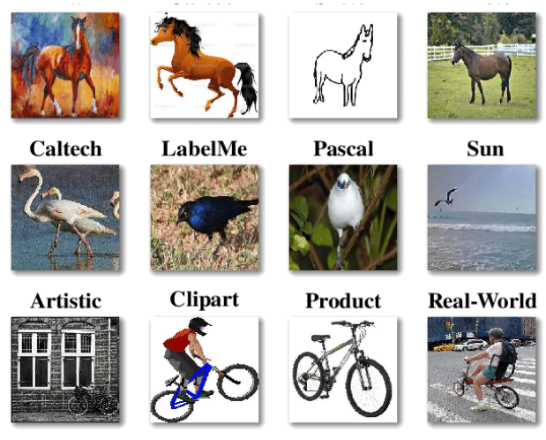
1 Introduction
Domain generalization(DG): aims to address domain shift simulated by training and evaluating on different domains
DomainBed: diverse DG benchmarks under a fair evaluation protocol by Facebook
PACS
VLCS
OfficeHome
PACS
DomainBed

Slide 6
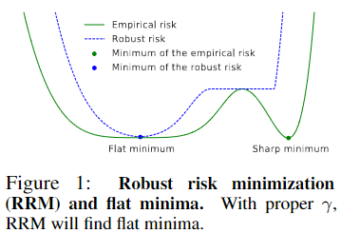
2 A Theoretical Relationship between Flatness and Domain Generalization
Optimizing algorithm with seeking flat minima
SWA, SAM, SWAD (proposed)
SWA Finds flat minima by a weight ensemble approach. (finds flatter minima than ERM, SAM)

Slide 7
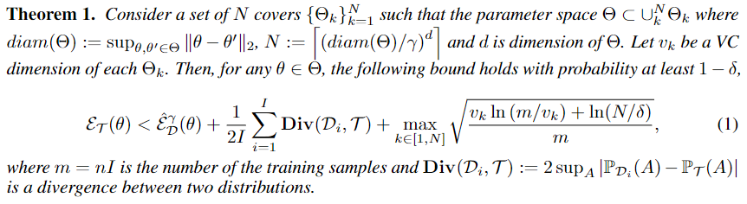
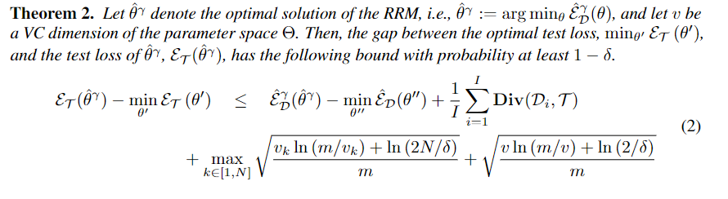
2 A Theoretical Relationship between Flatness and Domain Generalization

Slide 8
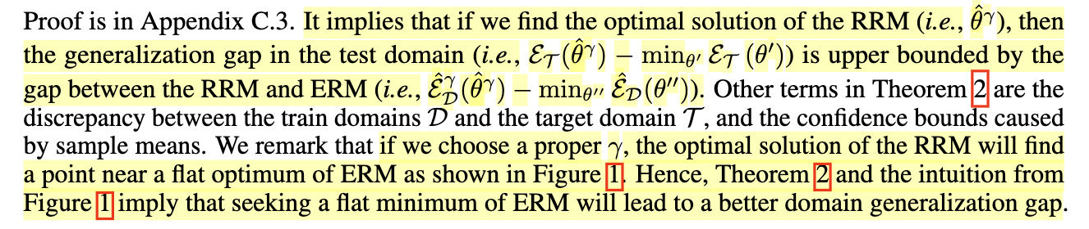
2 A Theoretical Relationship between Flatness and Domain Generalization
- RRM: 이웃 parameter 중 최악
- RRM의 optimal을 찾는 과정은
generalization gap에 upper bound를 만들어준다.
- 적절한 이웃 범위의 RRM optimal을 찾는 과정은
ERM의 flat optimal으로 향한다.
-> ERM의 flat optimal을 찾는 것을 목표로 할 수 있다.

Slide 9
3 SWAD: Domain Generalization by Seeking Flat Minima
A baseline method: Stochastic weight averaging
We propose SWAD method with SWA baseline
SWA
1. Cyclical or high rate scheduling으로 model update
2. K epochs의 model update 동안 ensembled model을 만든다.
3. 각기 다른 local optima에 대한 ensembled solution으로 local minimum 탈출을 꾀한다.
Dense and overfit-aware SWA strategy
SWA(Stochastic Weight Averaging) -> SWAD(Stochastic Weight Averaging Densely)
We propose some solutions for the difficulties of SWA toward domain generalization in several ways.
1. SWA averages a few weights (usually less than 10) -> in accurate approximation on high-dimensional space
2. DG uses relatively small training epochs

Slide 10
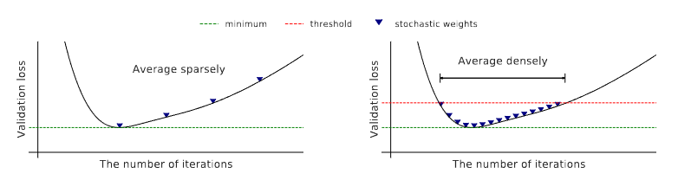
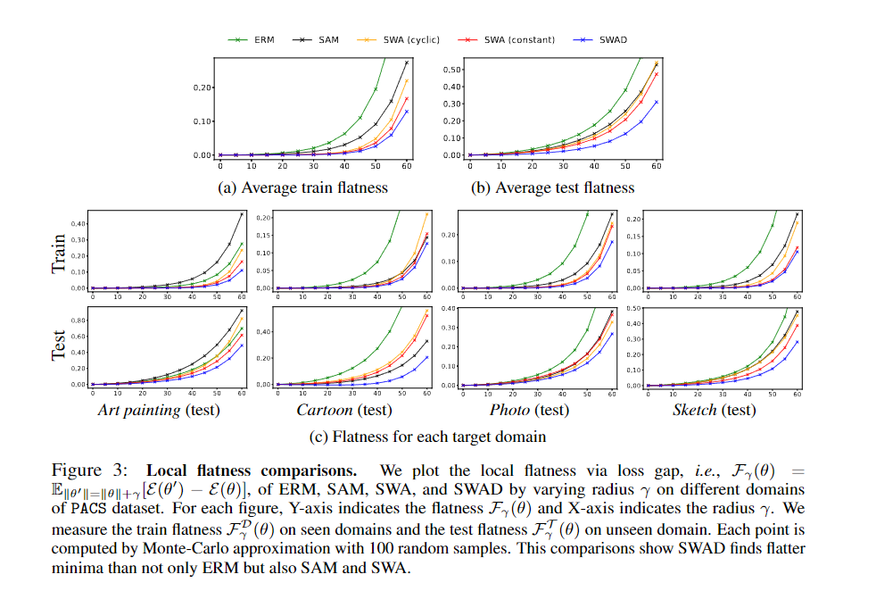
3 SWAD: Domain Generalization by Seeking Flat Minima

Slide 11
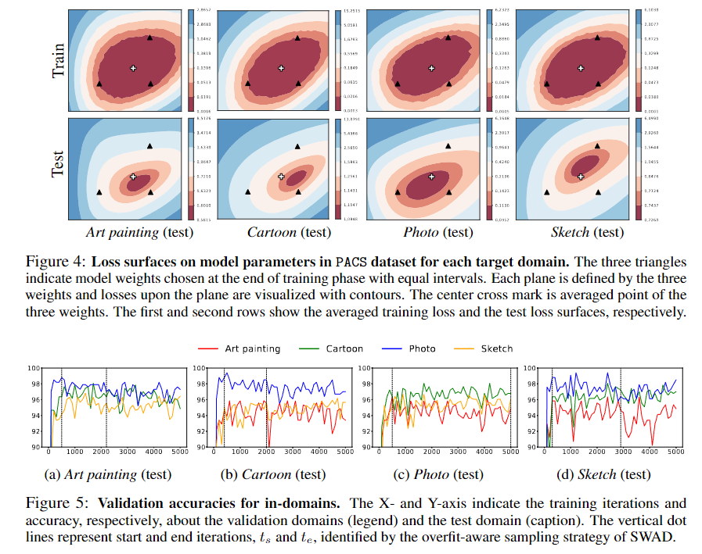
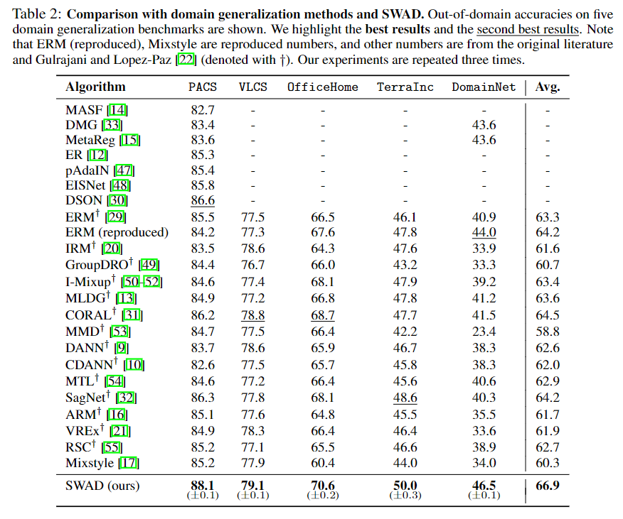
3 SWAD: Domain Generalization by Seeking Flat Minima
Empirical analysis of SWAD and flatness (contd)

Slide 12
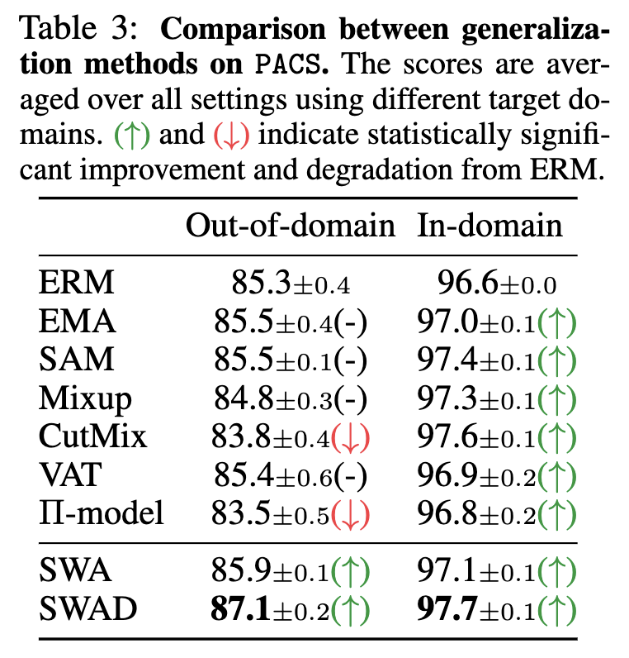
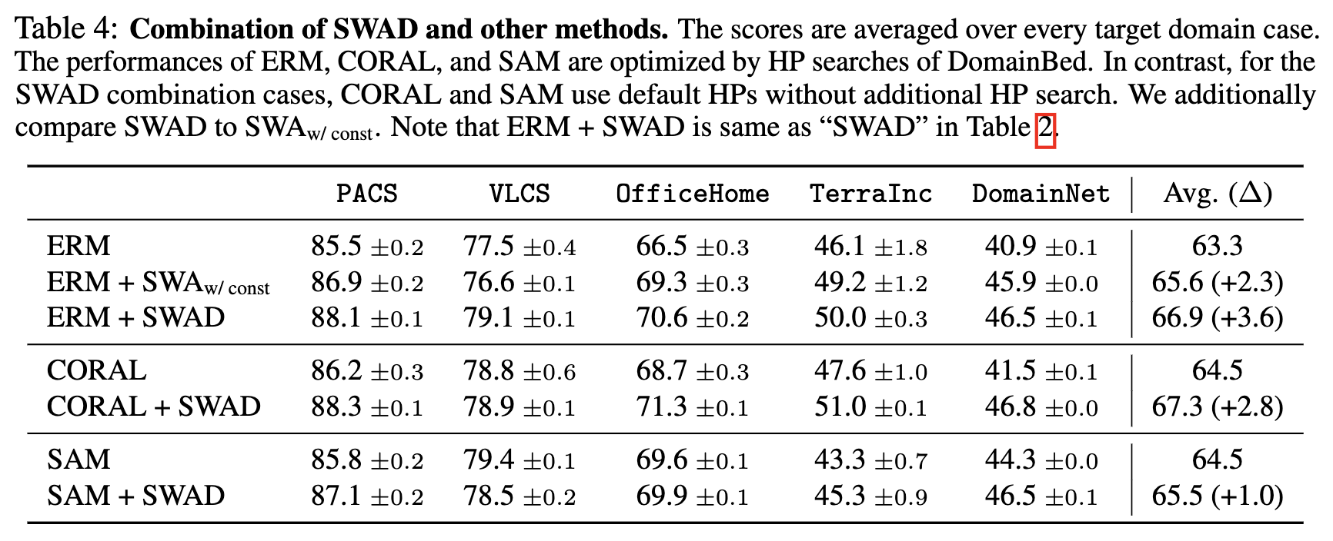
4 Experiments
Main results

Slide 13
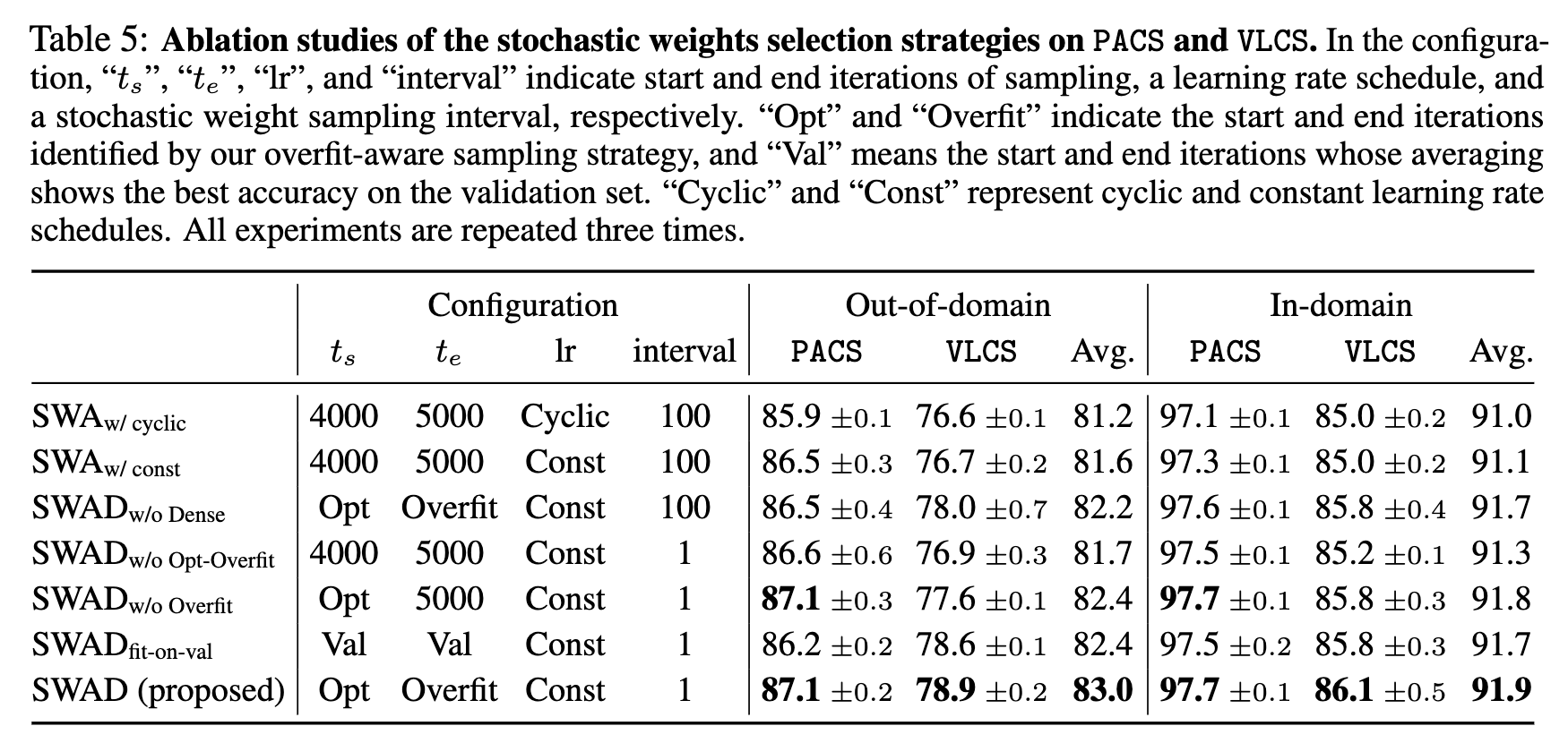
4 Experiments
Ablation study

Slide 14
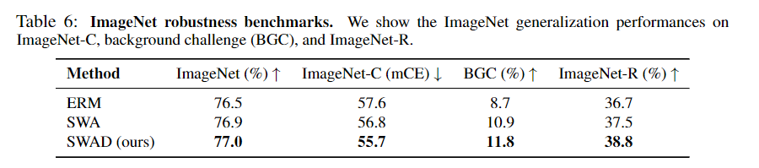
4 Experiments
Exploring the other applications: ImageNet robustness

Slide 15
5 Discussion and Limitations
Algorithm has confidence error bound
Although the idea of SWAD shows the relationship between flat minima and DG, it is not a perfect and theoretically guaranteed solver for flat minima but a heuristic approximation.
SWAD focuses only on the flat minima, not strongly utilize domain=specific information
Idea
SWA, SAM? SAM이 SWA보다 좋은 점?
Domain generalization?

