Slide 1
Sharpness-Aware Minimization Alone can Improve Adversarial Robustness
Zeiming Wei, Jingyu Zhu, Yihao Zhang
AdvML Frontiers workshop @ ICML 23’
KwanHee Lee

Slide 2
Contents
- Intro
- Related work : sharpness / adv robustness
- Empirical understanding
- Theoretical analysis
- Experiments

Slide 3
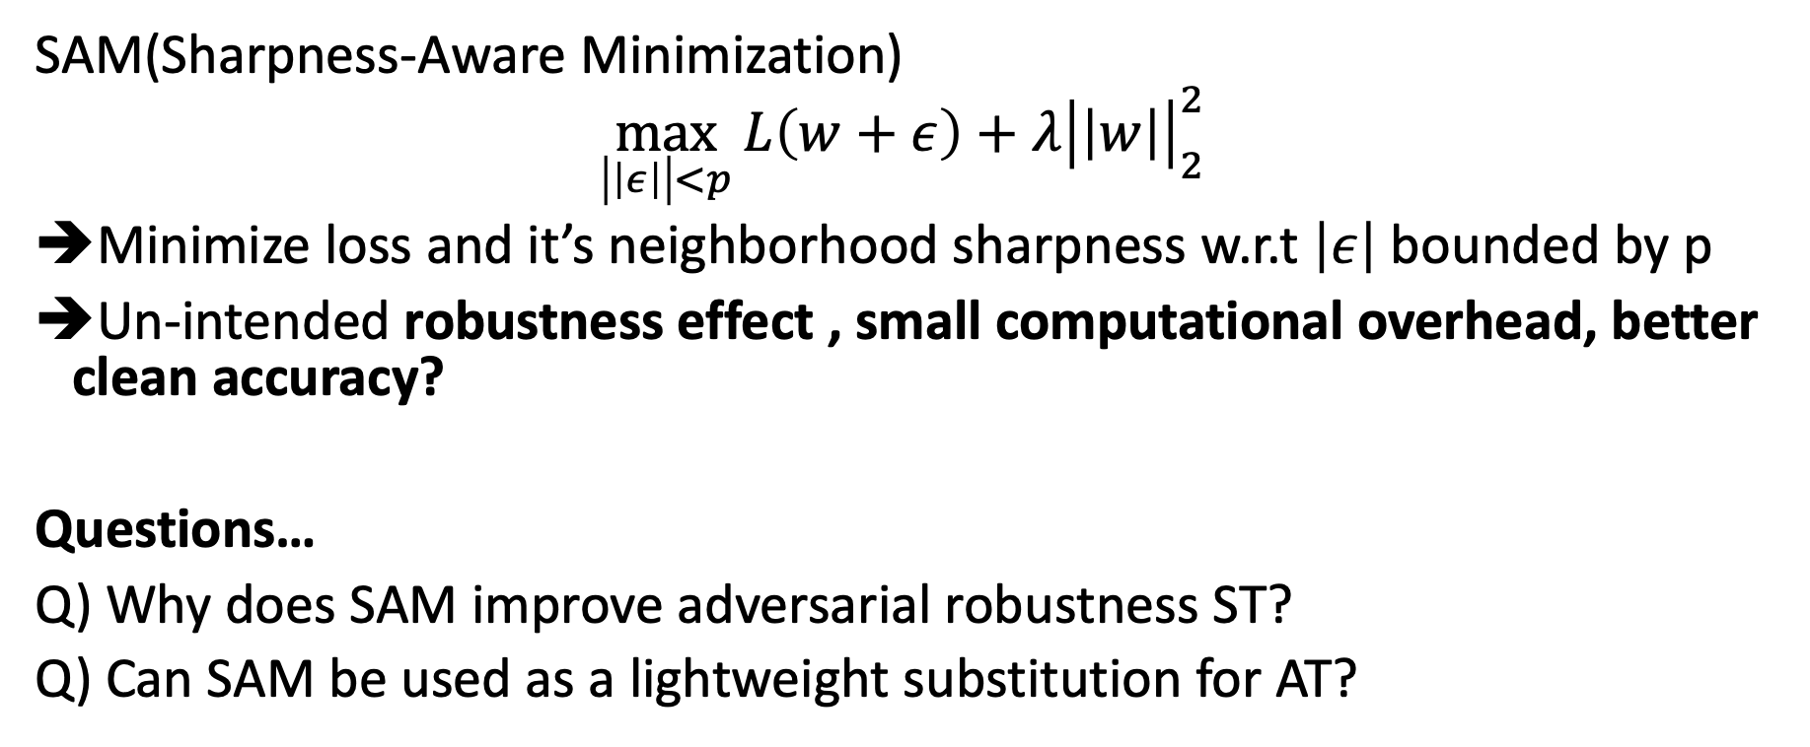
Intro
SAM(Sharpness-Aware Minimization)
$$\max_{\left|\left|ε\right|\right|<p}{L\left(w+ε\right)+λ{\left|\left|w\right|\right|}_{2}^{2}}$$
Minimize loss and it’s neighborhood sharpness w.r.t $\left|ε\right|$ bounded by p
Un-intended robustness effect , small computational overhead, better clean accuracy?
Questions…
Q) Why does SAM improve adversarial robustness ST?
Q) Can SAM be used as a lightweight substitution for AT?

Slide 4
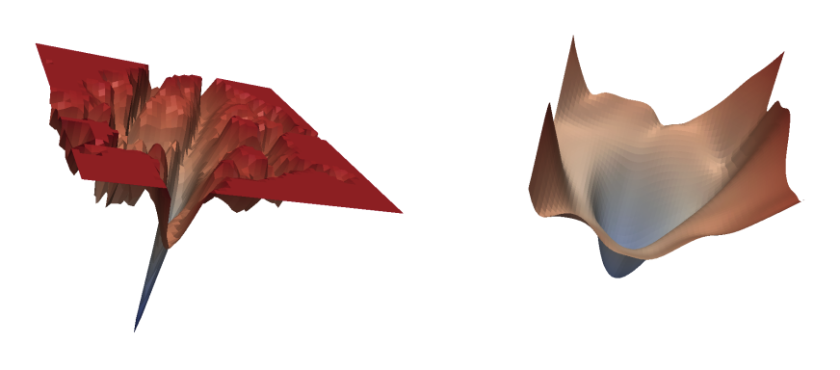
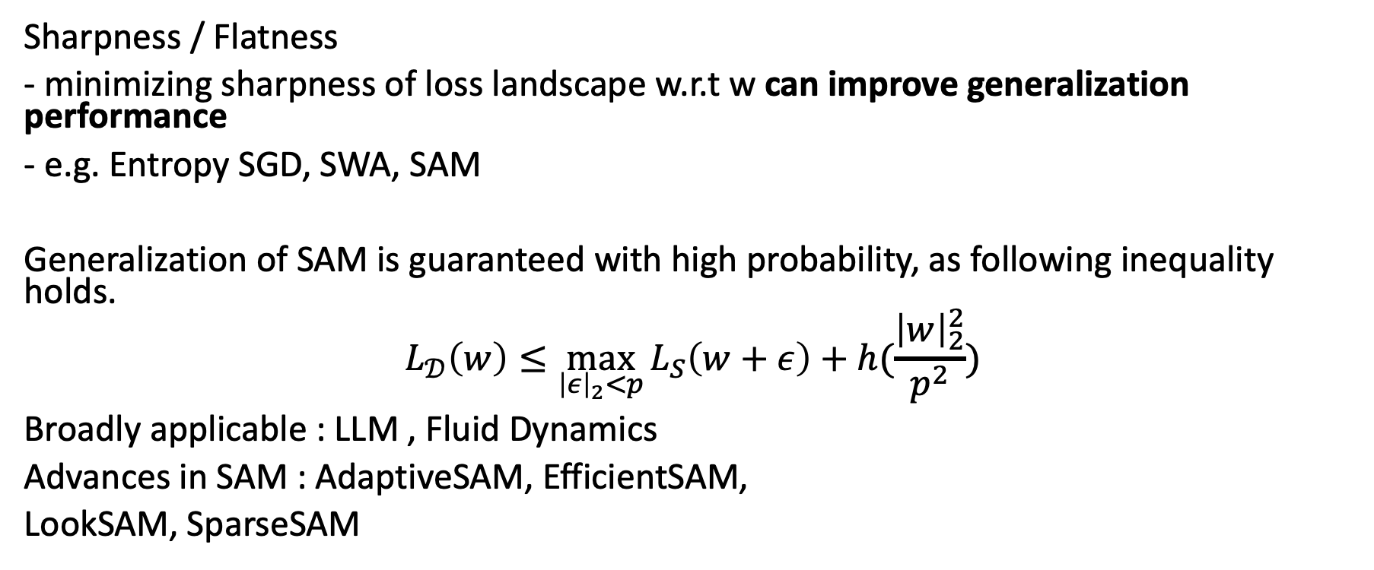
Related Work : Sharpness
Sharpness / Flatness
- minimizing sharpness of loss landscape w.r.t w can improve generalization performance
- e.g. Entropy SGD, SWA, SAM
Generalization of SAM is guaranteed with high probability, as following inequality holds.
$$L_{𝒟}\left(w\right)≤\max_{{\left|ε\right|}_{2}<p}{L_{S}\left(w+ε\right)+h(\frac{{\left|w\right|}_{2}^{2}}{p^{2}}})$$
Broadly applicable : LLM , Fluid Dynamics
Advances in SAM : AdaptiveSAM, EfficientSAM,
LookSAM, SparseSAM

Slide 5
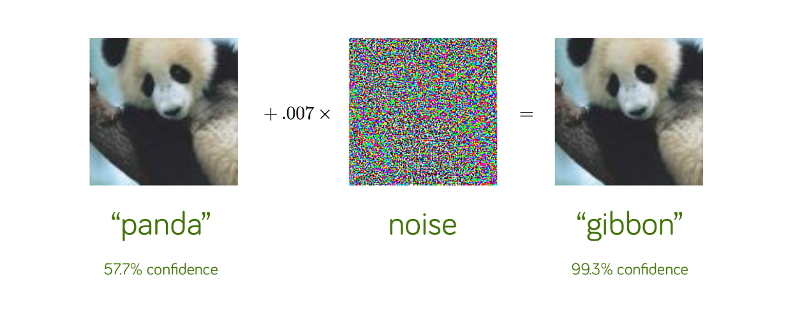

Related Work : Adv. Robustness
Adversarial Example
fools models easily with small perturbation (Szegedy et al., 2013 ; Goodfellow et al., 2014)
Solution : Many ideas have been suggested
but AT is most promising way.
AT :
$$\min_{w}{E_{(x,y)\sim D}\max_{\left|δ\right|≤ε}{L(w;x+δ,y)}}$$
PGD is typcially used to generate adversarial samples for inner loop optimization
$$x^{t+1}=Π_{B\left(x,ε\right)}(x^{t}+α ⋅sign\left(∇_{x}l\left(θ;x^{t},y\right)\right))$$
B(x,e) -> perturbation bound
Cons
Computational burden (adv examples)
Class-wise fairness (class-dependent robustness)
Decrease in natural(clean) accuracy

Slide 6
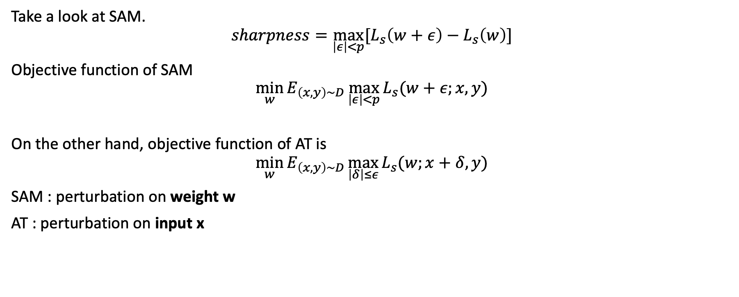
Empirical Understanding
Take a look at SAM.
$$sharpness=\max_{\left|ε\right|<p}{[L_{s}\left(w+ε\right)−L_{s}\left(w\right)]}$$
Objective function of SAM
$$\min_{w}{E_{\left(x,y\right)\sim D}\max_{\left|ε\right|<p}{L_{s}(w+ε;x,y)}}$$
On the other hand, objective function of AT is
$$\min_{w}{E_{\left(x,y\right)\sim D}\max_{\left|δ\right|≤ε}{L_{s}(w;x+δ,y)}}$$
SAM : perturbation on weight w
AT : perturbation on input x

Slide 7
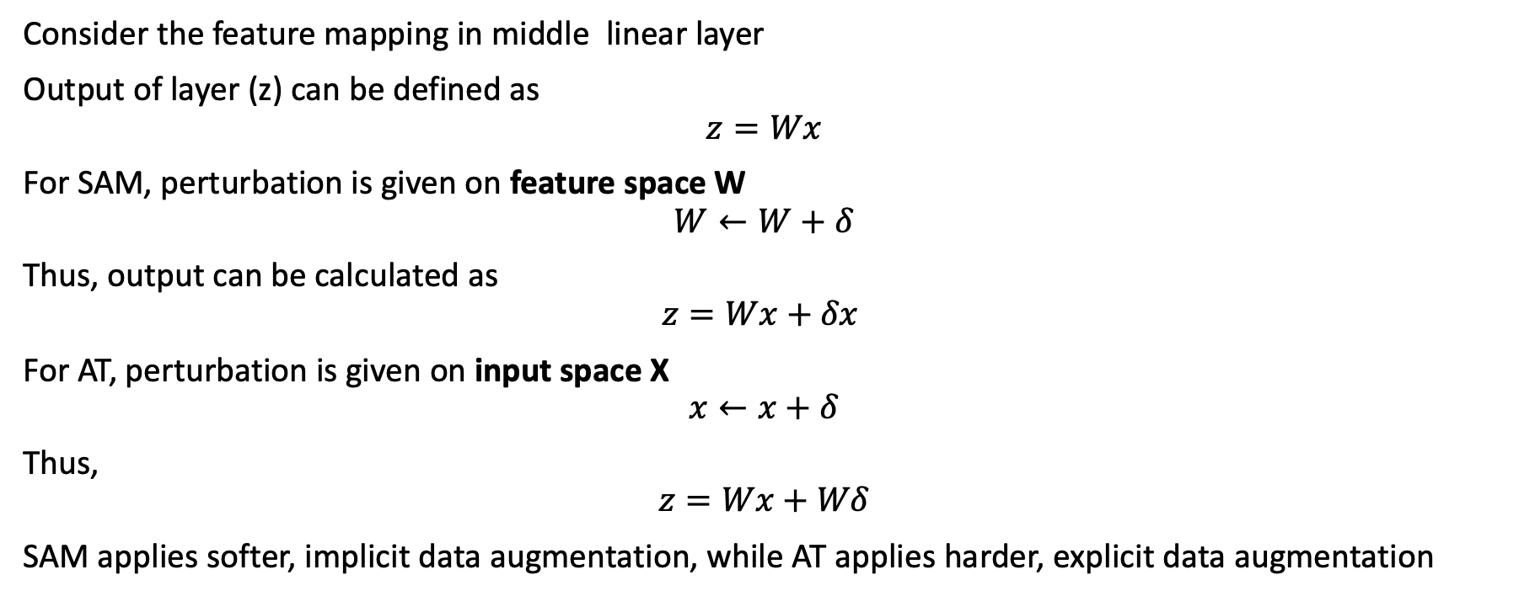
Empirical Understanding
Consider the feature mapping in middle linear layer
Output of layer (z) can be defined as
$$z=Wx$$
For SAM, perturbation is given on feature space W
$$W←W+δ$$
Thus, output can be calculated as
$$z=Wx+δx$$
For AT, perturbation is given on input space X
$$x←x+δ$$
Thus,
$$z=Wx+Wδ$$
SAM applies softer, implicit data augmentation, while AT applies harder, explicit data augmentation

Slide 8
Empirical Understanding
Both SAM and AT learns robust features, but there exists tradeoff between robustness and accuracy.
Robust Features – (Tsipras et al., 2018)
-> robust models learn features that are different from standard models, in which the learned feature representation of robust models are closer to human perception, and aligns well with salient data characteristics

Slide 9
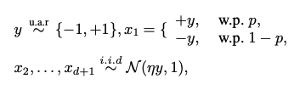
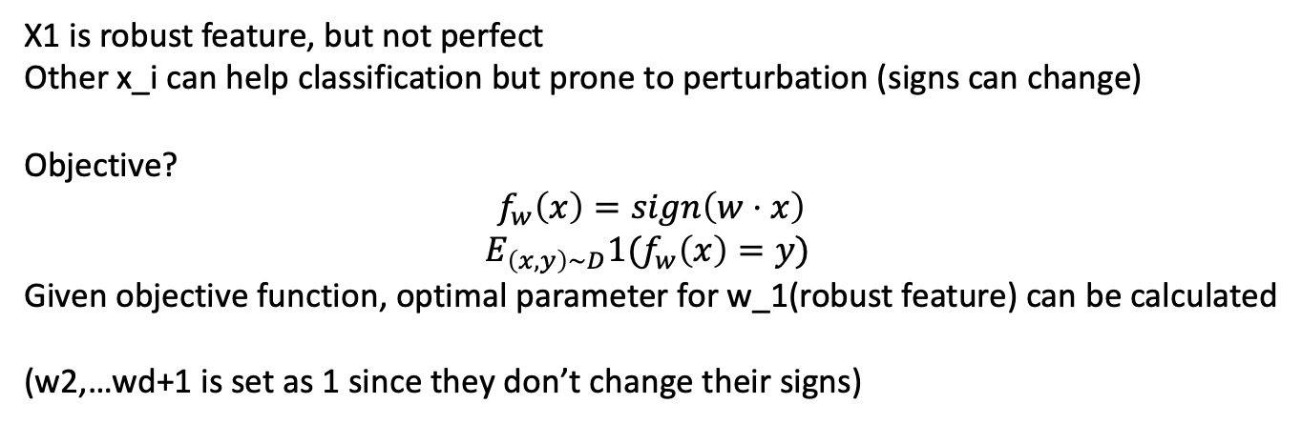

Theoretical Analysis
$η$ is small number >0
X1 is robust feature, but not perfect
Other x_i can help classification but prone to perturbation (signs can change)
Objective?
$$f_{w}\left(x\right)=sign\left(w⋅x\right)$$
$$E_{\left(x,y\right)\sim D}1(f_{w}\left(x\right)=y)$$
Given objective function, optimal parameter for w_1(robust feature) can be calculated
(w2,…wd+1 is set as 1 since they don’t change their signs)

Slide 10



Theoretical Analysis

Slide 11
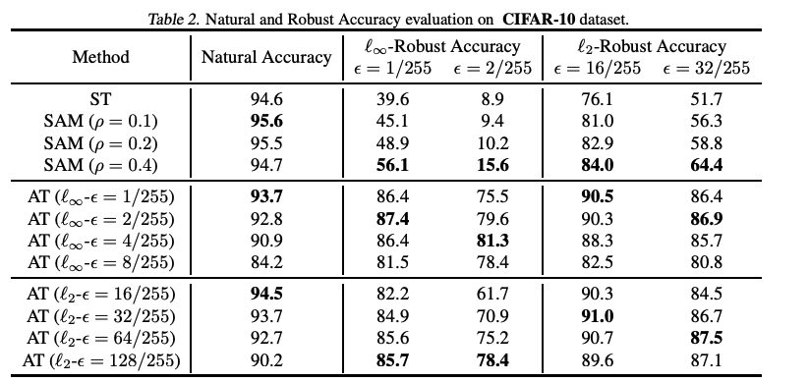
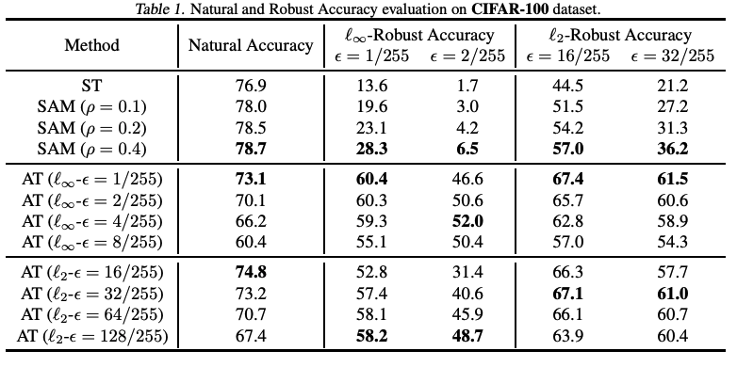
Experiments
SAM can improve performance(clean accuracy) and robustness
AT is an upper bound of Robustness
Consider SAM as Simple,lightweight replacement of AT?

