Slide 1
Conventional Adversarial Training
ICLR’19 paper review
202111278 컴퓨터공학부 김환희

Slide 2
목차
FGSM-AT
PGD-AT
TLA (Triplet Loss Adversarial training)
ANL (Adversarial Noise Layer)
BAT (Bilateral Adversarial Training)
EAT (Ensemble Adversarial Training)
PED (Promoting Ensemble Diversity)
ALP (Adversarial Logit Pairing)
FAT (Friendly Adversarial Training)
Overfitting
Free
SLAT (Single-step Latent Adversarial Training)
GradAlign
Fast AT

Slide 3
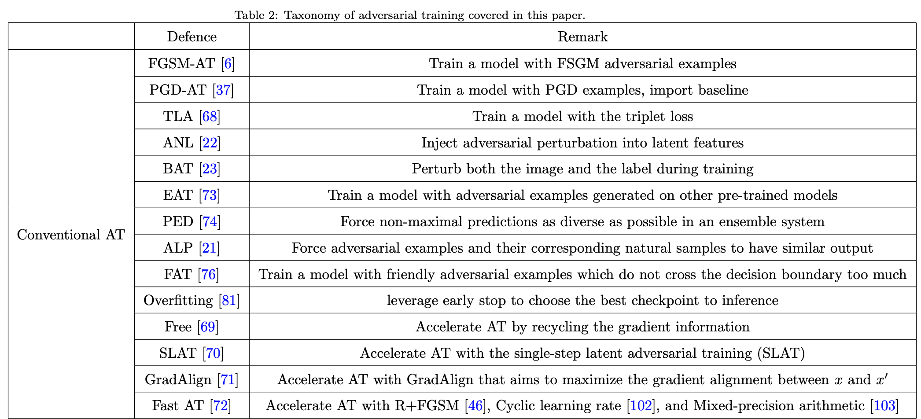
Conventional Adversarial Training

Slide 4
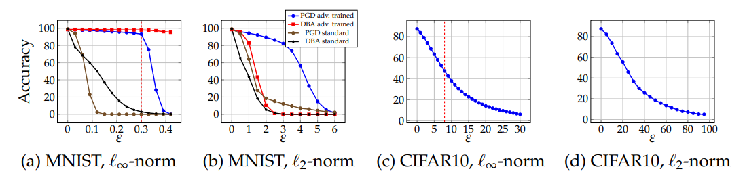
Conventional Adversarial Training
FGSM-AT
Ian J. Goodfellow et al., (2015), Explaining and Harnessing Adversarial Examples, ICLR
Train a model with FGSM adversarial examples
PGD-AT
Aleksander Madry et al., (2018), Towards Deep Learning Models Resistant to Adversarial Attacks, ICLR
Train a model with PGD examples, import baseline

Slide 5
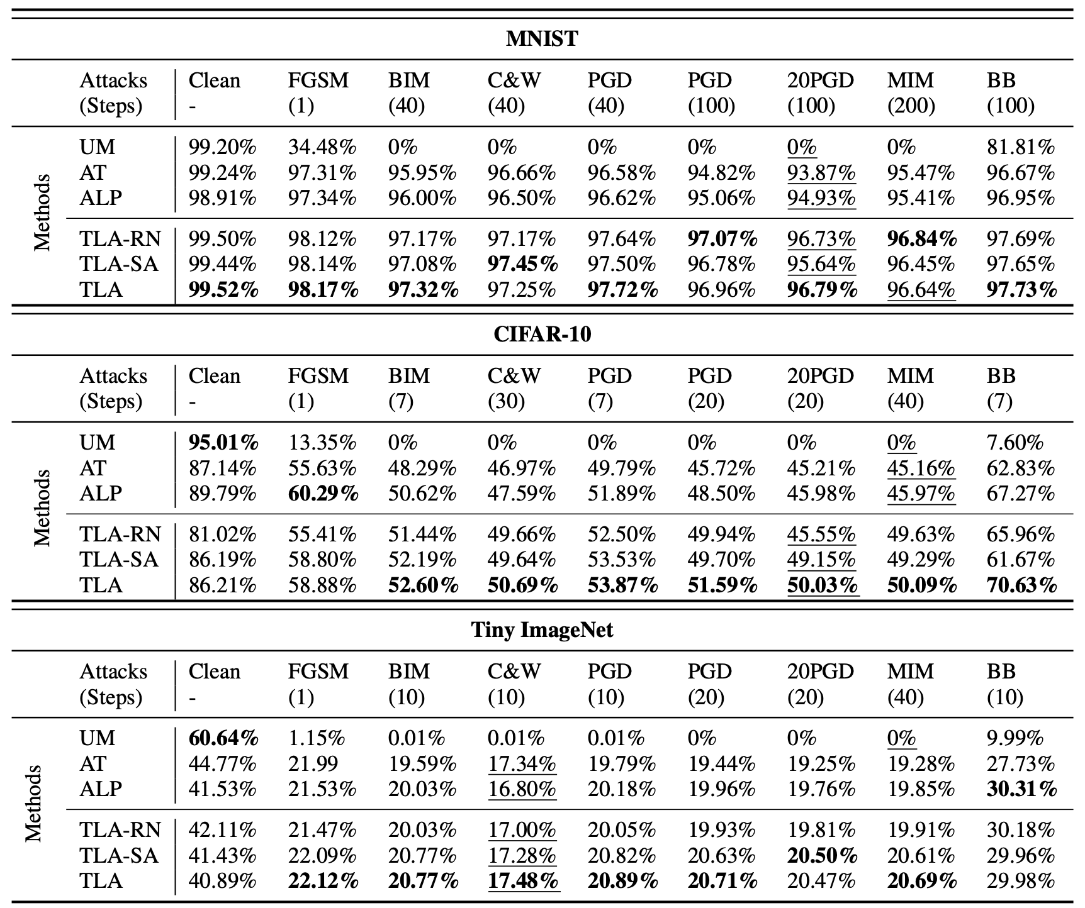
Conventional Adversarial Training
TLA (Triplet Loss Adversarial training)
Chengzhi Mao et al., (2019), Metric Learning for Adversarial Robustness, NeurIPS
Train a model with triplet loss

Slide 6
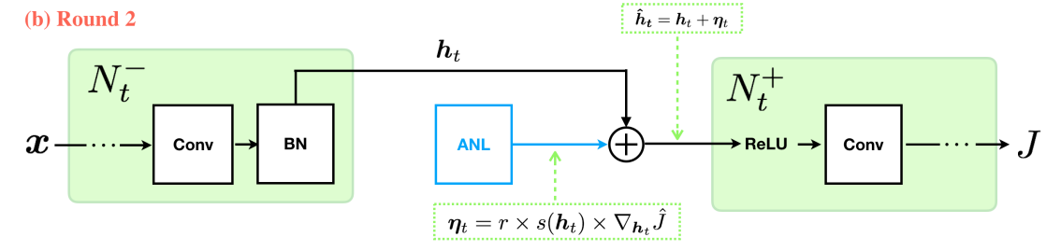
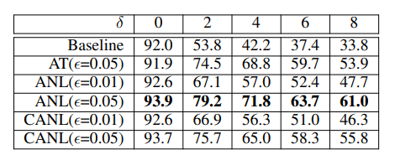
Conventional Adversarial Training
ANL (Adversarial Noise Layer)
Zhonghui You et al., (2018), Adversarial noise layer: Regularize neural network by adding noise, IEEE
Inject adversarial perturbation into latent features

Slide 7
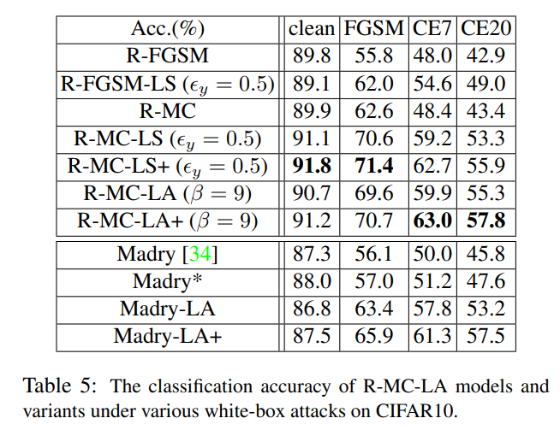

Conventional Adversarial Training
BAT (Bilateral Adversarial Training)
J. Wang et al., (2019), Bilateral adversarial training: Towards fast training of more robust models against adversarial attacks, IEE
Perturb both the image and the label during training
$$\max_{y^{′}∈S_{y}}{L\left(x, y^{′};θ\right)}$$

Slide 8
Conventional Adversarial Training
EAT (Ensemble Adversarial Training)
Ian J. Goodfellow et al., (2018), Ensemble adversarial training: Attacks and defenses, ICLR
Train a model with adversarial examples generated on other pre-trained models

Slide 9
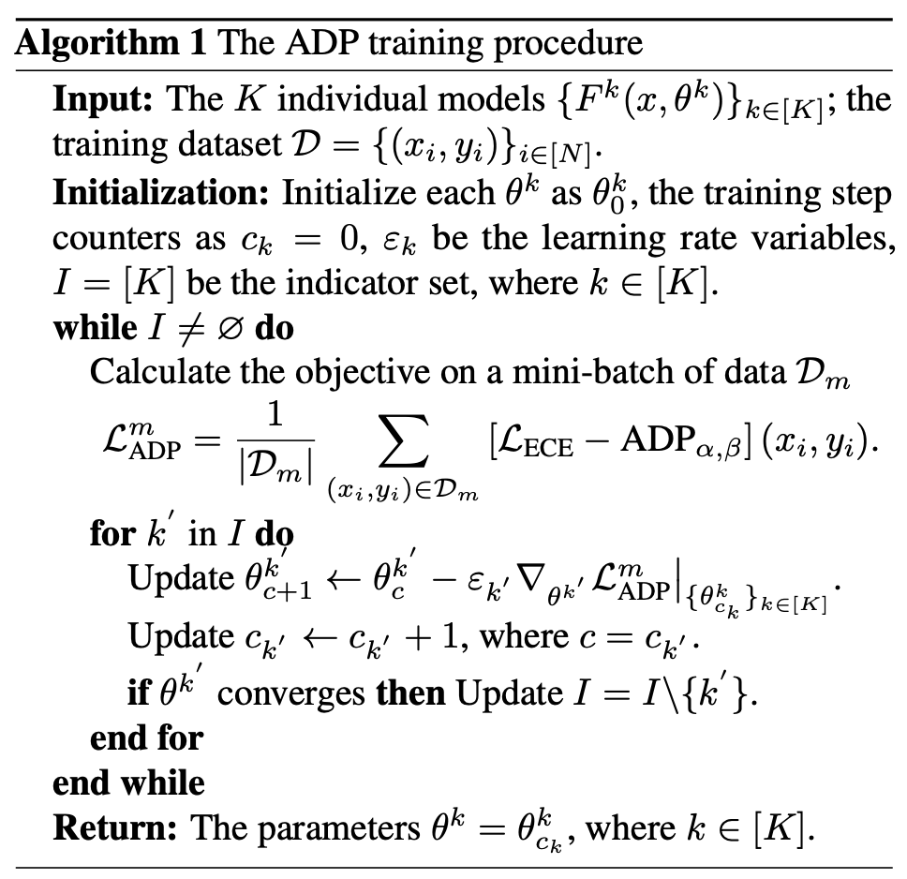
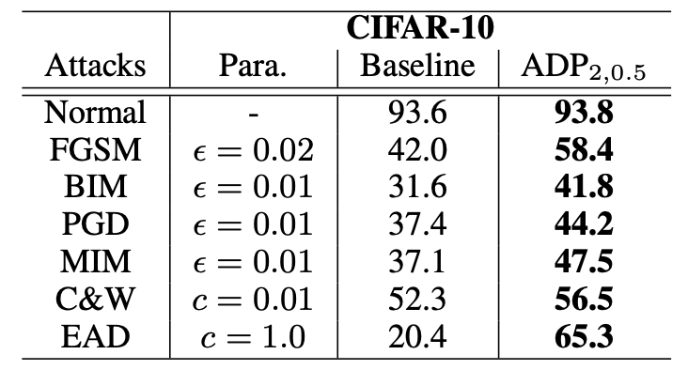

Conventional Adversarial Training
PED (Promoting Ensemble Diversity)
T. Pang et al., (2019), Improving adversarial robustness via promoting ensemble diversity, ICML
Force non-maximal predictions as diverse as possible in an ensemble system

Slide 10
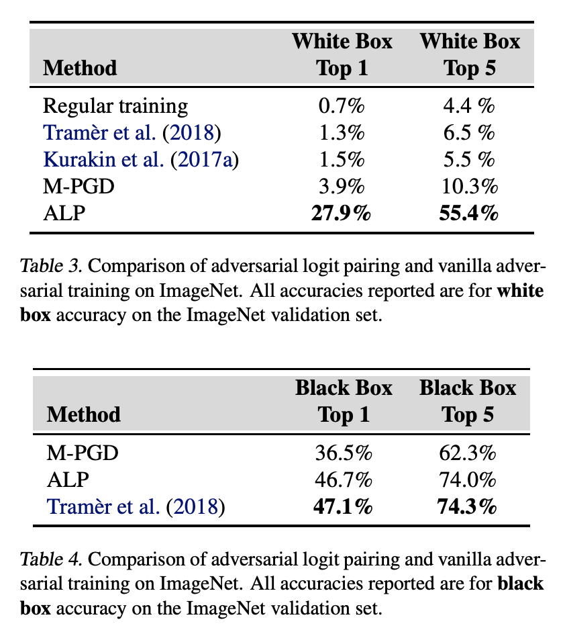
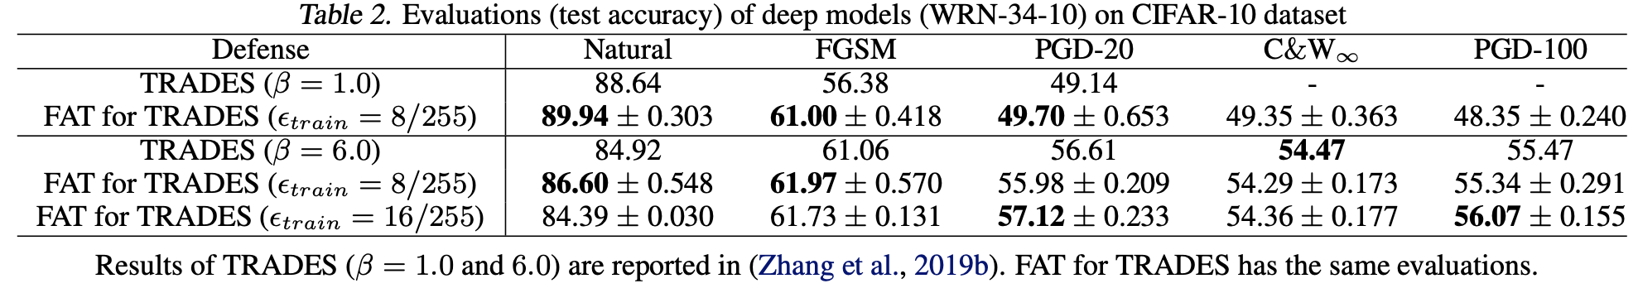
Conventional Adversarial Training
ALP (Adversarial Logit Pairing)
H. Kannan, Ian J. Goodfellow, A. Kurakin, (2018), Adversarial logit pairing, arXiv
Force adversarial examples and their corresponding natural samples to have similar output
FAT (Friendly Adversarial Training)
J. Zhang et al., (2020), Attacks which do not kill training make adversarial learning stronger, ICML
Train a model with friendly adversarial examples which do not cross the decision boundary too much

Slide 11
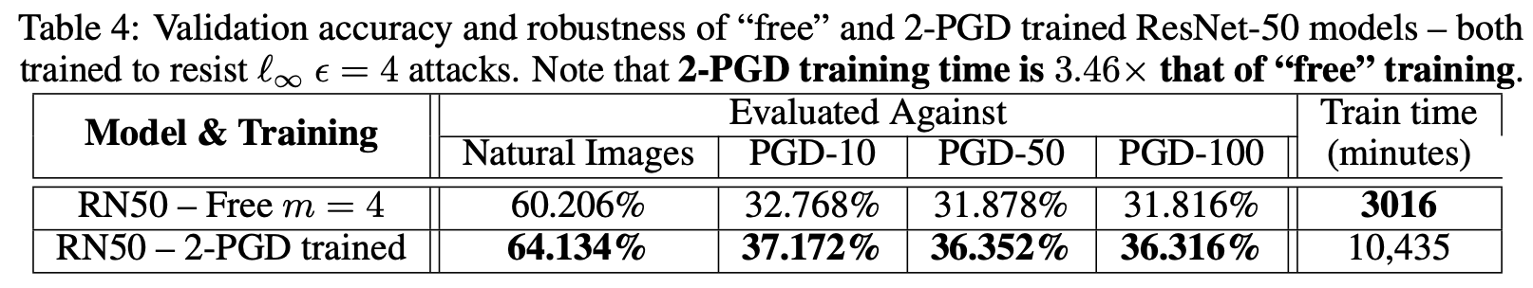
Conventional Adversarial Training
Overfitting
L. Rice et al., (2020), Overfitting in adversarially robust deep learning, ICML
Leverage early stop to choose the best checkpoint to inference
Free
A. Shafahi et al., (2019), Adversarial training for free!, NeurIPS
Accelerate AT by recycling the gradient information
SLAT (Single-step Latent Adversarial Training)
G. Y. Park et al., (2021), Reliably fast adversarial training via latent adversarial perturbation, ICCV
Accelerate AT with the single-step latent adversarial training

Slide 12
Conventional Adversarial Training
GradAlign
M. Andriushchenko et al., (2020), Understanding and improving fast adversarial training, NeurIPS
Accelerate AT with GradAlign that aims to maximize the gradient alignment between x and x’
Fast AT
E. Wong et al., (2019), Fast is better tham free: Revisiting adversarial training, ICLR
Accelerate AT with R+FGSM, Cyclic learning rate, and Mixed-precision arithmetic

Slide 13
Conventional Adversarial Training
GradAlign
M. Andriushchenko et al., (2020), Understanding and improving fast adversarial training, NeurIPS
Accelerate AT with GradAlign that aims to maximize the gradient alignment between x and x’
Fast AT
E. Wong et al., (2019), Fast is better tham free: Revisiting adversarial training, ICLR
Accelerate AT with R+FGSM, Cyclic learning rate, and Mixed-precision arithmetic

