Slide 1
SGD with Large Step Size Learns Sparse Features
M Andriushchenko et al., ICRL 2023

Slide 2
Contents
Abstract
Introduction
Related Work
Effective Dynamics of SGD
Experiments
Conclusion

Slide 3
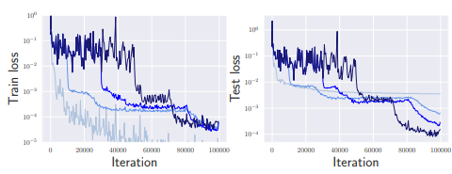
Abstract
Using SGD with Large step size (Learning Rate)
Makes loss stabilization, which induces stochastic dynamics that biases it implicitly towards sparse predictor
With step size decay after stabilization, gradient and noise drive together the dynamics of SGD through the loss landscape
Without any explicit regularization, only by stochastic dynamics of SGD
Questions)
- why and how does loss stabilize with SGD?
- why does it find sparse networks?
Figure2. loss curve on simple diagonal linear network

Slide 4
Introduction
Need of this research?
- understanding of high-performance DNN remains incomplete
- Large step-size schedules (multistep scheduler) : sudden drops in training loss (16’ resnet)
- Overparameterized networks generalize well while fitting perfectly with train set : optimization – generalization, implicit bias (Understanding deep learning requires rethinking generalization, ICRL 17’)
But to enter this beneficial feature learning regimes -> long time, and not explainable
What does this work do?
- focus on step size schedule on resnet, and.. Observe
- loss remains constant : loss stabilization at the start of the training phase
- longer the stabilization process, better the generalization ability
-> stabilization helps to amplify noise that drives SGD to find sparse features

Slide 5
Introduction
Questions)
- Bouncing directions?
- how does this paper focus on stability of
Loss function?
- Through the lens of stochastic optimization process?
Contributions?
1. effective dynamics behind loss stabilization
- fast movement : bouncing directions, causes loss stabilization
- slow dynamics : combination of gradient and multiplicative noise
2. SDE model / sparse feature training
- using Stochastic Differential Equation(SDE), models the effective slow dynamics
where, these noise makes model sparse predictors.
3. Insights?
- by above contributions, analyze that large step size and loss stabilization learns sparse features
- large step size SGD identifies sparse features
- eventually fits into data with step size schedule

Slide 6
Related work
Questions)
- Relation between step size and sharpness(flatness)?
- EoS?
- Multistep Scheduler : Resnet , 16’
Stabilizes loss, sudden drop in loss
Why? What causes this dynamics to happen?
Absence of explanation
- Large Step Size and minimization of flatness
SGD iterates toward flatness minima with large step size : incorrect flatness measure
Full-GD with large step size moves toward flat solutions : loss on generalization
- Absence of Stochastic Process : GD with large step size
Edge of stability phenomenon : sharpness becomes right below 2/learning rate after training.
Catapult mechanism
- Compression : hidden structures inside overparameterized network
SGD with large step can be the key component of sparse networks

Slide 7

Effective Dynamics of SGD
Consider simple optimization process
$$L\left(θ\right)≔\frac{1}{2n}{\left(∑h\left(θ\right)−y\right)}^{2}$$
Where,
$$θ_{t+1}=θ_{t}−η\left(h_{θ_{t}}\left(x\right)−y\right)∂_{θ}h_{θ}(x)$$

Slide 8
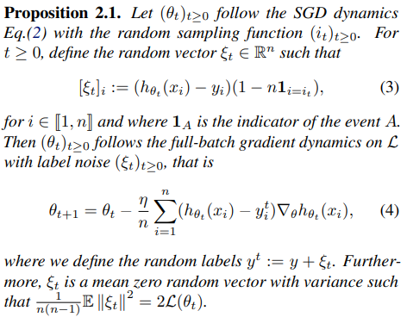
Effective Dynamics of SGD
Background 1 . SGD = GD with Label Noise ??

Slide 9
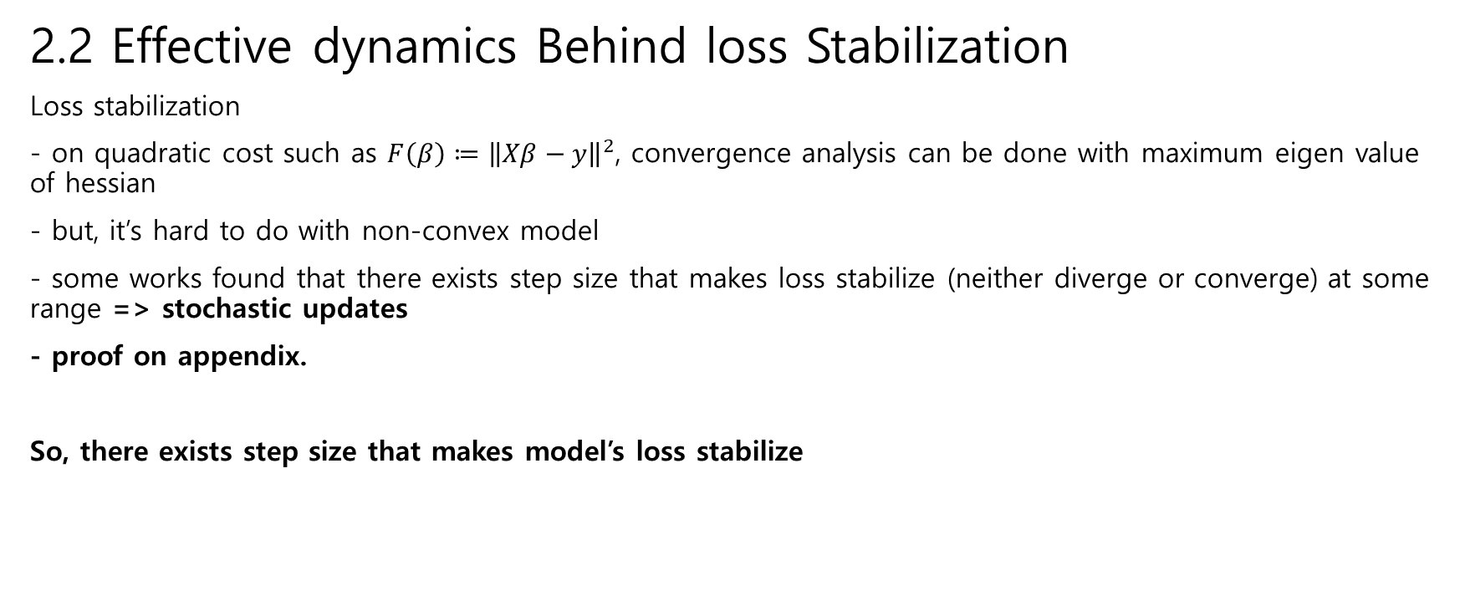
Effective Dynamics of SGD
2.2 Effective dynamics Behind loss Stabilization
Loss stabilization
- on quadratic cost such as $F\left(β\right)≔{\left\|Xβ−y\right\|}^{2}$, convergence analysis can be done with maximum eigen value of hessian
- but, it’s hard to do with non-convex model
- some works found that there exists step size that makes loss stabilize (neither diverge or converge) at some range => stochastic updates
- proof on appendix.
So, there exists step size that makes model’s loss stabilize

Slide 10

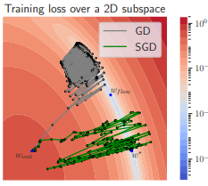
Effective Dynamics of SGD
Proposition 1. SGD is well modelled by GD with constant label noise during loss stabilization
gradient
Brownian motion (noise)
This SDE can be seen as effective slow dynamics
=> bouncing rapidly in some directions , inducing loss stabilization

Slide 11

Effective Dynamics of SGD
Derivative at Diagonal Linear Networks
This noise makes coordinates outside of the support of the sparsest signal
and oscillates in parameter space at level
Which makes convergence to sparse predictor after step size decay.

Slide 12

Effective Dynamics of SGD
Sparse Feature Learning for Deep/ General Netwokrs
Above equation can be represented as matrix in general models,
Thus, noise can be represented as jacobian
And, experimental results show that noise part of the model does
L2 normalization on the columns of jacobian
Inducing low-rank jacobian
Gradients align, and redundant gradients may occur
Meaning of “flatness” , faster convergence?

Slide 13
Experiments
Observations
Loss Stabilization : training loss stabilizes around a high level set until step size is decayed
Generalization benefit : longer stabilization leads to better generalization
Sparse feature learning : longer stabilization leads to sparser features

Slide 14
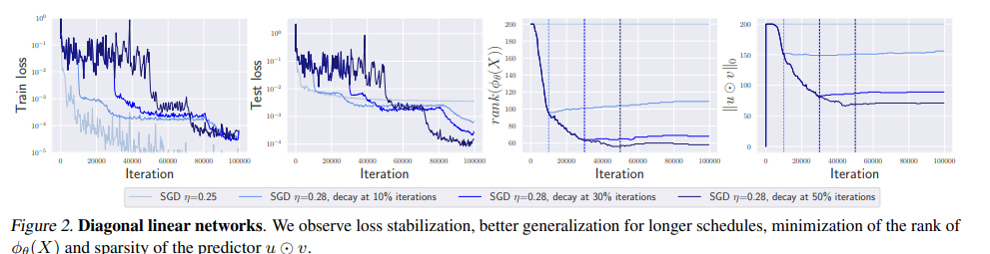
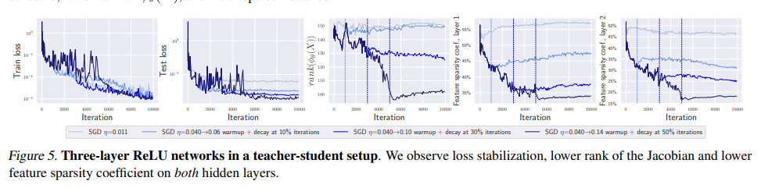
Experiments

Slide 15
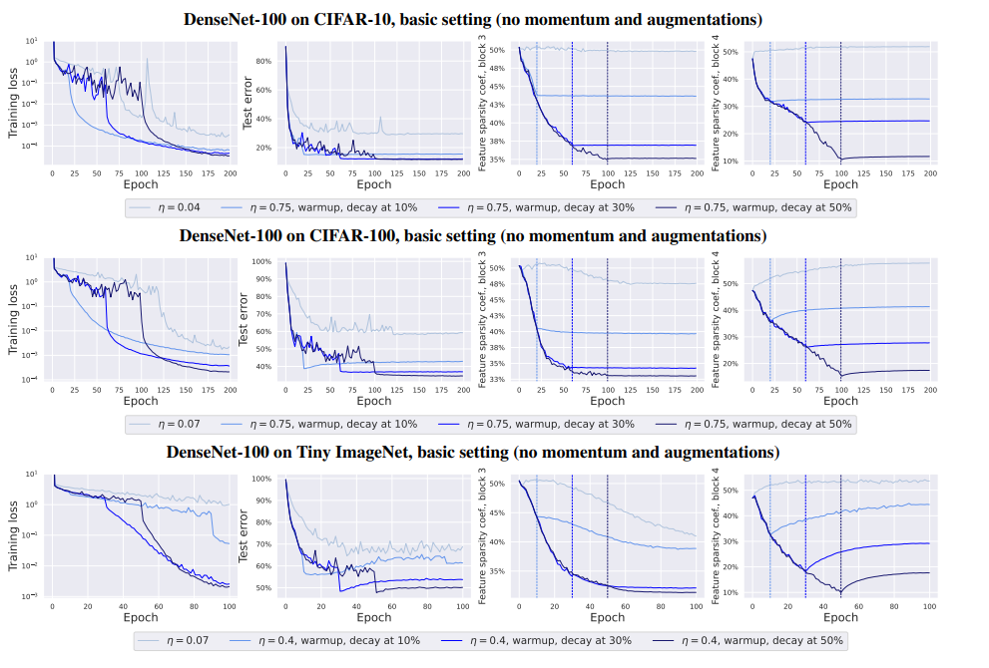
Experiments

Slide 16
Conclusion
Three stages of SGD dynamics
Initial phase -> loss down to some level that stabilization can occur
Loss stabilization phase, where noise and gradient directions combine to find architecture-dependent sparse representations
Final stage where step size is decayed and fit into data with sparse representation

Slide 17
Conclusion
Comparison with flatness measures
SAM optimizes sharpness explicitly to make loss stabilize, and goal is to achieve implicit bias (generalization)
But, SGD with large step can induce implicit bias by itself.

