Slide 1
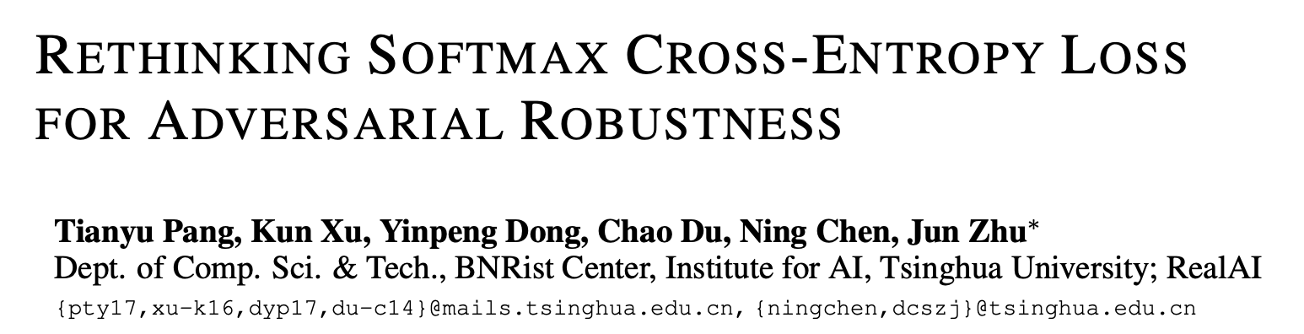
ICLR’20 paper review
202111278 컴퓨터공학부 김환희

Slide 2
목차
Abstraction
1 Introduction
2 Preliminaries
3 Methodology
4 Experiments
5 Conclusion
이 논문을 인용한 논문 (from NeurIPS, AAAI)

Slide 3
Rethinking SCE loss for adversarial robustness
Abstract
We formally show SCE(Softmax Cross-Entopy) is not proper to supervisory signal because the learned feature points are spreaded over the space sparsely in training.
We propose MMC(Max-Mahalanobis Center) loss to induce dense feature regions explicitly.
1 Introduction
Defense methods are ineffective to adaptive attacks.
AT methods are slow and have less generalization, so many alternative ATs are emerging.
We want to induce high density regions in the feature space and the robustness of the network.
SCE make the training points to spread over the space sparcely.

Slide 4
Rethinking SCE loss for adversarial robustness
2 Preliminaries
We use adaptive attacks which are much more powerful than non-adaptive attacks

Slide 5
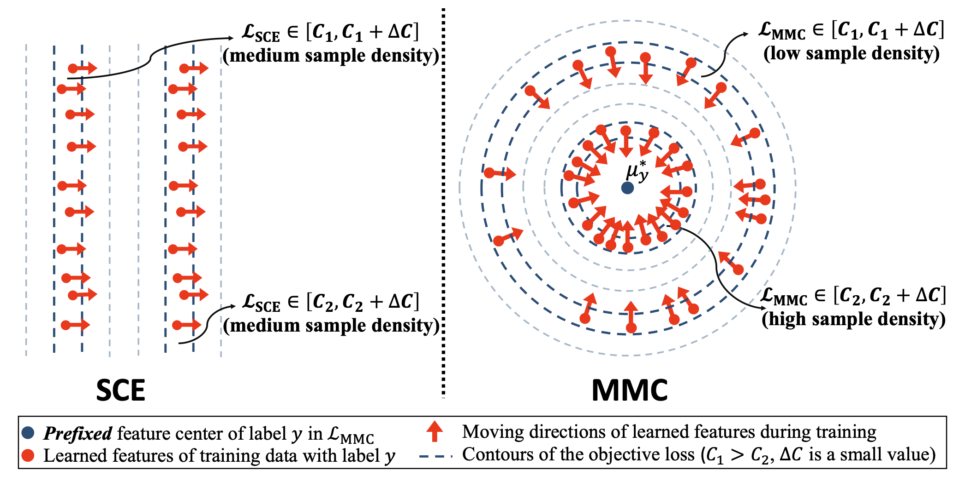
Rethinking SCE loss for adversarial robustness
3 Methodology
We define the notion of sample density in the feature space, then we compare that of SCE and our new MMC loss.

Slide 6
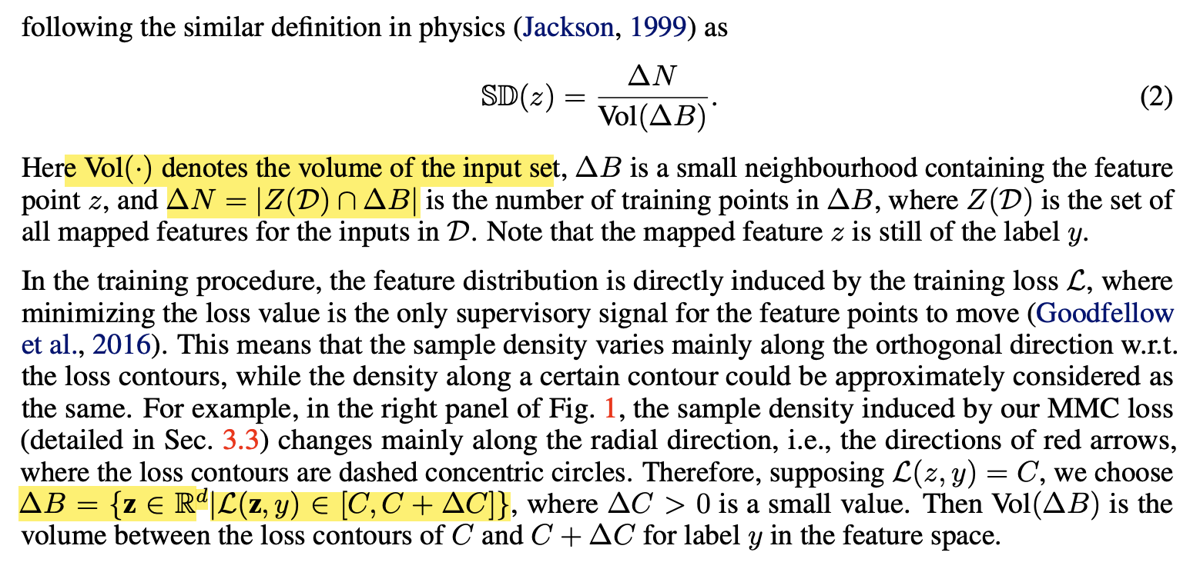
Rethinking SCE loss for adversarial robustness
3.1 Sample density in the feature space
Sample density means the number of training points in same loss contour volume

Slide 7


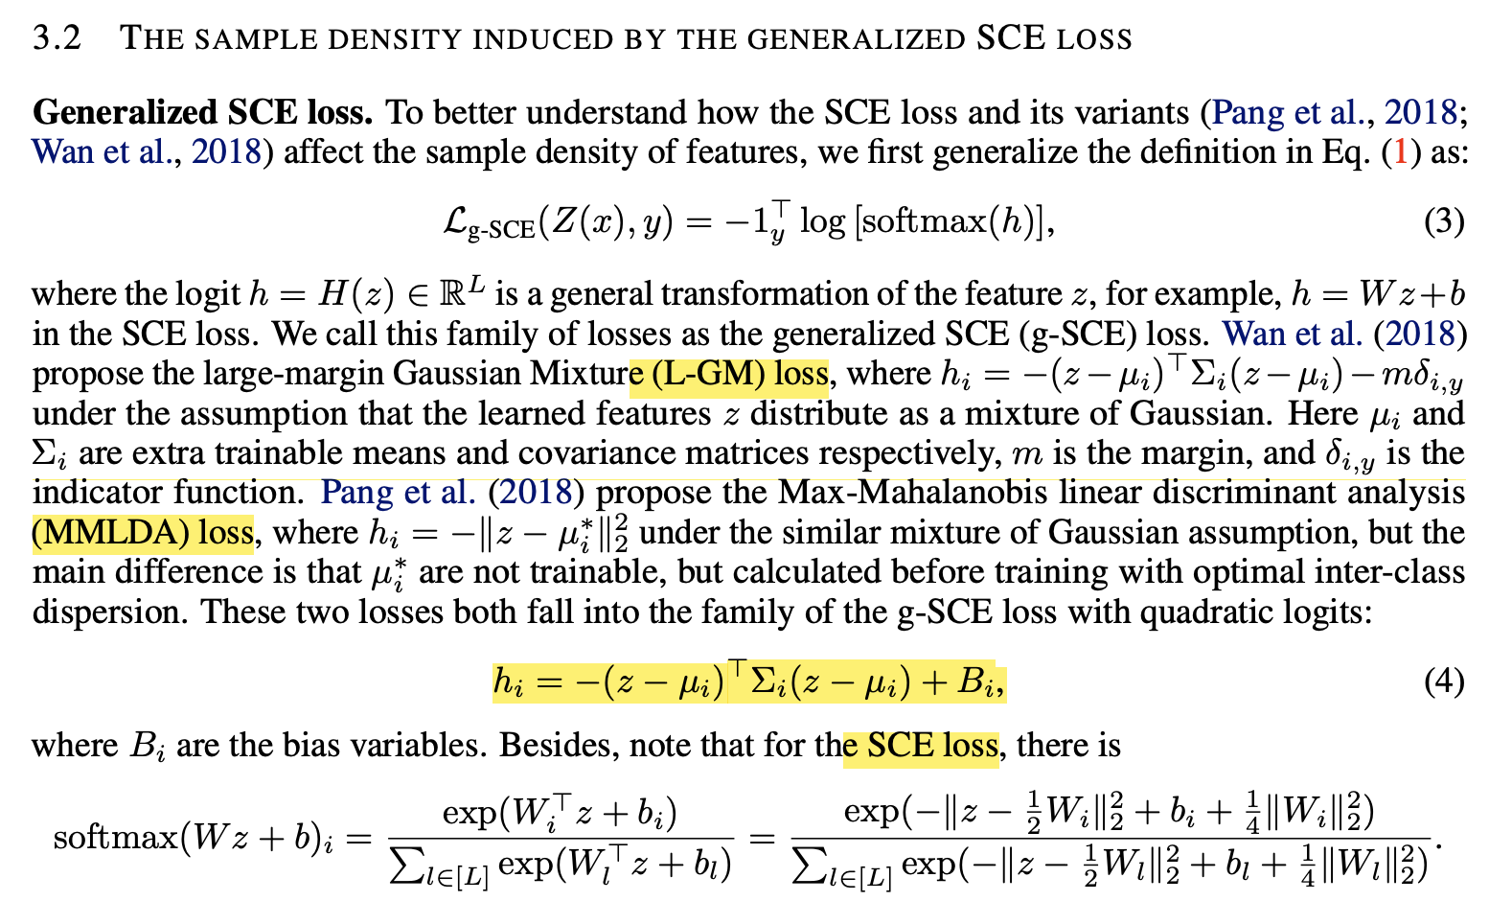
Rethinking SCE loss for adversarial robustness
3.2 The sample density induced by the generalized SCE loss
SCE loss
Generalized SCE loss
L-GM loss, MMLDA loss, and SCE loss are in g-SCE in same logit form:
?

Slide 8
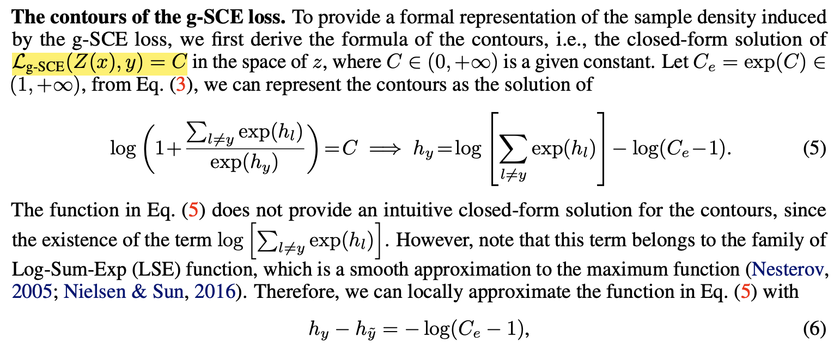
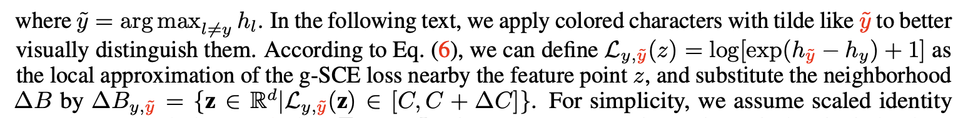
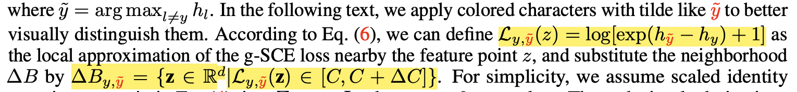
Rethinking SCE loss for adversarial robustness
We can get an approximated sample density from an approximated contour of g-SCE

Slide 9
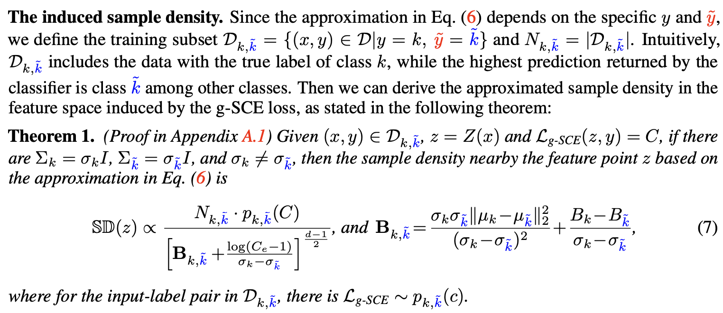
Rethinking SCE loss for adversarial robustness

Slide 10
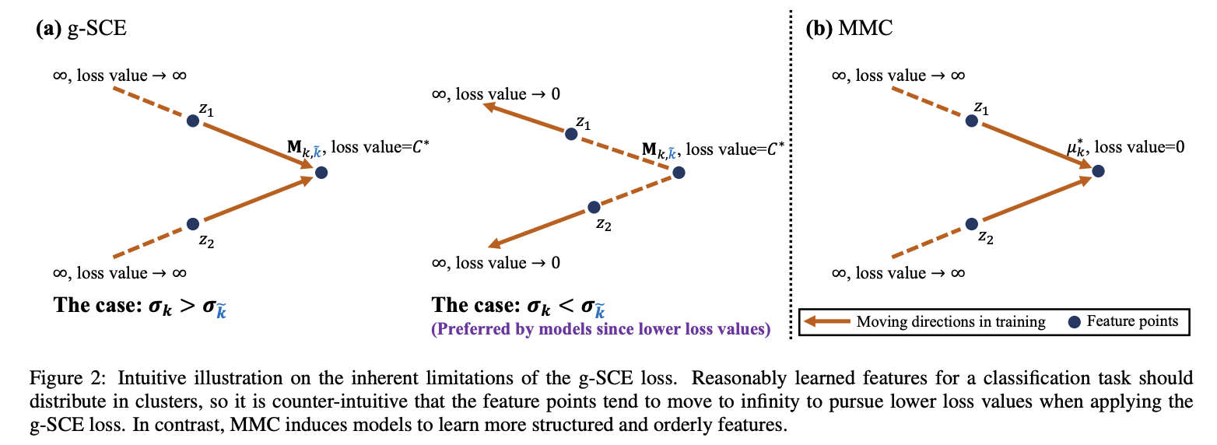
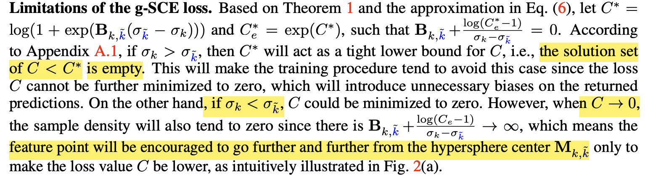
Rethinking SCE loss for adversarial robustness
g-SCE loss seems to practice unstably in some conditions

Slide 11
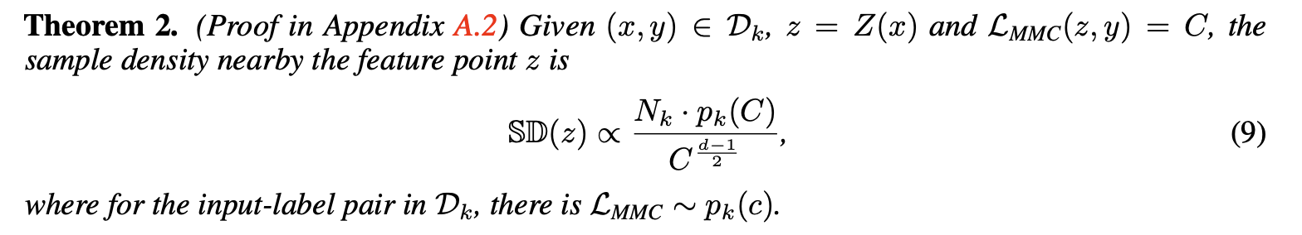
Rethinking SCE loss for adversarial robustness
3.3 Max-Mahalanobis center loss
MMC loss will induce higher sample density
MMC loss will have better exploiting model capacity

Slide 12
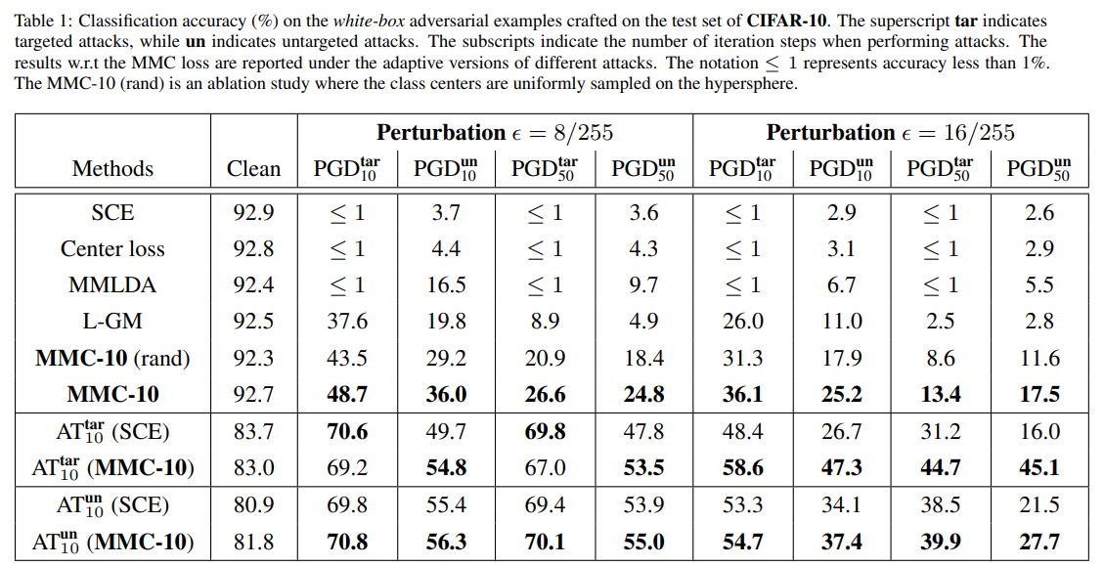
Rethinking SCE loss for adversarial robustness
4 Experiments

Slide 13
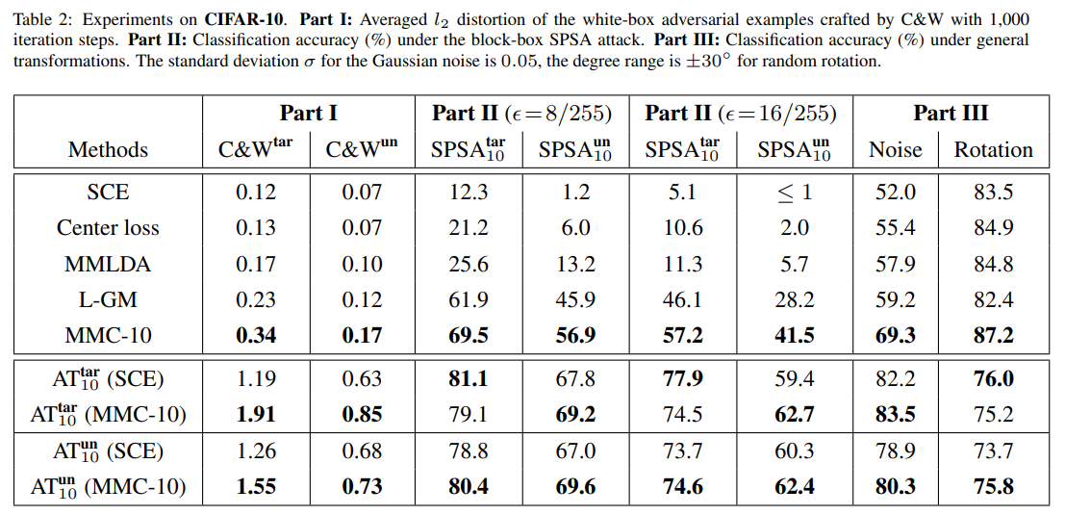
Rethinking SCE loss for adversarial robustness
4 Experiments

Slide 14
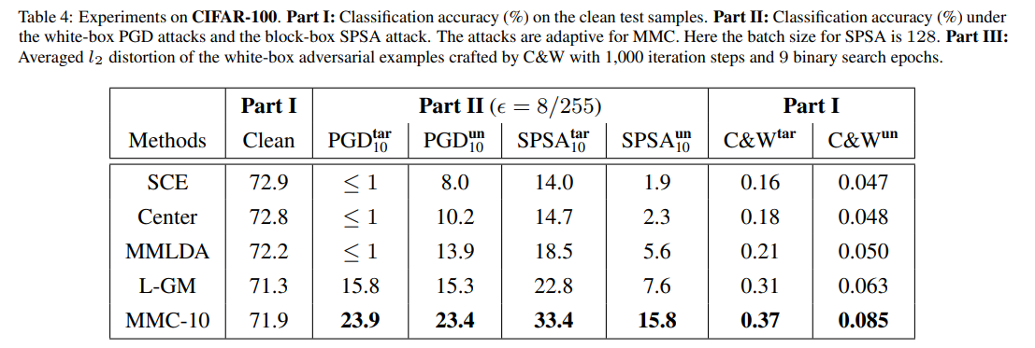
Rethinking SCE loss for adversarial robustness
4 Experiments

Slide 15
Rethinking SCE loss for adversarial robustness
5 Conclusion
MMC has reliable robustness
MMC keeps high performance on clean inputs
MMC introduces little extra computation
MMC is compatiable with the existing defense mechanisms

Slide 16
이 논문을 인용한 논문
Baseline으로 사용 / related work
Chih-Hui Ho et al., (2022), DISCO: Adversarial Defense with Local Implicit Functions, NeurIPS (cited 10)
F Tramer et al., (2020), On adaptive attacks to adversarial example defenses, NeurIPS (cited 750)
H Huang, (2021), Exploring architectural ingredients of adversarially robust deep neural networks, NeurIPS (cited 80)
Roland S. Zimmermann et al., (2022), Increasing confidence in adversarial robustness evaluations, NeurIPS cited(6)
Tianyu Pang 논문
Tianyu Pang et al.,m (2020), Boosting adversarial training with hypersphere embedding, NeurIPS (cited 133)
HE(Hypersphere Embedding)를 AT에 적용해 성능 향상
Metric learning의 예시로 나옴
Yinpeng Dong et al., (2020), Adversarial distributional training for robust deep learning, NeurIPS (cited 104)
Related work에서 new loss를 이용한 defense method 나열 중에 나옴

Slide 17
이 논문을 인용한 논문
B Wu et al., (2023), Towards in-distribution compatiable out-of-distribution detection, AAAI
Cited 0
S Mei et al., (2023), Towards interpreting and utilizing symmetry property in adversarial examples, AAAI
Cited 0
C Liu et al., (2022), Robust Binary Models by Pruning Randomly-initialized Networks, NeurIPS
Cited 1
L Bethune et al., (2022), Pay attention to your loss: understanding misconceptions about lipschitz neural networks, NeurIPS
Cited 18
X Li et al., (2021), Improving adversarial robustness via rpbabilistically compact loss with logit constraints, AAAI
Cited 19
Tianyang Hu et al., (2022), Understanding suqare loss in training overparameterized neural network classifiers, NeurIPS
Cited 5
NTK?

