Slide 1
SAMAT Formulation
KwanHee Lee
Week13
Graduation Project 1
CSE, Konkuk Univ.

Slide 2
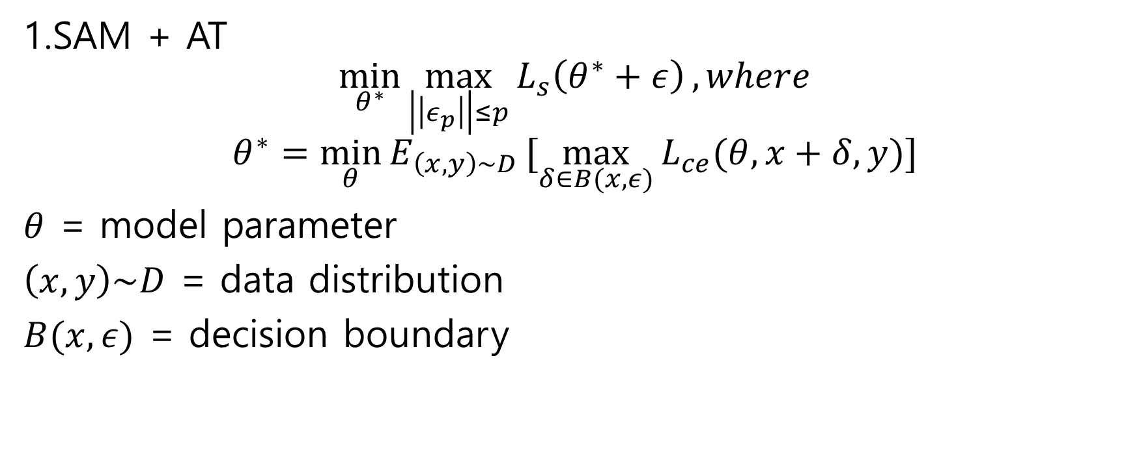
Formulation
SAM
1.SAM + AT
$$\min_{θ^{∗}}{\max_{\left|\left|ε_{p}\right|\right|≤p}{L_{s}\left(θ^{∗}+ε\right)}}, where$$
$$θ^{∗}=\min_{θ}{E_{\left(x,y\right)\sim D }[\max_{δ∈B(x,ε)}{L_{ce}(θ,x+δ,y)]}}$$
$θ$ = model parameter
$\left(x,y\right)\sim D$ = data distribution
$B(x,ε)$ = decision boundary
AT

Slide 3
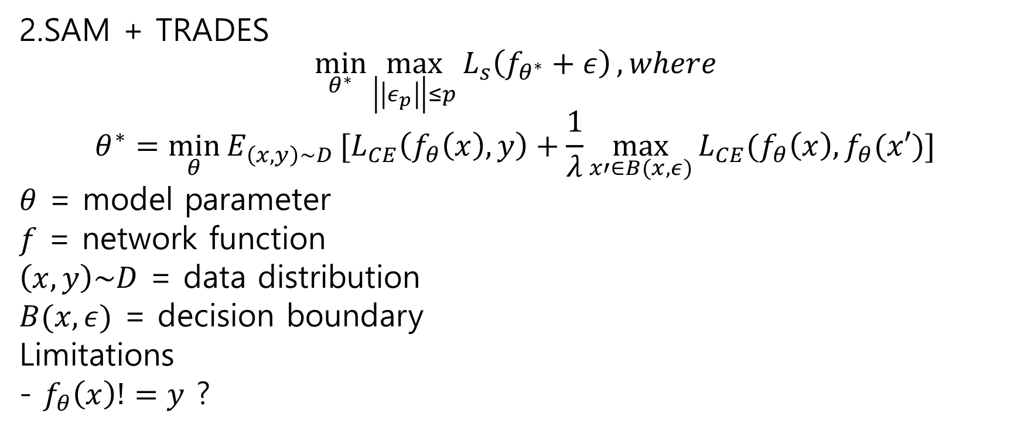
Formulation
SAM
2.SAM + TRADES
$$\min_{θ^{∗}}{\max_{\left|\left|ε_{p}\right|\right|≤p}{L_{s}\left(f_{θ^{∗}}+ε\right)}}, where$$
$$θ^{∗}=\min_{θ}{E_{\left(x,y\right)\sim D }[L_{CE}\left(f_{θ}\left(x\right),y\right)+\frac{1}{λ}\max_{x′∈B(x,ε)}{L_{CE}(f_{θ}\left(x\right),f_{θ}(x′)]}}$$
$θ$ = model parameter
$f$ = network function
$\left(x,y\right)\sim D$ = data distribution
$B(x,ε)$ = decision boundary
Limitations
- $f_{θ}\left(x\right)!=y$ ?
clean
Robust loss

