Slide 1
Explainable Credit Risk Assessment using Hybrid (Rough Set Theory) and LLm
Shyam prasad S (23mid0347)
Pooja s (23mid0224)
Arul amuthan rt (23MID0284)

Slide 2
Introduction
1.1 Background
Credit risk assessment is a critical task in financial institutions. Banks must evaluate whether a loan applicant is likely to repay the loan. Incorrect decisions can lead to:
Financial loss (approving risky applicants)
Customer dissatisfaction (rejecting safe applicants)
Traditional machine learning models such as Support Vector Machines and Random Forests provide high prediction accuracy but often lack interpretability. In financial applications, explainability is essential due to regulatory requirements and ethical considerations.

Slide 3
Problem Statement
To develop an Explainable Credit Risk Assessment System that:
Predicts whether a loan applicant is:
Low Risk
High Risk
Generates:
Rule-based explanation using Rough Set Theory
Natural language explanation using Tiny Llama

Slide 4
Objective
The objectives of this project are:
To preprocess and prepare the German Credit dataset.
To apply Rough Set Theory for rule extraction and feature reduction.
To compare ML performance before and after RST.
To integrate Tiny Llama for natural language explanation generation.
To design a hybrid Explainable AI system for financial decision-making.

Slide 5
Literature Overview
Name | Common approaches: | Limitation :
Credit Risk Prediction | Logistic Regression Decision Trees, SVM Random Forest, Neural Networks | Black-box nature reduces transparency.
Rough Set Theory in Finance | Rough Set Theory (Pawlak, 1982) is used for: Rule extraction Feature selection Handling uncertainty Knowledge discovery | Advantages: No probabilistic assumptions Works directly on decision tables Produces interpretable IF–THEN rules
Explainable AI and LLMs | Recent developments integrate: Rule-based systems Feature attribution methods Large Language Models (LLMs) | Tiny Llama enables: Lightweight deployment Natural language explanation generation Offline local usage (via Ollama)

Slide 6
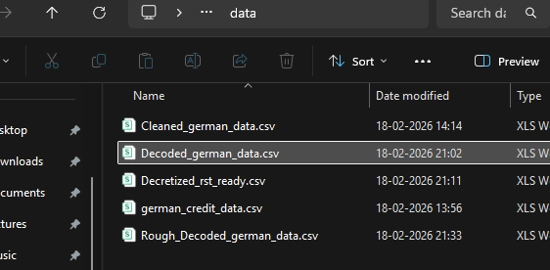
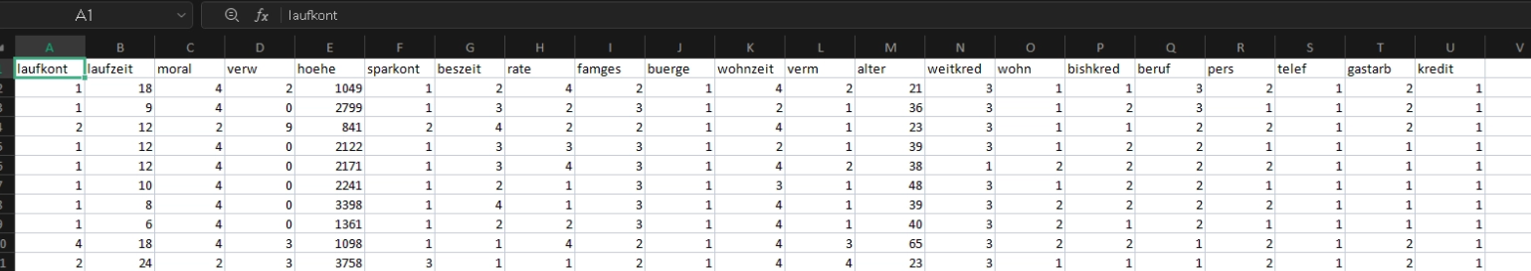
Dataset Description
Dataset Used:
German Credit Dataset (UCI Repository)
Total records: 1000
Attributes: 20 condition attributes + 1 decision attribute
Target variable: Risk (Low Risk / High Risk)

Slide 7
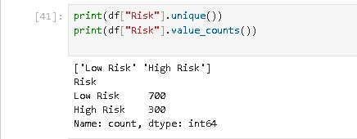
Dataset Description
Target Distribution
Low Risk: 700
High Risk: 300
The dataset is moderately imbalanced (70:30 ratio).

Slide 8
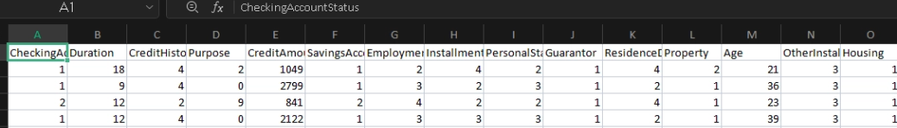
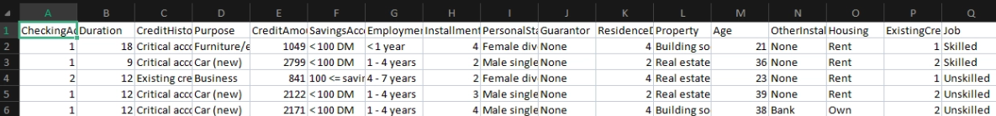
Data Cleaning and Preprocessing
Renamed German attribute names to English
Converted numeric encodings to meaningful categories
Corrected pandas null parsing issue

Slide 9
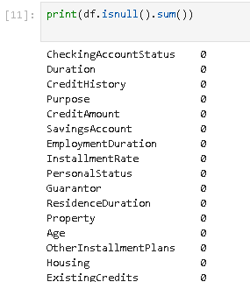
Data Cleaning and Preprocessing
Ensured no missing values:
Applied quantile-based discretization
a data preprocessing technique that transforms continuous-valued attributes into discrete, categorical intervals (bins) to enable knowledge reduction and rule extraction

Slide 10
Preprocessing -Categorical Decoding
All encoded numeric values were converted to meaningful labels.
Encoded | Decoded
CreditHistory = 4 | Critical account
SavingsAccount = 1 | < 100 DM
Housing = 2 | Own

Slide 11
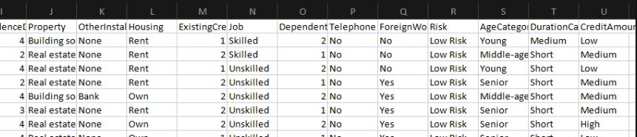
Preprocessing -Discretization (Quantile-Based)
Continuous variables were discretized into three categories using equal-frequency binning.
Age → AgeCategory
Young
Middle-aged
Senior
Duration → DurationCategory
Short
Medium
Long
CreditAmount → CreditAmountCategory
Low
Medium
High

Slide 12

Rough Set Theory Framework
Decision Table
A decision table is defined as:
$DT=\left(U , A∪\left\{D\right\}\right)$
Where:
U = set of 1000 applicants
A = condition attributes
D = Risk (decision attribute)
Indiscernibility Relation:
Two objects are indiscernible if they share identical attribute values.
This forms equivalence classes.

Slide 13
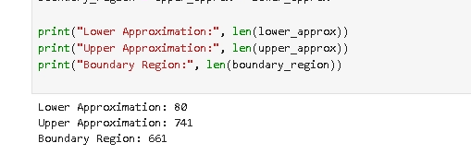
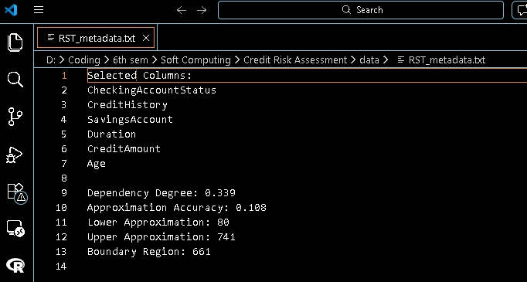
Rough Set Theory Framework
Lower and Upper Approximation
For class “High Risk”:
Lower Approximation → Definitely high risk
Upper Approximation → Possibly high risk
This handles inconsistency in data.
Reduct Concept
Reduct = Minimal subset of attributes preserving classification ability.
Goal: Reduce 20 attributes → smaller essential subset.
Benefits:
Reduced complexity
Improved interpretability
Stronger rule clarity

Slide 14
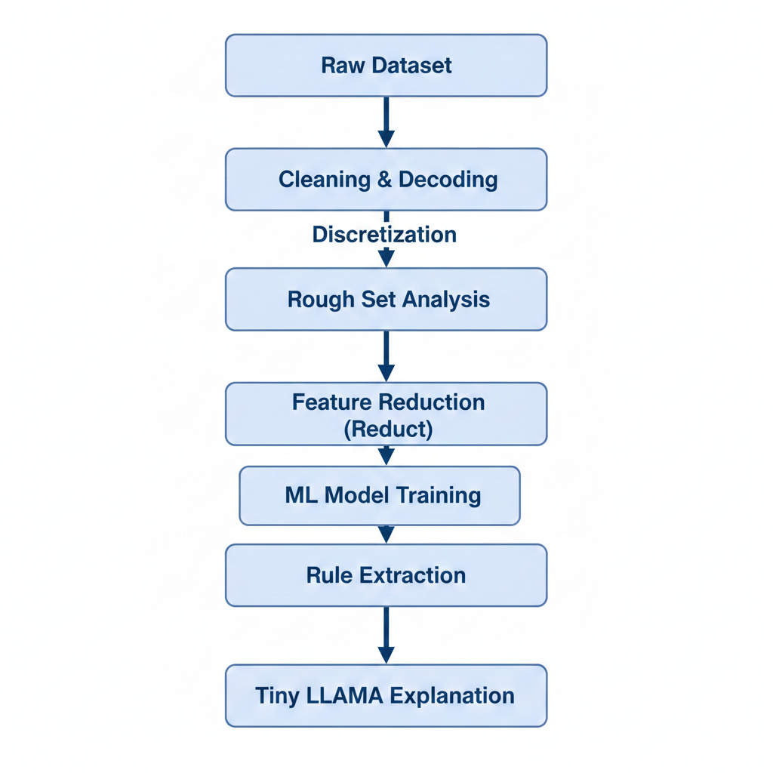
Proposed System Architecture

Slide 15
Tiny Llama Integration
After prediction:
Ex,
Structured rule:
IF CreditHistory = Critical account
AND SavingsAccount = < 100 DM
AND DurationCategory = Long
THEN High Risk
Prompt given to Tiny Llama:
Explain why this applicant is high risk in simple terms.
Generated output:
The applicant is classified as high risk due to poor credit history and limited savings, combined with a long loan duration which increases repayment uncertainty.

Slide 16
Work Completed So Far
Dataset selection and understanding
Column renaming and decoding
Handling pandas NA issue
Full categorical transformation
Quantile-based discretization
Creation of RST-ready dataset

Slide 17
Expected Contribution
Hybrid Explainable AI framework
Rule-based credit risk model
Feature reduction using Rough Sets
Natural language explanation via Tiny Llama
Regulatory-friendly AI system

Slide 18
Review 1 Conclusion
The project has successfully completed dataset preparation and preprocessing stages. The decision table has been constructed and discretized for Rough Set analysis.
The next phase will focus on rule extraction and feature reduction using Rough Set Theory, followed by integration with machine learning models and Tiny Llama for explanation generation.

