Slide 1
Calibo AI Academy
Telco Customer Churn Prediction
Logistic Regression Classification Model
PRESENTED BY
ASHIKA REDDY
MACHINE LEARNING • CLASSIFICATION
Telco Customer Churn | Project overview and presentation title.
01

Slide 2
02 • BUSINESS PROBLEM
ASHIKA REDDY
Why Churn Prediction Matters
Losing customers is costly, so the goal is to spot who is likely to leave before they do.
SITUATION
COMPLICATION
A telecom company sells phone and internet services to thousands of customers on monthly or longer contracts.
Customers leave (churn) without warning, and retention teams cannot contact everyone. They need to know who to prioritise.
THE BUSINESS QUESTION
Can customer details and service usage predict whether a customer will churn?
DATA
MODEL
SUCCESS
Telco customer dataset
Logistic Regression
Catch churners reliably
Business Problem | Defines the objective, stakeholder and success measure.
02

Slide 3
03 • DATA FOUNDATION
ASHIKA REDDY
Dataset Overview
Customer-level records with demographics, services, billing and churn status.
7,043
21
1,869
26.5%
Customers
Columns
Churned
Churn rate
CUSTOMER PROFILE
SERVICES
BILLING & TARGET
Gender, senior citizen, partner, dependents and tenure (months with the company).
Phone, multiple lines, internet type, online security, backup, device protection, tech support and streaming.
Contract, paperless billing, payment method, monthly and total charges. Target: Churn (Yes/No).
Dataset | 7,043 customers described by 21 columns, with no missing values at load.
03

Slide 4
04 • ETL & DATA PREPARATION
ASHIKA REDDY
Preparing the Data for Modeling
Five cleaning steps turn the raw file into model-ready numbers.
01
02
03
04
05
FIX TYPES
FILL GAPS
DROP ID
ENCODE TARGET
ONE-HOT
TotalCharges was text, so it was converted to numeric.
11 blanks created by conversion were filled with 0.
customerID removed because it has no predictive value.
Churn mapped: No = 0, Yes = 1.
Categorical columns converted to dummy variables (drop_first).
Result: a fully numeric feature table (X) and a 0/1 churn label (y), ready for splitting and scaling.
Data Preparation | Cleaning, encoding and conversion applied before training.
04

Slide 5
05 • EXPLORATORY ANALYSIS
ASHIKA REDDY
Churn Distribution
About one in four customers left, so the classes are imbalanced.
73.5%
Stayed
5,174 customers
26.5%
Churned
1,869 customers
WHY IT MATTERS
Accuracy alone can mislead here, so recall and precision are tracked for churners.
Class Balance | 5,174 customers stayed and 1,869 churned (26.5%).
05

Slide 6
06 • MODEL APPROACH
ASHIKA REDDY
Building the Logistic Regression Model
Split, scale, train and predict with a simple, explainable classifier.
SPLIT
SCALE
TRAIN
PREDICT
80% train / 20% test
StandardScaler
Logistic Regression
Churn probability
→
→
→
Stratified on churn, random_state = 42
Fit on training data only, then applied to test data
max_iter = 1000
Default cut-off of 0.5 for the first evaluation
WHY LOGISTIC REGRESSION
It outputs a churn probability per customer, which lets the business choose how aggressive to be.
Methodology | 80/20 stratified split, standardised features, logistic regression.
06

Slide 7
07 • MODEL PERFORMANCE
ASHIKA REDDY
Evaluation Results at 0.5 Threshold
Tested on 1,409 unseen customers.
80.7%
65.8%
56.7%
60.9%
0.842
ACCURACY
PRECISION
RECALL
F1 SCORE
ROC-AUC
Overall correct predictions
Predicted churners who really churned
Actual churners the model caught
Balance of precision and recall
Ability to rank churners higher
STRENGTH
WEAKNESS
Good overall accuracy and an AUC above 0.84 show the model separates churners from loyal customers well.
Recall of 56.7% means about 43% of real churners are missed at the default cut-off.
Results | Accuracy 80.7%, precision 65.8%, recall 56.7%, F1 60.9%, ROC-AUC 0.842.
07

Slide 8
08 • MODEL PERFORMANCE
ASHIKA REDDY
Confusion Matrix
Where the model is right and where it makes mistakes.
PREDICTED
Stay
Churn
CORRECT PREDICTIONS
Stay
925
True negatives
110
False positives
1,137 of 1,409 customers (925 stayers + 212 churners) were classified correctly.
MISSED CHURNERS
ACTUAL
Churn
162
False negatives
212
True positives
162 customers who churned were predicted to stay. These are the costliest errors.
FALSE ALARMS
110 loyal customers were flagged as churn risks, wasting some retention effort.
Confusion Matrix | 925 true negatives, 110 false positives, 162 false negatives, 212 true positives.
08

Slide 9
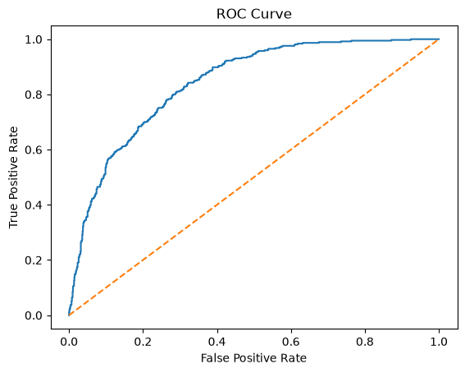
09 • MODEL PERFORMANCE
ASHIKA REDDY
ROC Curve and Class Report
The curve sits well above the random-guess line.
Class | Precision | Recall | F1 | Support
Stay | 0.85 | 0.89 | 0.87 | 1,035
Churn | 0.66 | 0.57 | 0.61 | 374
Accuracy |  |  | 0.81 | 1,409
READING THE RESULTS
The model is stronger on loyal customers (recall 0.89) than on churners (recall 0.57). Because churn is the minority class, the churn rows are the ones to improve.
ROC-AUC | 0.842 indicates strong ability to rank churners above non-churners.
09

Slide 10
10 • OPTIMISATION
ASHIKA REDDY
Tuning the Decision Threshold
Lowering the cut-off trades precision for much higher recall.
75.4%
recall at threshold 0.3, up from 56.7% at 0.5
TRADE-OFF
Precision falls to 51.9% at 0.3, so more loyal customers get contacted. Pick the threshold by retention cost.
Threshold Tuning | At 0.3, recall rises from 56.7% to 75.4% while F1 stays near 0.61.
10

Slide 11
11 • BUSINESS INSIGHTS
ASHIKA REDDY
What the Results Mean
Turning model output into retention decisions.
01
Target by probability
02
Use a lower threshold
Rank customers by predicted churn probability and contact the highest-risk group first.
At 0.3 the model catches about 282 of 374 churners, versus 212 at 0.5.
03
Accept some false alarms
04
Watch class imbalance
Extra contacts to loyal customers usually cost less than losing a customer.
With only 26.5% churners, recall and F1 are better guides than accuracy.
Business Insights | Use probabilities to target retention where it pays off.
11

Slide 12
12 • FINAL CONCLUSION
ASHIKA REDDY
Conclusion and Next Steps
A solid baseline that is ready to guide retention outreach.
“Logistic regression predicts churn with 80.7% accuracy and 0.842 ROC-AUC; a 0.3 threshold lifts recall to 75.4%.”
WHAT WE DID
WHAT WE FOUND
NEXT STEPS
Cleaned 7,043 records, encoded features, scaled data and trained and evaluated a logistic regression model.
Strong ranking ability, but only 56.7% recall at 0.5. Threshold tuning improves churner capture.
Try other models, handle class imbalance, and deploy the saved model and scaler for scoring.
Conclusion | Logistic regression reaches 0.842 ROC-AUC and the model and scaler are saved for reuse.
12

