Slide 1
Calibo AI Academy
Advertising Sales Prediction
Multiple Linear Regression Model
PRESENTED BY
ASHIKA REDDY
MACHINE LEARNING • REGRESSION
Advertising Sales Prediction | Project overview and presentation title.
01

Slide 2
02 • BUSINESS PROBLEM
ASHIKA REDDY
Why Advertising Analysis Matters
Advertising budgets are limited, so each channel must earn its share.
SITUATION
COMPLICATION
A company spends on TV, Radio and Newspaper advertising and wants to understand how each affects Sales.
Without evidence, budget may go to channels that add little. Decision makers need a clear estimate of each channel's effect.
THE BUSINESS QUESTION
Can advertising spend on TV, Radio and Newspaper predict Sales?
DATA
MODEL
SUCCESS
Advertising dataset
Multiple Linear Regression
Accurate, explainable forecasts
Business Problem | Defines the objective, stakeholder and success measure.
02

Slide 3
03 • DATA FOUNDATION
ASHIKA REDDY
Dataset Overview
Advertising spend per medium and the resulting Sales.
190
4
0
14.51
Records
Columns
Missing values
Average Sales
INPUTS (X)
TARGET (y)
DATA QUALITY
TV, Radio and Newspaper advertising spend.
Sales, a continuous number, which is why regression is used.
All values are present, so no cleaning or filling was needed.
Dataset | 190 records, 4 columns and no missing values.
03

Slide 4
04 • EXPLORATORY ANALYSIS
ASHIKA REDDY
Summary Statistics
Spend varies widely, with TV the largest channel on average.
Variable | Mean | Std Dev | Min | Max
TV | 154.33 | 79.19 | 5.40 | 293.60
Radio | 23.65 | 14.03 | 0.80 | 49.60
Newspaper | 29.25 | 21.80 | 0.30 | 114.00
Sales | 14.51 | 4.64 | 4.80 | 25.50
READING THE TABLE
TV spend ranges from 5.4 to 293.6, while Radio tops out at 49.6. Newspaper has the widest relative spread, with a maximum of 114.
MISSING DATA
None found in any column.
Statistics | TV averages 154.33, Radio 23.65, Newspaper 29.25 and Sales 14.51.
04

Slide 5
05 • MODEL APPROACH
ASHIKA REDDY
Building the Regression Model
Select, split, train, predict and evaluate.
SELECT
SPLIT
TRAIN
PREDICT
Inputs and target
80% train / 20% test
Linear Regression
Sales estimates
→
→
→
TV, Radio, Newspaper predict Sales
152 training and 38 testing rows, random_state = 42
fit() learns the coefficients
predict() on unseen test data
WHY MULTIPLE LINEAR REGRESSION
Sales depends on three advertising inputs, and the coefficients are easy to explain.
Methodology | 80/20 split gives 152 training and 38 testing records.
05

Slide 6
06 • MODEL PERFORMANCE
ASHIKA REDDY
Evaluation Results
Tested on 38 unseen records.
1.1753
3.0100
1.7349
0.8606
MAE
MSE
RMSE
R²
Average absolute error in Sales units
Average squared error
Typical error in Sales units
Share of Sales variation explained
STRENGTH
ERROR SIZE
An R² of 0.86 means the three channels explain about 86% of the variation in Sales on unseen data.
Predictions are off by about 1.2 to 1.7 Sales units on average, against an average Sales of 14.51.
Results | MAE 1.1753, MSE 3.0100, RMSE 1.7349 and R-squared 0.8606.
06

Slide 7
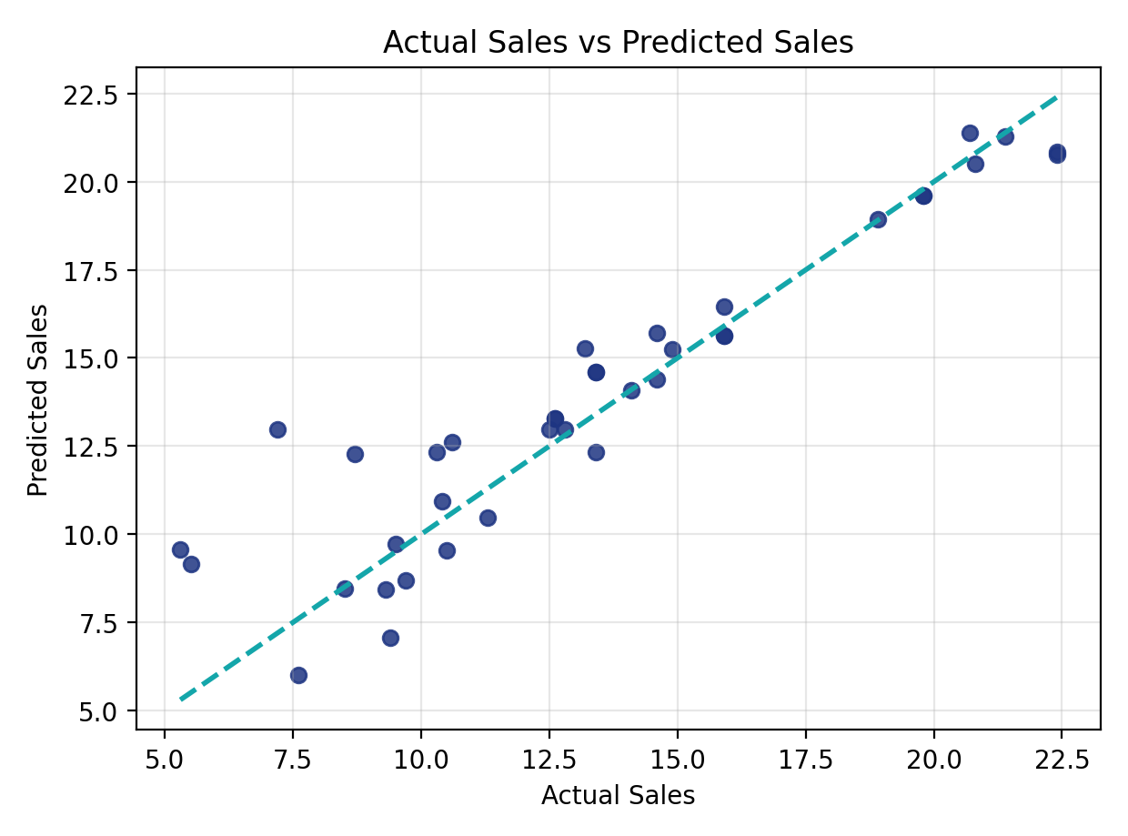
07 • MODEL PERFORMANCE
ASHIKA REDDY
Actual vs Predicted Sales
Points close to the dashed line are accurate predictions.
WHAT THE PLOT SHOWS
Predicted values track actual values along the ideal line, with scatter that matches the RMSE of about 1.73.
WHERE IT STRUGGLES
A few points sit further from the line, so individual forecasts can still miss by two Sales units or more.
Prediction Quality | Test predictions follow the ideal line closely.
07

Slide 8
08 • MODEL INSIGHTS
ASHIKA REDDY
Understanding the Coefficients
Expected change in Sales for one more unit of spend, other inputs held constant.
3.7582
Intercept: baseline Sales with zero spend
RADIO
About +0.19 Sales per extra unit of Radio spend.
TV AND NEWSPAPER
TV adds about 0.04; Newspaper is near zero.
Coefficients | Radio 0.1882, TV 0.0424, Newspaper -0.0049, intercept 3.7582.
08

Slide 9
09 • MODEL INSIGHTS
ASHIKA REDDY
Strongest and Weakest Channels
Comparing coefficients across the three media.
STRONGEST IMPACT
MIDDLE
LEAST IMPACT
Radio
TV
Newspaper
0.1882
0.0424
-0.0049
Each extra unit of Radio spend is linked to the biggest rise in Sales.
A smaller effect per unit, but TV has the largest budget range and the strongest correlation with Sales (0.78).
Effectively zero in this model, so Newspaper adds little once TV and Radio are included.
TAKEAWAY
Radio shows the strongest estimated effect; Newspaper shows the least.
Channel Impact | Radio has the strongest effect and Newspaper the least.
09

Slide 10
10 • MODEL PERFORMANCE
ASHIKA REDDY
Individual Predictions
Actual Sales, predicted Sales and the error for the first test records.
# | Actual Sales | Predicted Sales | Error
1 | 13.40 | 14.59 | -1.19
2 | 12.60 | 13.27 | -0.67
3 | 13.20 | 15.26 | -2.06
4 | 9.30 | 8.43 | +0.87
5 | 20.80 | 20.50 | +0.30
6 | 22.40 | 20.76 | +1.64
7 | 10.60 | 12.61 | -2.01
8 | 12.50 | 12.96 | -0.46
READING THE ERRORS
Positive error means the model under-predicted; negative means it over-predicted.
OBSERVATION
In these eight rows, errors range from -2.06 to +1.64, in line with an RMSE of 1.73.
Prediction Table | Error = actual minus predicted Sales.
10

Slide 11
11 • BUSINESS APPLICATION
ASHIKA REDDY
Predicting Sales for a New Budget
Using the trained model to test a planned spend.
150
20
30
13.73
Predicted Sales
→
TV spend
Radio spend
Newspaper spend
HOW IT IS CALCULATED
HOW TO USE IT
Sales = 3.76 + 0.0424 × TV + 0.1882 × Radio − 0.0049 × Newspaper, using the learned coefficients.
Change the three spend values to compare budget plans before committing real money.
Budget Scenario | TV 150, Radio 20 and Newspaper 30 gives predicted Sales of 13.73.
11

Slide 12
12 • FINAL CONCLUSION
ASHIKA REDDY
Conclusion and Next Steps
A reliable baseline that points to Radio as the channel to watch.
KEY RESULT
Multiple linear regression explains 86% of Sales variation, and Radio has the strongest effect.
WHAT WE DID
WHAT WE FOUND
NEXT STEPS
Trained a regression model on 152 records and tested it on 38 unseen records.
R² 0.8606, RMSE 1.73. Radio is strongest; Newspaper adds almost nothing.
Check real campaign costs per channel and test other models for better performance.
Conclusion | R-squared 0.8606 and Radio as the strongest channel; check real costs and test other models.
12

