Slide 1

Calibo AI Academy
Retail Category Intelligence
Retail Product Performance — Exploratory Data Analysis
PRESENTED BY
RENDLA PAVITHRA
G. AKASH
M.V. ASHIKA REDDY
A. MANISH
MUC01 • GROUP 14 • JANUARY–JUNE 2026
Notes:
Cover slide — team names centered; Vattikuti Foundation and logos removed.

Slide 2
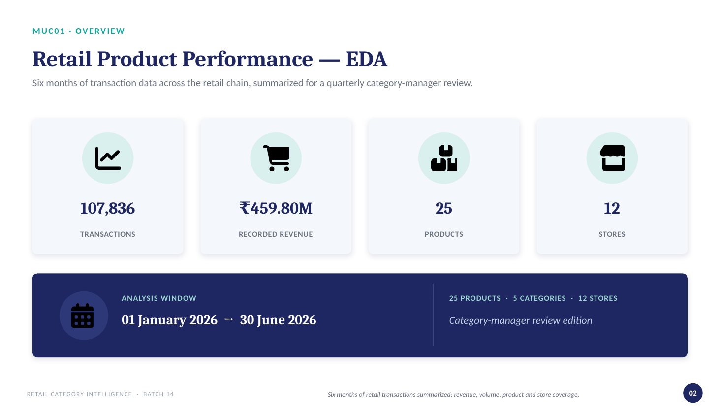

Slide 3
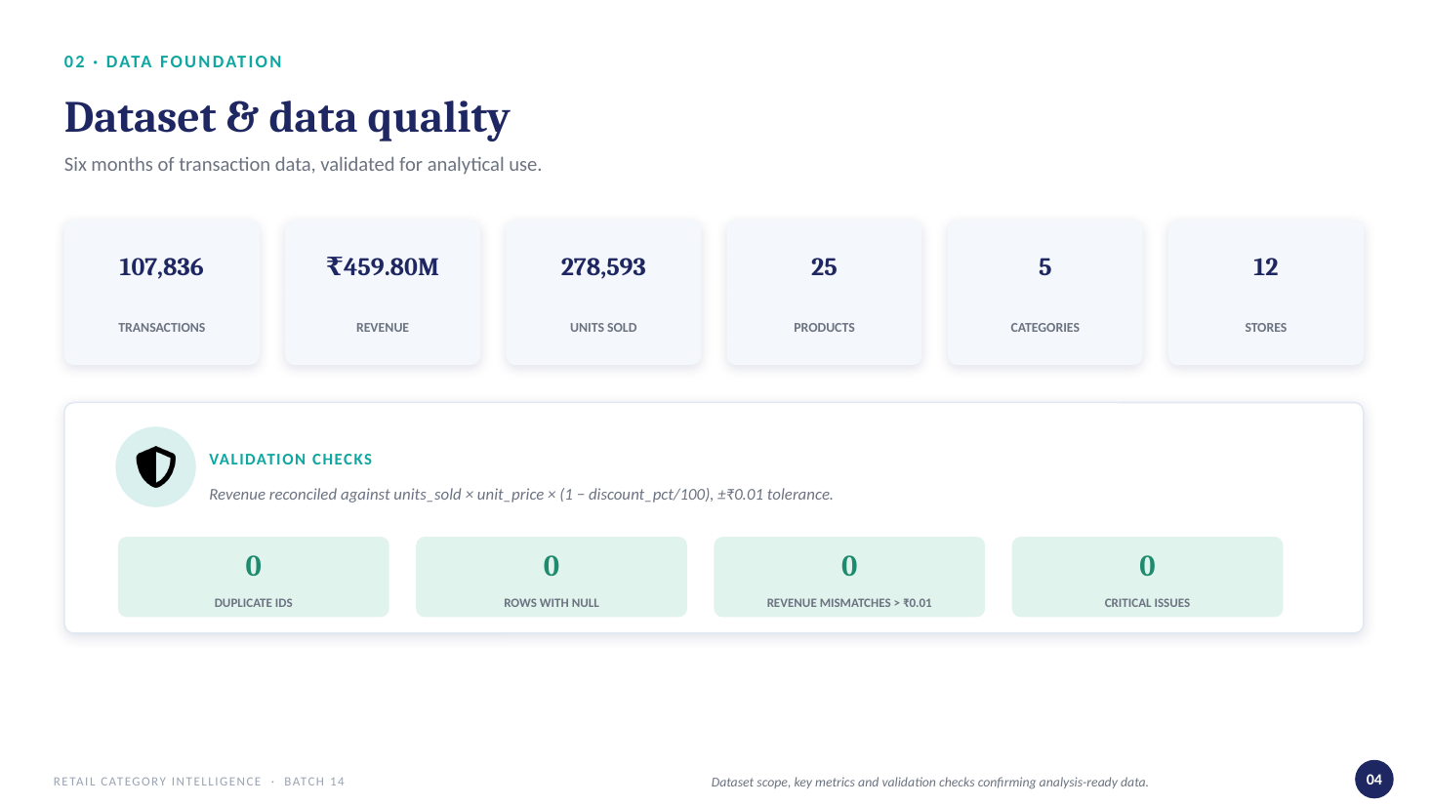

Slide 4
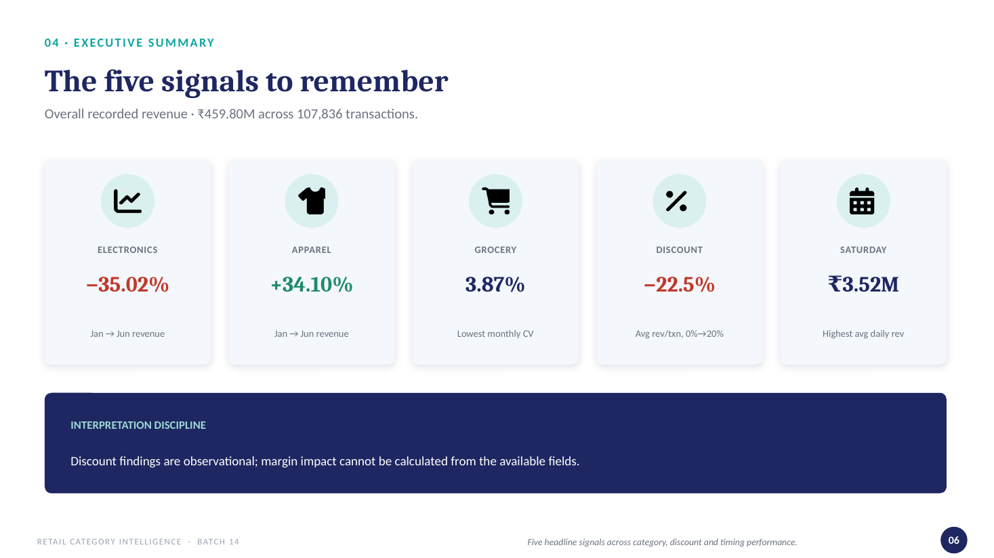

Slide 5
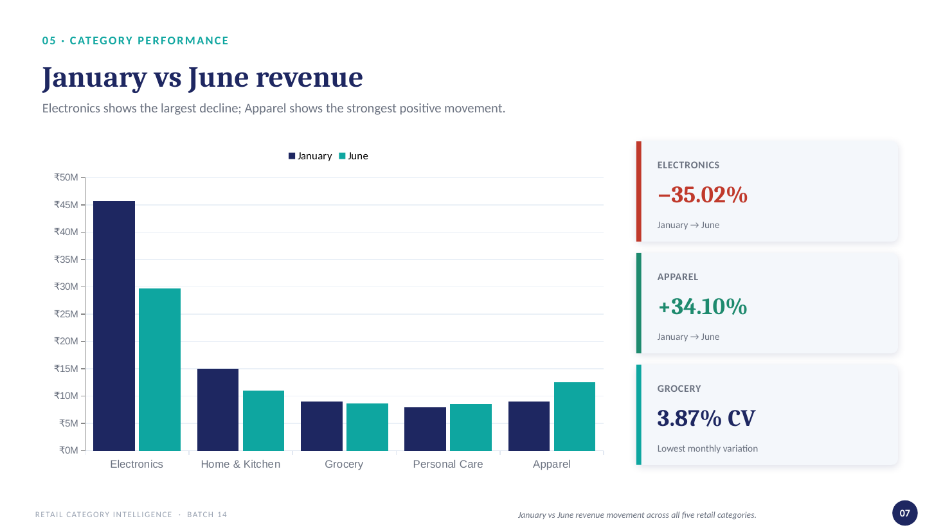

Slide 6
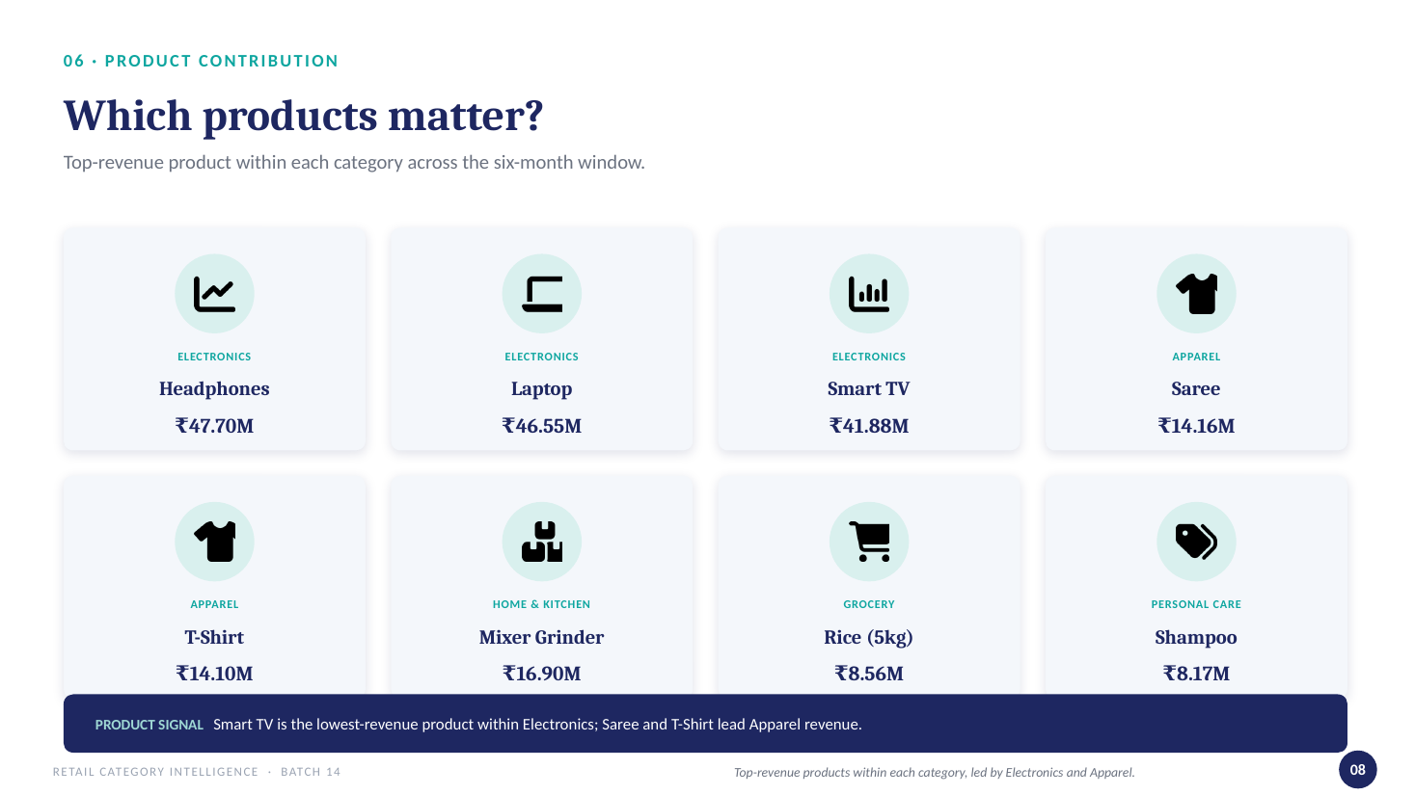

Slide 7
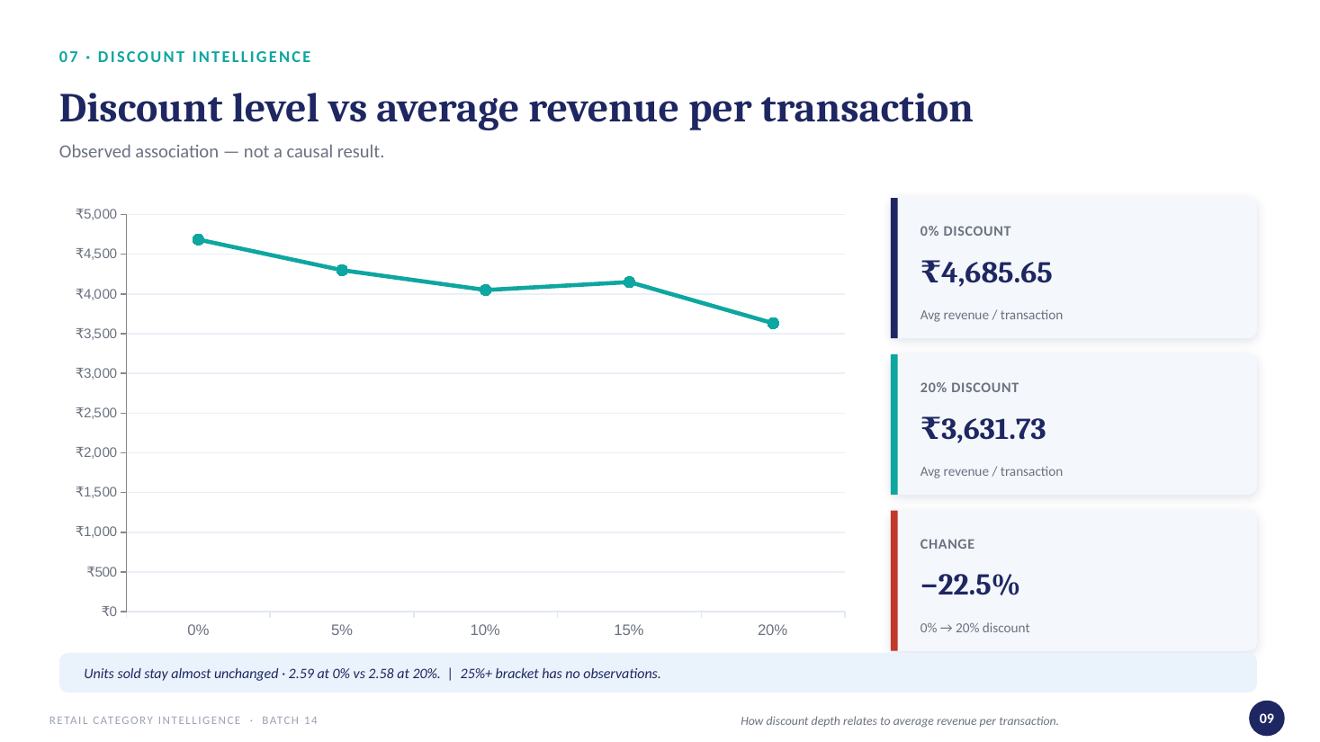

Slide 8
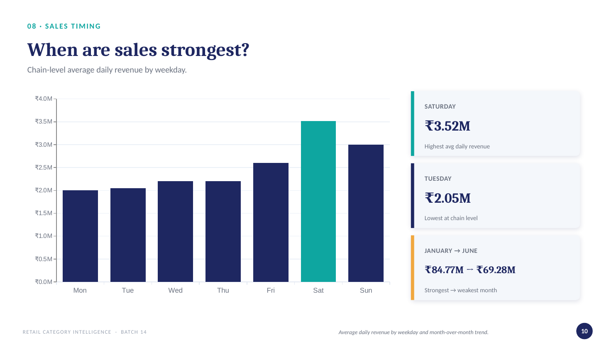

Slide 9


