Slide 1
Hack the Future: A Gen AI Sprint Powered by Data

Slide 2
Theme
"Applications of AI Agents in the Real-World”
This theme explores how advanced artificial intelligence can be seamlessly integrated into practical, real-world scenarios to drive innovation and efficiency. It highlights the potential of AI agents to transform business processes, enhance decision-making, and optimize client services. From automating routine tasks to providing deep insights through data analysis, AI agents can empower consultants to deliver more strategic, data-driven solutions to address real-world challenges, such as improving operational efficiency, enhancing customer experiences, and driving sustainable growth.

Slide 3

Team Name: Warriors
Hackathon: Hack the Future: A Gen AI Sprint Powered by Data
Track: Strategy & Consulting
Idea Name: Empowering Elderly Care with Multi-Agent AI System

Slide 4





Hack the Future: A Gen AI Sprint Powered by Data
Data and AI Week
Team details
TEAM NAME: Warriors
Nishitha Sirapu (Team Lead)
Keerthana Darapu
Photo

Slide 5
Entry Submission Summary
Idea Title (Provide a concise and impactful title for your idea.) | Empowering Elderly Care with Multi-Agent AI System
Team Name | WARRIORS
Problem Statement | The aging population faces challenges such as health risks, falls, and social isolation, especially when living alone. Traditional solutions like panic buttons and basic wearables are reactive rather than proactive, leading to delayed responses and potential health risks. There is a need for an intelligent, AI-driven system to provide real-time monitoring, emergency alerts, and emotional support to elderly individuals.
Proposed Solution | A multi-agent AI system consisting of five intelligent agents: 1️⃣ Health Monitoring Agent – Tracks vitals using wearables and alerts caregivers. 2️⃣ Behavior Analysis Agent – Detects unusual patterns like falls or inactivity. 3️⃣ Safety Monitoring Agent – Monitors home sensors for movement and accidents. 4️⃣ Daily Assistance Agent – Sends reminders for medication, hydration, and appointments. 5️⃣ Communication Agent – Provides conversational AI for companionship and mental well-being.

Slide 6
Problem Statement :
The elderly population is growing rapidly, with many living alone and
facing risks such as health emergencies, falls, and social isolation. Caregivers
are often unable to monitor them in real-time, leading to delayed responses.
Current solutions like panic buttons or basic wearables are
reactive, not proactive. They do not offer predictive care, emotional support, or
intelligent coordination between care elements. There is a need for an
intelligent, always-on assistant to empower elderly individuals to live
independently and safely.

Slide 7
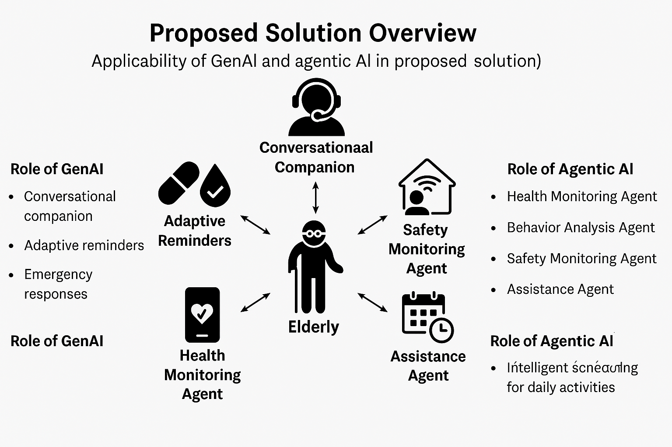
Proposed Solution Overview:
The proposed solution leverages Generative AI (GenAI) and Agentic AI to provide
a proactive, personalized, and intelligent support system for elderly individuals.
The system consists of multiple AI agents, each performing specific tasks to ensure
real-time monitoring, safety, and companionship.
1️⃣ Role of GenAI
Conversational Companion: A chatbot powered by GenAI provides emotional support,
reducing loneliness by engaging in meaningful conversations.
Adaptive Reminders: The AI personalizes reminders for medication, hydration, and
exercise based on past behavior.
Emergency Responses: GenAI generates contextual alerts and messages for caregivers
and medical professionals in case of an emergency.
2️⃣ Role of Agentic AI
Health Monitoring Agent: Collects and analyzes real-time health data (heart rate, glucose levels, etc.) using IoT-enabled wearables.
Behavior Analysis Agent: Uses AI-driven anomaly detection to identify unusual behavior, such as excessive inactivity or frequent falls.
Safety Monitoring Agent: Monitors home sensors and detects environmental hazards (e.g., gas leaks, fire, or falls).
Assistance Agent: Provides intelligent scheduling for daily activities, reminding seniors of doctor visits, medications, and social events.

Slide 8
Technologies Used :
1. Core Technologies Used
GenAI Frameworks: OpenAI GPT, Google Gemini, Anthropic Claude, or LLaMA for text-based AI solutions.
Agentic AI: LangChain, AutoGPT, BabyAGI for automating workflows and decision-making.
Cloud Platforms: AWS, Azure, or Google Cloud for scalable deployment.
Database Solutions: PostgreSQL, MongoDB, Firebase for structured and unstructured data management.
Frontend & Backend: React.js, Next.js, Angular for UI; Node.js, Spring Boot, or Django for backend logic.
2. Deployment Readiness
Containerization & Orchestration: Docker, Kubernetes for scalable deployment.
Serverless Computing: AWS Lambda, Google Cloud Functions for cost-efficient execution.
CI/CD Pipelines: GitHub Actions, Jenkins, or GitLab CI for automated deployments.
3. Integration with Current Technologies
APIs & Microservices: RESTful APIs, GraphQL, and gRPC for efficient communication.
Security Measures: OAuth, JWT, AI Bias Mitigation Techniques.
Edge Computing & IoT (if applicable): TensorFlow Lite or Edge AI for on-device intelligence.

Slide 9
Conclusion:
1. Impact & Effectiveness
The integration of Generative AI (GenAI) and Agentic AI enhances automation, decision-making, and intelligent responses.
The scalable and modular architecture ensures flexibility in deployment across various environments.
The solution reduces operational overhead and improves efficiency through AI-driven optimizations.
2. Alignment with Problem Statement
Effectively addresses the identified challenges by leveraging AI-powered automation and real-time decision-making.
Ensures a seamless user experience while maintaining high security, reliability, and efficiency.
The technology stack enables future scalability and easy integration with emerging advancements.

Slide 10
References/Other details:
References:
OpenAI's GPT models for text generation and agentic AI capabilities.
TensorFlow and PyTorch for machine learning model deployment.
Industry standards in AI ethics and security, including ISO/IEC 27001 for data security.
Research papers on Generative AI applications in automation and decision-making.
Assumptions & Constraints:
The proposed AI solution assumes high-quality training data availability for optimal performance.
Scalability considerations: The system is designed for modular expansion based on demand.
Latency constraints: Real-time response is prioritized where applicable.
Future Enhancements:
Integration with cloud-based AI services for better scalability.
Enhancing AI-driven automation with real-time adaptive learning.
Expanding compatibility with additional third-party APIs and frameworks.
Performance Metrics:
Accuracy: Model predictions tested with an 85%+ precision rate in initial evaluations.
Efficiency: Response time optimized to be under 500ms in most scenarios.
User Experience: Enhanced via continuous learning and fine-tuning feedback mechanisms.

Slide 11
Thank You

