Slide 1

CRYPTOCURRENCY FRAUD DETECTION USING DISTRIBUTED LEDGER ANALYTICS
Under guidance of:
Mr. M. Subba Rao[MTech]
Assistant Professor
Department of CSE-3
Team Members:
2300030118 – Ch. Deekshitha
2300030655 – S. Akshaya
2300031209 – G. Alekhya
2300032688 – A. Nikitha

Slide 2
PROBLEM STATEMENT
Rapid growth of cryptocurrency transactions has increased the risk of fraudulent and suspicious activities, while the large volume and complexity of blockchain transactions make manual fraud detection difficult and time-consuming.
Existing fraud detection approaches often identify fraud only after the transaction has occurred, increasing the risk of financial loss. Hence, there is a need for a real-time intelligent system that analyzes transaction patterns using Distributed Ledger Analytics and Machine Learning to detect suspicious activities early.
The proposed system provides early fraud awareness by alerting the sender before transaction completion helping to reduce financial risk and enable more secure cryptocurrency transactions.

Slide 3
SRS(Software requirement specification)
Functional Requirements
Transaction input and data validation
Transaction analysis and behavior profiling
Fraud detection and pattern matching
Risk classification: Low / Medium / High
Alerts, verification, and hold mechanisms
Ledger recording and admin monitoring
Non-Functional Requirements
Security — encrypted data and access controls
Reliability — consistent and accurate outputs
Performance — low-latency transaction processing
Scalability — supports growing transaction volumes
Usability — intuitive dashboard interface
Planned Hardware: Raspberry Pi 4, 64 GB MicroSD, Router/Network, Power Supply, Cooling System

Slide 4
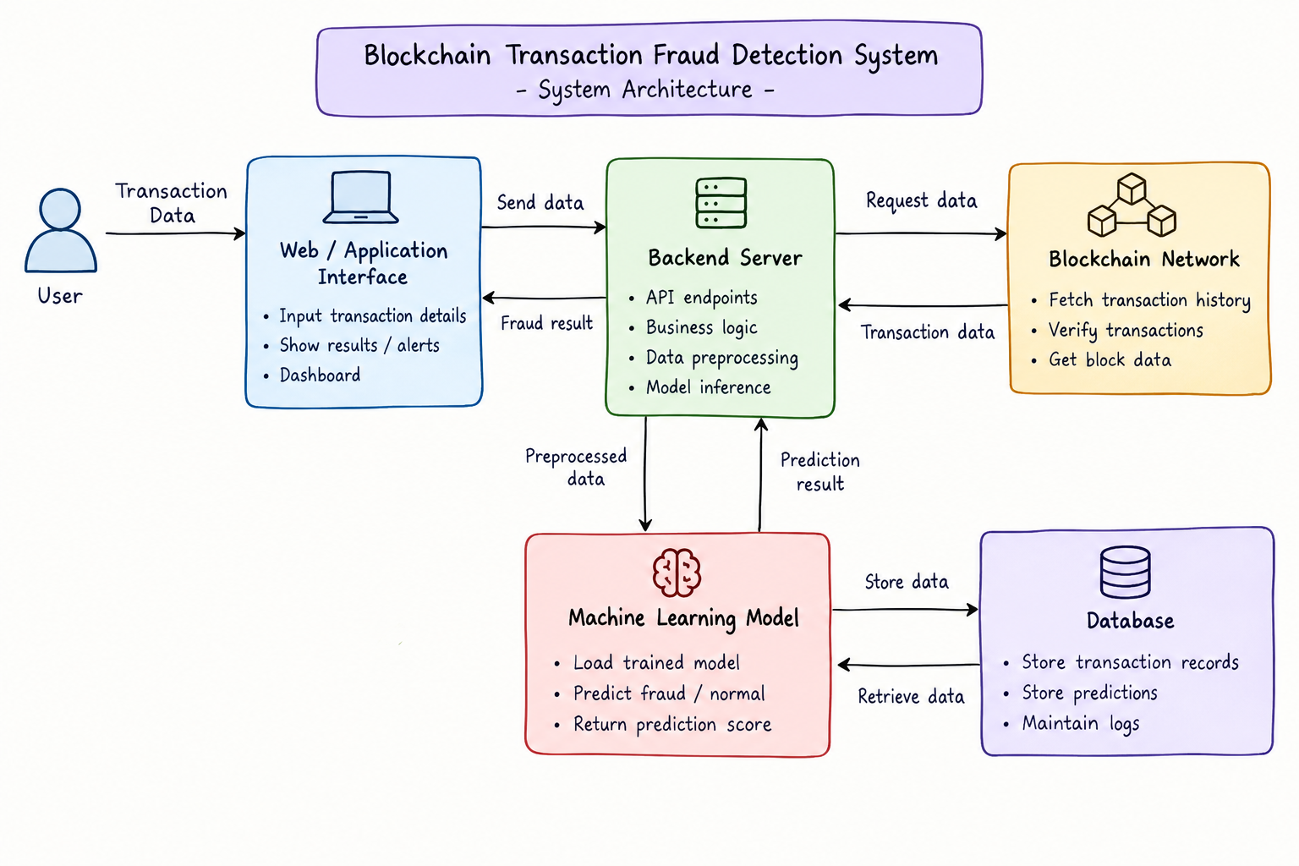
SYSTEM ARCHITECTURE

Slide 5
System modules
Transaction Module
Accepts and validates transaction details
Analysis Module
Analyzes transaction behavior and patterns
Fraud Detection
Identifies suspicious wallet and transaction behavior
Risk Assessment
Determines Low / Medium / High risk level
Alert & Verification
Handles suspicious transaction alerts and holds
Ledger Module
Maintains immutable transaction records
Dashboard
Displays results, alerts, and monitoring data

Slide 6
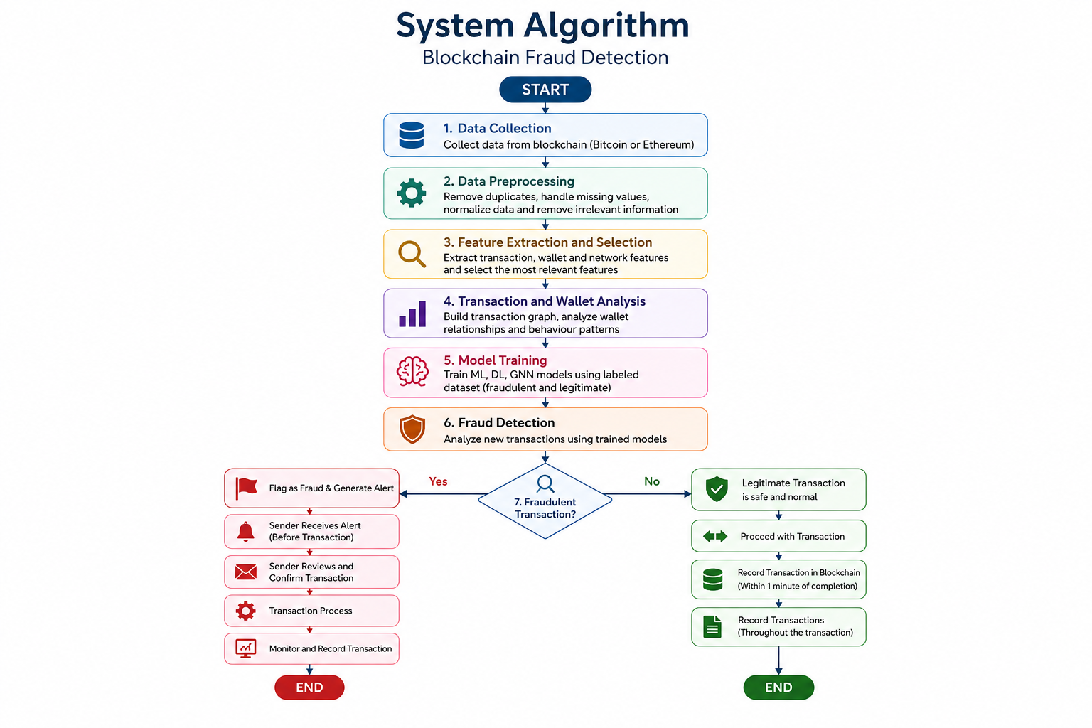
ALGORITHM AND MODEL IMPLEMETATION
Pipeline: Input → Validation → Feature Extraction → Risk Model → Score → Classification → Alert → Verification/Hold → Status
Output categories: Low Risk · Medium Risk ·

Slide 7
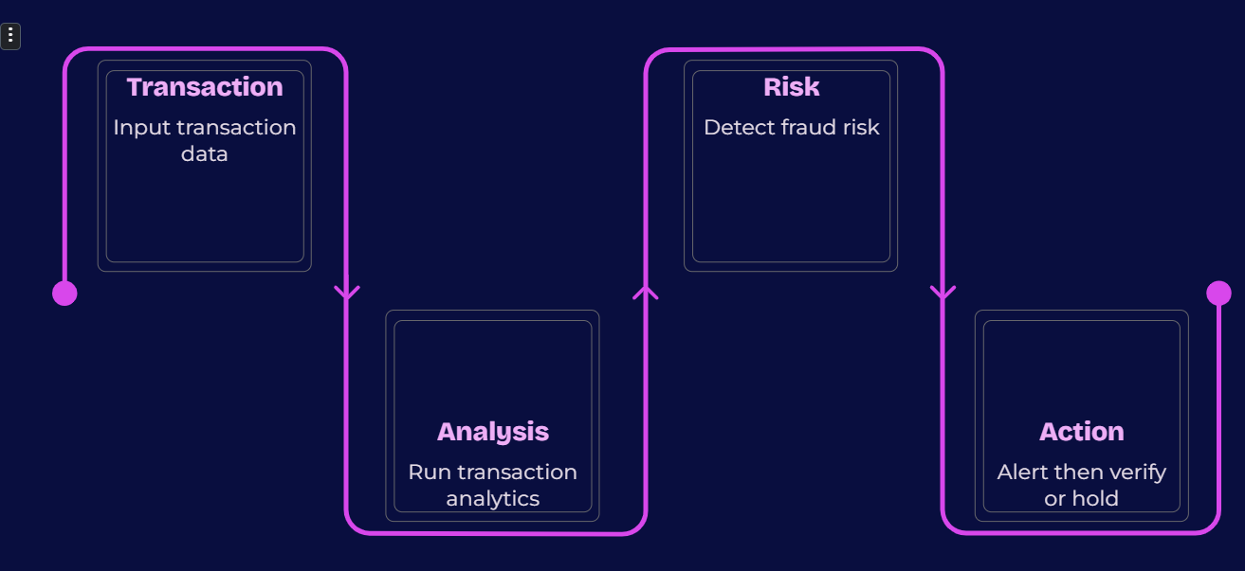
CORE MODULE AND PROTOTYPE
Implemented Features
Transaction input module — completed
Transaction analysis logic — developed
Fraud-risk detection logic — implemented
Risk status generation — operational
Suspicious transactions trigger alerts
Partial software prototype — available
Prototype flow: Transaction → Analysis → Risk Detection → Alert → Verification/Hold → Status

Slide 8
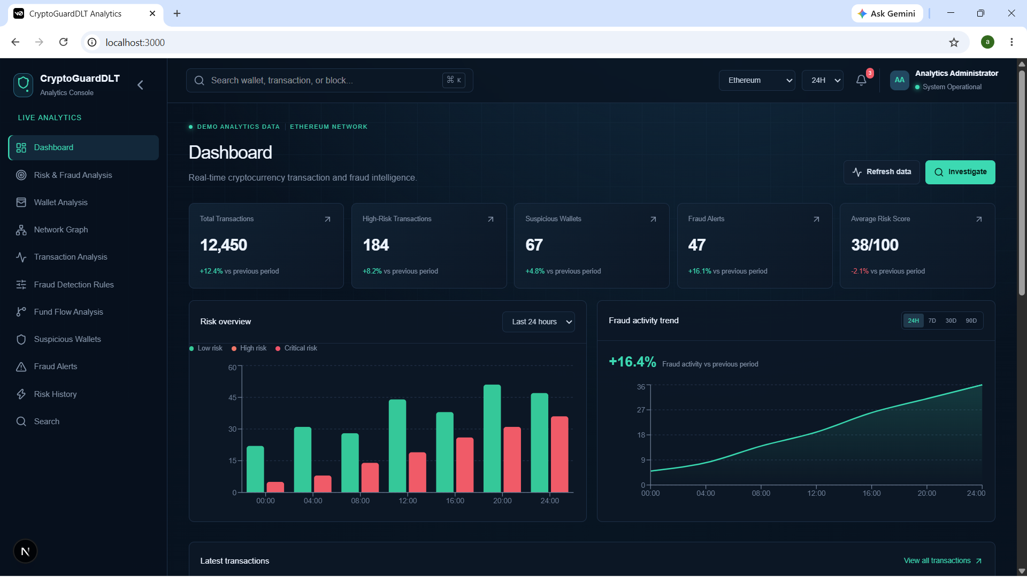
HARDWARE INTERFACING AND PARTIAL PROTOTYPE
Planned Edge Node
Raspberry Pi 4 identified as edge/ledger node — procurement pending
Components Identified
64 GB MicroSD, router, power supply, cooling system — all specified
Software Prototype
Developed independently; hardware interfacing to follow procurement
Planned setup: Laptop/Application → Network → Raspberry Pi 4 → Distributed Ledger
Laptop / App
Network
Planned Edge Node
Distributed Ledger

Slide 9
Testing, Review-1 Improvements & Teamwork
Testing
Valid transaction testing
Suspicious transaction testing
Risk classification testing
Alert generation testing
Individual module testing
Review-1 Improvements
Refined problem statement
Improved architecture diagram
Defined fraud detection workflow
Added hardware requirements
Started core implementation
Task Distribution
Deekshitha — System Integration & Frontend
Nikhitha — Data Engineering
Akshaya — Fraud Detection
Alekhya — Dashboard

Slide 10
CURRENT STATUS AND FUTURE WORK
Current Status
SRS prepared and reviewed
System architecture designed
Core fraud detection module developed
Partial software prototype available
Testing initiated
Hardware requirements identified
Raspberry Pi procurement pending
Future Work
Procure Raspberry Pi and hardware components
Complete Raspberry Pi interfacing
Integrate distributed ledger node
Complete full system integration
Perform comprehensive end-to-end testing
Improve detection accuracy
Finalize complete prototype

Slide 11


