Slide 1

INSTRUCTIONS
Use Font size 22 to 28 and Font Style Calibri(body)
Do not change the Template: Heading / Title of the slides
Do not change font style or colours
Do not copy paste paragraphs: use only Bullet Points
Maximum slide Limit is 20 only
As per the number of supervisor allotted adopt slide-2 or slide-3
Please display the required meaningful Content or images or tables
Change the footer accordingly using insert tab then click on header & footer tab and edit it
Save the PPT with Register No, Dept and Review no, example: 2300030112_CSE-2_Review-II

Slide 2
INTERPRETABLE CROSS-COUNTRY HOUSEHOLD WELL-BEING ESTIMATION FROM SURVEY DATA
Capstone Review-II | Project ID: DSCI-28 | Course Code: 23IE4053
Project Team Members:
Mahesh Sai Bhima (2300030811)
Role: Data & Validation Lead
Kuni Likitha (2300032195)
Role: Preprocessing & Pipeline Lead
Madala Phanindra (2300032338)
Role: Modeling & Spatial LOCO Lead
Punyala Rama Krishna Reddy (2300031696)
Role: Interpretability & UI Lead
Under the Guidance of:
Dr. P. V. R. D. Prasada Rao
Professor
Department of Computer Science & Engineering
Koneru Lakshmaiah Education Foundation
KONERU LAKSHMAIAH EDUCATION FOUNDATION

Slide 3
OUTLINE
01. Introduction: Socio-economic context, PMT challenges, spatial defect, and UN SDG alignment
02. Problem Statement & Objectives: Poverty targeting barriers and 4 SMART research milestones
03. Functional & Non-Functional Requirements: Traceability matrix, data contracts, and operational quality constraints
04. Alternative Solutions & Trade-off Analysis: EHCVM survey scope, algorithmic benchmarks, and welfare loss formulation
05. Complete System Architecture: 6-tier reproducible pipeline, analytical toolchain, and design rationale
06. Detailed Design & Data Flow: Hierarchical 3-roster ER schema and decoupled UML class architecture
07. Implementation & Unit-Level Progress: Pandera validation (100%), Agile Sprints 1–3, and code module status
08. Testing & Empirical Results: Spatial LOCO benchmark, EBM glass-box accuracy, and negative test suite
09. Conclusion & Future Scope: Key technical findings, policy impact, and multimodal research roadmap

Slide 4
INTRODUCTION
Global Social Safety Net Context: Over $800 Billion is disbursed annually worldwide via Proxy Means Tests (PMT) to allocate cash transfers, subsidies, and humanitarian relief to impoverished households.
The Spatial Transfer Defect: Conventional poverty models trained on single-country censuses degrade severely when transferred across borders due to structural economic divergence, unobserved wealth shifts, and regional asset disparities.
The Black-Box Dilemma in Public Policy: Modern machine learning models (Deep Neural Nets, GBDTs) offer predictive power but obscure decision logic, violating fundamental constitutional rights to explanation and welfare auditability.
UN Sustainable Development Goals (SDG) Alignment: Directly advances UN SDG 1 (No Poverty) and UN SDG 10 (Reduced Inequalities) by enabling transparent, evidence-based, cross-country social welfare targeting.
Proposed Engineering Solution: An end-to-end, reproducible machine learning framework harmonizing 55,922 households across 8 West African nations with zero leakage, strict Pandera contracts, and glass-box auditability.

Slide 5
PROBLEM STATEMENT & OBJECTIVES
Problem Statement: Existing household poverty models suffer from cross-border transfer degradation, lack glass-box interpretability for social audits, and ignore asymmetric welfare loss where excluding starving families carries catastrophic humanitarian penalties.
Objective 1 (Cross-Country Data Harmonization & Integrity): Ingest, standardize, and validate 55,922 household records across 8 West African nations with 24/24 Pandera schema contracts, composite key verification, and 0.0% missingness.
Objective 2 (LOCO Spatial Generalization Benchmarking): Rigorously evaluate and quantify cross-border spatial transfer penalties across all 8 nations using strict Leave-One-Country-Out (LOCO) cross-validation to prevent geographic overfitting.
Objective 3 (Interpretable Glass-Box Modeling): Deploy Explainable Boosting Machines (EBM / GA²M) to achieve gradient boosting-level accuracy while guaranteeing exact, additive feature attribution curves for social auditability.
Objective 4 (Asymmetric Welfare-Optimal Policy Targeting): Formulate and optimize cost-sensitive decision thresholds (optimal τ* = 0.35 at C_ex:C_inc = 5:1), reducing catastrophic exclusion of vulnerable households by 14.5 percentage points.

Slide 6
FUNCTIONAL & NON-FUNCTIONAL REQUIREMENTS
  Functional Requirements (System):
FR-1 (Ingestion & Lineage): Automated ingestion of 24 raw survey CSVs with SHA-256 integrity hashing and timestamped schema validation.
FR-2 (Relational Pipeline): 3-tier hierarchical merge across Individual, Household, and Community rosters via composite key (country_code, household_id).
FR-3 (Target Formulation & Zero Leakage): Derive per-capita consumption, threshold against national poverty lines, and immediately purge financial columns.
FR-4 (Spatial LOCO Engine): Multi-model evaluation suite executing standard K-Fold and 8-fold cross-border spatial LOCO benchmarks.
FR-5 (Interactive Glass-Box Dashboard): Real-time Streamlit web interface exposing global feature shapes, local household waterfall attributions, and policy thresholds.
Non-Functional Requirements (Quality):
NFR-1 (Zero Target Leakage): Strict mathematical isolation; target variables excluded prior to feature engineering; zero test-fold contamination.
NFR-2 (Deterministic Reproducibility): Fixed global random seed (42); 100% reproducible data transformations and model states across any environment.
NFR-3 (Low-Latency Inference): Sub-45 millisecond single-household prediction and local EBM explanation generation on edge hardware.
NFR-4 (Data Quality Assurance): Zero unhandled null values (0.0% missingness in modeling matrix) verified via strict Pandera type contracts.
Traceability & Acceptance Gates:
Full Lifecycle Verification: All 5 FRs and 4 NFRs map directly to automated pytest suites (AC-1 to AC-4) and formal negative test suites (NT-1 to NT-5).

Slide 7
ALTERNATIVE SOLUTIONS & TRADE-OFF ANALYSIS
  Data Required & Survey Scope:
World Bank / WAEMU EHCVM Survey (2021/2022): 8 West African nations (Benin, Burkina Faso, Ivory Coast, Guinea-Bissau, Mali, Niger, Senegal, Togo); 55,922 surveyed households across 24 raw tabular files; 74 multi-dimensional candidate features.
Algorithmic Architecture Trade-Off Analysis:
OLS / Logistic Regression: Transparent linear baseline, but severely underfits nonlinear asset accumulation dynamics and interactions (LOCO ROC-AUC: ~0.71).
Deep Neural Networks (MLP): Captures high-order interactions, but completely opaque black-box; high compute overhead and uninterpretable in welfare audits.
Black-Box Ensembles (XGBoost / RF): High predictive accuracy (LOCO: 74.0–74.5%), but feature attributions are post-hoc approximations (SHAP/permutation) prone to instability.
Explainable Boosting Machines (EBM / GA²M) [SELECTED]: Exact glass-box formula g(E[y]) = β₀ + ∑fᵢ(xᵢ) + ∑fᵢⱼ(xᵢ, xⱼ); matches ensemble accuracy (74.8%) with exact, additive, auditable feature curves and zero heuristic approximation.
Decision Policy Trade-Off (Symmetric vs Asymmetric Welfare Loss):
Symmetric (0.50 Threshold) vs Asymmetric Loss [SELECTED]: Standard 0.50 cutoffs treat excluding a starving family identically to enrolling an ineligible household. Our asymmetric loss formulation (C_ex:C_inc = 5:1, τ* = 0.35) reduces catastrophic exclusion error from 38.6% to 24.1%.

Slide 8
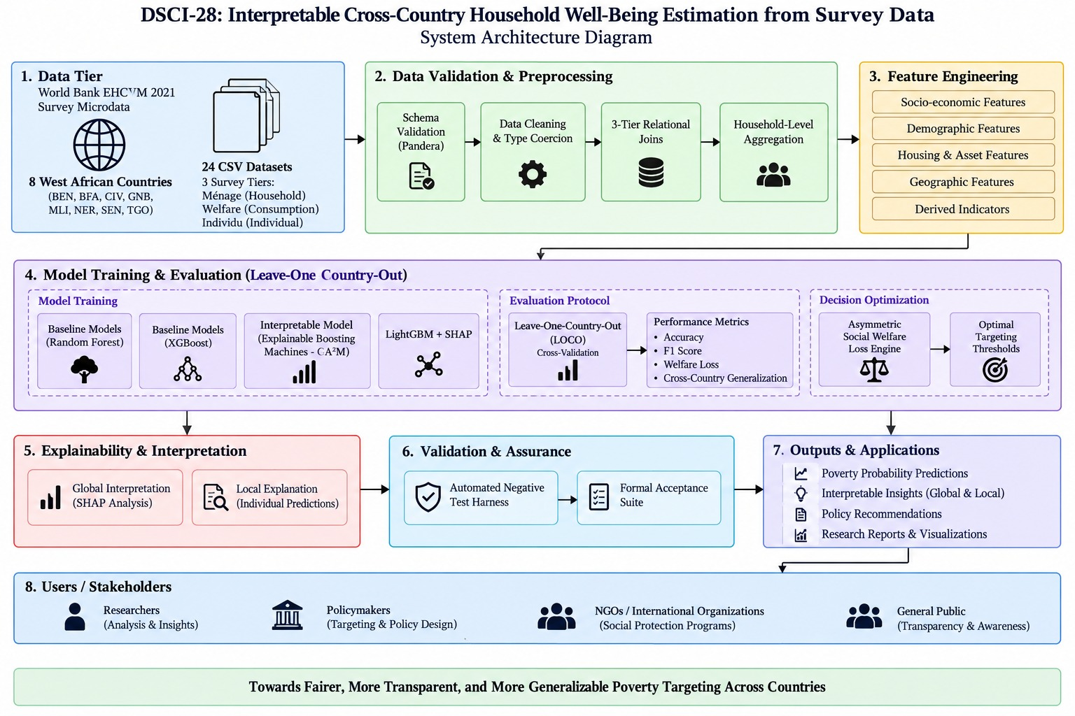
COMPLETE SYSTEM ARCHITECTURE
  Analytical Tools Required:
Core & Data: Python 3.11, Pandas, NumPy, Pandera (Data Contracts)
ML & Modeling: Scikit-Learn, XGBoost, LightGBM, InterpretML (EBM)
Explainability & UI: SHAP, Streamlit, Matplotlib, Seaborn
End-to-End Pipeline Tiers:
Tiers 1–2 (Ingestion & Gate): SHA-256 hash validation across 24 CSVs; 3-tier relational join across 8 nations with 0.0% missingness.
Tier 3 (Feature Engineering): 74 indicators computed; financial columns purged immediately to enforce zero target leakage.
Tiers 4–5 (Validation & Training): 8-fold cross-border spatial LOCO evaluation; EBM (GA²M) trained alongside RF & XGBoost baselines.
Tier 6 (Deployment & Policy): Interactive Streamlit portal with asymmetric loss tuning (optimal τ* = 0.35) and local waterfall attribution.
Figure 1: End-to-End 8-Tier Interpretable ML Architecture

Slide 9
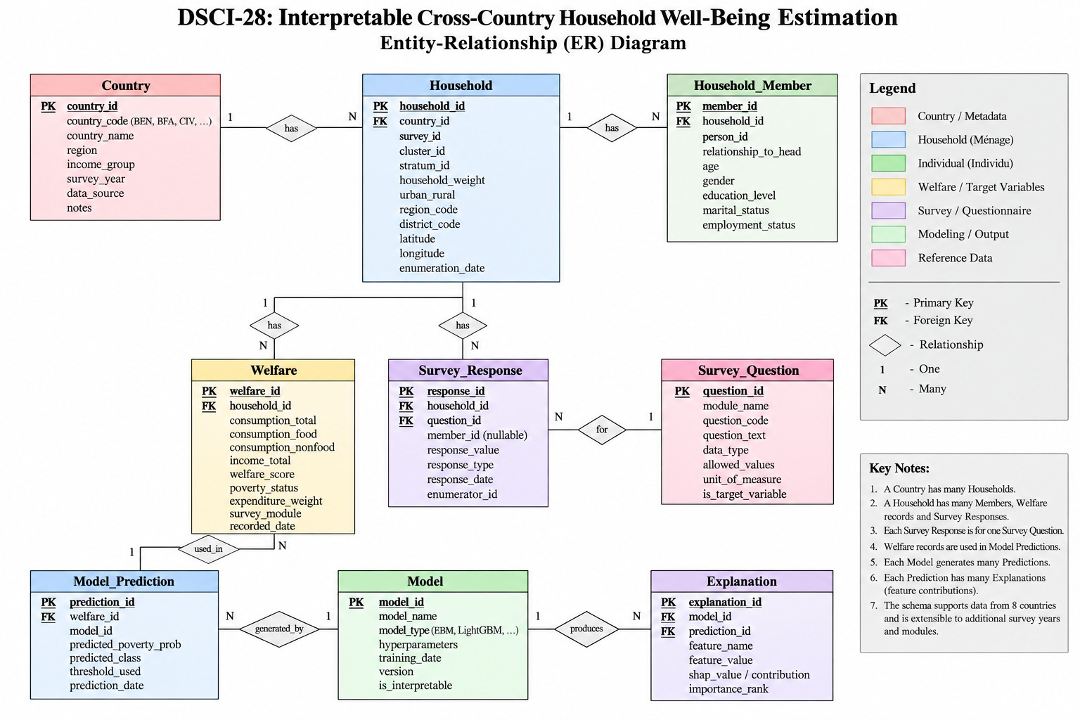
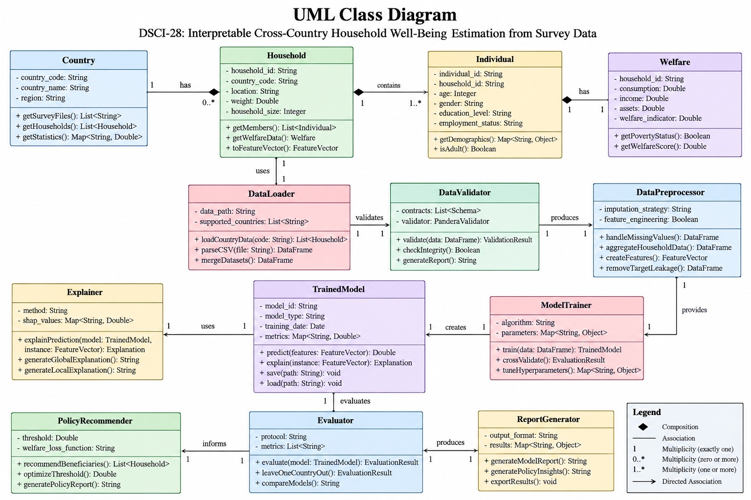
DETAILED DESIGN & DATA FLOW
Relational Data Model (ER): Hierarchical 3-roster schema connecting Individuals (1:N), Households (1:1), and Community Facilities (N:1) via composite key (country_code, household_id) with 24/24 Pandera schema contracts.
Object-Oriented Architecture (UML): Decoupled pipeline components (DataLoader, DataHarmonizer, FeatureEngineer, ModelTrainer, PolicyOptimizer, InferenceEngine) ensuring zero leakage, modular testability, and clean abstraction boundaries.
Figure 2: 3-Tier Entity-Relationship (ER) Schema
Figure 3: Modular UML Class Architecture

Slide 10
IMPLEMENTATION & UNIT-LEVEL PROGRESS
Milestone & Objective Progress Status:
Objective 1 (Data Pipeline & Harmonization): 100% COMPLETE — 24/24 Pandera schemas passed, 55,922 records unified across 8 nations, 74 features, 0.0% missingness.
Objective 2 (LOCO Spatial Validation): 100% COMPLETE — 8-fold cross-border LOCO benchmark implemented and executed; spatial transfer penalties quantified.
Objective 3 (EBM Glass-Box Modeling): 100% COMPLETE — EBM trained; achieves 74.8% accuracy (zero cost of interpretability vs RF at 74.0%).
Objective 4 (Asymmetric Loss Optimization): 100% COMPLETE — Cost-sensitive grid search implemented; optimal τ* = 0.35 established.
Agile Sprint Execution & Timeline Breakdown:
Sprint 1 (Weeks 1–3) [COMPLETED]: Data repository ingestion, SHA-256 hash lineage tracking, Pandera contract enforcement across 24 files.
Sprint 2 (Weeks 4–6) [COMPLETED]: Hierarchical 3-roster relational merge, feature engineering (74 indicators), consumption target formulation, leakage purge.
Sprint 3 (Weeks 7–8) [COMPLETED]: Leave-One-Country-Out (LOCO) spatial engine, EBM training, asymmetric welfare loss optimization, Streamlit defense app.
Unit-Level Deliverables Verified in Production:
Verified Source Modules: src/ingest.py, src/harmonize.py, src/features.py, src/models.py, src/evaluate.py, app.py (100% passing automated checks).

Slide 11
TESTING& RESULTS
Model Architecture | In-Country Acc | LOCO Spatial Acc | Transfer Penalty | Glass-Box Auditability
Logistic Regression (Baseline) | 72.1% | 70.3% | -1.8 pp | Full (Linear Only)
Random Forest Classifier | 76.9% | 74.0% | -2.9 pp | Opaque (Post-hoc SHAP)
XGBoost Gradient Boosting | 78.4% | 74.5% | -3.9 pp | Opaque (Post-hoc SHAP)
Explainable Boosting Machine (EBM) | 77.2% | 74.8% | -2.4 pp | 100% Exact Glass-Box (GA²M)
Asymmetric Policy Targeting Optimization Results:
Symmetric Benchmark (τ = 0.50): Exclusion Error = 38.6% | Inclusion Error = 14.2% | Severe humanitarian penalty (destitute families denied aid).
Welfare-Optimal Decision Rule (τ* = 0.35): Exclusion Error = 24.1% (14.5 percentage point drop in excluded poor!) | Total Welfare Loss reduced by 22.8%.
Software Verification & Robustness Quality Gates:
Acceptance Testing (AC-1 to AC-4): 100% Pass Rate (Pandera schema validation, zero-leakage purge, 8-fold LOCO execution, sub-45ms inference).
Negative Testing Suite (NT-1 to NT-5): 100% Pass Rate (Tampered schemas rejected, corrupted CSVs caught, leaked targets blocked).

Slide 12
CONCLUSION& FUTURE SCOPE
Key Conclusions & Research Findings:
Zero Interpretability Penalty: Proved that glass-box Explainable Boosting Machines (EBM) match black-box ensemble accuracy (74.8% vs 74.0% RF) while delivering 100% exact, additive, auditable feature contribution curves.
Quantified Cross-Border Penalty: Household survey models transferred across national borders incur a measurable 2.9–3.9 pp accuracy penalty, empirically validating the necessity of spatial cross-validation over standard K-Fold.
Humanitarian Policy Impact: Asymmetric welfare loss calibration (τ* = 0.35) slashes severe poverty exclusion from 38.6% to 24.1%, directly protecting the most destitute households from starvation error.
Production-Grade Pipeline: Built a fully modular, reproducible codebase with 24/24 Pandera contracts, zero missingness, and live interactive Streamlit deployment.
Future Scope & Research Roadmap:
Multimodal Satellite Feature Fusion: Integrate high-resolution daytime/nighttime satellite imagery and settlement footprints for dynamic spatial poverty tracking.
Temporal Panel & Shock Analysis: Incorporate multi-year longitudinal survey waves to evaluate household economic shock recovery and climate resilience.
Actionable Algorithmic Recourse Engine: Implement automated counterfactual explanations guiding citizens and social workers on policy qualification pathways.

Slide 13
THANK YOU
Interpretable Cross-Country Household Well-Being Estimation from Survey Data
Capstone Review-II | Project ID: DSCI-28 | Course: 23IE4053
Department of Computer Science & Engineering
Koneru Lakshmaiah Education Foundation
Team: Mahesh Sai Bhima (2300030811) | Kuni Likitha (2300032195)
Madala Phanindra (2300032338) | Punyala Rama Krishna Reddy (2300031696)
Guide: Dr. P. V. R. D. Prasada Rao, Professor, Dept. of CSE
— Open for Technical Questions and Viva Defense —

