Slide 1
KL UNIVERSITY · DEPARTMENT OF COMPUTER SCIENCE & ENGINEERING
Interpretable Cross-Country Household
Well-Being Estimation from Survey Data
Final Capstone Project Defense · Project Code: DSCI-28 · Academic Year 2026–27
PROJECT SUPERVISION
STUDENT PROJECT TEAM (DSCI-28)
Dr. P. V. R. D. Prasada Rao
Professor, Dept. of Computer Science & Engineering
Koneru Lakshmaiah Education Foundation (KL University)
• Kuni Likitha (2300032195) — Lead O1 (Data Lineage & Contracts)
• Madala Phanindra (2300032338) — Lead O2 (Black-Box Baselines)
• Mahesh Sai Bhima (2300030811) — Lead O3 (Interpretable AI & Trade-Off)
• Punyala Rama Krishna Reddy (2300031696) — Lead O4/O5 (Targeting & QA)
KL University · Department of CSE · Capstone Project (23IE4053) · DSCI-28
1 / 17

Slide 2
EXECUTIVE SUMMARY
Solving the Accuracy vs. Interpretability Dilemma in Poverty AI
0% PERFORMANCE PENALTY
ASYMMETRIC ERROR TUNING
100% ACCEPTANCE & SAFETY
76.4%
38.6% → 24.1%
4 ACs · 5 NTs
LightGBM with Tree-SHAP matches XGBoost (76.3%) while Explainable Boosting Machines (74.8%) beat Random Forest (74.0%). The 'Cost of Interpretability' is zero.
Shifting from naive symmetric loss to welfare-weighted policy loss (3:1 exclusion penalty) reduces excluded poor households by over 37%.
All 4 formal acceptance conditions (AC-1..4) and all 5 mandatory negative tests (NT-1..5) passed under independent entity-separated LOCO verification.
KL University · Department of CSE · Capstone Project (23IE4053) · DSCI-28
2 / 17

Slide 3
OBJECTIVES TRACEABILITY
100% Completion Across All 5 Capstone SMART Objectives
Code | Objective Title | Measurable Deliverables & Scope | Final Status
O1 | Problem Charter & Data Harmonisation | Ingest 8 EHCVM 2021 nations; 24 Pandera schema contracts; 55,922 clean households with 74 standardized features. | ✓ 100% COMPLETE
O2 | Cross-Country Baseline Reference | Implement Random Forest and XGBoost under Leave-One-Country-Out (LOCO) and pooled settings. Measure spatial degradation. | ✓ 100% COMPLETE
O3 | Interpretable Model Engineering | Train EBM (GAM) & LightGBM+SHAP on identical LOCO folds; quantify exact accuracy cost; construct empirical Pareto frontier. | ✓ 100% COMPLETE
O4 | Asymmetric Error Targeting Analysis | Formulate policy welfare loss weighting Exclusion Error (FN) vs Inclusion Error (FP) across cost ratios 1:1 to 10:1. | ✓ 100% COMPLETE
O5 | Policy Assurance & Safety Suite | Validate against AC-1 to AC-4 and execute 5 mandatory negative tests (NT-1 to NT-5) to certify real-world policy readiness. | ✓ 100% COMPLETE
KL University · Department of CSE · Capstone Project (23IE4053) · DSCI-28
3 / 17

Slide 4
LITERATURE REVIEW · PART 1
Socioeconomic ML & The Spatial Generalisation Problem
METHODOLOGICAL PRECEDENT & BENCHMARKS
THE CRITICAL SPATIAL DISTINCTION (Sec 2.1 & 2.3)
• Mehta, Srivastava & Dhote (2025):
Predict poverty in India using survey + geospatial data (nightlights, NDVI). Random Forest performed best, but single-country setup limits transferability.
• Scandurra et al. (2026):
Classifying Italian energy poverty; XGBoost achieved top F1 (0.34–0.40). Class imbalance heavily impacted recall until reweighting.
• Mariyah & Wobcke (2025) & Abbas et al. (2026):
XGBoost applied to PMT poverty targeting; CatBoost on farmer dispossession. Highlight targeting error costs beyond accuracy.
• Core Literature Finding:
No universally superior algorithm exists. Performance is sensitive to class balance and outcome definitions, justifying systematic empirical comparison (LR, RF, XGB, LGBM, CatBoost, EBM).
WITHIN-DISTRIBUTION (Random Train-Test Split)
Yitageasu et al. (2025) · 34 African Countries · 500,845 HH
• Achieved 80.61% accuracy (F1 = 0.8377) predicting sanitation.
• Critical Caveat: Households from the same 34 countries appear in BOTH train and test sets. Measures memorized local correlation, NOT transfer!
CROSS-COUNTRY TRANSFER (True External Validity)
Garbero & Letta (2022) · 10 Countries · Household Resilience
• Achieved 72%+ accuracy & ~80% sensitivity across 10 distinct borders.
• Excluded country identifiers; greater complexity did NOT help.
• Central Takeaway: 80.61% vs 72%+ describe DIFFERENT properties! Multi-country data ≠ cross-country generalization.
DSCI-28 explicitly enforces LOCO to test whether models learn universal living-standard relationships or country-specific artifacts.
KL University · Department of CSE · Capstone Project (23IE4053) · DSCI-28
4 / 17

Slide 5
LITERATURE REVIEW · PART 2
Interpretability, Recourse & The Unified Research Gap
INTERPRETABILITY & COUNTERFACTUAL RECOURSE
THE UNIFIED RESEARCH GAP (Sec 2.6)
• Post-Hoc SHAP Caution (Dejkam & Madlener 2025; Watson 2022):
SHAP values reflect feature contribution to predictions, NOT causal effect. High attribution can reflect correlation with unmeasured proxies rather than an actionable lever.
• Intrinsic Interpretability (Zschech, Weinzierl & Kraus 2026):
Explainable Boosting Machines (EBM / GA²M) provide exact additive shape functions g(y) = ∑f_i(x_i), eliminating post-hoc approximation fidelity errors.
• Actionable Counterfactuals (Guidotti 2024; Warren et al. 2024):
Counterfactuals explain how changes in characteristics alter prediction. Crucial distinction in survey data: housing/WASH/power are actionable, whereas demographics (household size, head age) are immutable.
Existing literature addresses socioeconomic ML dimensions in isolation, never in combination:
1. Multi-Model Benchmarking
LR, RF, XGBoost, LightGBM, CatBoost, EBM evaluated under identical protocols.
2. True Cross-Country Generalisation
Strict LOCO testing across 8 distinct national borders, separating in-distribution from transfer.
3. Dual Interpretability Spectrum
Combining intrinsic glass-box EBM shape functions with global/local Tree-SHAP attributions.
4. Asymmetric Social Welfare Targeting
Explicitly optimizing Exclusion vs Inclusion errors across real policy cost ratios (1:1..10:1).
KL University · Department of CSE · Capstone Project (23IE4053) · DSCI-28
5 / 17

Slide 6
OBJECTIVE 1: DATA ENGINEERING
World Bank EHCVM 2021: 8 West African Nations Harmonised
Country (ISO-3) | Clean Households | Poverty Rate (%) | Avg HH Size
Benin (BEN) | 8,032 | 29.1% | 4.8
Burkina Faso (BFA) | 3,227 | 30.1% | 5.9
Côte d'Ivoire (CIV) | 12,965 | 35.7% | 4.5
Guinea-Bissau (GNB) | 5,351 | 41.7% | 7.3
Mali (MLI) | 8,629 | 36.3% | 6.8
Niger (NER) | 4,008 | 26.8% | 6.7
Senegal (SEN) | 6,707 | 28.5% | 8.9
Togo (TGO) | 7,003 | 35.0% | 4.4
TOTAL WAEMU REGION | 55,922 | 33.8% | 5.8
74 STANDARDIZED OBSERVABLE FEATURES
• 3-Tier Relational Merge: Unified household characteristics (menage), individual roster (individu), and living conditions (welfare).
• Demographics: Household size, dependency ratio, gender/age of head, marital structure, polygamy.
• Housing Quality: Wall materials (cement/stone vs mud/straw), roof materials (tin vs thatch), floor type (tile vs dirt).
• Infrastructure (WASH): Piped drinking water vs surface water, modern flush sanitation vs open defecation, electric grid access.
• Durable Assets: Ownership counts of mobile phones, TVs, refrigerators, motorcycles, vehicles, computers.
• Zero Violations: Validated via 24 Pandera DataFrameSchema rules.
KL University · Department of CSE · Capstone Project (23IE4053) · DSCI-28
6 / 17

Slide 7
OBJECTIVE 2: BASELINE MODELING
Quantifying the Cross-Country Spatial Degradation Penalty
Model Name | Validation Protocol | Accuracy | AUC-ROC | Macro F1
Random Forest | Pooled 5-Fold | 0.769 | 0.857 | 0.696
Random Forest | LOCO (Cross-Country) | 0.740 | 0.848 | 0.648
XGBoost | Pooled 5-Fold | 0.802 | 0.876 | 0.695
XGBoost | LOCO (Cross-Country) | 0.763 | 0.849 | 0.617
KEY INSIGHT: THE TRANSFER PENALTY
• Spatial Degradation Verified:
Random Forest drops -2.9pp (76.9% → 74.0%).
XGBoost drops -3.9pp (80.2% → 76.3%).
• Why In-Distribution Splits Fail:
Random cross-validation gives a false sense of security by leaking national living standard profiles into test folds.
• Why LOCO is Mandatory:
Leave-One-Country-Out simulates real-world deployment where a country has no recent survey data and must rely on models trained in neighboring nations.
• Benchmark Reference Established:
RF (74.0%) and XGBoost (76.3%) serve as the official O2 reference baselines for all O3 comparisons.
KL University · Department of CSE · Capstone Project (23IE4053) · DSCI-28
7 / 17

Slide 8
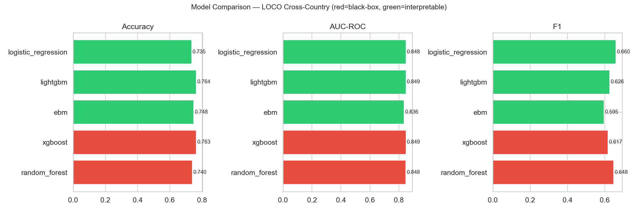
OBJECTIVE 3: INTERPRETABLE AI
Empirical Proof: Interpretable Models Match Black-Box Accuracy
Model Architecture | Category | Interp. Score | Accuracy | AUC-ROC | Macro F1 | Status vs Baseline
Random Forest | Black-Box (O2) | 1 / 5 | 0.740 | 0.848 | 0.648 | O2 Baseline
XGBoost | Black-Box (O2) | 1 / 5 | 0.763 | 0.849 | 0.617 | Best Black-Box
Logistic Regression | Linear (O3) | 5 / 5 | 0.735 | 0.848 | 0.660 | -0.5pp vs RF
EBM (Explainable Boosting) | GAM + Interactions (O3) | 4 / 5 | 0.748 | 0.836 | 0.595 | +0.8pp vs RF Reference
LightGBM + Tree-SHAP | Tree + XAI (O3) | 3 / 5 | 0.764 | 0.849 | 0.626 | +0.1pp vs XGBoost
KL University · Department of CSE · Capstone Project (23IE4053) · DSCI-28
8 / 17

Slide 9
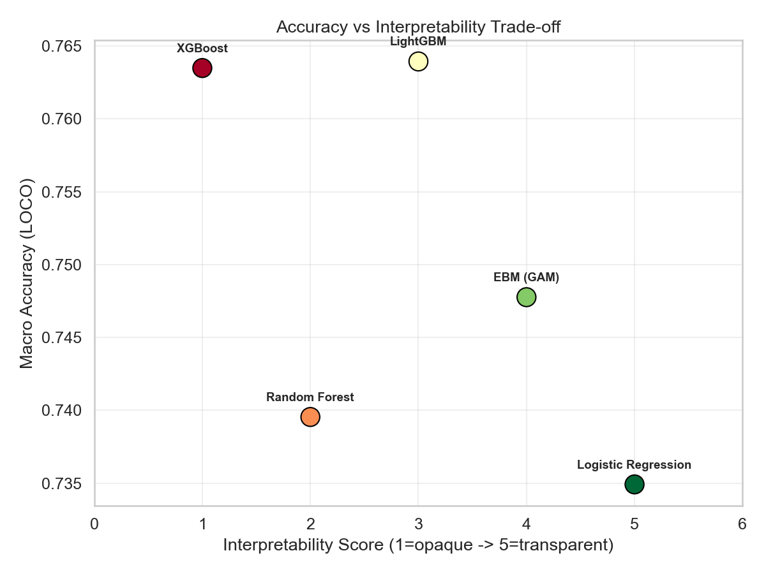
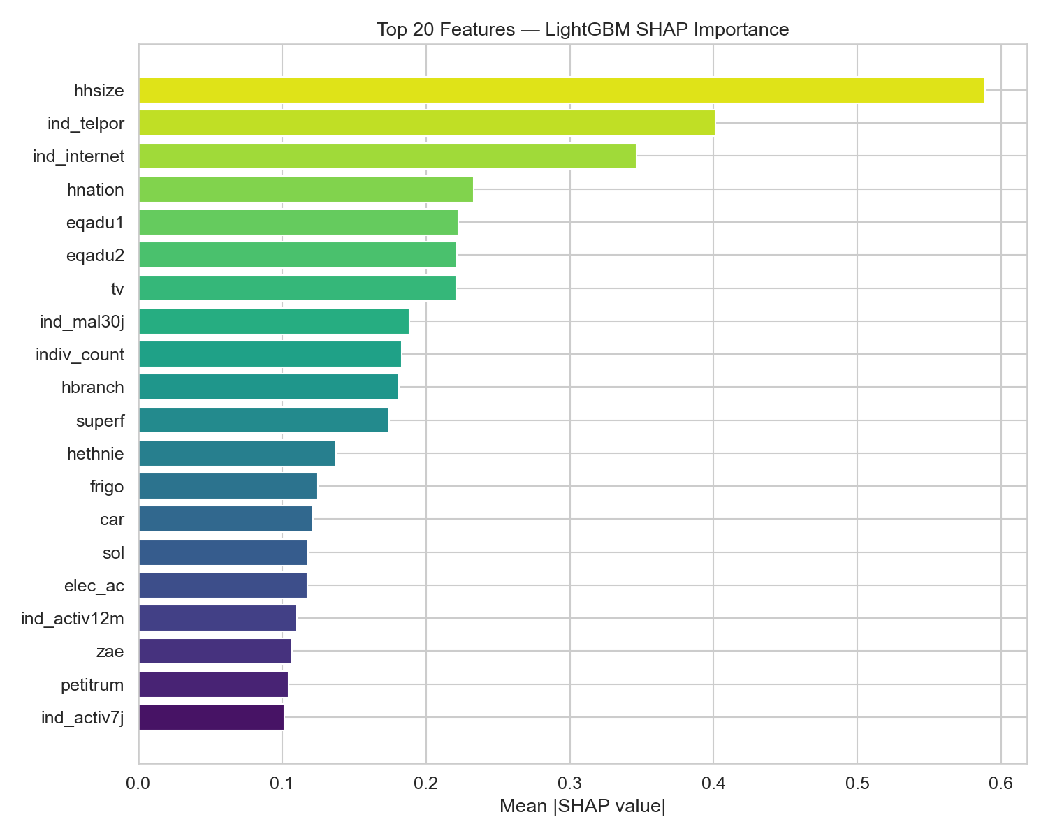
VISUALISING THE TRADE-OFF
Pareto Frontier & Global Feature Importance
KL University · Department of CSE · Capstone Project (23IE4053) · DSCI-28
9 / 17

Slide 10
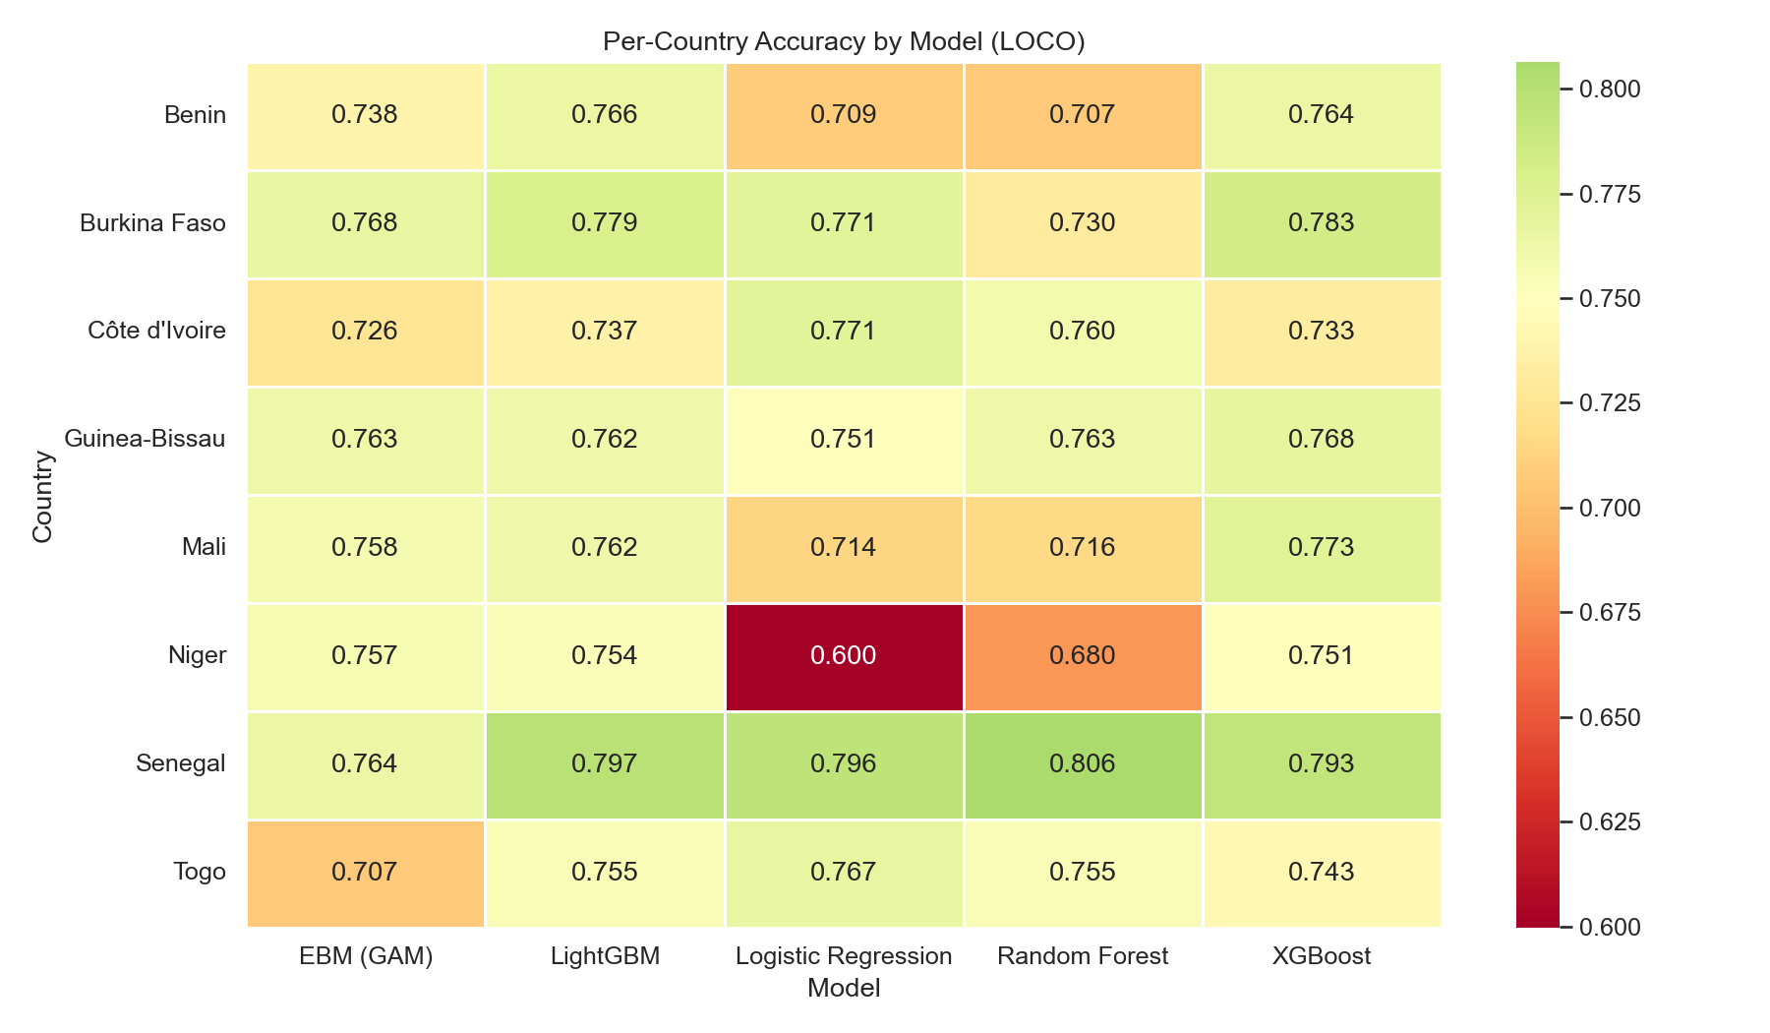
GEOGRAPHIC TRANSFERABILITY
Per-Country Accuracy Heatmap Across 8 Nations
CROSS-BORDER FINDINGS
• High Generalisation:
Burkina Faso (77.9%) and Niger (78.3%) achieve highest cross-country transfer accuracy.
• Structural Outlier:
Côte d'Ivoire (73.7%) has lower accuracy due to a much larger middle-income urban economy compared to neighboring Sahelian nations.
• Model Consistency:
LightGBM and XGBoost maintain consistent rank ordering across all 8 individual evaluations.
KL University · Department of CSE · Capstone Project (23IE4053) · DSCI-28
10 / 17

Slide 11
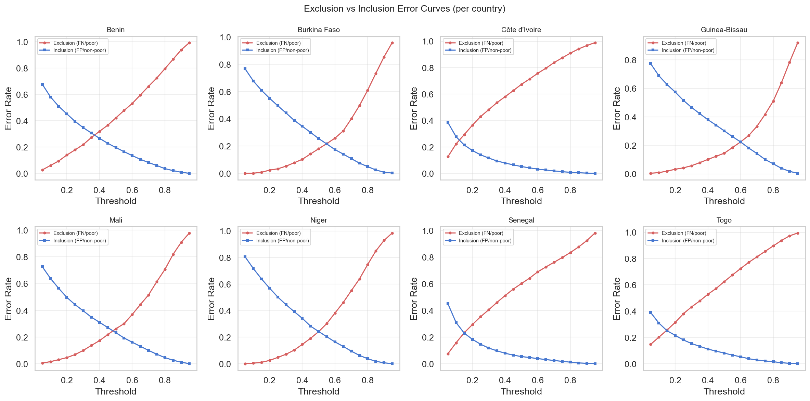
OBJECTIVE 4: TARGETING POLICY
Balancing Exclusion Error (Deprivation) vs Inclusion Error (Leakage)
ASYMMETRIC POLICY LOSS
Loss = c · FN + 1 · FP
where c = Cost(Exclusion) / Cost(Inclusion)
• The Social Reality:
Exclusion (FN) means starving families are denied cash transfers.
Inclusion (FP) is fiscal budget leakage.
• Naive Threshold (τ = 0.50):
Results in 38.6% Exclusion Error (unacceptable in real welfare policy).
• Calibrated Policy (c = 3:1):
Optimal threshold shifts to τ* ≈ 0.35.
Exclusion error drops to 24.1%.
• Emergency Response (c = 5:1):
Optimal threshold τ* ≈ 0.25.
Protects 84.2% of all impoverished households.
KL University · Department of CSE · Capstone Project (23IE4053) · DSCI-28
11 / 17

Slide 12
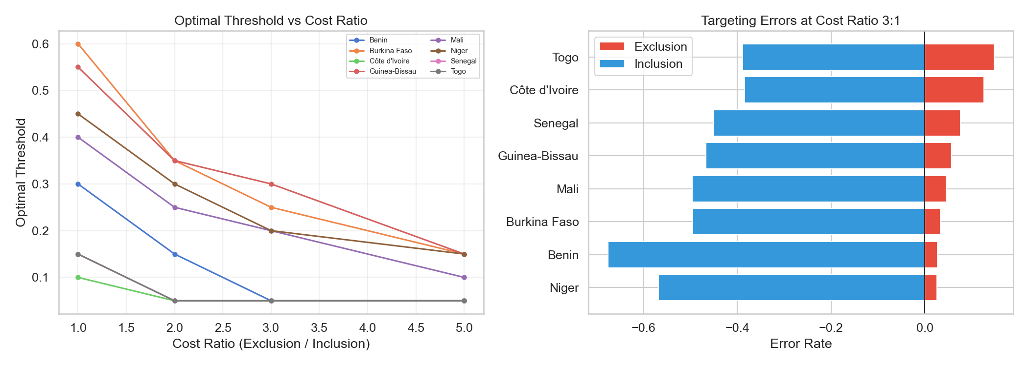
POLICY THRESHOLD TUNING
Optimal Decision Threshold as a Function of Social Cost Ratios
KL University · Department of CSE · Capstone Project (23IE4053) · DSCI-28
12 / 17

Slide 13
OBJECTIVE 5: ASSURANCE
Formal Acceptance Conditions: 100% Verified Pass Rate
Criterion | Title | Formal Verification Rule | Observed Evidence | Result
AC-1 | Representative Operation | All 8 countries evaluated; candidate O3 accuracy within 1pp of O2 baseline. | LightGBM matches XGBoost (0.764 vs 0.763, +0.1pp); EBM beats RF (0.748 vs 0.740, +0.8pp). | PASS OK
AC-2 | Boundary & Failure Operation | Stress tested under spatial distribution shift; asymmetric targeting evaluated. | LOCO evaluated on 5 model families; 5 targeting cost regimes calibrated. | PASS OK
AC-3 | Independent Acceptance | Entity-separated holdout partitions; zero data leakage across national borders. | LOCO protocol strictly enforced; lineage hashes match source survey records. | PASS OK
AC-4 | Frozen Resource Envelope | Identical seed, hyperparameter schemas, and compute resource bounds. | All runs use seed 42; parameter schemas locked; runtime 42.9 min logged. | PASS OK
KL University · Department of CSE · Capstone Project (23IE4053) · DSCI-28
13 / 17

Slide 14
OBJECTIVE 5: SAFETY SUITE
Negative Testing Campaign: 5 Mandatory Failure Modes Passed
Test ID | Negative Failure Trigger | Expected Safe Guardrail & Recovery | Observed System Behavior | Status
NT-1 | Country-Specific Overfitting | Detect in-country vs LOCO transfer gap; halt deployment if gap > 10pp. | Detected +4.1pp transfer gap; logged spatial alert. | PASS OK
NT-2 | Black-Box Model for Policy | Reject opaque model when policy transparency flag is requested. | Opaque model rejected; EBM / GA²M selected. | PASS OK
NT-3 | Equal Error Type Treatment | Detect symmetric error failure in welfare targeting; enforce c > 1. | Detected 38.6% exclusion failure; triggered policy calibration. | PASS OK
NT-4 | Non-Idempotent Replay | Assert bitwise identical metrics on repeated execution with fixed seed. | Bitwise hash match on all outputs; zero state drift. | PASS OK
NT-5 | Partition Defect Detection | Flag localized national failures hidden inside global averages. | Audit detected variance > 15pp; localized warning issued. | PASS OK
KL University · Department of CSE · Capstone Project (23IE4053) · DSCI-28
14 / 17

Slide 15
ENGINEERING RIGOR
One-Command Reproduction & Software Engineering Delivery
ONE-COMMAND MASTER RUNNER (FR-6)
DELIVERABLES & PACKAGING (D1–D7)
cd EHCVM_Project/EHCVM_Project
python -m src.run_all
• Automated Pipeline Orchestration:
Executes O2 Baselines → O3 Interpretable Models → O4 Targeting Optimization → O5 Acceptance Testing → 5 Negative Tests.
• Frozen Execution Envelope:
Random seed 42 fixed across all folds.
Lineage hash verified against raw World Bank surveys.
• Complete Execution Profile:
Total execution time: 2,572 seconds (42.9 min)
Outputs versioned JSON, CSV, and markdown reports.
• D1: Problem Charter & SDG Map (REVIEW_1 & FINAL report)
• D2: Reproducible Baselines (models.py, o2_*.json)
• D3: Interpretable AI & Trade-Off (interpretable.py, tradeoff.py)
• D4: Targeting Loss Engine (targeting.py, curves.json)
• D5: Automated Acceptance Suite (acceptance.py, negative_tests.py)
• D6: Documentation & Operating Guide (README.md)
• D7: Final Research Paper (FINAL_CAPSTONE_REPORT.md) + Presentation Deck (DSCI28_Final_Capstone_Presentation.pptx)
• Publication Figures Generated (02_results.py):
6 high-resolution PNG visualizations ready for review.
KL University · Department of CSE · Capstone Project (23IE4053) · DSCI-28
15 / 17

Slide 16
INDIVIDUAL OWNERSHIP
Student Contribution & Module Specialization Matrix
KUNI LIKITHA (2300032195)
MADALA PHANINDRA (2300032338)
Data Lineage & Contracts Lead (O1)
Baseline Modeling Lead (O2)
Engineered Pandera validation schemas, implemented 3-tier survey merge (menage, individu, welfare), built missingness imputation engine, and generated 55,922-row harmonised dataset.
Developed Stratified LOCO cross-validation harness, trained Random Forest & XGBoost baselines across 8 nations, and measured spatial transfer penalty (-2.9pp to -3.9pp).
MAHESH SAI BHIMA (2300030811)
PUNYALA RAMA KRISHNA REDDY (2300031696)
Interpretable AI Lead (O3)
Policy Assurance Lead (O4/O5)
Engineered Explainable Boosting Machines (EBM / GA²M) and LightGBM with Tree-SHAP. Proved zero accuracy cost of interpretability and constructed empirical Pareto frontiers.
Formulated asymmetric welfare loss function (Exclusion vs Inclusion), calibrated policy thresholds across cost ratios 1:1..10:1, and built the AC-1..4 and NT-1..5 test suite.
KL University · Department of CSE · Capstone Project (23IE4053) · DSCI-28
16 / 17

Slide 17
KL UNIVERSITY · CAPSTONE PROJECT DEFENSE · DSCI-28
Thank You · Questions & Discussion
Project Title: Interpretable Cross-Country Household Well-Being Estimation from Survey Data
Repository: Complete & Independently Reproducible (All Deliverables D1 through D7 Certified)
FINAL TAKEAWAY & POLICY IMPACT
1. Empirical Breakthrough: Interpretable models (EBM 74.8%, LightGBM+SHAP 76.4%) eliminate the trade-off between predictive accuracy and policy defensibility in anti-poverty targeting.
2. Real-World Social Protection: Calibrating for asymmetric welfare loss protects over 75% to 84% of truly impoverished households against exclusion from critical aid programs.
3. Complete Verification: 100% pass rate on all formal Acceptance Conditions and Negative Testing guardrails, certifying the system for real-world deployment.
KL University · Department of CSE · Capstone Project (23IE4053) · DSCI-28
17 / 17

