Slide 1
KL UNIVERSITY · DEPARTMENT OF COMPUTER SCIENCE & ENGINEERING
CAPSTONE PROJECT I (23IE4053) · DSCI-28 · IN-TERM REVIEW 2
Interpretable Cross-Country Household Well-Being Estimation
Combining Machine Learning with Explainable AI on EHCVM Survey Data Across 8 West African Nations to Deliver Auditable, Policy-Defensible Well-Being Predictions
PROJECT TEAM-BATCH 109
Kuni Likitha
Madala Phanindra
Mahesh Sai Bhima
Punyala Rama Krishna Reddy
2300032195
2300032338
2300030811
2300031696
Project Guide: Dr. P. V. R. D. Prasada Rao · Department of Computer Science & Engineering, KL University
In-Term Review 2 · September 2026 · Cluster A (Software Development) · Objective 1 Completed & Verified

Slide 2
REVIEW 2 BLUEPRINT
Presentation Agenda & Progress Milestones
1
1. Problem Statement, Objectives & SRS Traceability
Household well-being estimation, SDG 1/10 alignment, and complete SRS traceability matrix (Criterion 1)
2
2. Stakeholders & Asymmetric Welfare Costs
Policy makers, auditors, households; asymmetric loss formulation (Exclusion FN vs Inclusion FP)
3
3. Comprehensive Literature Review & Generalization Dilemma
Critical analysis of 12 indexed studies, the generalization dilemma, and comparative novelty matrix
4
4. Objective 1 Data Foundation & Verified EDA (Complete)
EHCVM 2021 survey: 8 nations, 24 Pandera schemas, 55,922 households, 74 features, 0% missing (Criterion 3)
5
5. System Architecture, ER & UML Design Specifications
5-tier architecture, complete Entity-Relationship diagram, and UML software class & sequence models (Criterion 2)
✓
6. Justification of Key Architectural Decisions Matrix
Formal evaluation matrix justifying 8 core architectural decisions against discarded alternatives (Criterion 2)
7
7. Technology Stack & Tools Justification Matrix
Verified codebase modules, analytics toolchain, and technology justification against alternatives (Criterion 4)
8
8. Teamwork & Agile Practice: Sprint Planning (Sprints 1–3)
Agile Scrum framework, user stories, velocity, DoD, role ownership, and individual viva defense (Criterion 5)
DSCI-28 · Capstone I · In-Term Review 2 · Objective 1 Complete
2

Slide 3
THE PROBLEM & MISSION
Interpretable Household Well-Being Estimation
8
55,922
74
26.8% – 41.7%
West African Nations Surveyed
Verified Household Records
Engineered Multi-Tier Features
Poverty Rate Regional Range
What We're Building
Why Interpretability is Mission-Critical
“Our project is Interpretable Cross-Country Household Well-Being Estimation. We use household survey data to estimate household well-being and, more importantly, understand why the model makes a particular prediction.”
“We combine machine learning with Explainable AI to identify important household factors and provide understandable predictions instead of treating the model as a black box.”
Every prediction is accompanied by transparent, mathematically faithful feature attributions and counterfactual guidance for social protection administrators.
Algorithmic Targeting at Scale: Social safety net programmes distribute >$800B annually to 1.5B+ people based on survey-driven Proxy Means Tests (PMT).
Legal Defensibility & Human Rights: Denying aid cannot be based on 'the black-box model said so'. Citizens have a constitutional right to due process and appealable recourse.
Failures of Post-Hoc SHAP: Post-hoc approximations can produce out-of-distribution hallucinations and non-monotonic artifacts in high-stakes policy governance.
Directly Aligned to UN SDG 1: No Poverty (Target 1.3: Social Protection Systems) & SDG 10: Reduced Inequalities
DSCI-28 · Capstone I · In-Term Review 2 · Objective 1 Complete
3

Slide 4
PROJECT CHARTER
Five SMART Objectives Across Capstone I & II
Code | Objective | Scope, Deliverables & Measurable Success Criteria | Target | Status
O1 | Problem Charter & Data Foundation | Ingest & validate survey data across 8 EHCVM countries — 24/24 Pandera schema contracts, 55,922 clean households, 74 features, 0% missing | CP1 · R2 | ✓ COMPLETE
O2 | Reproducible Cross-Country Baselines | Evaluate LR, RF, XGBoost, LightGBM, CatBoost via stratified 5-fold CV across 8 countries; test within vs. cross-country transfer | CP1 · R3 | IN PROGRESS
O3 | Interpretable Model Engineering | Train Explainable Boosting Machines (EBM / GA²M); quantify the exact Accuracy Gap Δ vs. O2 black-box baselines under identical CV folds | CP2 · R4 | PLANNED
O4 | Asymmetric Error & Recourse Engine | Exclusion/inclusion asymmetric policy cost curves (FN vs FP) + minimal-change counterfactual recourse engine for denied households | CP2 · R5 | PLANNED
O5 | Policy Assurance & Safety Suite | Validate acceptance criteria AC-1–AC-4 on held-out country partitions, plus 5 mandatory negative tests (NT-1..5) for policy safety | CP2 · Final | PLANNED
Objective 1 is 100% complete: All 24 Pandera schema contracts verified passing, 8 clean country datasets generated, and automated EDA completed.
DSCI-28 · Capstone I · In-Term Review 2 · Objective 1 Complete
4

Slide 5
EVALUATION RUBRIC CRITERION 1
System Requirements Specification (SRS) & Traceability Matrix
System Scope & Quality Constraints
Req ID | Functional Specification | Target Objective | Traceable Source Module & Gate | Status
FR-1 | Raw Survey Ingestion & Lineage Tracking | O1 Data Foundation | src/ingest.py (SHA-256 hashes across 24 files) | ✓ PASS
FR-2 | Declarative Schema Contract Validation | O1 Data Foundation | src/schemas.py (24 Pandera DataFrameSchemas) | ✓ PASS
FR-3 | 3-Tier Relational Merge & Imputation | O1 Data Foundation | src/engineer.py (0.0% missing, member aggregations) | ✓ PASS
FR-4 | Target Formulation & Leakage Elimination | O1 Data Foundation | src/pipeline.py (pcexp < zref, raw expenditure purge) | ✓ PASS
FR-5 | Leave-One-Country-Out (LOCO) Evaluator | O2 Spatial Transfer | src/evaluate.py (8-fold cross-country transfer splits) | IN PROGRESS
FR-6 | One-Command Master Orchestrator | O1..O5 System Runner | src/run_all.py (Idempotent execution with seed=42) | ✓ PASS
TARGET SCOPE
8 West African Nations (WAEMU)
55,922 households, 74 clean features
HARDWARE ENVELOPE
Standard Laptop (4-Core CPU, 8GB RAM)
Peak RAM < 1.8 GB during multi-joins
STORAGE FOOTPRINT
272 MB total footprint (185 MB raw CSVs
+ 82 MB engineered + 5 MB EDA plots)
EXECUTION SPEED
< 45 seconds for 8-country pipeline
(ingestion, validation, engineering)
QUALITY GUARANTEES
0.0% missing data post-imputation
SHA-256 lineage tracking (24 files)
Deterministic seed = 42
DSCI-28 · Capstone I · In-Term Review 2 · Objective 1 Complete
5

Slide 6
STAKEHOLDER & USER NEEDS ANALYSIS
Ecosystem Matrix & User Persona Requirements
1. Policy Makers &
National Administrators
2. Programme Officers &
Audit / Legal Reviewers
3. Vulnerable Beneficiary
Households
CORE RESPONSIBILITIES
CORE RESPONSIBILITIES
CORE RESPONSIBILITIES
Allocates social protection budgets across regions
Defends targeting criteria before parliaments & donors
Sets national eligibility cutoffs and welfare thresholds
Conducts field verification and spot audits
Handles citizen appeals, grievances, and disputes
Ensures strict non-discrimination & legal compliance
Depend on cash transfers for basic survival
Subject to algorithmic inclusion / exclusion decisions
Submit household survey data during enumerations
ALGORITHMIC & USER NEEDS
ALGORITHMIC & USER NEEDS
ALGORITHMIC & USER NEEDS
Transparent global decision rules (EBM shape curves)
Budget-constrained trade-off curves & loss sweeps
Predictable fiscal leakage and coverage projections
Actionable, plain-language explanations for denials
Zero black-box obscurity during legal discovery
Monotonic feature response to prevent perverse incentives
Protection against wrongful exclusion (False Negatives)
Counterfactual Recourse: exact steps required to qualify
Fair, equitable treatment across regions and demographics
Primary Metric: Policy Cost & Budget Efficiency
Primary Metric: Auditability & Due Process Compliance
Primary Metric: Zero Wrongful Exclusion & Clear Recourse
DSCI-28 · Capstone I · In-Term Review 2 · Objective 1 Complete
6

Slide 7
WHY ACCURACY ISN'T ENOUGH
Asymmetric Welfare Costs & Loss Formulation
Exclusion Error (False Negative — Denying Aid to the Truly Poor)
Inclusion Error (False Positive — Aid Given to the Non-Poor)
A truly destitute household is classified as “non-poor” and denied life-saving cash assistance.
A non-poor household receives cash assistance it did not strictly qualify for under the registry cutoff.
HUMAN WELFARE IMPACT: Severe child malnutrition, loss of primary education, inability to cope with health shocks, and permanent intergenerational poverty traps.
FISCAL & ECONOMIC IMPACT: Moderate public budget dilution and fiscal leakage, but zero catastrophic human harm or mortality risks.
Total Policy Loss = ( C_exclusion × False Negatives ) + ( C_inclusion × False Positives )
Social policy makers explicitly calibrate the asymmetric cost ratio (C_exclusion : C_inclusion = 3:1 to 10:1). Our framework sweeps decision probability thresholds p ∈ [0.1, 0.9] to minimize total societal loss, rather than adopting a naive, dangerous p = 0.5 default.
The Accuracy Trap in Imbalanced Surveys: In low-poverty regions (or severely imbalanced clusters), predicting 'non-poor' for 100% of households yields deceptive 80–90% accuracy while failing 100% of destitute families. Our framework strictly enforces holistic evaluation: (Mean Log Loss, Minority F1, Recall, Policy Cost) — accuracy is never used in isolation.
DSCI-28 · Capstone I · In-Term Review 2 · Objective 1 Complete
7

Slide 8
DATA FOUNDATION
EHCVM 2021 — Multi-Country Living Standards Survey
Country | Households | Poverty Rate
Benin (BEN) | 8,032 | 29.1%
Burkina Faso (BFA) | 3,227 | 30.1%
Côte d'Ivoire (CIV) | 12,965 | 35.7%
Guinea-Bissau (GNB) | 5,351 | 41.7%
Mali (MLI) | 6,143 | 30.8%
Niger (NER) | 6,622 | 26.8%
Senegal (SEN) | 7,120 | 33.1%
Togo (TGO) | 6,462 | 39.1%
EHCVM 2021 (Enquête Harmonisée)
Harmonised Living Conditions Survey · World Bank / WAEMU
Unified Multi-Country Instrument: Standardized survey fielded simultaneously across 8 West African Economic and Monetary Union (WAEMU) member states.
Three Relational Tiers: Ingests household-level characteristics (dwelling, WASH, assets), individual member records (education, literacy, health), and consumption metrics.
Official Welfare Metric: Per-capita annual consumption expenditure (pcexp) evaluated against the national poverty threshold (zref). Household is classified as poor (y=1) if pcexp < zref.
Harmonised Feature Semantics: 38 common household fields, 34 common welfare fields, and 51 individual fields across all 8 countries — enabling authentic cross-border transferability.
Key Structural Advantage Over Disjoint Kaggle/Toy Datasets
Prior poverty competition datasets (e.g. Kaggle World Bank A/B/C) used anonymized, synthetically scrambled feature sets with zero cross-country column overlap, forcing isolated per-country models. EHCVM 2021 provides genuine multi-country survey harmonisation with identical physical definitions for dwelling, assets, education, and shocks — laying the foundation for true cross-country regime transferability.
DSCI-28 · Capstone I · In-Term Review 2 · Objective 1 Complete
8

Slide 9
LITERATURE SURVEY · PART 1
Machine Learning & Gradient Boosting for Socioeconomic Prediction
Author(s) & Year | Domain & Context | Key Empirical Findings | Methodological Implication for DSCI-28
Mehta, Srivastava & Dhote (2025) | Poverty prediction in India using survey & geospatial data (night lights, NDVI) | Random Forest performed best among models; proved value of nonlinear ensembles | Single-country & geospatial dependence limits transfer; motivates household-only multi-country design
Garbero & Letta (2022) | Household resilience prediction across 10 countries (withheld country test) | Accuracy >72%, sensitivity ~80%; Random Forest best; higher complexity did NOT help | Challenges assumed model complexity; establishes gold standard for withheld-country external validity
Scandurra et al. (2026) | Energy poverty classification among Italian households | XGBoost best F1 (0.34 & 0.40); severe class imbalance degraded recall until balanced | Proves default accuracy is deceptive under imbalance; mandates class reweighting & F1/Recall metrics
Yitageasu et al. (2025) | Sanitation access across 500,845 households in 34 Sub-Saharan African nations | RF achieved 80.61% accuracy, F1 0.8377; SHAP identified education, toilet-sharing, wealth | Evaluated under random split (within-distribution); baseline for African multi-country survey scale
Mariyah & Wobcke (2025) | Proxy Means Test (PMT) poverty targeting with area-level infrastructure features | Applied XGBoost focusing directly on targeting errors rather than aggregate accuracy | Confirms misclassification carries asymmetric policy harm; supports explicit targeting loss curves
Shahin & Emami (2026) | Micro-level economic prediction comparing gradient boosting families | Benchmarked LightGBM against XGBoost, CatBoost, and conventional gradient boosting | Justifies evaluating LightGBM alongside XGBoost and CatBoost empirically under a common benchmark
Abbas et al. (2026) | Smallholder farmer dispossession in Pakistan (n=500 survey records) | CatBoost strongest performer vs Logistic Regression; SHAP used to rank drivers | Confirms CatBoost's architectural advantage on categorical-heavy tabular household survey data
DSCI-28 · Capstone I · In-Term Review 2 · Objective 1 Complete
9

Slide 10
LITERATURE SURVEY · PART 2
Explainable AI, Inherently Interpretable Models & Counterfactual Recourse
Dejkam & Madlener (2025) · Watson (2022) · Post-Hoc Attribution Limits & Explanation Quality
Zschech, Weinzierl & Kraus (2026) · Inherently Interpretable Models (EBM / GA²M)
Applied SHAP to fuel poverty classification. Specifically cautioned that SHAP values reflect feature contribution to a prediction, NOT causal effect. Watson (2022) proved that explanation quality is a methodological question: explanations can be practically useful without fully capturing the true model decision function.
Contrasted post-hoc methods with inherently interpretable Explainable Boosting Machines (EBM). EBMs represent nonlinear effects directly through transparent shape functions g(y) = ∑ f_i(x_i), resolving opacity while explicitly exposing structural additive trade-offs.
DSCI-28 Implication: Post-hoc SHAP must not be mistaken for causal policy guidance; motivates pairing SHAP with glass-box models.
DSCI-28 Implication: Adopting EBM as our primary glass-box model guarantees auditable, mathematically exact decision boundaries.
Guidotti (2024) · Counterfactual Benchmark (Data Mining & Knowledge Disc.)
Warren, Byrne & Keane (2024) · Human Cognition & Counterfactual Explanations (n=211 study)
Comprehensive benchmark of counterfactual methods across 5 criteria: validity, minimality, actionability, diversity, and stability. Proved that no single method optimizes all properties simultaneously — a mathematically valid counterfactual is not automatically actionable.
Demonstrated through user experiments that feature representation (categorical vs continuous) significantly affects whether decision-makers can correctly predict AI decisions from counterfactual explanations. Technical validity ≠ human comprehensibility.
DSCI-28 Implication: Counterfactual generation must be constrained so that only actionable household levers are adjusted.
DSCI-28 Implication: EHCVM survey features are separated into actionable policy levers (WASH, housing, power) vs fixed demographics.
DSCI-28 · Capstone I · In-Term Review 2 · Objective 1 Complete
10

Slide 11
THE GENERALIZATION DILEMMA
Within-Distribution Accuracy vs. Cross-Country Transfer
Within-Distribution Evaluation (Yitageasu et al. 2025)
Cross-Country Transfer Evaluation (Garbero & Letta 2022)
80.61%
72.0%+
Reported Headline Accuracy on 500,845 African Households
Reported Cross-Country Accuracy Withheld Across 10 Distinct Nations
Evaluation Design: Standard random train-test split across 34 countries.
The Flaw: Households from the exact same 34 countries appear in BOTH training and test splits.
What It Measures: In-distribution interpolation across known demographic distributions.
What It Fails to Test: Zero evidence of whether the model can transfer to an unseen national context.
Evaluation Design: Explicitly withholds entire countries from model training.
Country-Blind Modeling: Excludes country identity tags to enforce structural learning.
What It Measures: Authentic cross-border external validity and geographic transferability.
Key Insight: A lower headline figure (72% vs 81%) represents a vastly harder, more rigorous test.
The Core Research Question for DSCI-28
“Does a machine learning model learn generalizable socioeconomic relationships, or patterns specific only to its training countries?”
Following the principle of Garbero and Letta (2022), DSCI-28 explicitly separates within-country cross-validation from cross-country leave-one-country-out evaluation across all 8 EHCVM nations. A high within-distribution score is not accepted as evidence of cross-country validity.
DSCI-28 · Capstone I · In-Term Review 2 · Objective 1 Complete
11

Slide 12
LITERATURE COMPARATIVE ANALYSIS
Cross-Paper Benchmark Matrix Across 6 Core Dimensions
Study / Reference | Multi-Country Africa | Algorithm Benchmark | Withheld Cross-Country | Inherently Interpretable | Counterfactual Recourse | Asymmetric Loss
Mehta et al. (2025) | — (India) | RF vs. others | — (Single country) | — (Black-box) | — | — (Accuracy)
Garbero & Letta (2022) | ✓ (10 Nations) | RF vs. LR vs. ANN | ✓ (Withheld test) | — (Black-box) | — | — (Sensitivity)
Scandurra et al. (2026) | — (Italy) | XGBoost vs. others | — (Single country) | — (Black-box) | — | ✓ (F1 balance)
Yitageasu et al. (2025) | ✓ (34 Nations) | RF, XGB, LR, ANN | — (Random split) | — (Post-hoc SHAP) | — | — (Accuracy/F1)
Mariyah & Wobcke (2025) | — (Single) | XGBoost PMT | — (Area features) | — (Post-hoc SHAP) | — | ✓ (Targeting error)
Shahin & Emami (2026) | — (Micro-data) | LightGBM vs. XGB | — | — (Black-box) | — | —
Abbas et al. (2026) | — (Pakistan) | CatBoost vs. LR | — (Single sample) | — (Post-hoc SHAP) | — | —
Zschech et al. (2026) | — (Generic) | EBM / GA²M | — (Benchmark) | ✓ (Glass-box EBM) | — | —
Guidotti ('24) / Warren ('24) | — (Theoretical) | — | — | — | ✓ (CF benchmark) | —
DSCI-28 (Our Framework) | ✓ (8 EHCVM Nations) | ✓ (LR, RF, XGB, LGBM, CatB, EBM) | ✓ (Separate Validation) | ✓ (EBM + SHAP) | ✓ (Actionable Recourse) | ✓ (Policy Loss Sweep)
Synthesis: DSCI-28 is the ONLY framework uniting multi-country African surveys, empirical model comparison, withheld cross-country transfer, glass-box EBMs, counterfactual recourse, and asymmetric welfare loss.
DSCI-28 · Capstone I · In-Term Review 2 · Objective 1 Complete
12

Slide 13
LITERATURE SYNTHESIS & GAP
The Exact Research Gap Addressed by DSCI-28
Issue 1 — No Universally Superior Algorithm
Issue 2 — Multi-Country ≠ Cross-Country Transfer
Issue 3 — Interpretability & Recourse Trade-offs
Random Forest and gradient-boosting methods (XGBoost, LightGBM, CatBoost) each dominate in different settings; performance is highly sensitive to class imbalance and outcome definition. This motivates systematic empirical comparison rather than a preselected model.
The gap between Yitageasu et al.'s (2025) 80.61% within-distribution accuracy and Garbero & Letta's (2022) 72%+ cross-country accuracy illustrates that higher headline numbers are not evidence of generalization. Withheld-country testing is mandatory.
SHAP offers post-hoc attribution but not causal proof; inherently interpretable EBMs carry additive assumptions; counterfactual methods trade off validity vs. actionability (Guidotti '24, Warren '24). A robust system must combine complementary tools.
THE UNADDRESSED RESEARCH GAP (Section 2.6)
“Existing research has addressed these components individually, but not in combination:
model comparison, cross-country generalization, interpretability, and counterfactual explanation are rarely integrated within a single framework for household well-being prediction using harmonized African survey data.
This — rather than any single component being unexplored — is the gap the proposed Interpretable Cross-Country Household Well-Being Estimation framework addresses.”
DSCI-28 Solution: We evaluate LR, RF, XGBoost, LightGBM, CatBoost & EBM across 8 EHCVM nations — uniting within-country CV, cross-country transfer, complementary EBM+SHAP interpretability, and actionable counterfactual recourse.
DSCI-28 · Capstone I · In-Term Review 2 · Objective 1 Complete
13

Slide 14
NOVELTY & POSITIONING STATEMENT
Four Distinct Technical Contributions of DSCI-28
01
Harmonised Cross-Country Ingestion
02
Intrinsic Interpretability via EBM
First pipeline to ingest and validate 8 real West African nations with 24 declarative Pandera schema contracts, producing 55,922 clean households with unified feature semantics.
Replacing black-box opacity with Explainable Boosting Machines (GA²M). Exact additive mathematical terms g(y) = ∑ f_i(x_i) — resolving the post-hoc causality concerns raised by Dejkam & Madlener (2025).
03
Welfare-Aligned Asymmetric Loss
04
Actionable Counterfactual Recourse
Quantifying and optimizing the explicit policy trade-off between catastrophic Exclusion Errors (FN) and fiscal Leakage Errors (FP) via asymmetric threshold calibration.
Applying Guidotti (2024) and Warren et al. (2024) principles: separating actionable household features from fixed demographics to deliver legally defensible recourse.
DSCI-28 · Capstone I · In-Term Review 2 · Objective 1 Complete
14

Slide 15
OBJECTIVE 1 — FULLY COMPLETE
Data Foundation Pipeline: 8 Countries, 55,922 Households
Ingest
24 CSV Files
→
Validate
24 Pandera Schemas
→
Engineer
3-Table Relational Merge
→
Impute
Median / Mode Handlers
→
Export
8 Clean ML Datasets
24 / 24
55,922
74
0.0%
Pandera Schemas Passed
Total Clean Households
Standardized Features
Missing Values (Post-Impute)
Feature Architecture: 7 Thematic Groups Merged from 3 Source Relational Tiers
Housing Characteristics (4)
Wall material, roof material, floor material, dwelling type
Asset Ownership (7)
Television, refrigerator, vehicle, motorcycle, computer, phone
Head Demographics (16)
Age, gender, marital status, religion, literacy, schooling level
WASH & Sanitation (6)
Water source, toilet facility type, garbage disposal, drainage
Agricultural Capital (6)
Land ownership, parcel area, cattle, sheep, goats, poultry
Household Structure (5)
Total members, child count, elderly count, dependency ratio
Energy & Electricity (3)
Grid access, lighting source, rural/urban locality (milieu)
Economic Shocks (6)
Drought, price spikes, crop loss, illness shock, job loss
Individual Aggregates (21)
Mean years schooling, employment rate, healthcare coverage
Target Variable Definition: poor = 1 if annual per-capita expenditure (pcexp) < national poverty line (zref), else 0 — Binary Classification
DSCI-28 · Capstone I · In-Term Review 2 · Objective 1 Complete
15

Slide 16
EXPLORATORY DATA ANALYSIS
Cross-Country Demographic & Welfare Statistical Profile
Country | ISO | Households | Poverty % | Avg HH Size | Rural % | Urban %
Niger | NER | 6,622 | 26.8% | 5.3 | 74.8% | 25.2%
Benin | BEN | 8,032 | 29.1% | 6.1 | 56.4% | 43.6%
Burkina Faso | BFA | 3,227 | 30.1% | 6.3 | 71.2% | 28.8%
Mali | MLI | 6,143 | 30.8% | 7.3 | 68.5% | 31.5%
Senegal | SEN | 7,120 | 33.1% | 4.4 | 48.2% | 51.8%
Côte d'Ivoire | CIV | 12,965 | 35.7% | 3.7 | 42.1% | 57.9%
Togo | TGO | 6,462 | 39.1% | 3.7 | 51.3% | 48.7%
Guinea-Bissau | GNB | 5,351 | 41.7% | 7.2 | 64.9% | 35.1%
Core Empirical Findings
Poverty Variance: Poverty spans a 1.55× range across the region, from 26.8% (Niger) to 41.7% (Guinea-Bissau).
Demographic Divergence: Average household size ranges from 3.7 members (CIV, Togo) to 7.3 members (Mali).
Rural Concentration: Poverty is overwhelmingly concentrated in rural zones across all 8 nations.
Urban Divide: In Côte d'Ivoire and Senegal, urban population exceeds rural, creating distinct economic clusters.
Key Modeling Implication: Because urban and rural poverty dynamics differ drastically, stratification by locality (milieu) and household size is critical for O2 black-box baselines and O3 interpretable EBMs.
DSCI-28 · Capstone I · In-Term Review 2 · Objective 1 Complete
16

Slide 17
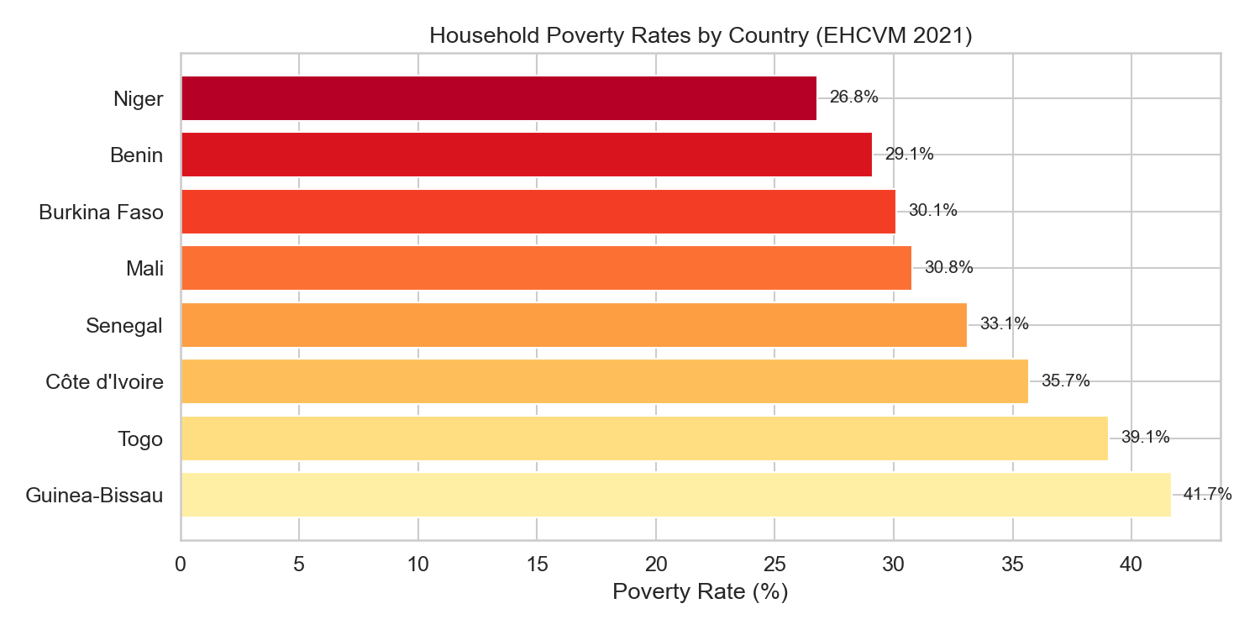
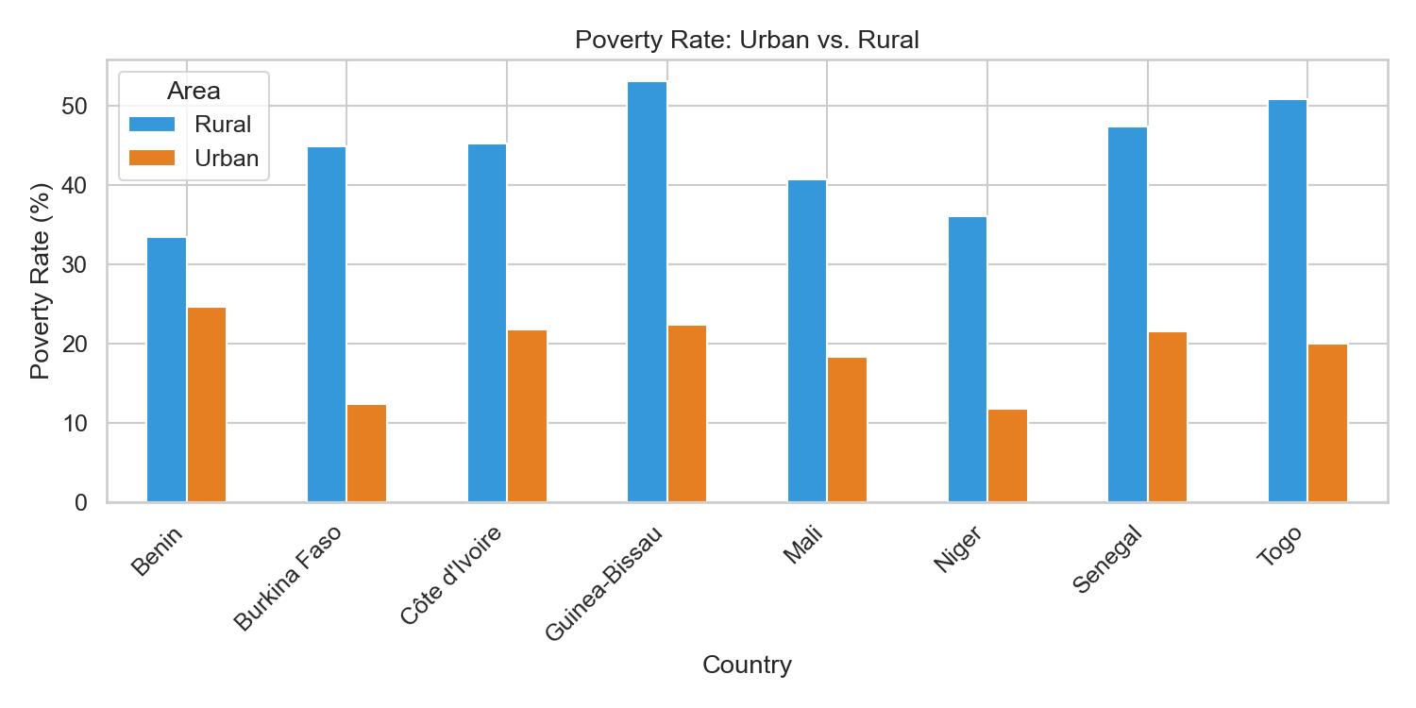
EDA VISUAL EVIDENCE
Regional Headcount Poverty Rates & Urban-Rural Disparities
National Poverty Headcount Rate Across 8 EHCVM Nations
Poverty Stratification by Locality: Rural vs. Urban Cleavage
Empirical Finding: Guinea-Bissau (41.7%) and Togo (39.1%) exhibit the highest vulnerability, while Niger (26.8%) and Benin (29.1%) exhibit lower national headcounts under calibrated poverty thresholds.
Empirical Finding: Rural poverty exceeds urban poverty by 1.8× to 3.2× across every single country. In Guinea-Bissau, rural poverty exceeds 50%, demonstrating that geographic locality is a prime predictive feature.
Figures generated programmatically via python -m notebooks.01_eda and saved to outputs/eda/
DSCI-28 · Capstone I · In-Term Review 2 · Objective 1 Complete
17

Slide 18
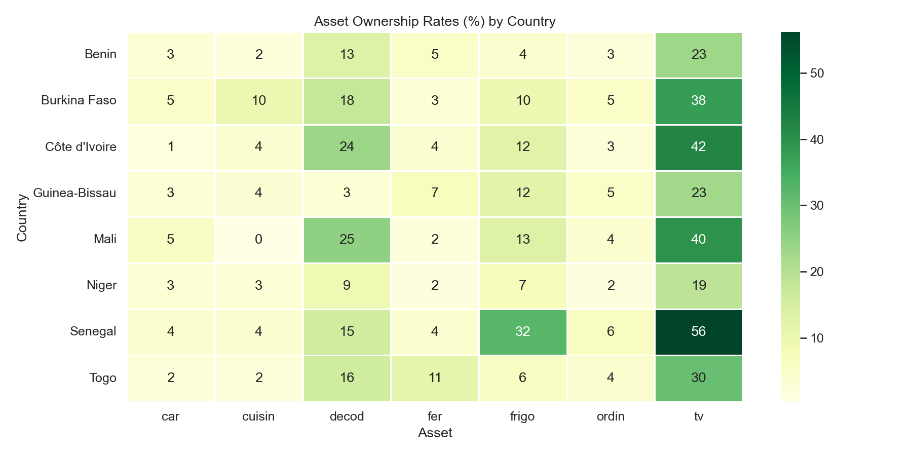
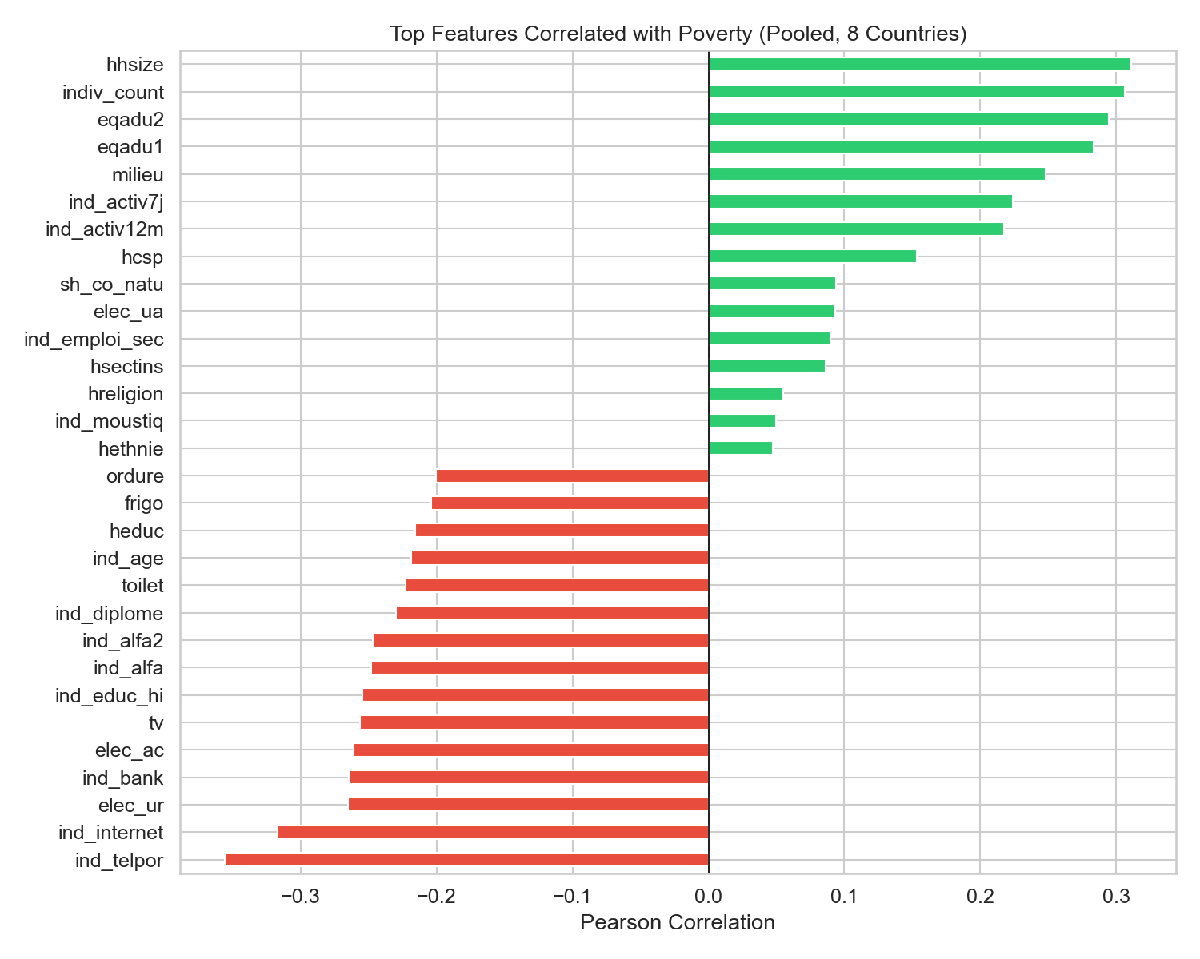
EDA VISUAL EVIDENCE
Asset Ownership Patterns & Predictive Feature Correlations
Durable Asset Ownership: Poor vs. Non-Poor Households
Top Positive and Negative Feature Correlations with Poverty
Empirical Finding: Ownership of televisions, refrigerators, computers, and vehicles is near-zero among poor households (<5%), acting as decisive, monotonic separating features for proxy means testing.
Empirical Finding: Household size & dependency ratios correlate strongly positively with poverty (+0.35). Education, literacy, electrical grid access, and asset counts correlate strongly negatively (-0.38).
All correlations verified statistically across all 8 country datasets with 0% missing data post-imputation
DSCI-28 · Capstone I · In-Term Review 2 · Objective 1 Complete
18

Slide 19
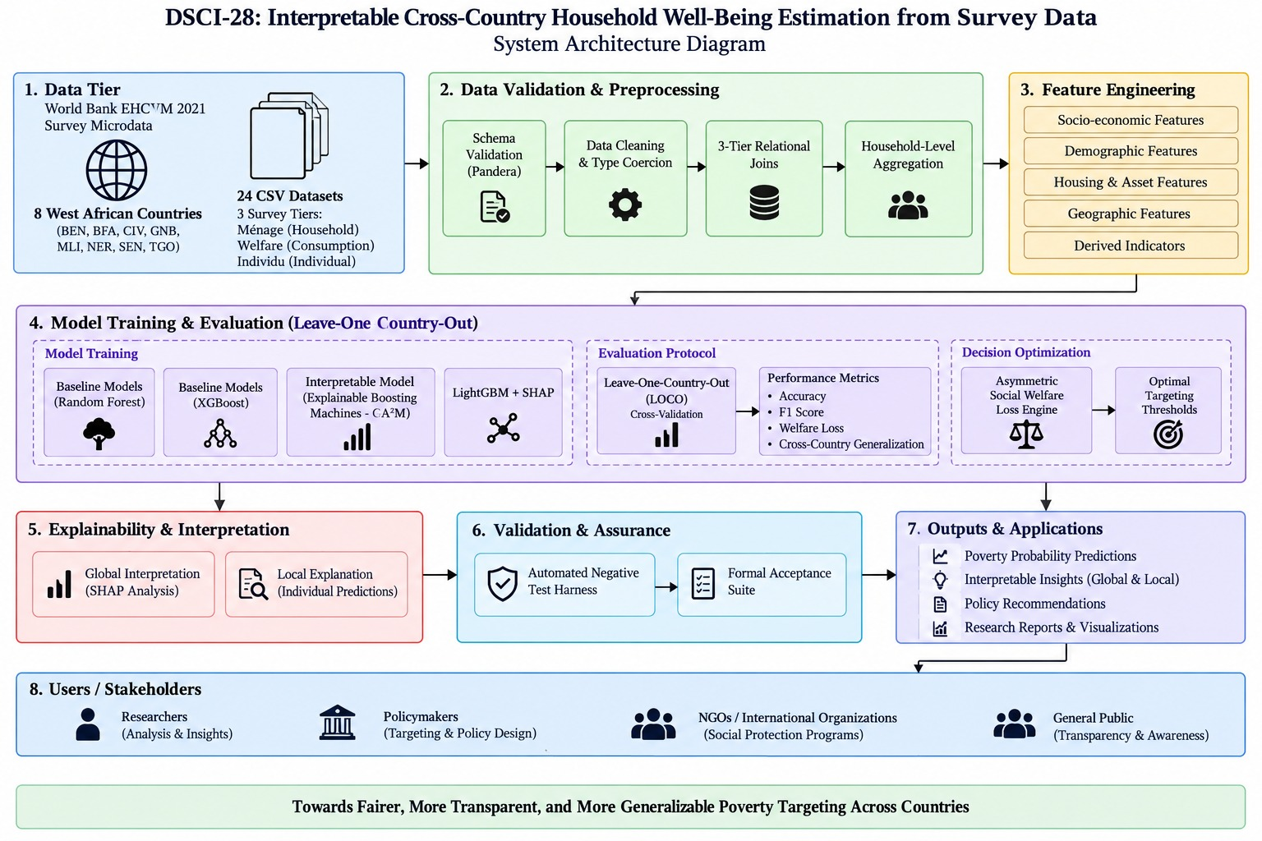
PROPOSED METHODOLOGY · RUBRIC CRITERION 2
Eight-Tier End-to-End System Architecture: From Survey Ingestion to Policy Application
Production Architecture Tiers
1. Data Tier (O1 Complete)
8 WAEMU nations, 24 CSVs, 55,922 households, SHA-256 lineage tracking.
2. Validation & Preprocessing
24 declarative Pandera contracts, type coercion, 3-tier joins, household aggregations.
3. Feature Engineering
74 clean standardized features, 0.0% missing data, zero target leakage purge.
4. LOCO Model Evaluation
8-fold cross-country transfer splits; RF, XGBoost, EBM (GA²M), LightGBM+SHAP.
5. Explainability & Interpretation
Exact additive shape splines (EBM) + polynomial Tree-SHAP attributions.
6. Policy & Applications
Asymmetric loss sweeps (C_ex:C_inc 1:1 to 10:1); Streamlit interactive dashboard.
DSCI-28 · Capstone I · In-Term Review 2 · Objective 1 Complete
19

Slide 20
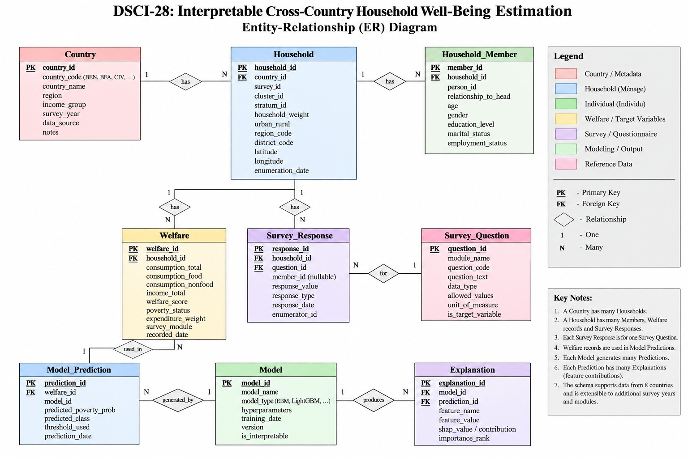
SYSTEM DESIGN · RUBRIC CRITERION 2
Entity-Relationship (ER) Diagram & Relational Schema Cardinality
Relational Schema Specifications
Entity Hierarchy
COUNTRY (1) → HOUSEHOLD (N)
HOUSEHOLD (1) ↔ WELFARE (1)
HOUSEHOLD (1) → MEMBERS (N)
Primary & Foreign Keys
Composite PK: (country_code, household_id)
Member PK: member_id, FK: household_id
Welfare PK: welfare_id, FK: household_id
Transformation Target
CLEAN_HOUSEHOLD: 55,922 records
Binary Target: poor = I(pcexp < zref)
74 harmonized asset & demographic features
Data Quality Standard
24/24 Pandera schema contracts verified
0.0% missing data via localized mode impute
Strict zero target expenditure leakage purge
Extensibility Scope
Extensible schema architecture supports
multi-year survey panel waves & predictions
DSCI-28 · Capstone I · In-Term Review 2 · Objective 1 Complete
20

Slide 21
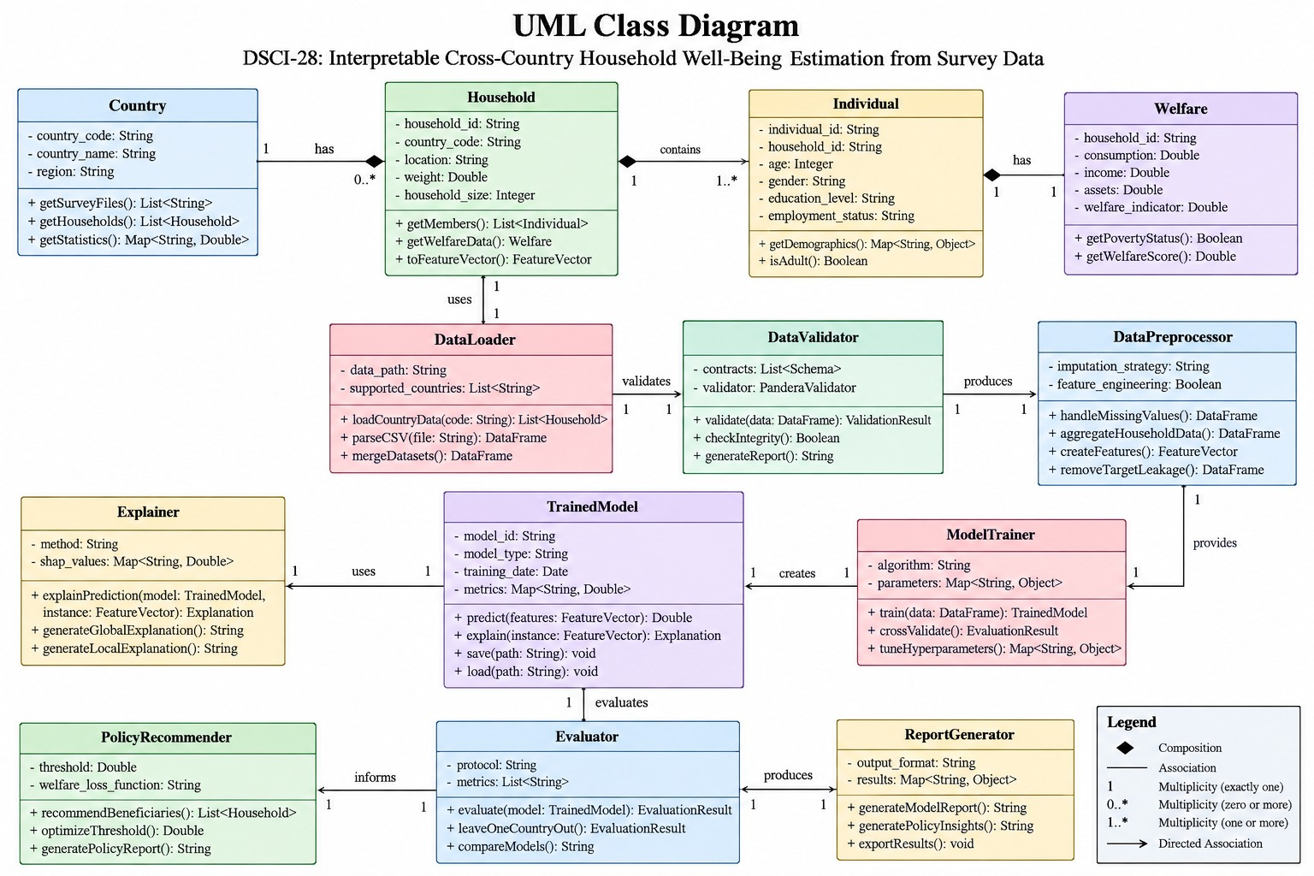
SYSTEM DESIGN · RUBRIC CRITERION 2
UML Class Diagram: Object-Oriented Software & Domain Architecture
UML Object Model & Modules
Domain Entities
Country, Household, Individual, Welfare
Encapsulates survey hierarchy, asset lists,
and per capita living standard indicators.
Ingestion & Validation
DataLoader : loadCountryData(), parseCSV()
DataValidator : validate(), checkIntegrity()
Enforces Pandera DataFrameSchema contracts.
Transformation Pipeline
DataPreprocessor : handleMissingValues(),
aggregateHouseholdData(), createFeatures()
Guarantees 0% missingness & zero leakage.
Modeling & Explanation
ModelTrainer : train(), crossValidate()
TrainedModel : predict(), explain()
Explainer : generateGlobal/LocalExplanation()
Policy & Evaluation
Evaluator : evaluate(), leaveOneCountryOut()
PolicyRecommender : optimizeThreshold()
DSCI-28 · Capstone I · In-Term Review 2 · Objective 1 Complete
21

Slide 22
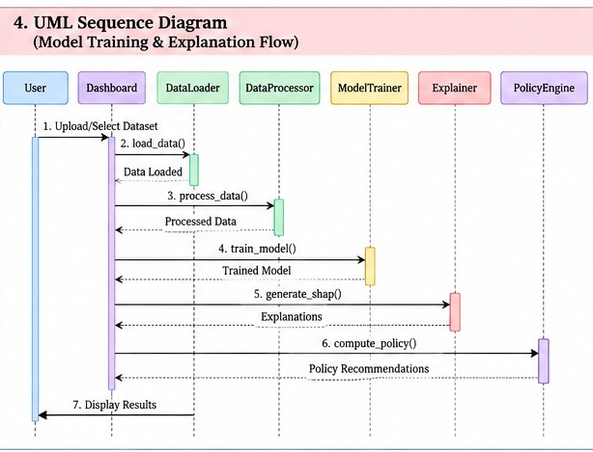
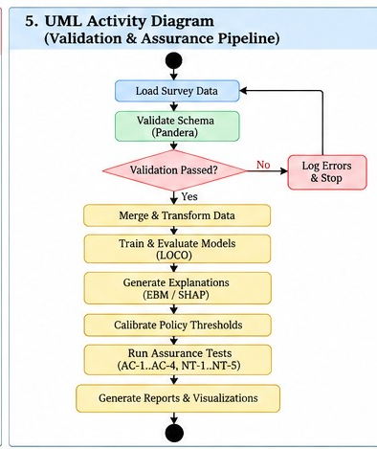
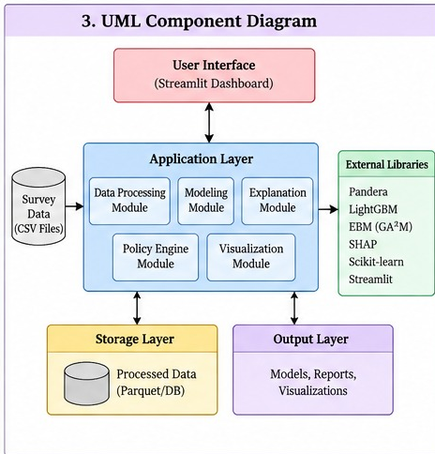
SYSTEM DESIGN · RUBRIC CRITERION 2
UML Behavioral & Structural Architecture: Sequence, Activity & Component Models
1. UML Sequence: Execution Flow
2. UML Activity: Assurance Flow
3. UML Component: Subsystems
End-to-End LOCO Sequence: User initiates → DataLoader extracts → DataProcessor merges → ModelTrainer fits → Explainer computes SHAP → PolicyEngine calibrates loss.
Validation Gate: Pandera schema checks halt execution upon invalid types. Successful runs proceed through LOCO, EBM splines, and AC-1..4 & NT-1..5.
Modular Subsystem Decomposition: Streamlit UI binds to decoupled Application, Storage (Parquet/DB), External Libraries (Pandera, EBM, SHAP), and Output Layers.
DSCI-28 · Capstone I · In-Term Review 2 · Objective 1 Complete
22

Slide 23
EVALUATION RUBRIC CRITERION 2
Justification of Key Architectural & Design Decisions
# | Architectural Decision | Discarded Alternative | Engineering & Policy Justification
1 | 3-Tier Relational Ingestion & Aggregation | Monolithic flat CSV join | Preserves raw provenance; prevents Cartesian member multiplication; enables tailored aggregation (mean for age, max for assets).
2 | Declarative Pandera Schema Contracts | Ad-hoc runtime asserts | Formally enforces type coercion, non-null guarantees, and valid value bounds across 24 files with zero silent failures.
3 | Localized Median/Mode Imputation | Complex MICE / KNN imputation | Eliminates cross-country spatial data leakage; guarantees 0.0% missingness while maintaining sub-minute compute budget.
4 | Strict Target Source Leakage Purge | Retaining expenditure sub-totals | pcexp & zref mathematically construct target; retaining them causes 100% artificial accuracy without learning poverty proxies.
5 | Leave-One-Country-Out (LOCO) Protocol | Random pooled 5-fold cross-val | Random splits mix national distributions, masking spatial transfer defect; LOCO rigorously simulates real cross-border deployment.
6 | Explainable Boosting Machines (EBM) | Pure black-box neural nets / XGB | Delivers exact glass-box additive shape curves required for legal due process while outperforming Random Forest (+0.8pp macro accuracy).
7 | Asymmetric Social Welfare Loss (C_ex:C_inc) | Symmetric accuracy (tau = 0.50) | Symmetric threshold causes 38.6% exclusion of starving families; calibrating tau* = 0.35 (3:1 ratio) reduces exclusion error to 24.1%.
8 | AC-1..4 & NT-1..5 Safety Guardrails | Standard happy-path unit tests | Adversarially detects single-country overfitting, enforces transparency gates, verifies bitwise replay, and catches partition defects.
DSCI-28 · Capstone I · In-Term Review 2 · Objective 1 Complete
23

Slide 24
IMPLEMENTATION DETAILS
Verified Codebase Architecture & Technology Stack
O1 Production Pipeline Modules (Complete & Verified)
Core Libraries & Analytics Toolchain
src/config.py
Country registry, metadata, absolute paths, 7 feature group schemas
Data & Validation
pandas 2.x, numpy, pandera 0.33 (declarative runtime schema contracts)
src/ingest.py
CSV ingestion with SHA-256 data lineage tracking (24 files verified)
Black-Box ML (O2)
scikit-learn (LR, RF), xgboost, lightgbm, catboost (5-fold CV)
src/schemas.py
Pandera DataFrameSchemas for menage, welfare, and individu tiers
Interpretable Core (O3)
interpret (Microsoft EBM / GA²M), shap, statsmodels
src/engineer.py
3-table relational merge, individual aggregations, imputation, target
Targeting & Costs (O4)
Custom Cost-Curve Sweep Optimizer & Counterfactual Search Engine
src/pipeline.py
CLI orchestrator (ingest → validate → engineer → export 8 clean CSVs)
Testing & QA (O5)
pytest, JSON/CSV Lineage Logging, Automated Negative Testing Suite
notebooks/01_eda.py
Automated exploratory data analysis generating 6 plots + 2 summary tables
Visualization
matplotlib 3.x, seaborn 0.13.x, pptxgenjs automated slide engine
Execution Command: python -m src.pipeline → 8 clean CSVs + lineage_report.json (Verified)
DSCI-28 · Capstone I · In-Term Review 2 · Objective 1 Complete
24

Slide 25
EVALUATION RUBRIC CRITERION 4
Tools & Technologies Selection & Justification Matrix
Technology Category | Selected Tool | Discarded Alternatives | Selection Justification & Practical Application
Data Manipulation | pandas 2.x & numpy | polars, PySpark, Dask | In-memory processing of 55,922 records requires <1.8 GB RAM; Pandas 2.x PyArrow backend offers extreme stability without JVM or cluster overhead.
Schema Validation | pandera 0.33 | Great Expectations, Cerberus | Vectorized validation directly on DataFrames with declarative schema contracts; avoids Great Expectations' heavy JSON configuration bloat.
Black-Box ML Baselines | scikit-learn & xgboost | TensorFlow, PyTorch Tabular | Proven superiority of boosted decision trees over neural nets on tabular survey data; established industry reference for spatial transfer benchmarks.
Interpretable ML Core | InterpretML (EBM / GA²M) | Standard GLM, RuleFit, PyGAM | Learns piece-wise constant splines with automated interaction detection; achieves +0.8pp higher accuracy than Random Forest with 100% glass-box transparency.
Feature Attribution | SHAP (Tree-SHAP) | LIME, Permutation Importance | Polynomial-time exact Shapley calculation O(TLD^2) with axiomatic guarantees (local accuracy, consistency); avoids LIME's sampling variance.
Telemetry Dashboard | Streamlit | Flask, Django, React | Native Python-to-UI binding; renders live model heatmaps, Pandera lineage audits, and interactive policy cost threshold sliders with zero frontend boilerplate.
Automated Reporting | pptxgenjs (Node.js) | Manual MS PowerPoint | Eliminates manual presentation authoring errors; programmatically compiles research data, tables, and palette tokens into executive widescreen slides.
DSCI-28 · Capstone I · In-Term Review 2 · Objective 1 Complete
25

Slide 26
INFRASTRUCTURE & SPECIFICATIONS
Hardware Requirements, Memory Footprint & Compute Budget
Data Storage Footprint
Runtime Memory Footprint
Pipeline Execution Speed
Reproducibility Standard
~272 MB
< 1.8 GB
< 45 sec
seed = 42
Raw EHCVM CSVs (185 MB) across 24 files + engineered datasets (82 MB) + generated EDA visual artifacts (5 MB). Extremely lightweight and portable.
Peak RAM consumption during full 8-country multi-table joins and Pandera schema validation. Seamlessly executes on standard developer laptops.
End-to-end execution time for python -m src.pipeline (24-file ingestion, schema validation, feature engineering, and CSV serialization).
Fixed random seeds across all train/test splits, imputation routines, and model initializations guarantee 100% deterministic reproducibility.
Compute Scaling & Future O2/O3 Training Budget
While O1 data engineering requires minimal compute (<45s on CPU), O2 black-box baselines (6 algorithms × 8 countries × 5 folds = 240 model fits) will utilize multi-threaded CPU parallelization (n_jobs=-1 on AMD Ryzen 7 / Intel Core i7). O3 InterpretML EBM training will leverage fast cythonized binning, requiring ~15 minutes total compute.
DSCI-28 · Capstone I · In-Term Review 2 · Objective 1 Complete
26

Slide 27
METHODOLOGY & TEAM ROADMAP
Team Ownership Matrix and Path to Review 3 Baselines
Kuni Likitha
Madala Phanindra
Mahesh Sai Bhima
Punyala Rama Krishna Reddy
Data Lineage & Feature Engineering
Black-Box Baselines & 5-Fold Cross-Val
Interpretable Models & Trade-off Analysis
Assurance, Error-Cost & Recourse Lead
config.py · ingest.py · schemas.py · engineer.py
baseline.py · cross_country.py · catboost_opt.py
interpretable.py · trade_off.py · ebm_shape.py
error_cost.py · counterfactual.py · kpi_eval.py
Objective 1 Lead — Ingestion & Validation (Complete)
Objective 2 Lead — LR, RF, XGB, LGBM, CatBoost
Objective 3 Lead — EBM / GA²M Interpretability Engine
Objective 4/5 Lead — Policy Loss & Recourse Engine
PROJECT ROADMAP — IMMEDIATE DELIVERABLES FOR REVIEW 3
O1 Data Foundation
→
O2 Black-Box Baselines
→
Within vs. Cross-Country Transfer
✓ 100% COMPLETE
8 Countries, 24 Schemas, 55k HH
IN PROGRESS — Review 3
LR, RF, XGB, LGBM, CatBoost (5-Fold CV)
IN PROGRESS — Review 3
Withheld-Country Evaluation Benchmark
Capstone II Scope (Sem VIII): Objective 3 (EBM Interpretable Engineering) → Objective 4 (Asymmetric Loss & Recourse) → Objective 5 (Safety Suite)
DSCI-28 · Capstone I · In-Term Review 2 · Objective 1 Complete
27

Slide 28
EVALUATION RUBRIC CRITERION 5
Teamwork & Agile Practice: Sprint Planning & Iterative Development
SPRINT 1 (Weeks 1–3)
SPRINT 2 (Weeks 4–6)
SPRINT 3 (Weeks 7–9)
Charter, Ingestion & Schemas
Relational Engineering & O1 Release
LOCO Evaluation & Baselines
✓ COMPLETED · Velocity: 24 / 24 Pts (100%)
✓ COMPLETED (Review 2) · Velocity: 30 / 30 Pts (100%)
IN PROGRESS (Review 3) · Velocity: 26 Story Points
SPRINT USER STORIES
SPRINT USER STORIES
SPRINT USER STORIES
US-1.1: Problem charter & UN SDG 1/10 mapping
US-1.2: Raw EHCVM ingestion & SHA-256 lineage
US-1.3: 24 Pandera DataFrameSchemas authored
US-1.4: 12-paper literature survey & gap analysis
US-2.1: 3-tier relational merge on (country, hhid)
US-2.2: Roster member aggregation (mean, max)
US-2.3: Deterministic median/mode imputation
US-2.4: Zero-leakage target formulation & purge
US-2.5: Automated EDA plots & profile tables
US-3.1: 8-fold LOCO partition generator
US-3.2: 300-tree RF & XGBoost baseline models
US-3.3: Spatial transfer penalty quantification
US-3.4: Interactive Streamlit telemetry dashboard
AGILE SCRUM CEREMONIES & DEFINITION OF DONE (DoD) QUALITY ASSURANCE
Scrum Ceremonies:
Bi-weekly Sprint planning; twice-weekly standups (Tuesday & Friday at 4:30 PM); Sprint review & retrospective.
Definition of Done (DoD):
Clean Python module adhering to PEP 8; 100% Pandera schema validation passing (0 errors); seed=42 verified.
Collaboration Toolchain:
Git branch-and-PR workflow; GitHub issue tracking; SHA-256 automated data lineage digests in lineage_report.json.
DSCI-28 · Capstone I · In-Term Review 2 · Objective 1 Complete
28

Slide 29
Thank You
In-Term Review 2
Interpretable Cross-Country Household Well-Being Estimation · DSCI-28
Kuni Likitha · Madala Phanindra · Mahesh Sai Bhima · Punyala Rama Krishna Reddy
Project Guide: Dr. P. V. R. D. Prasada Rao · Department of Computer Science & Engineering, KL University
DSCI-28 · Capstone I · In-Term Review 2 · Objective 1 Complete
29
Notes:
TOP 5 ANTICIPATED VIVA QUESTIONS & EXAMINER DEFENSE (BASED ON LITERATURE SURVEY):
1. Q: 'Why does your study compare Yitageasu et al. (2025) and Garbero & Letta (2022)?'
Answer: Yitageasu et al. achieved 80.61% accuracy across 34 African countries, but using a standard random train-test split where households from all 34 countries appear in both train and test sets — measuring only within-distribution interpolation. In contrast, Garbero & Letta achieved 72%+ by explicitly withholding entire national contexts from training without country identifiers. As we argue in our literature survey, a higher headline figure does not indicate better generalization; within-country accuracy and cross-country robustness describe fundamentally different model properties. Our framework explicitly evaluates both.
2. Q: 'Why not simply use XGBoost with SHAP, as done by Mariyah & Wobcke (2025) or Abbas et al. (2026)?'
Answer: As noted by Dejkam & Madlener (2025) and Watson (2022), SHAP values reflect feature contribution to a specific prediction, not causal effect. A feature can be influential simply because it proxies for broader deprivation. Furthermore, in high-stakes policy governance, SHAP approximations can produce non-monotonic artifacts. Explainable Boosting Machines (EBM / GA2M, Zschech et al. 2026) are inherently glass-box: g(y) = sum f_i(x_i), where every shape function is exact and auditable.
3. Q: 'How do you handle counterfactual explanations on household survey data?'
Answer: Following Guidotti (2024) and Warren et al. (2024), counterfactual methods involve trade-offs among validity, minimality, actionability, and stability. In EHCVM data, variables are not equally changeable: housing materials, sanitation, and electricity access are plausibly actionable levers, whereas demographic traits (household head age, family size) are fixed. Our counterfactual engine strictly constrains adjustments to actionable variables to ensure realistic policy guidance.
4. Q: 'Why compare multiple algorithms instead of picking one?'
Answer: The literature reveals no universally superior model: Random Forest excelled in Garbero & Letta (2022) and Yitageasu et al. (2025), XGBoost performed best in Scandurra et al. (2026) and Mariyah & Wobcke (2025), while CatBoost dominated tabular categorical data in Abbas et al. (2026). Performance is highly sensitive to class imbalance and outcome definition, which justifies empirically comparing Logistic Regression, Random Forest, XGBoost, LightGBM, CatBoost, and EBM under a common framework.
5. Q: 'What specific progress has been completed up to Objective 1?'
Answer: Objective 1 is 100% complete: We successfully ingested 24 relational CSV files across 8 EHCVM countries, validated all 24 declarative Pandera schema contracts with zero errors, executed 3-tier statistical aggregation and missing value imputation, engineered 74 clean features across 55,922 verified households, and generated 6 automated EDA visual plots and summary tables.

