Slide 1
Technical Training
Filer
M-Utility

Slide 2
Topics to be Covered
Trigger

Slide 3
What is a Filer?
The term filer is a definition in DATA-QWIK that manages changes (insert, update, delete) to a table as well as integrity verification
Consists of stabilized data (rules) and procedural code to manage the table updates
Results in a compiled routine (or set of routines) enabling these rules for run-time execution

Slide 4
DATA-QWIK Filer Elements
Triggers Definitions
Journal Definitions
Foreign Key Definitions
Index Definitions

Slide 5
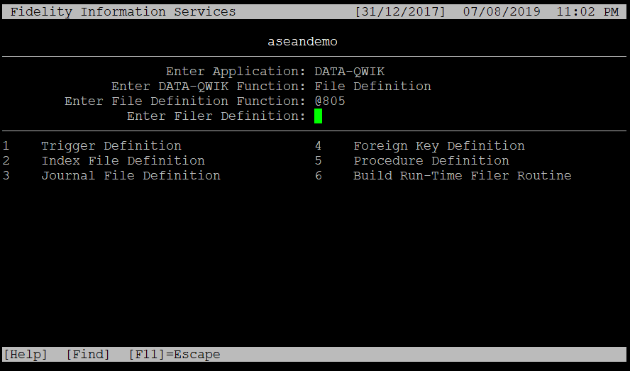
Accessing Filer Definitions
Below is the filer definition screen:
Run function @805

Slide 6
Trigger Definition
Triggers provide a means to define business rules within the database definition.
This ensures that the business rules are enforced for all updates of the database.
Triggers may be used to create default values, update other column values, perform edit checking, or cause actions to other tables.
In a client/server environment, business rules must be enforced using the triggers.

Slide 7
Trigger Types
Business rules must be enforced using triggers. In a client / server environment, Triggers are executed (or ‘fired’) as a result of specific actions or events associated with a table. Six Trigger types are supported.
Before Insert - Occurs before the database is updated when inserting a new row.
After Insert - Occurs after the database is updated when inserting a new row.
Before Update - Occurs before the database is physically updated when performing an update and may be limited to changes to specific columns.
After Update - Occurs after the database is physically updated when performing an update and may be limited to changes to specific columns.
Before Delete - Occurs before the database is updated when deleting a row.
After Delete - Occurs after the database is updated when deleting a row.

Slide 8
Before Insert
A Before Insert trigger is executed upon the insert of a new row into a table, before the database is physically updated.
Generally, this type of Trigger is used to default values into columns where no value is provided or to perform editing checking for columns that are required before further processing.
Note: Only one Before Insert trigger is allowed for a table.

Slide 9
After Insert
The After Insert trigger is primarily responsible for providing validation of all the business rules associated with a row in a table. An After Insert trigger has two roles:
  It is executed upon insert of a new row into a table, after the database has been physically updated (a Transaction Processing rollback will occur in the event of a failure during the After Insert trigger).
  It is also executed to provide integrity checking for a table.
If a certain relationship must exist between columns, the After Insert trigger would verify the relationship. After Insert Triggers are also used to manipulate related tables.
Only a single After Insert trigger is allowed for a table
  Example:
  When inserting a new LN row, a row must also be inserted into LNBIL0. This can be managed by the LN After Insert trigger which enables DATA-QWIK to manage this type of related update.

Slide 10
Before Update
Before Update triggers may be specified to be executed associated with one or more columns.
The Trigger will then execute only when an update to a column in the list is performed.
The Trigger executes on update of the specified column (or columns) before the database is physically updated.
Multiple Before Update triggers may be defined for a table.
The order in which Before Update triggers will execute is not predictable or guaranteed.
Coding should never assume knowledge of the order of execution.

Slide 11
After Update
After Update triggers may be executed in association with one or more columns.
The Trigger will then execute only if an update to a column in the list is performed.
The Trigger executes on the update of the specified column(s) after the database is physically updated (with a Transaction Processing rollback occurring in the event of a failure).
Multiple After Update triggers may be defined for a table.
The order in which After Update triggers will execute is not predictable or guaranteed.
Coding should never assume knowledge of the order of execution.

Slide 12
Before Delete
Before Delete triggers are executed before a row is physically deleted from a table.
Before Delete triggers may check various conditions to ensure that it is allowable to delete a row before allowing processing to proceed.
Note: Only one Before Delete trigger is allowed for a table.

Slide 13
After Delete
After Delete triggers are executed after a row is physically deleted from a table.
After Delete triggers can be used to manipulate information in other tables related to the deletion.
  Example: After a delete has been performed, log an entry into a ‘Log’ table for Auditing purposes.
Note: Only one After Delete trigger is allowed for a table.

Slide 14
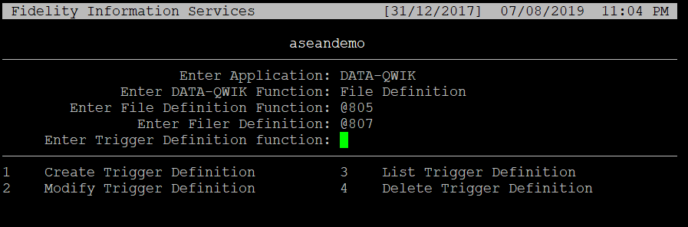
Accessing Triggers
Batch definition access: run a function @807

Slide 15
Accessing Triggers
The following table shows the Trigger Definition maintenance functions by function ID (these may be entered from any menu)
Compiling the trigger, use Build Run-Time Filer Routine function: @DBSFILB
Description | Function ID
Create Trigger Definition | DBSDFL
Modify Trigger Definition | DBSDFCO
List Trigger Definition | DBSDFD
Delete Trigger Definition | DBSDF9
Build Run-Time Filer Routine | DBSFILB

Slide 16
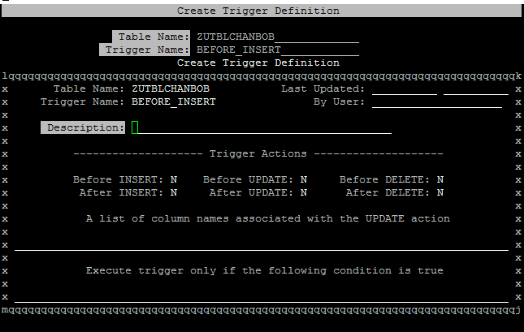
Trigger Control Page
Example Trigger definition control page

Slide 17
Trigger Control Page items
The following are descriptions of the fields located on this screen:
Table Name - Displays the table name the trigger is associated with.
Trigger Name - Displays the name of the Trigger.
Description - A freeform text description of the action the Trigger will perform.
Trigger Actions - Displays the actions this Trigger will be performing.
List of column names - Displays the columns that will be updated.
Note: we can use this keyword to represent table object.

