Slide 1
Hibernate
A framework for Object-relational mapping (ORM Framework)
It simplifies the interaction between Java objects and relational databases by providing a way to map Java objects to DB tables and vice versa
Hibernate implements the Java Persistence API standard (JPA)
JPA allows for developers to work with different ORM frameworks using a common API
Several layers of abstraction:
JPA -> Hibernate -> JDBC -> Database

Slide 2
Benefits
Simplified database interaction: abstracts the low-level details of database interaction, such as JDBC connection management and SQL queries, allowing developers to focus on the business logic and OOP instead of SQL logic
Object relational mapping: Hibernate maps Java objects to DB tables, providing a seamless integration between OOP and relational databases
Database independence: Hibernate supports various databases such as MySQL, PostgreSQL, Oracle, and SQL Server, which allows developers to switch between databases with minimal code changes required
Caching: Hibernate provides built-in caching mechanisms to store frequently accessed data in-memory, which reduces the number of database queries required
Query language: Hibernate provides its own query language, called HQL (Hibernate Query Language), which is similar to SQL syntactically, but operates on Java objects instead of tables and columns

Slide 3
Hibernate Configuration
All of our model classes will be considered “entities” within the ORM paradigm
An entity is a representation of both an object in Java as well as a table in the database
Ex. Users entity -> users class AND users table
The model classes are configured using JPA annotations (@)
Configuration class: responsible for setting up database connection properties. The configuration is usually loaded from an XML file called hibernate.cfg.xml or through programmatic configuration
SessionFactory interface: is a factory class that creates Session instances. The SessionFactory object is initialized from the Configuration object. It should be created only once when the application starts up, and should be shared across the entire application
Session interface: represents a single unit of work with the database, providing methods for creating, reading, updating, and deleting records. It manages transactions, which ensure data consistency and integrity. Sessions are created from the SessionFactory itself
Transaction interface: represents finer grained control over transactions performed. A Transaction object is scoped to a particular Session object

Slide 4
JPA Annotations
@Entity: the model classes should be each annotated with an @Entity annotation to specify that it is an entity. This means that the class will be mapped to a database table
@Table: this annotation should be used to specify the table name if you want for the table name to be different from the name of the class
@Id: this annotation should be used to annotate the field in the class that should act as the primary key
@GeneratedValue: this annotation is used along with the @Id annotation to define how the primary key should be generated, such as autoincrementing, etc.
@Column: used to specify properties of a column in the database, such as the name of the column, the maximum length, whether its unique, or whether it is nullable, etc.

Slide 5
JPA Annotations (cont.)
@ManyToOne
Ex. Reimbursements and Users, in the Reimbursements class, we would be mapping to the Users class using @ManyToOne
@OneToMany
Ex. Users and Reimbursements, in the Users class, we would be mapping to the Reimbursements class using @OneToMany
@OneToOne
@ManyToMany
Uni-directional mappings v. Bi-directional mappings
In general, you should perform only uni-directional mappings instead of bi-directional mappings unless you know what you are doing
If you do bi-directional without some extra configuration and tweaking of your classes, then you will run into infinite loops that end up crashing your program

Slide 6
Hibernate Object States
There are 3 different object states that an Entity object can have
Transient: a regular Java object that is not being tracked by Hibernate
Persistent: a Java object that is being tracked by Hibernate. Any changes made to a persistent object, when the session is flushed, will be updated in the actual database
Detached: a Java object that used to be tracked by Hibernate, but was evicted from a Hibernate session (or close the Session)

Slide 7
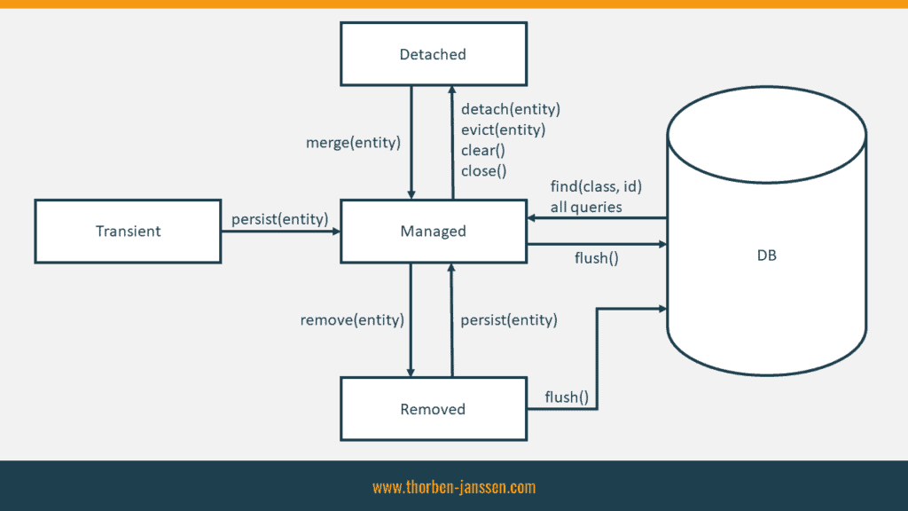

Slide 8
Spring Boot
Spring Boot is a project within the Spring framework ecosystem that simplifies the development of Spring applications
Spring Framework is a modern framework for Java development that introduces features such as dependency injection and inversion of control
We can plug in various projects such as Spring Data JPA into our Spring Boot project to perform various database operations at an even more abstract level than JPA.
Spring Data JPA -> JPA -> Hibernate -> JDBC -> Database

