Slide 1
Variations in Wi-Fi Beacon Packets RSSIs due to interference from different Wi-Fi devices and the usage of different chipset
Aravinth, S. Panchadcharam
Supervisors:
Dr. Arash Behboodi
Filip Lemic

Slide 2
Outline
Introduction
Problem statement
Initial design idea
Initial implementation idea
Expected Results
Schedule
Conclusion

Slide 3
Introduction
Beacon packet:
Contains information about the network
Transmitted periodically to announce the presence of a Wireless LAN
RSSI
RSSI - Received Signal Strength Indicator
Indicates the power of a signal that is received at the receiver side
One field of a beacon frame
Beacon packets’ RSSI values are extensively used for ranging and localization purposes – They should be accurate!!
Notes:
- What is RSSI?
- RSSI is a measurement of the power present in a received RF - WIFI signal.
- How is it reported?
- RSSI can be used internally in a wireless networking card to determine when the amount of radio energy in the channel is below a certain threshold at which point the network card is clear to send (CTS). Once the card is clear to send, a packet of information can be sent.
- How and Where is it used?
- Visually represent the signal strength to the end user and RF Based Localization algorithms

Slide 4
Problem Statement
RSSI values from beacon packets have significant variations:
Calculation of the RSSI values is not defined by any standard
Various chipsets report RSSI values differently
RSSI measurements vary with temperature
RSSI measurements are affected by different types of interference
The relation between RSSI values and distance between transmitter and receiver is unreliable
Idea – examine how RSSI values are changed due to interference, different chipsets and distance
Notes:
- Change in RSSI due to various reasons.
- Interferences - overlapping of unintended signals in time and frequency and caused by many other factors such as distance, temperature, construction of the room
- Eg. change in distance does cause normal path loss. instead shows a weird zig-zag behaviour
- There is no standardized relationship of any particular physical parameter to the RSSI reading. The 802.11 standard does not define any relationship between RSSI value and power level in mW or dBm.
- Eg. Cisco Systems cards have a RSSI_Max value of 100 and will report 101 different power levels, where the RSSI value is 0 to 100. Another popular Wi-Fi chipset is made by Atheros. An Atheros based card will return an RSSI value of 0 to 127 (0x7f) with 128 (0x80) indicating an invalid value.

Slide 5
Initial Design Idea
examine how RSSI values are changed experimentally by doing RSSI measurements
Measuring, storing and analyzing Wi-Fi beacon packets’ RSSI values:
In different scenarios:
without controlled interferences and with minimized uncontrolled interference
with controlled interferences:
Different types of controlled interference
Different amounts of controlled interference
In two different testbeds:
TKN – TWIST testbed
iMinds – w-iLab.t II

Slide 6
Initial implementation idea
Robotic platform will be used for measuring in a precise and repeatable way:
Robot will enable an automatic measurement survey
Robot will provide accurate locations where measurements are taken
Storage of the data using web service (R2DM) implemented for the EVARILOS project
Interference generation using different devices:
Wi-Fi routers – generation of the Wi-Fi traffic or jamming on the Wi-Fi channels
ZigBee nodes – generation of the ZigBee (IEEE 802.15.4) traffic or jamming on the ZigBee channels
Signal generator – generation of microwave or Bluetooth interference

Slide 7
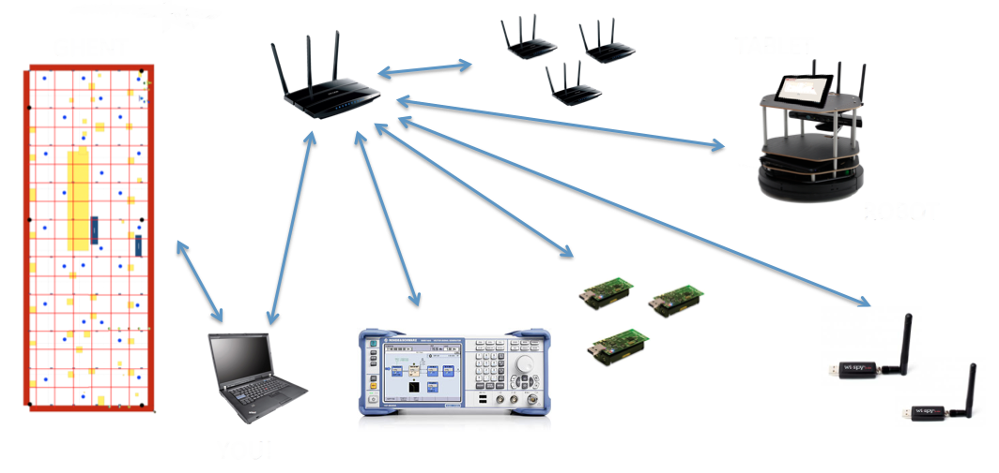
Initial Implementation Idea
Envisioned Components:

Slide 8
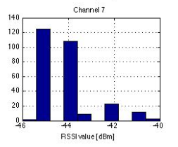
Expected Results
Expected result is a database of the beacon packets’ RSSI measurements collected in different testbeds, at various locations and in different scenarios
Analysis of the results:
Calculation of statistical data describing the results, e.g. mean value and standard deviation
Graphical presentation of the results
Capturing the changes of RSSI values due to interference, different chipsets and distance
Is there a pattern??

Slide 9
Time Plan
16.10.2013 – Project Introduction
04.11.2013 – Project Presentation
3 weeks – Experiments preparation, defining the scenarios, locations, interference types and parameters, etc.
25.11.2013 – 1st Milestone
3 weeks – Experiments, measurements
23.12.2013 - 2nd Milestone
3 weeks – Analyzing the achieved results, calculation of the statistical data, presentation of the results
20.1.2014 – Final presentation
27.1.2014 – Submission
Notes:
Approximate Schedule

Slide 10
Thanks for your attention!
Notes:
Question?

