Slide 1
Variations in Wi-Fi Beacon Packets RSSIs due to Different Types of Interference
Aravinth, S. Panchadcharam
Supervisors:
Dr. Arash Behboodi
Filip Lemic

Slide 2
Outline
Introduction
Raw Data Visualization Tool + Short DEMO
Experiments without Interferences
Repeatability of Experiments
Initial Interference Scenarios
Initial Experiments with Interferences
Schedule
Conclusion

Slide 3
Introduction
RSSI: Received Signal Strength Indicator
Indicator of the power of the received signal
Indicated by the receiver device
GOAL:
Examine how RSSI values are changed due to various interference types at different locations

Slide 4
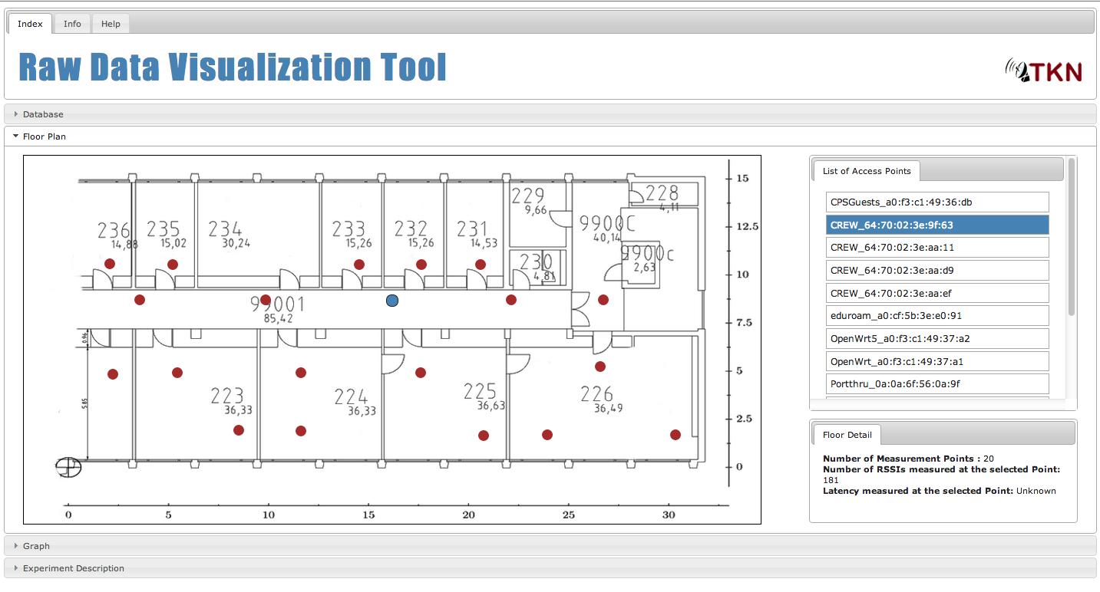
Raw Data Visualization Tool

Slide 5
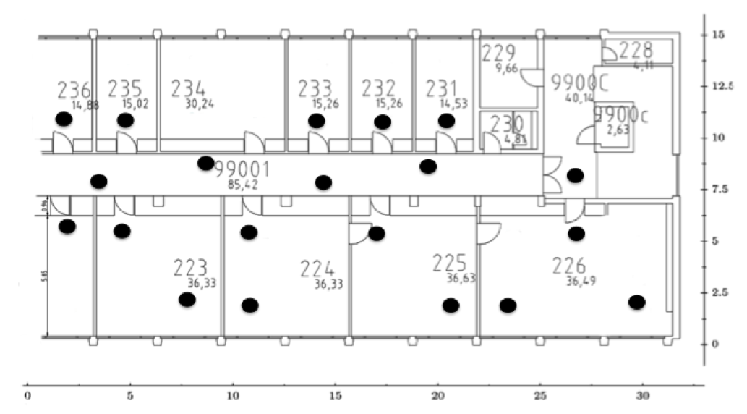
Experiments without Interferences
Scenario :
20 measurement points are defined in the 2nd floor of TWIST Testbed as shown below

Slide 6
Experiments without Interferences
Laptop with a WiFi Adapter is positioned at the measurement points using a Robot
It is also equipped with WiSpy to the measure wireless spectrum
At every measurement point 20 scans of WiFi Access Points available in the environment are done and RSSI values are stored
Experiments are carried out in the afternoons of Saturday when uncontrolled interferences are minimal
This experiment is repeated once

Slide 7
Initial Experiments with Interferences
Scenario :
20 measurement points are defined in the 2nd floor of TWIST Testbed as shown in the slide 5
Controlled interference are generated using IEEE 802.15.4 carrier jammer application with the transmission power of 0 dBm on the channel 22 (2460 MHz)
5 of IEEE 802.15.4 Tmote Sky nodes are used as jamming sources
At every measurement point 40 scans are done and RSSI values are stored

Slide 8
Time Plan
16.10.2013 – Project Introduction
04.11.2013 – Project Presentation
3 weeks – Development of graphical presentation tool, experiments preparation, defining the scenarios, locations, interference types, etc.
27.11.2013 – 1st Milestone
3 weeks – Experiments, measurements
15.01.2014 - 2nd Milestone
3 weeks – Analyzing the achieved results, calculation of the statistical data, presentation of the results
10.2.2014 – Final presentation
27.2.2014 – Submission
Notes:
Approximate Schedule

Slide 9
Thanks for your attention!
Notes:
Question?

