Slide 1
Variations in Wi-Fi Beacon Packets RSSIs due to Different Types of Interference
Aravinth, S. Panchadcharam
Supervisors:
Dr. Arash Behboodi
Filip Lemic

Slide 2
Outline
Introduction
Milestones
Statistical Data
Results

Slide 3
Introduction
RSSI: Received Signal Strength Indicator
Indicator of the power of the received signal
Indicated by the receiver device
GOAL:
Examine how RSSI values are changed due to various interference types
It is being achieved by doing measurements, storing the experiments data, visualizing it and analysing the results

Slide 4
Milestones
Project environment details such as Testbeds, technologies, tools and previous measurement data are acquired.
Measurement data visualization tool is implemented.
Reference scenarios and scenarios with controlled interferences were defined.
Experiments were carried out.
Data required for statistical analysis is extracted with the help of the visualization tool.
Statistical analysis is done

Slide 5
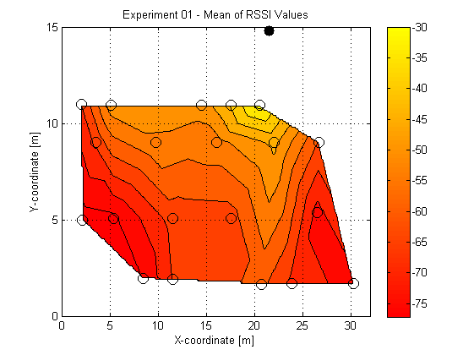
Spatial Distribution of mean RSSIs

Slide 6
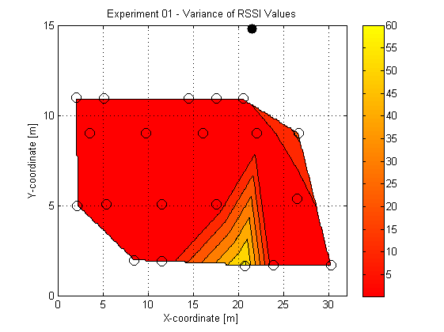
Spatial Distribution of variance of RSSI

Slide 7
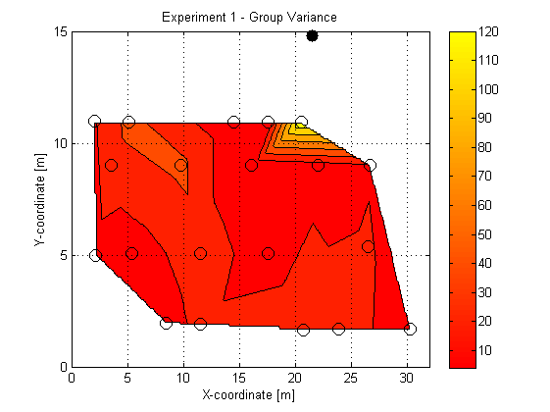
Group variance of RSSI

Slide 8
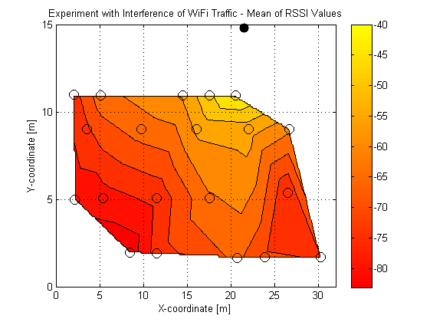
Spatial Distribution of mean RSSIs

Slide 9
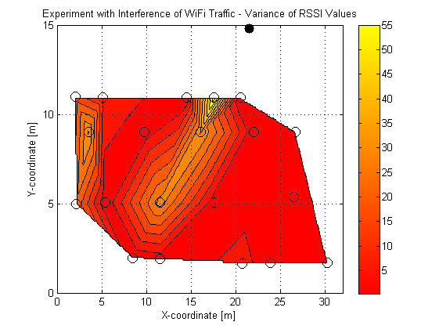
Spatial Distribution of variance of RSSI

Slide 10
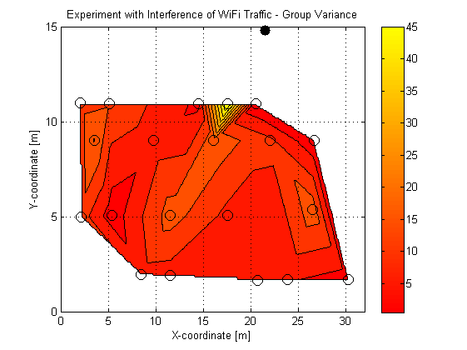
Group variance of RSSI

Slide 11
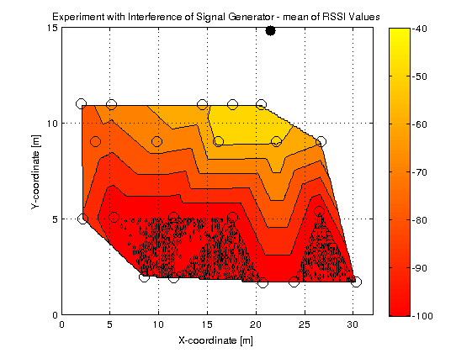
Spatial Distribution of mean RSSIs

Slide 12
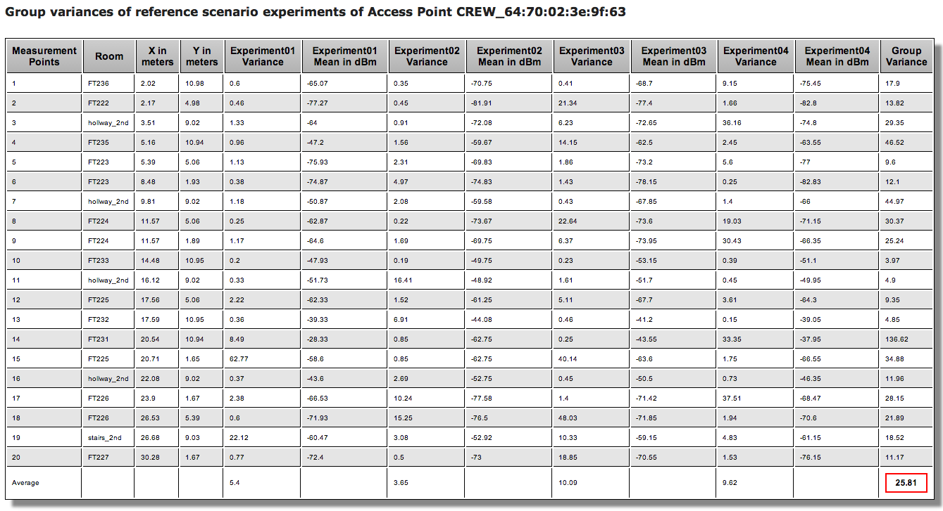
Group Variances

Slide 13
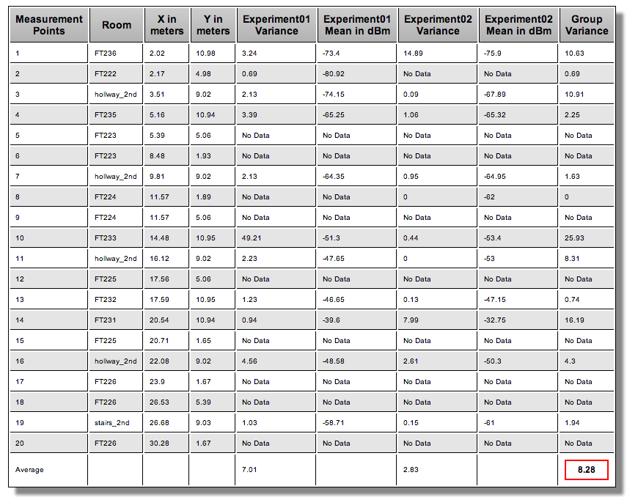
Group Variances

Slide 14
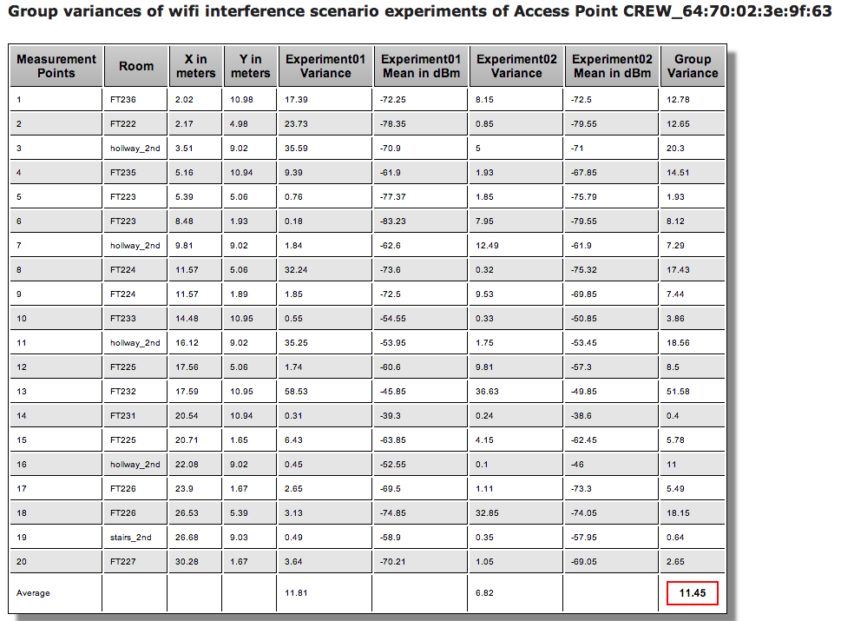
Group Variances

Slide 15
Results & Future work
Results show that there is a variations in the RSSI values due to interferences.
Repetitions and experiments with various interference pattern should be carried out in order to get the clear view of variation due to interferences.
Gathered data should be further studied.

Slide 16
Thanks for your attention!
Notes:
Question?

