Slide 1
Structs
By: John Riley

Slide 2
What is a Struct?
A structure type (or struct type) is a value type that can encapsulate data and related functionality
Structs allow the programmer a way to create their own custom data type.
Created by using the struct keyword
Structs are similar to classes in many ways, but they also have their differences.

Slide 3
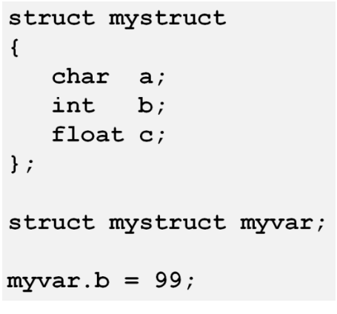
Example of a Structure:

Slide 4
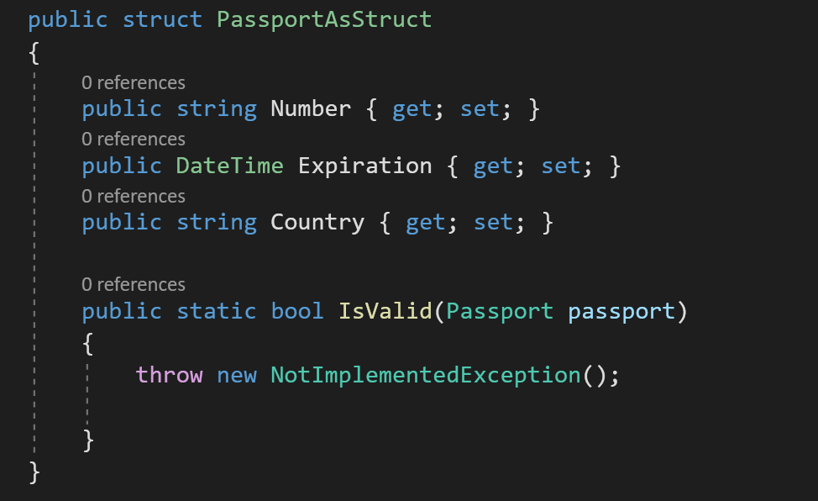
Example of a structure:

Slide 5
A Few Similarities Between Struct and Class
Both are container types, meaning that they contain other types as members
Both have members, which can include constructors, methods, properties, fields, constants, etc.
Member of both can have individualized access levels. For example, one member can be declared Public and another Private.
Structs and Classes can both implement an interface

Slide 6
Some Differences Between Struct and Class
Structs are Value Types (stored in the stack)
Elements of a structure are public by default
Structures do not support inheritance
You cannot declare a default constructor
Does not require “New” keyword for instantiation
Structure members cannot be declared abstract, virtual, or protected
Classes are reference types(stored in the heap)
Variables are private by default
Classes do support inheritance
You can define a default constructor
Must use “New” keyword for instantiation

Slide 7
Why Might I use a Struct Instead of a Class?
If you want to create a data type that only uses value type members, a struct works really well in this situation.
Structs are particularly useful for small data structures that have value semantics. Ex: (Complex numbers, points in a coordinate system, or key-value pairs in a dictionary are all good examples of structs).
If in a scenario where memory management is futile to your project, a struct may be a viable option since it doesn’t require heap allocation. It makes memory management simpler, which can sometimes improve performance.

Slide 8
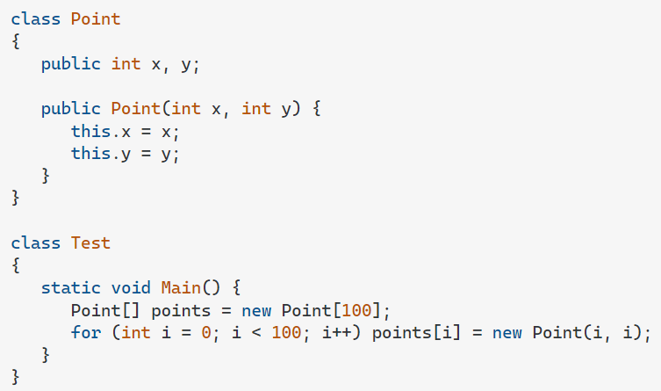
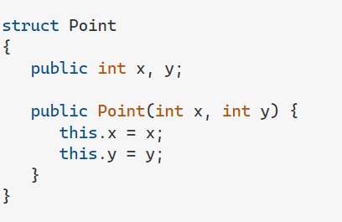
With a structure, only one object is instantiated for the array. All the instances of the Point structure are stored in-line inside of the array, thus requiring less memory allocation.
With a class, the array would instantiate 101 objects. One for the array, and 100 for each of the elements of the array.

Slide 9
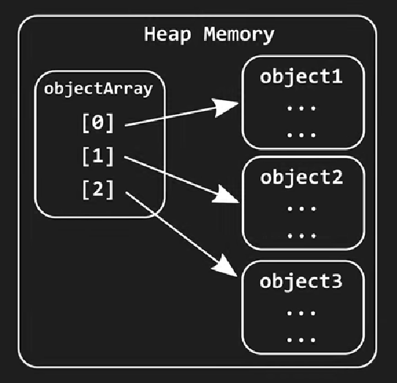
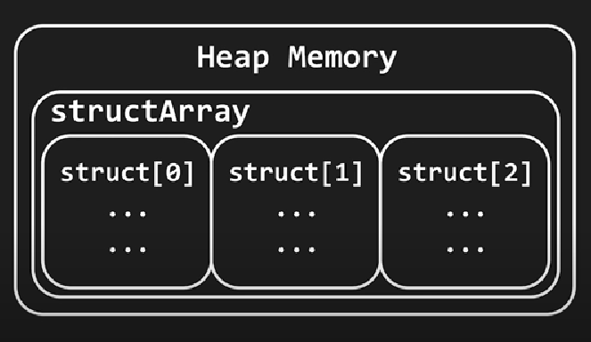
Class:
Reference:

