Slide 1
Create basic customer database
Get travel plans
Send customer sign up form
Format data for use in API’s
Scrape Hotel Website
Very General Overview
Hotels and Travel
Weather
Events
Emailed Report

Slide 2
Detailed Breakdown: Hotel
Needs:
Location
Budget
Start Date
End Date/Length of Stay
Amenities
Desired hotel rating (3-star, 4-star, 5-star)
Scrapes American Express
Returns recommended rooms based on user data

Slide 3



Detailed Breakdown: Weather
Uses free API, https://www.weatherapi.com
Needs:
Location
Start Date
End Date/Length of Stay
Records temps, precipitation, wind, and humidity

Slide 4

Detailed Breakdown: Events
Needs:
Location
Start Date
End Date/Length of Stay
Uses free API
https://location.foursquare.com/developer/reference/places-api-overview
Returns local events/venues found in the surrounding area

Slide 5
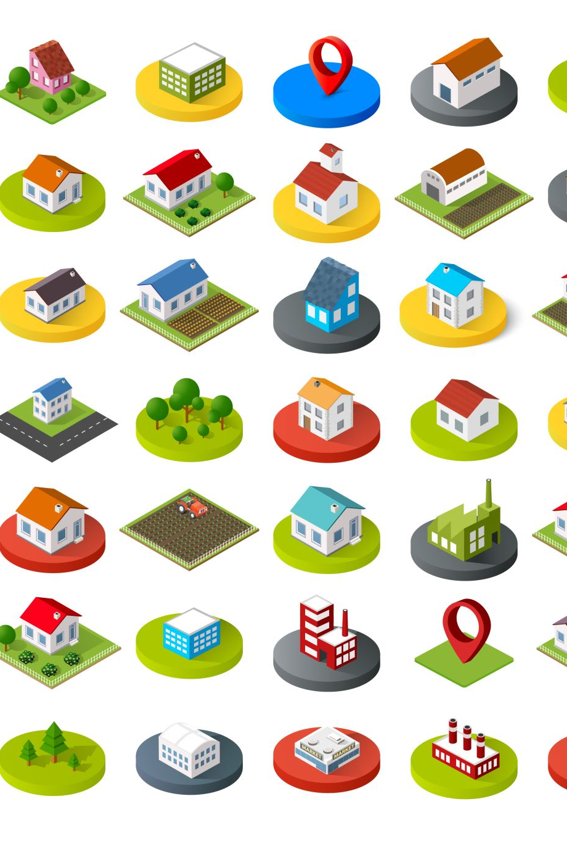
Detailed Breakdown: Restaurants
Needs:
Location
Uses free API
https://location.foursquare.com/developer/reference/places-api-overview
Returns local restaurants found in the surrounding area
Stretch goal

