Slide 1
Online Shopping System
Presented By
Group No : 10
Sandeep Kumar Singh - 230350320093
Sumit Kumar Dubey - 230350320092
Sanket Shivprasad Sarda - 230350320096
Sanket Sudarshan Chaugule - 230350320097
Vishal Madhukar Sangle - 230350320095

Slide 2
Introduction
The primary goal of our Shopping site is to sell goods online. In this application the customer can login, select products, quantity and proceed towards confirm order. After confirming the order Products provider will get a notification of the order. Payment method will be online through payment Gateway. This website will give the Customer a greater exposure to their products at their Ease of Comfort. It provides the user with a catalogue of different product available for purchase in the store.

Slide 3
Technology Used
We used Java Spring-Boot as backend and React JS as Frontend in our Project.
Spring-Boot :–
The main goal of the Spring Boot framework is to reduce overall development time and increase efficiency. React has become the first choice for frontend because it gives developers the ability to work with a virtual browser (more friendly than the real browser). Also, a JavaScript developer can become a productive developer in a few hours because there is a small API to learn, a few functions, and how to use them…
React :–
React allows developers to create large web applications that can change data, without reloading the page. The main purpose of React is to be fast, scalable, and simple. Spring

Slide 4


User Classes
User
Admin
Delivery Man
In this module User will register and buy any product.
In this module Admin can add or delete anything products.
In this module Delivery man deliver the address

Slide 5
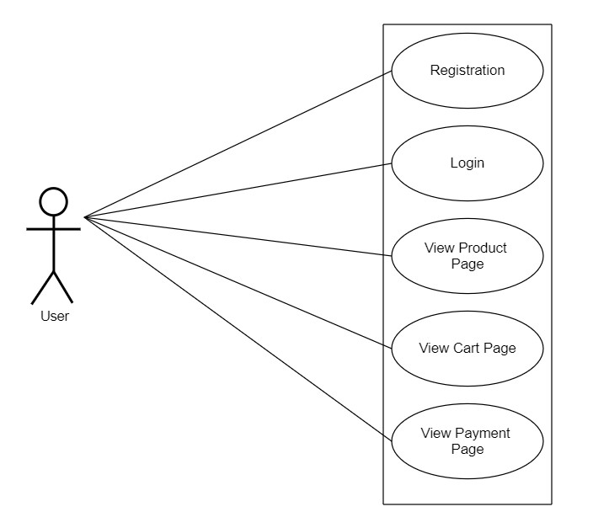
Use Case diagram for Users

Slide 6
Customer Module
After successful registration and authentication
The User can buy product.
User can add products in the cart.
Able to pay for the products they want to buy.

Slide 7
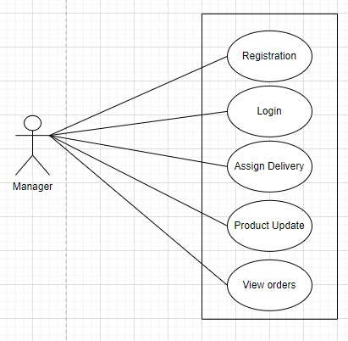
Use Case diagram for Manager

Slide 8
Manager Module
The Manager can
Add new Products.
Assign Delivery.
Delete products.
Edit products
View orders.

Slide 9
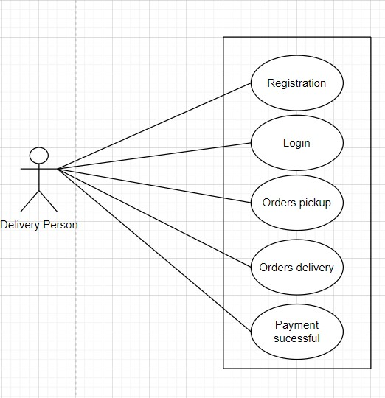
Use Case diagram for Delivery Person

Slide 10
Delivery Module
The Delivery Man can
View all Orders
Pick Up Order
Deliver Order

Slide 11
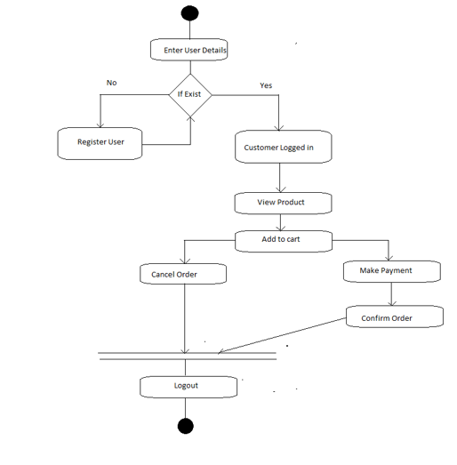
Activity Diagram : User

Slide 12
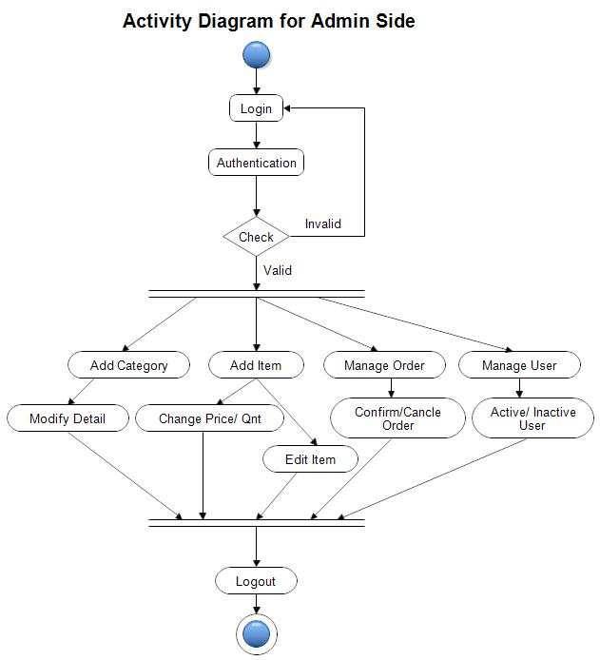
Activity Diagram : Admin

Slide 13
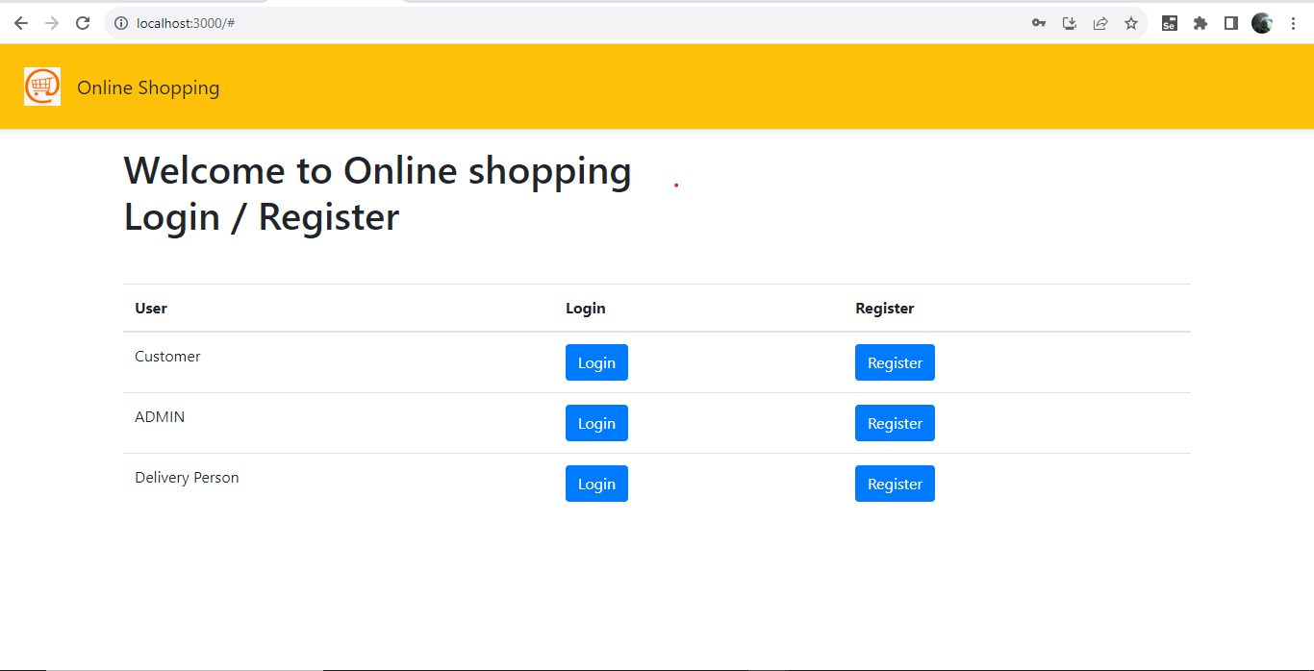

Slide 14
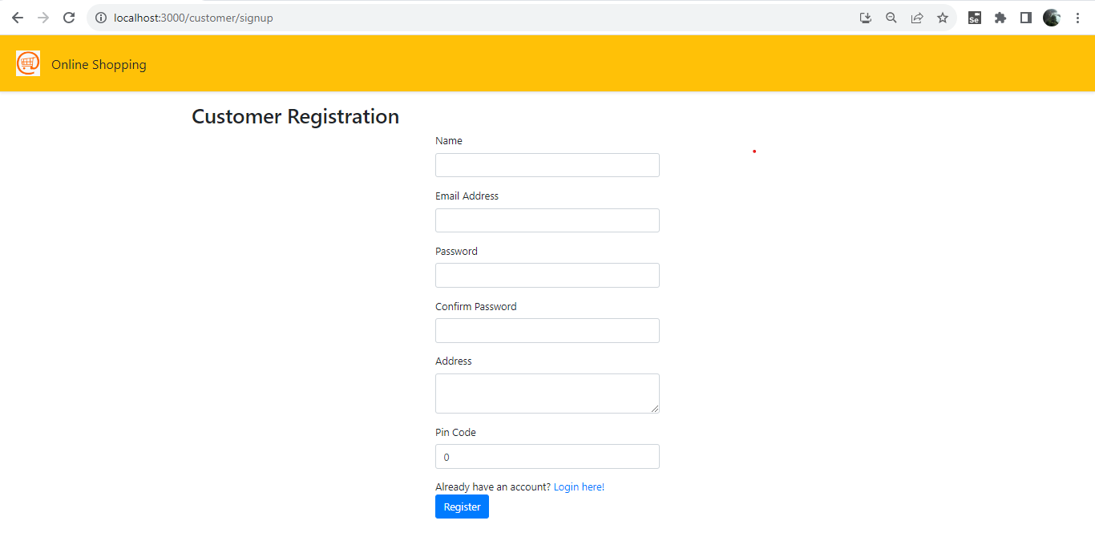

Slide 15
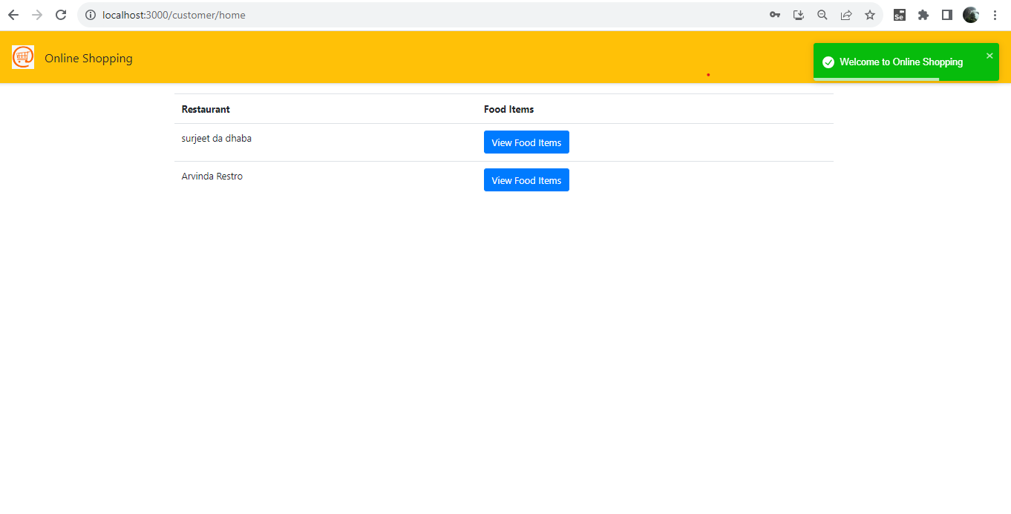

Slide 16
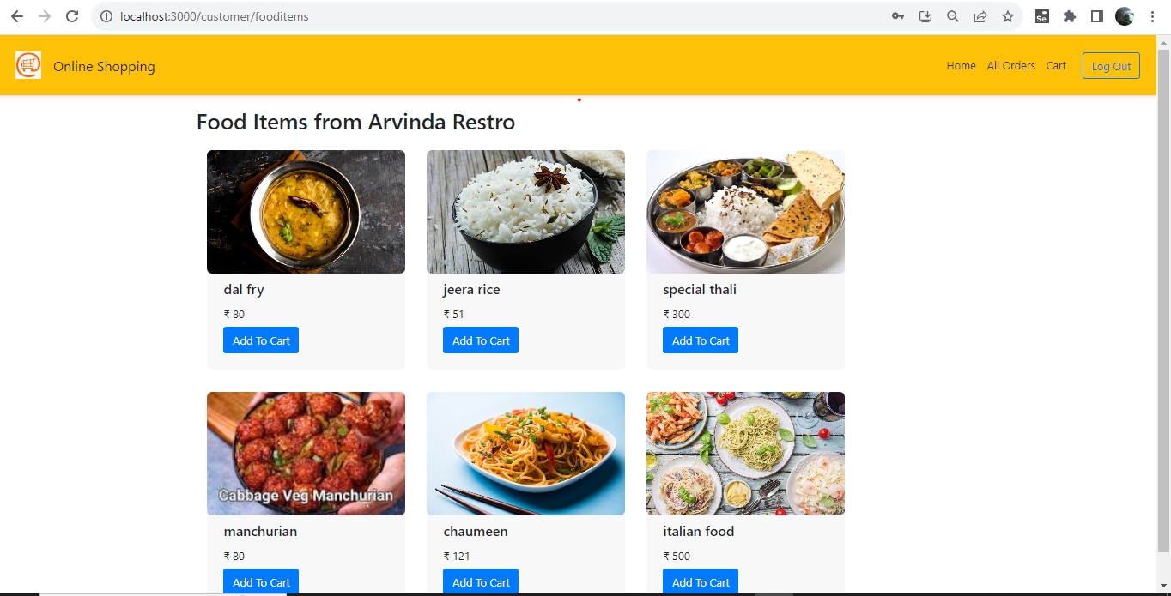

Slide 17
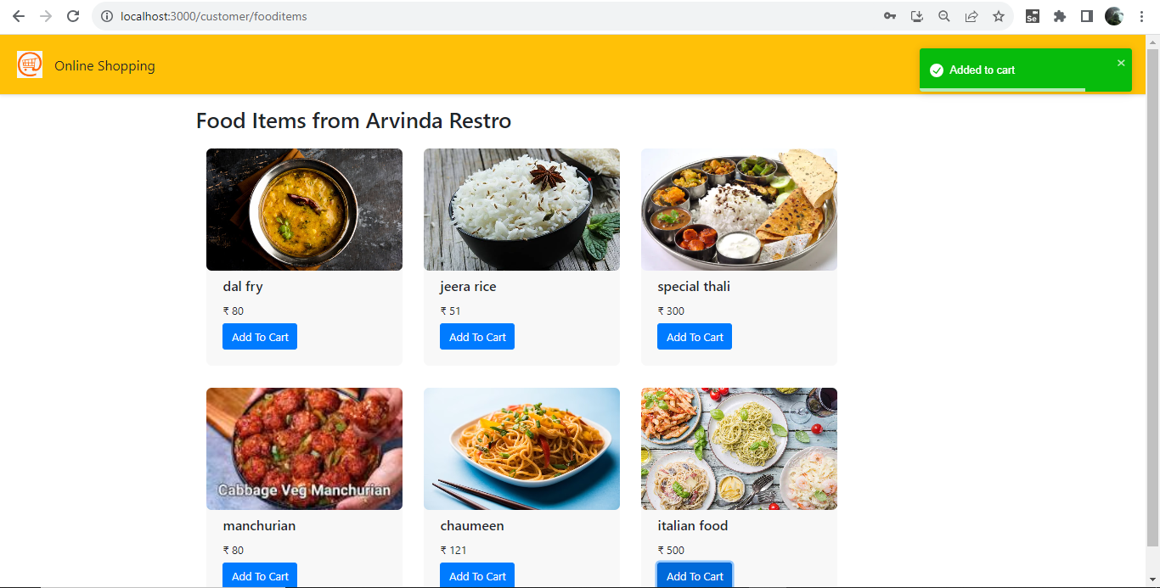

Slide 18
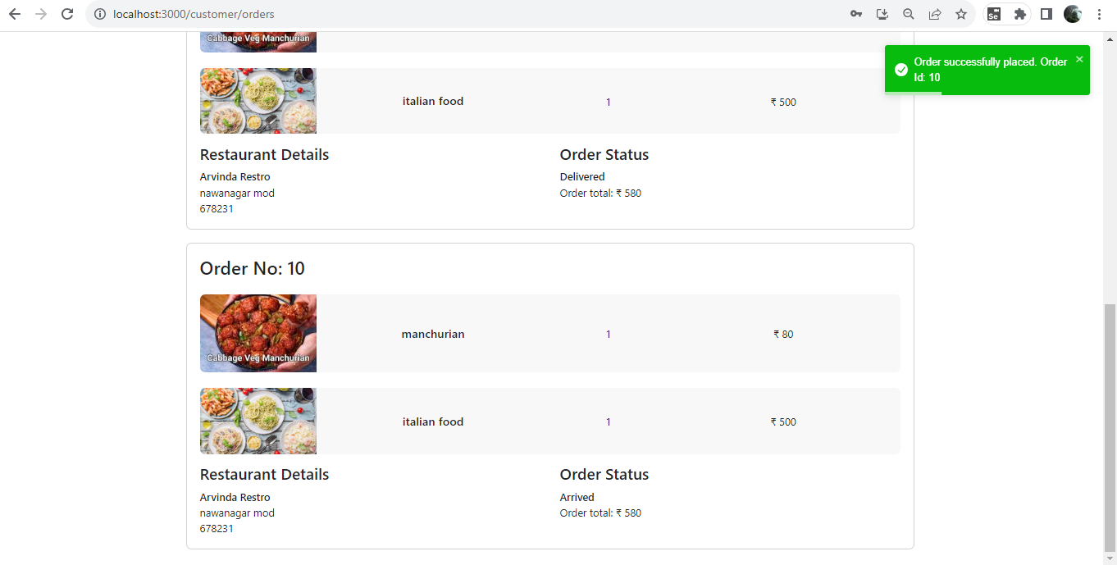

Slide 19
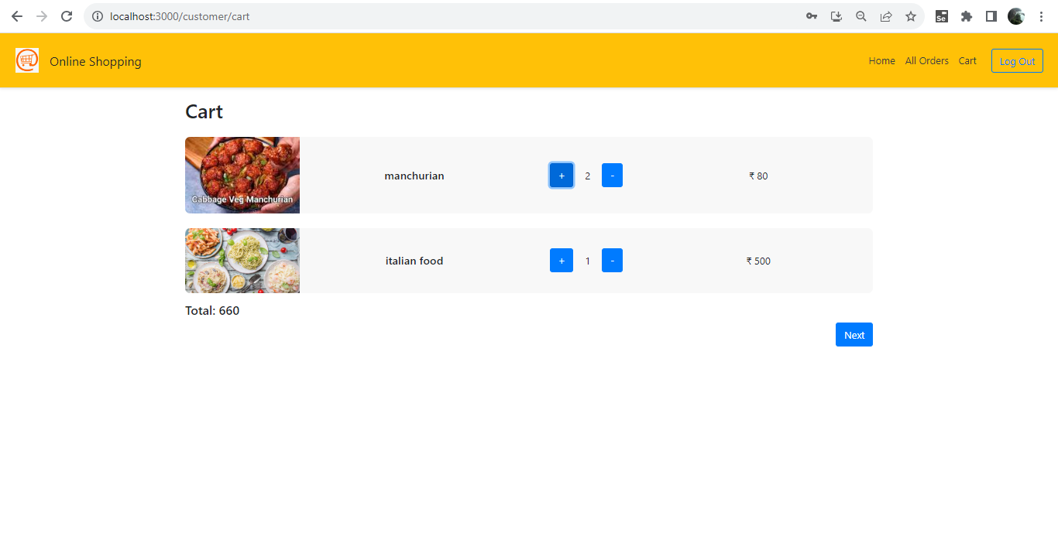

Slide 20
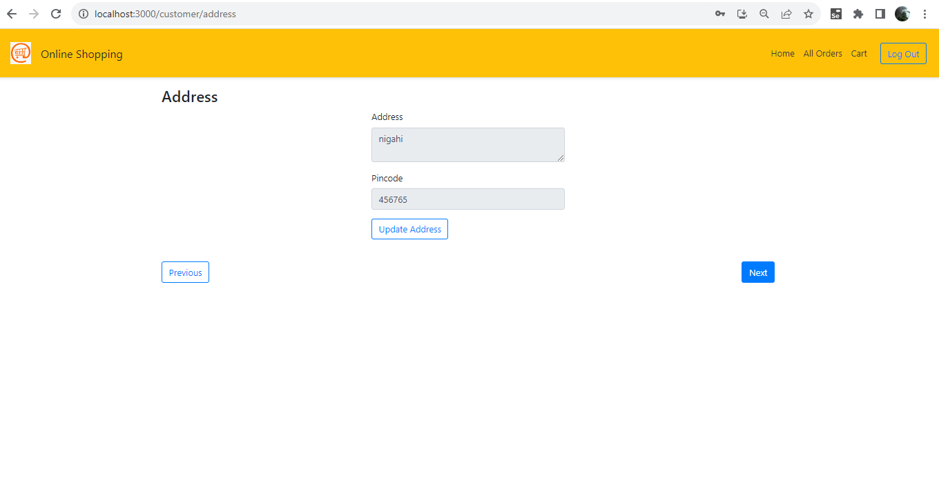

Slide 21
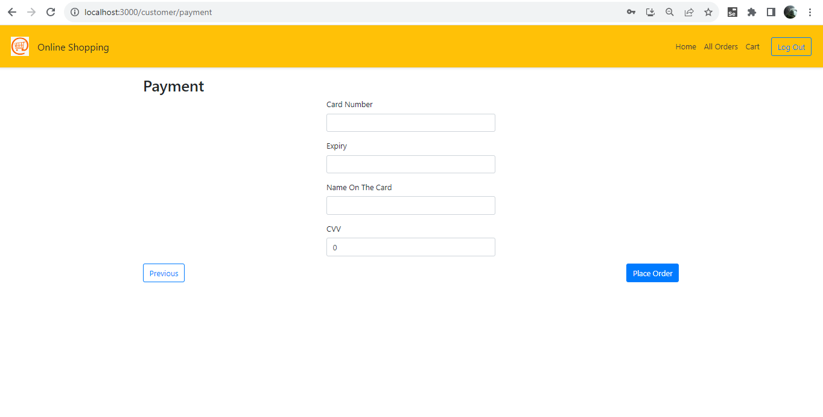

Slide 22
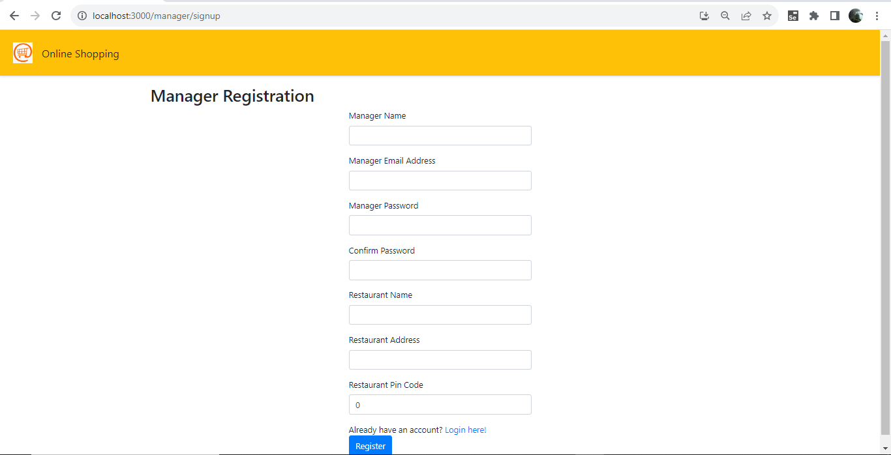

Slide 23
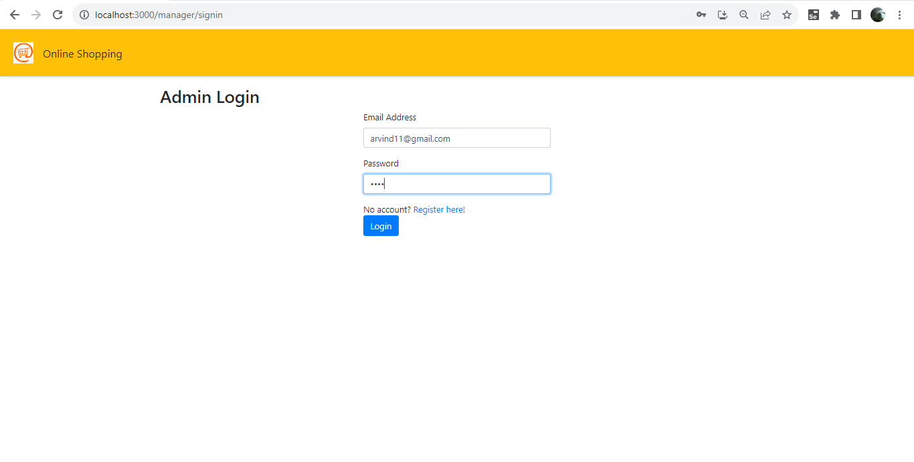

Slide 24
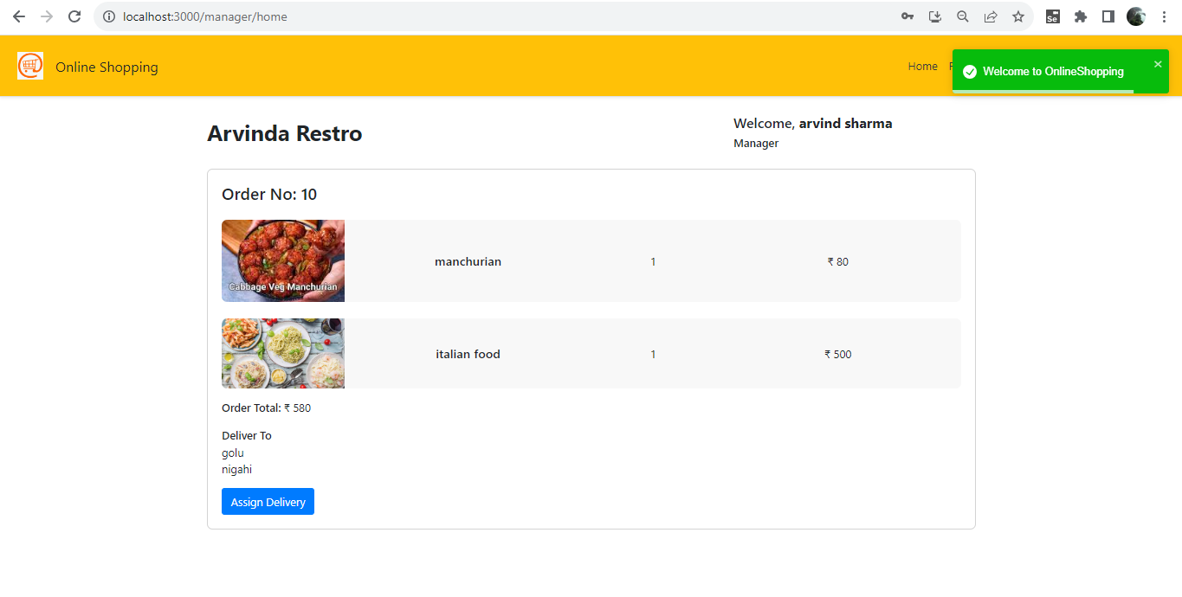

Slide 25
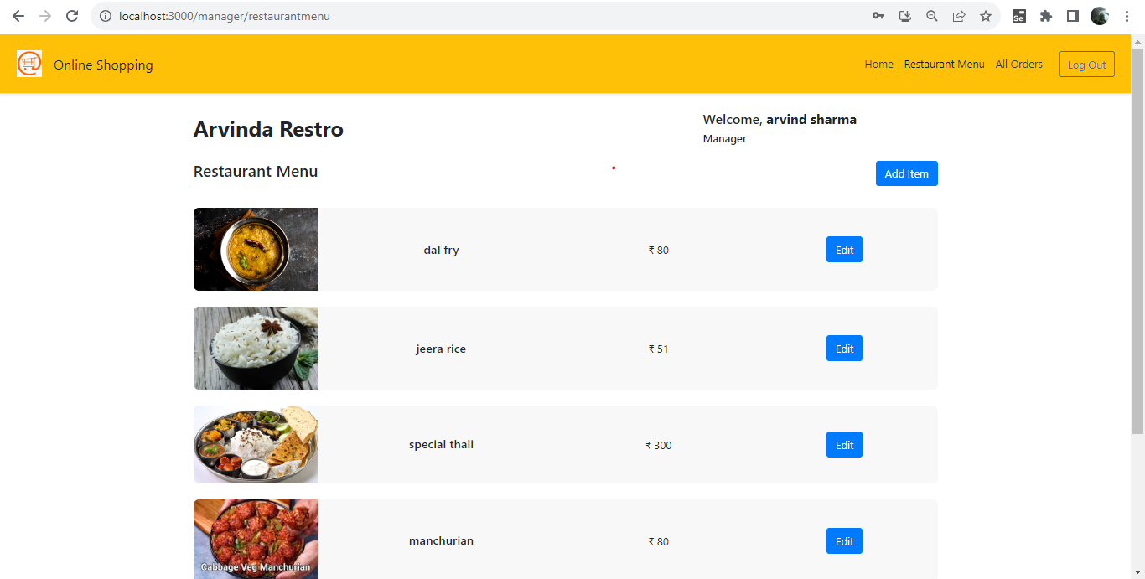

Slide 26
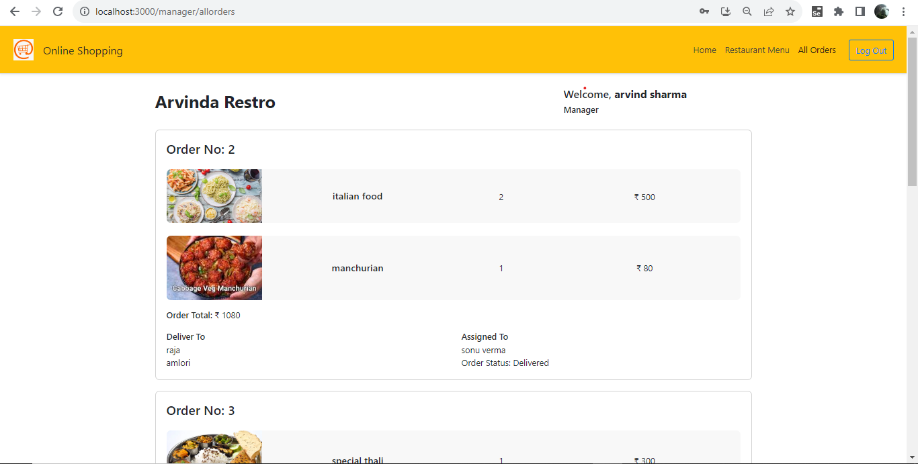

Slide 27
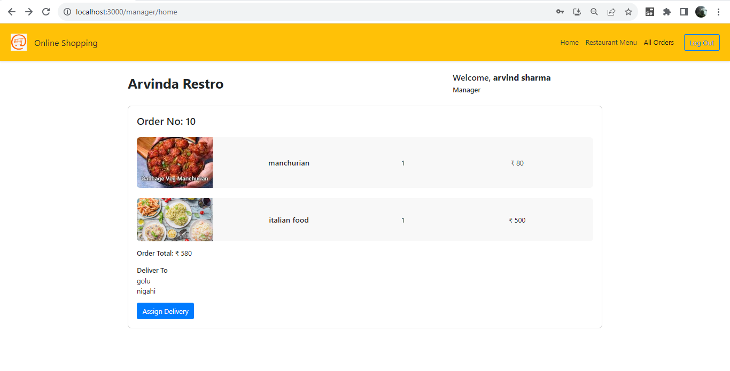

Slide 28
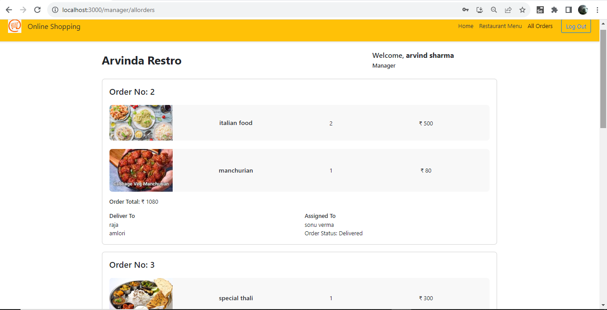

Slide 29
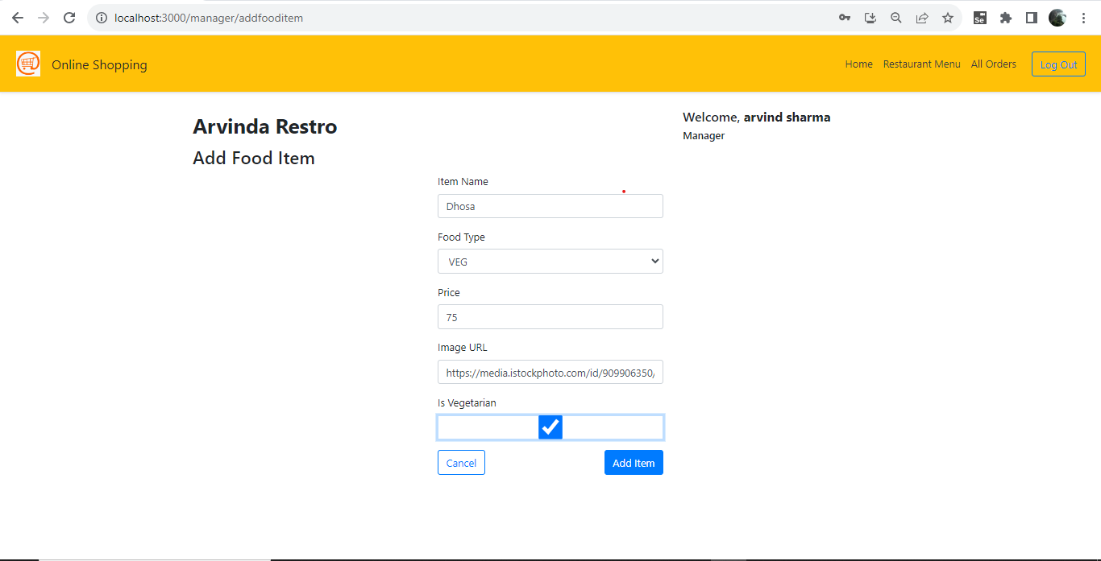

Slide 30
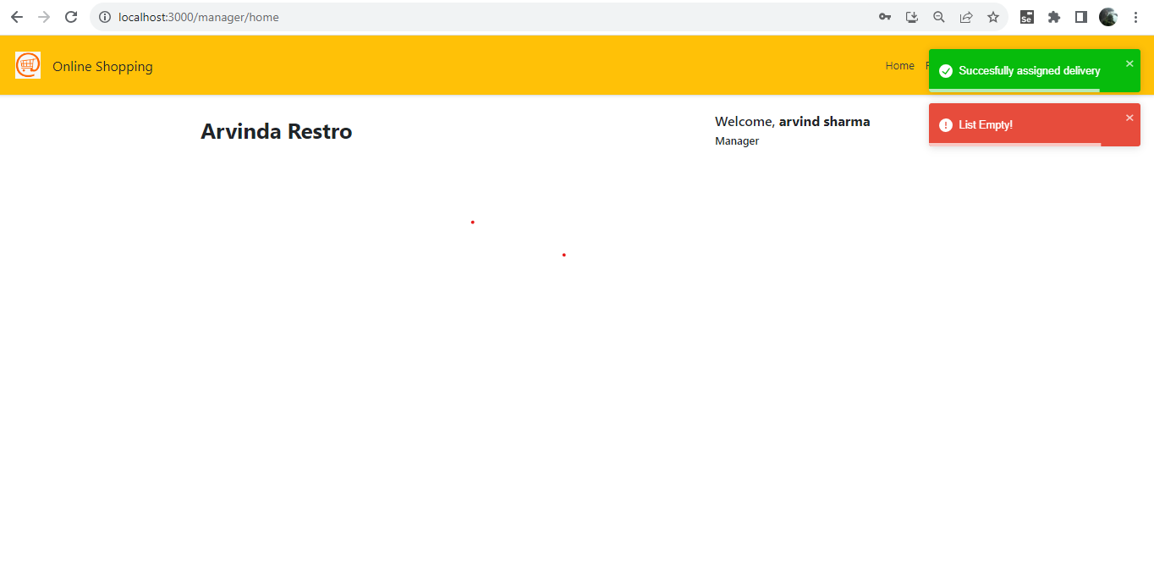

Slide 31
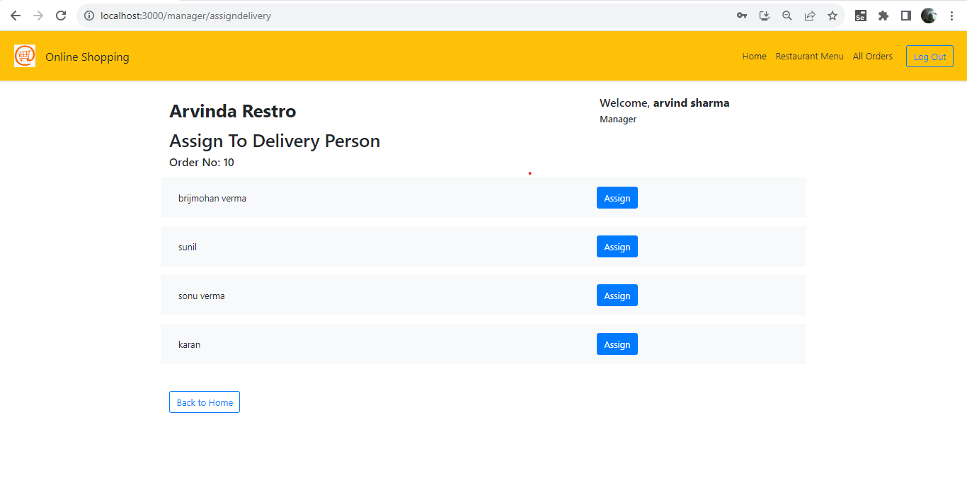

Slide 33
