Slide 1
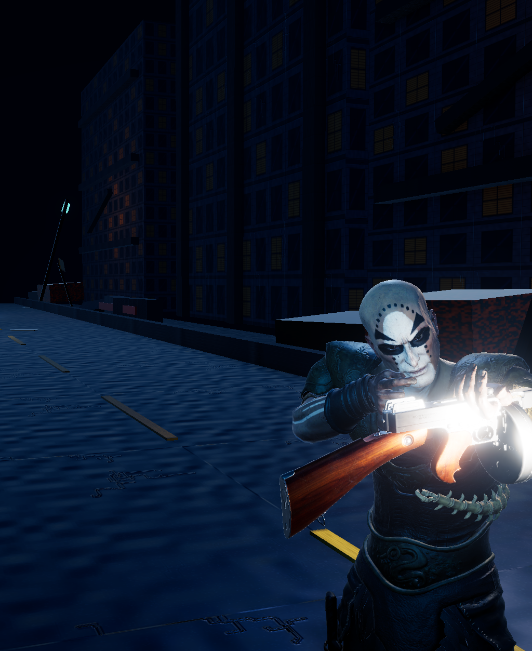

SR UNIVERSITY | DEPARTMENT REVIEW
School of Computer Science & Artificial Intelligence
ZOMBIE RUNNER
A 3D Survival Horror Endless Runner Game
Course: Game Mechanics, Design and Development (23CS201PE407)
Course Coordinator / Instructor: Dr. Vijaya Chandra Jadala
Submitted by Team Members:
1. J. Radha Krishna (Roll No: 2303A52055)
2. P. Makesh Babu (Roll No: 2303A52061)
3. M. Omprakash (Roll No: 2303A52057)
4. V. Siddharatha (Roll No: 2303A52463)

Slide 2
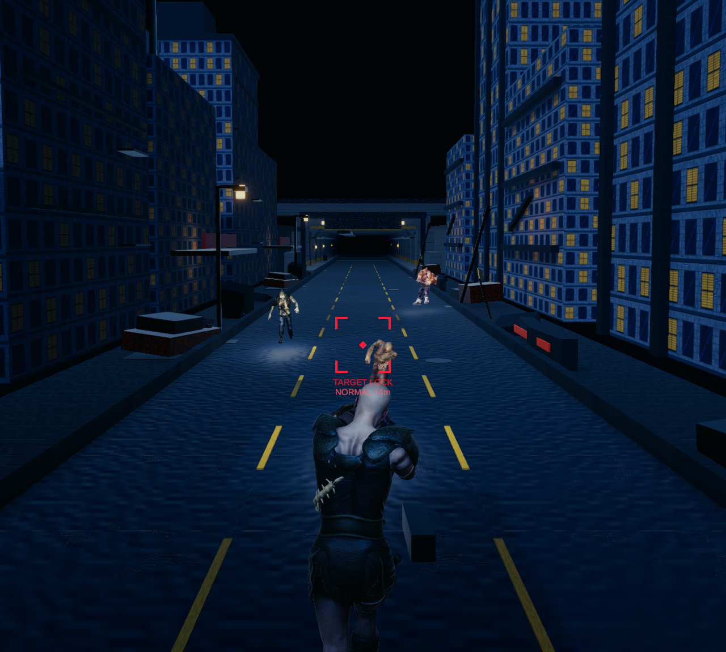
PROJECT OVERVIEW & GENRE SYNTHESIS
Bridging Endless Runner Velocity with Survival Horror Tension
Hybrid Genre Innovation
Zombie Runner evolves the traditional endless runner formula by injecting active firearm combat, ammo management, and visceral survival-horror stakes into high-speed three-lane locomotion.
Atmospheric Post-Apocalyptic Setting
Players sprint through decaying nocturnal city ruins and subterranean subway tunnels under cool moonlight, flickering emergency sodium fixtures, trilight ambient bounce, and volumetric fog.
Core Player Objectives & Loop
Sprint across 3 lanes, execute grounded jumps over roadblocks, slide under low overhead pipes, scavenge gold coins and ammunition, and eliminate pursuing zombies with raycast weapon fire.
Figure: Real-time gameplay showing player runner in motion along the 3-lane road

Slide 3
ACADEMIC MOTIVATION & PROJECT SCOPE
Addressing Key Game Mechanics & Technical Challenges
PROBLEM STATEMENT
Passive Evasion Fatigue: Traditional endless runners (Temple Run, Subway Surfers) offer only obstacle dodging. The lack of offensive combat reduces tactical engagement and player agency.
Atmospheric Disconnect: Sterile, brightly saturated daytime aesthetics fail to evoke tension, fear, or narrative immersion common in horror gaming.
High-Speed Combat Desynchronization: Integrating real-time shooting at high forward speeds often leads to hit registration misses, jerky camera jitter, and frame drops.
Garbage Collection Spikes: Continual runtime instantiation and destruction of road chunks, projectiles, and particle bursts trigger severe GC stutter on target platforms.
PROJECT OBJECTIVES
Modular Unity 6 Architecture: Develop a decoupled C# component architecture using ScriptableObjects, interface-based combat (IDamageable), and centralized managers.
Kinematic Locomotion Engine: Implement responsive 3-lane shifts, grounded jump physics, timed slide with collision box reduction, and progressive speed scaling (8 to 16 m/s).
Zombie AI & Raycast Combat: Engineer 3 distinct zombie archetypes with Mecanim state machines, hit reactions, forward raycast shooting, visual recoil, and bullet tracers.
Procedural Environment Streaming: Build a 5-segment circular object pool recycling 30m modular city ruins and subway tunnels with dynamic trilight and fog transitions.
Adaptive Horror Audio & Economy: Crossfade 4-tier synchronized horror music stems across tension states; persist coins, ammo reserves, and high scores via PlayerPrefs.

Slide 4
TECHNOLOGY STACK & PIPELINE
Engine, Rendering, Physics, and Audio Middleware
GAME ENGINE
Unity 6 (6000.5.9f1)
High-performance C# runtime, unified build pipeline, robust profiler, and modern URP graphics features.
RENDER PIPELINE
Universal Render Pipeline (17.5.0)
Optimized single-pass Forward+ rendering, custom Lit PBR materials, ACES tonemapping, and linear fog.
INPUT SYSTEM
Unity Input System (1.20.0)
Event-driven cross-platform input supporting both keyboard/mouse and mobile touchscreen fallbacks.
CHARACTER RIGGING
Adobe Mixamo & Mecanim
Humanoid avatar retargeting, baked in-place root motion, and multi-layer state machines.
AUDIO PIPELINE
Unity AudioMixer
5-bus routing (Master, Music, SFX, Ambient, UI) with logarithmic dB attenuation and 4 adaptive stems.
SOURCE CONTROL
Git & Git LFS
Version control with Git Large File Storage tracking high-resolution 3D models (FBX), audio (WAV), and PBR textures.

Slide 5
SOFTWARE ARCHITECTURE & MODULARITY
Decoupled Component-Based Architecture and Subsystems
Player Subsystem
Locomotion & Kinematics
- PlayerController: 3-lane horizontal lerp (-3, 0, +3m) at 14 m/s.
- Kinematic Jump: Grounded launch vy = sqrt(2gh) at g = -20 m/s².
- Combat Slide: CharacterController height 2.0m -> 1.05m.
- PlayerHealth: Invulnerability frames, shield absorption, death events.
Combat & Pooling
Raycast & Particle VFX
- ShootingController: Forward hitscan with auto-aim cone (<=12°).
- Weapon Recoil: Visual kickback (0.07m displacement, 3.5° climb).
- BulletTracer: Interpolated glowing raycast tracer lines.
- HitImpactManager: Pre-warmed zero-allocation blood/spark pools.
Enemy AI Subsystem
FSM & ScriptableObjects
- ZombieSpawner: Lane-aware spawner with alive limits (max 6).
- ZombieController: Mecanim FSM (Idle, Walk, Run, Attack, Hit, Death).
- ZombieConfig: Modular ScriptableObject data architecture.
- ZombieSoundEmitter: Logarithmic 3D spatial audio attenuation.
World & UI Systems
Streaming & Persistence
- EndlessRoadManager: Circular 5-segment pool of 30m road sections.
- EnvironmentThemeManager: 45m smooth trilight & fog blending.
- GameManager: Global finite state machine (Play, Pause, GameOver).
- SaveManager & ScoreManager: PlayerPrefs high score & banked coins.
KEY ARCHITECTURAL DECOUPLING: All damageable entities (Common/Fast/Heavy zombies, player health, and explosive barrels) implement the IDamageable interface. The weapon raycast system remains completely agnostic of enemy classes, ensuring clean decoupling and zero class dependencies.

Slide 6
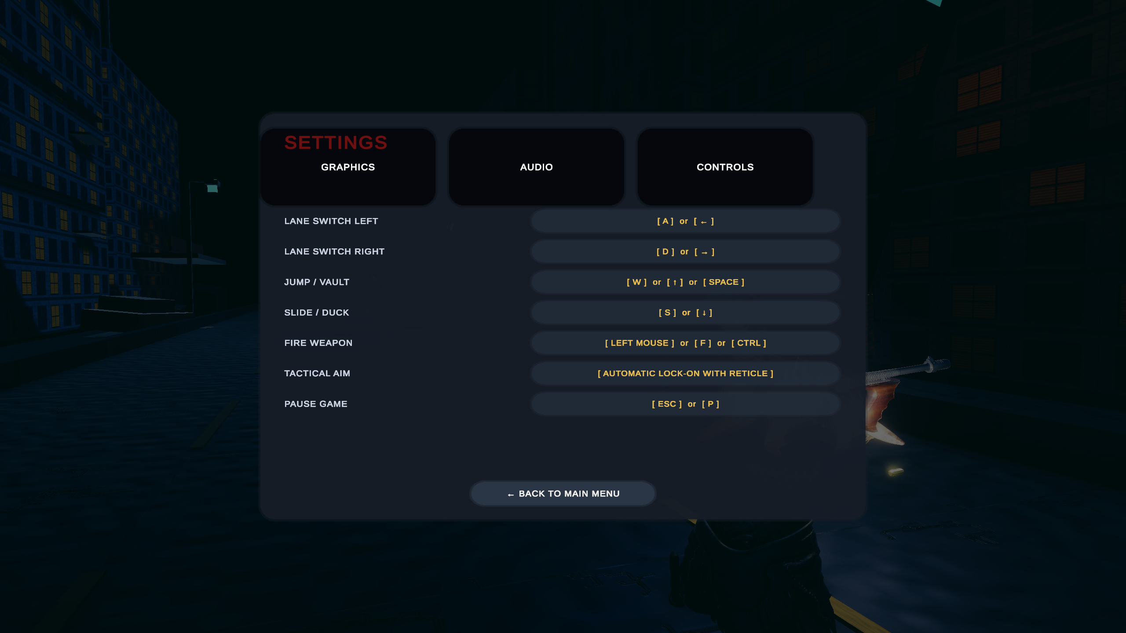
CORE GAMEPLAY MECHANICS
Locomotion, Ballistics, Raycast Combat, and Resource Economy
Three-Lane Locomotion
Discrete lane snapping at X = -3.0m, 0.0m, +3.0m using smooth frame-rate independent interpolation (14 m/s). Progressive speed acceleration from 8.0 m/s to 16.0 m/s.
Jump & Slide Physics
Kinematic vertical launch vy = sqrt(2gh) (h = 1.8m, g = -20 m/s²). Timed slide (0.8s) reduces CharacterController height from 2.0m to 1.05m while preserving humanoid mesh proportions.
Raycast Combat & Recoil
Forward hitscan with dynamic auto-aim cone (<=12°). Firing inflicts IDamageable damage, produces 0.07m visual kickback & 3.5° muzzle climb, and spawns glowing bullet tracers.
Scavenging & Economy
Gold coins bank permanently across runs. Ammunition boxes refill +15 rounds; medical kits restore +25 HP. 4 timed power-ups: Shield, Coin Magnet, Speed Boost, Double Coins.
Figure: In-game input controls reference guide modal (Keyboard & Mouse)

Slide 7
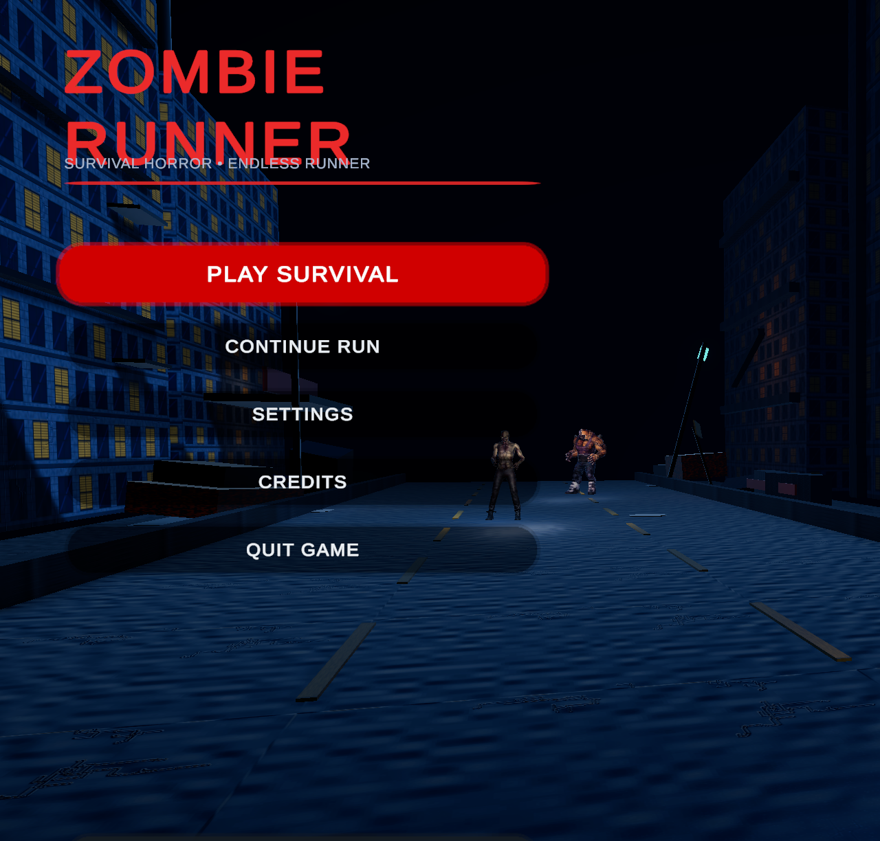

ENVIRONMENT & VISUAL DESIGN
Dual Biome Streaming and Calibrated Volumetric Lighting
ABANDONED CITY RUINS BIOME
- Architecture: Crumbling multi-story brick facades, cracked asphalt, worn lane markings.
- Obstacles & Props: Concrete barricades, roadblock barriers, abandoned cars, explosive barrels.
- Lighting: Directional cool-blue moonlight (#C0D6FA, 1.75 intensity) and flickering sodium streetlights.
Figure: Nocturnal city ruins environment with cool-blue moonlight and fog
SUBTERRANEAN SUBWAY TUNNEL BIOME
- Enclosure: Continuous solid 5.2m concrete side walls and 15.5m ceiling with 45° vaulted arches.
- Structural Ribs: Heavy portal columns spaced every 7.5m, industrial ventilation shafts, steel tracks.
- Luminaires: Balanced 4200K neutral ceiling luminaires & 2200K amber caged emergency bulkheads.
Figure: Authored PBR texture maps for Subway Tunnel concrete, hazard plinths, and steel

Slide 8
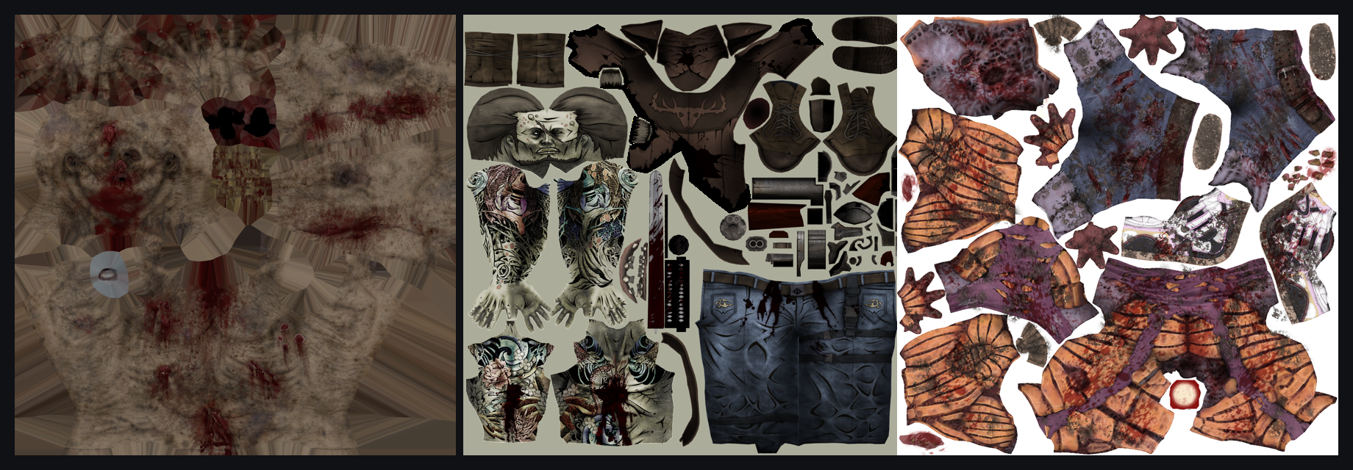
ZOMBIE AI & COMBAT SYSTEM
Modular Archetypes, Mecanim State Machines, and Audio Depth
COMMON RUNNER ZOMBIE | 3 HP (3 shots) | Speed: 5.0 m/s | Score: 100 pts
Rig: Mixamo Ch10 (Humanoid) * Combat: 10 DMG / 1.8m range
Balanced threat spawning across lanes. Claws and lunges at player when in range.
FAST SPRINTER ZOMBIE | 2 HP (2 shots) | Speed: 7.5 m/s | Score: 150 pts
Rig: Mixamo Yaku J Ignite * Combat: 8 DMG / 1.6m range
High velocity agile ambusher. Forces rapid lane evasion and quick auto-aim reflex fire.
Figure: Diffuse texture maps for Common, Fast Runner, and Heavy Brute zombies
COMBAT & AI BEHAVIOR HIGHLIGHTS
Damage Metric: Firearm deals exactly 1 damage point per shot. Common takes 3 hits, Fast takes 2 hits, Heavy takes 8 hits.
State Machine: Transitions between Idle, Walk, Run, Attack, Hit Reaction flinch, and lethal collapse with baked in-place root motion.
3D Spatial Audio: ZombieSoundEmitter provides logarithmic positional audio (2.5m to 24m) for directional threat awareness.
GC-Free Pooling: HitImpactManager pre-warms blood splatters, sparks, and bullet tracers with zero heap allocations per shot.
HEAVY BRUTE ZOMBIE | 8 HP (8 shots) | Speed: 3.2 m/s | Score: 250 pts
Rig: Mixamo Pumpkinhulk * Combat: 25 DMG / 2.2m range
Massive tank requiring sustained gunfire. Deals devastating damage on impact.

Slide 9
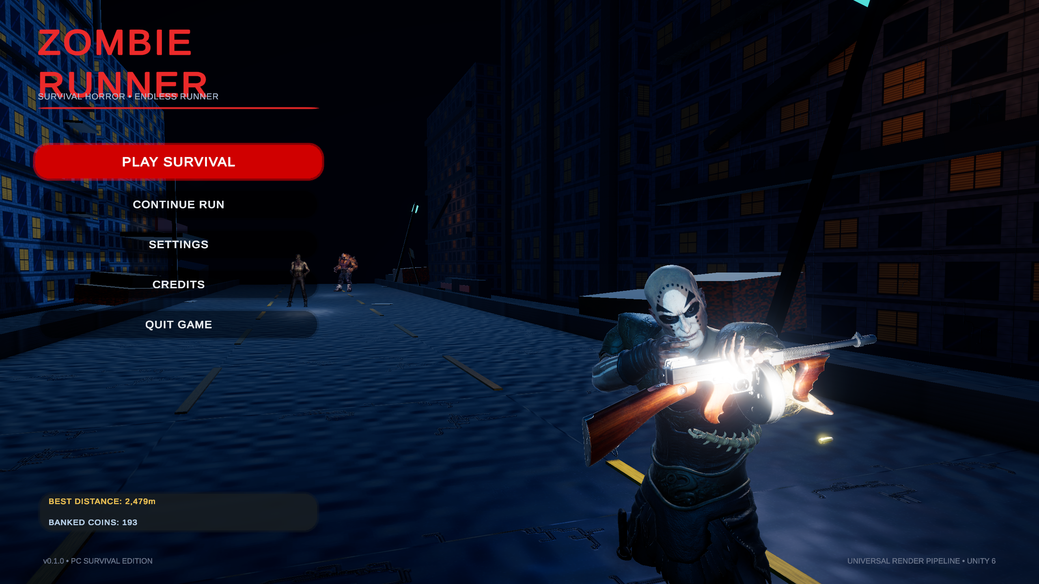
USER INTERFACE & GAME FLOW
Main Menu Staging, HUD Feedback, and State Progression
SEAMLESS GAME STATE TRANSITIONS
Main Menu -> Active Gameplay -> Game Over -> Retry / Revive / Menu
3D Main Menu Staging: Features an animated survivor character (Ch05) holding the Tommy Gun on a nocturnal street, accompanied by cinematic camera panning and multi-tab settings.
In-Game Survival HUD: Real-time TextMeshPro meters for distance (m), score (Distance + Kills), coin inventory, ammunition reserve, segmented health bar, and power-up countdowns.
Game Over & Record Celebration: Summarizes run statistics alongside persistent high scores loaded from PlayerPrefs. Surpassing the record triggers a prominent '(NEW BEST!)' celebratory banner.
One-Time Shielded Revive Loop: Players can trigger a single revive per run, granting full health, +30 ammunition rounds, and a 3-second invulnerability shield before resuming traversal.
Cross-Platform Adaptation: SafeAreaFitter queries Screen.safeArea, ensuring UI buttons and indicators avoid mobile camera notches and cutouts.
Figure: 3D Main Menu scene with survivor character staging, title, and buttons

Slide 10
VERIFICATION, REFACTORING & OPTIMIZATION
Iterative Engineering Workflow and Documented Technical Fixes
DEVELOPMENT & VERIFICATION WORKFLOW
Automated Editor Audits: Custom C# validation tools (ZombieCombatSystemValidator.cs, VisualAuditHelper.cs) automated hierarchy, avatar bone binding, and material audits.
Play Mode Systems Testing: Validated lane-switch clamping (-3m to +3m), airborne jump locking, power-up timer refresh logic, and PlayerPrefs score persistence.
Memory & GC Profiling: Profiler audits verified 0 bytes of heap allocation during active running by pooling road segments, enemies, bullet tracers, and particle VFX.
Windows Standalone Build: Verified smooth 60 FPS gameplay execution with native keyboard and mouse controls on Windows PC.
Verified Android Build: Completed automated Android build pipeline, producing Builds/Android/ZombieRunner.apk (42.9 MB, IL2CPP 64-bit, ARM64, minimum API 26) with zero compilation errors.
SIX DOCUMENTED ENGINEERING FIXES
1. Slide Mesh Decoupling: Decoupled CharacterController height reduction (1.05m) from humanoid visual transforms, eliminating mesh squash and ground sinking.
2. Jump Launch Cancellation: Added explicit isJumping flag to eliminate premature Grounded landing cancellation on launch frames.
3. Spawner Deadlock Bug: Auto-destroyed trailing zombies (> 12m behind runner) without score, preventing alive counter from capping at 6 and halting spawns.
4. Particle Lifecycle Bug: Instantiated GameObjects inactive before duration assignment, resolving over 100 duration mutation console errors.
5. Subway Tunnel Enclosure: Reconstructed solid 30m concrete tunnel with vaulted arches, eliminating repeating rectangular frames and open daylight leakage.
6. Audio Suite Overhaul: Synthesized organic 48s Brownian noise and 4 synchronized 75 BPM adaptive stems in D minor, eliminating irritating sine whistle loops.

Slide 11
ACADEMIC EVALUATION & ROADMAP
Core Competencies Mastered and Proposed Future Enhancements
LEARNING OUTCOMES ACQUIRED
Real-Time 3D Game Mechanics: Mastered kinematic character controllers, grounded jump physics, low-clearance sliding, and lane-based traversal in Unity 6.
Universal Render Pipeline Mastery: Configured custom Lit PBR materials, ACES tonemapping, Trilight ambient lighting, and balanced volumetric fog.
Animation Retargeting & State Machines: Retargeted Mixamo Humanoid rigs, baked in-place root motion, and orchestrated complex Mecanim transition graphs.
Object-Oriented Game Architecture: Implemented ScriptableObject data encapsulation, interface-based messaging (IDamageable), and zero-allocation circular object pooling.
Dynamic Audio Systems: Engineered 4-layer synchronized adaptive horror stems, logarithmic decibel attenuation, and 3D positional sound emitters.
PROPOSED FUTURE ENHANCEMENTS
(Strictly proposed future extensions beyond current verified scope)
1. Advanced Flocking & Ranged Mutant AI: Flocking runner hordes and acid-spitting mutants that force players to dodge incoming parabolic projectiles while running.
2. Expanded Weapon Arsenal: Collectible pump shotguns (wide-spread clearing), assault rifles, and grenade launchers with dedicated ammo economies.
3. Dynamic Subway Boss Encounters: Procedural tunnel breach events featuring a pursuing Nemesis juggernaut that must be damaged over sustained running distance.
4. Global Online Leaderboards: RESTful cloud database integration supporting asynchronous ghost runner replays and cross-platform high-score rankings.
5. Dynamic Atmospheric Weather VFX: Screen-space rain droplets, volumetric lightning strikes dynamically casting shadows, and destructible road barricades.

Slide 12
ACADEMIC PROJECT CONCLUSION
Zombie Runner - 3D Survival Horror Endless Runner
Successfully conceived, architected, and optimized an innovative hybrid survival-horror endless runner fulfilling all rigorous academic criteria for Game Mechanics, Design and Development (23CS201PE407).
Sincere Academic Gratitude:
Special thanks to our Course Coordinator & Instructor, Dr. Vijaya Chandra Jadala Sir, for his continuous guidance, technical encouragement, and pedagogical leadership.
Project Development Team:
1. J. Radha Krishna (Roll No: 2303A52055)
2. P. Makesh Babu (Roll No: 2303A52061)
3. M. Omprakash (Roll No: 2303A52057)
4. V. Siddharatha (Roll No: 2303A52463)
THANK YOU! QUESTIONS & DISCUSSION WELCOME.

