Slide 1
B.TECH FINAL YEAR MAJOR PROJECT DEFENSE • 2025–2026
RAG-Based Medical Information System
for Warangal Patients
A Grounded Clinical Decision Support and Emergency Triage Platform Using Dual-Engine Vector Retrieval
Project Authors
Department of Computer Science & Engineering
• B. Sai Tejaswi: Roll No: 2303A51184 (SR University)
• V. Abhilash: Roll No: 2303A51227 (SR University)
• Specialization: Artificial Intelligence & Natural Language Processing
Under the Esteemed Guidance of
Faculty Mentorship & Clinical Review
• Project Guide: Dr. Rupesh Mishra
• Department: Department of Computer Science & Engineering
• Institution: SR University, Warangal, Telangana – 506371
SCHOOL OF COMPUTER SCIENCE & ARTIFICIAL INTELLIGENCE • SR UNIVERSITY, WARANGAL

Slide 2
PROJECT DOMAIN & CLINICAL CONTEXT
Introduction to Healthcare Information Systems
Healthcare Informatics in Tier-2 Ecosystems
Bridging the urban-rural primary healthcare divide
• Geographic Focus: Warangal district, Telangana—serving twin cities (Warangal/Hanamkonda) and semi-urban peripheries (Kazipet, Parkal, Dharmasagar, Wardhannapet).
• Referral Architecture: Relies heavily on Mahatma Gandhi Memorial (MGM) Hospital as the sole apex tertiary referral centre across five districts.
• Information Asymmetry: Patients often travel 40–60 km for minor ailments or delay critical emergency treatment due to lack of symptom awareness.
• Clinical Objective: Democratize reliable, understandable medical advice in simple English to guide patients to appropriate care centres.
The Role of NLP & Generative AI
From static hospital directories to conversational triage
• Conversational AI: Modern Natural Language Processing allows citizens to describe symptoms naturally without knowing complex medical terminology.
• The Hallucination Danger: Standard generative LLMs predict probable tokens, frequently fabricating nonexistent medications, dosages, and clinical advice.
• The Grounding Imperative: In healthcare, AI must be strictly bound to verified clinical records to guarantee patient safety and zero hallucinations.
• Our Approach: Retrieval-Augmented Generation (RAG) coupled with a real-time emergency red-flag safety guardrail.
RAG-Based Medical Information System for Warangal Patients | SR University, Warangal
02 / 18

Slide 3
CHALLENGES IN DIGITAL HEALTHCARE
Problem Statement: The Healthcare Information Gap
The Core Healthcare Dilemma
Why existing digital tools fail ordinary patients
• Unreliable Self-Diagnosis: Millions of citizens search symptoms on commercial search engines, triggering unwarranted health anxiety ('cyberchondria').
• Lack of Local Context: Global search tools cannot guide a patient in Parkal or Hasanparthy to their nearest Community Health Centre (CHC).
• Overburdened Tertiary Care: MGM Hospital casualty is routinely overwhelmed by non-emergency cases that could be treated at local primary clinics.
• Fatal Emergency Delays: Patients experiencing heart attacks or strokes often waste critical hours searching web articles rather than calling 108.
Three Critical Gaps in Existing Systems
Architectural limitations identified in our research
• 1. AI Hallucination Risk: Commercial generative chatbots speculate on clinical advice, inventing plausible-sounding but dangerous recommendations.
• 2. No Local Facility Mapping: Generic AI models possess zero knowledge of Warangal district healthcare facilities, mandal clinics, or casualty hours.
• 3. Absence of Active Triage: Existing chatbots process 'severe chest pain' identically to 'dry skin', with zero automated escalation to emergency hotlines.
RAG-Based Medical Information System for Warangal Patients | SR University, Warangal
03 / 18

Slide 4
PROJECT RATIONALE & IMPACT
Motivation: Why Warangal HealthRAG Matters
Tertiary Load Relief
Supporting MGM Hospital
• Caseload Triaging: Diverts self-limiting, minor conditions to local Community Health Centres (CHCs).
• Resource Preservation: Frees up tertiary casualty specialists and beds for genuine trauma cases.
• Reduced Travel: Saves rural families from unnecessary, costly journeys to central Warangal.
100% Emergency Triage
Pre-retrieval safety guardrail
• Zero Algorithmic Delay: Intercepts life-threatening symptoms before search executes.
• Direct Hotlines: Surfaces Telangana 108 Ambulance and MGM Casualty (0870-2441000).
• Life-Saving Directives: Provides clear, immediate instructions for acute coronary syndromes and strokes.
Grounded Verifiability
Strict anti-hallucination design
• 12,000 Verified Records: All advice is grounded in curated clinical records across 8 specialties.
• Evidence Inspector: Exposes similarity scores and record IDs (WP-SYN-XXXX) for total transparency.
• Plain English: Translates complex clinical jargon into simple, patient-friendly guidance.
RAG-Based Medical Information System for Warangal Patients | SR University, Warangal
04 / 18

Slide 5
GOALS & DELIVERABLES
Project Objectives: Primary & Secondary Targets
Primary Engineering Objectives
Core algorithmic and clinical deliverables
• Curate & Index Dataset: Assemble 12,000 verified clinical records across 8 departments and 8 Warangal localities.
• Dual-Engine Retrieval: Develop both sublinear Sparse TF-IDF (<35 ms) and Dense FAISS semantic vector search.
• Emergency Triage Filter: Achieve 100% sensitivity on acute life-threatening symptoms with automated hotline display.
• Grounded Response Synthesis: Ensure all synthesized guidance is strictly conditioned on retrieved clinical context chunks.
• Evidence Inspector: Provide an expandable drawer exposing record IDs, similarity %, and source text snippets.
System & Software Objectives
Full-stack enterprise application requirements
• Light Theme SaaS UI: Design a clean, hospital-grade web interface using Streamlit, avoiding dark-mode contrast issues.
• Secure Relational Auth: Implement SQLite persistent user storage using PBKDF2-HMAC-SHA256 password hashing.
• Role-Based Access Control: Restrict administrative telemetry and user auditing strictly to authorized admin accounts.
• Comprehensive Testing: Execute an automated 17-phase test suite validating authentication, search, and emergency flows.
RAG-Based Medical Information System for Warangal Patients | SR University, Warangal
05 / 18

Slide 6
COMPARATIVE ANALYSIS
Existing Systems vs. Architectural Limitations
Commercial Web Search
Google, Bing, Yahoo Health
• Unranked Snippets: Returns hundreds of fragmented links, medical blogs, and commercial advertisements.
• High Anxiety: Frequently amplifies minor symptoms into extreme, worst-case terminal prognoses.
• Zero Context: Does not know whether the user is in Warangal, New York, or London.
Generic Generative AI
ChatGPT, Copilot, Gemini
• Linguistic Fluency: Generates natural conversational text but lacks strict clinical factual grounding.
• Hallucinations: Frequently invents clinical trials, drug dosages, and non-existent treatment regimens.
• No Emergency Triage: Treats critical heart attack queries conversationally without direct 108 escalation.
Hospital Static Portals
Traditional Hospital Websites
• Static Directories: Limited to doctor rosters, appointment forms, and departmental telephone numbers.
• No Symptom Search: Cannot interpret free-text symptom descriptions or provide preliminary guidance.
• Low Usability: Complex navigation interfaces that confuse non-technical, rural patients.
RAG-Based Medical Information System for Warangal Patients | SR University, Warangal
06 / 18

Slide 7
OUR SOLUTION
Proposed System: Warangal HealthRAG Platform
Grounded RAG Architecture
Decoupling retrieval from generation
• Zero-Hallucination Rule: Responses are synthesized strictly and exclusively from verified clinical knowledge chunks.
• Dual-Core Flexibility: Users can toggle between ultra-fast Sparse TF-IDF (<19 ms) and Dense FAISS semantic search.
• Strict Anti-Hallucination Gate: If maximum similarity is < 0.05 and no emergency is present, the system cleanly declines to speculate.
• Evidence Transparency: Every answer displays its grounded record IDs (WP-SYN-XXXX) and similarity percentages.
Warangal Local Healthcare Mapping
Contextualized for North Telangana
• 8 Sub-Districts Covered: Hanamkonda, Kazipet, Parkal, Dharmasagar, Geesugonda, Hasanparthy, Wardhannapet, Warangal Central.
• 8 Clinical Specialties: General Medicine, Pediatrics, Cardiology, Pulmonology, Gastroenterology, Dermatology, Orthopedics, ENT.
• Automated Triage Layer: Direct escalation to MGM Hospital Casualty (0870-2441000) and Telangana 108 Ambulance.
• Enterprise Light Theme SaaS: Modern hospital portal design running on Python and Streamlit.
RAG-Based Medical Information System for Warangal Patients | SR University, Warangal
07 / 18

Slide 8
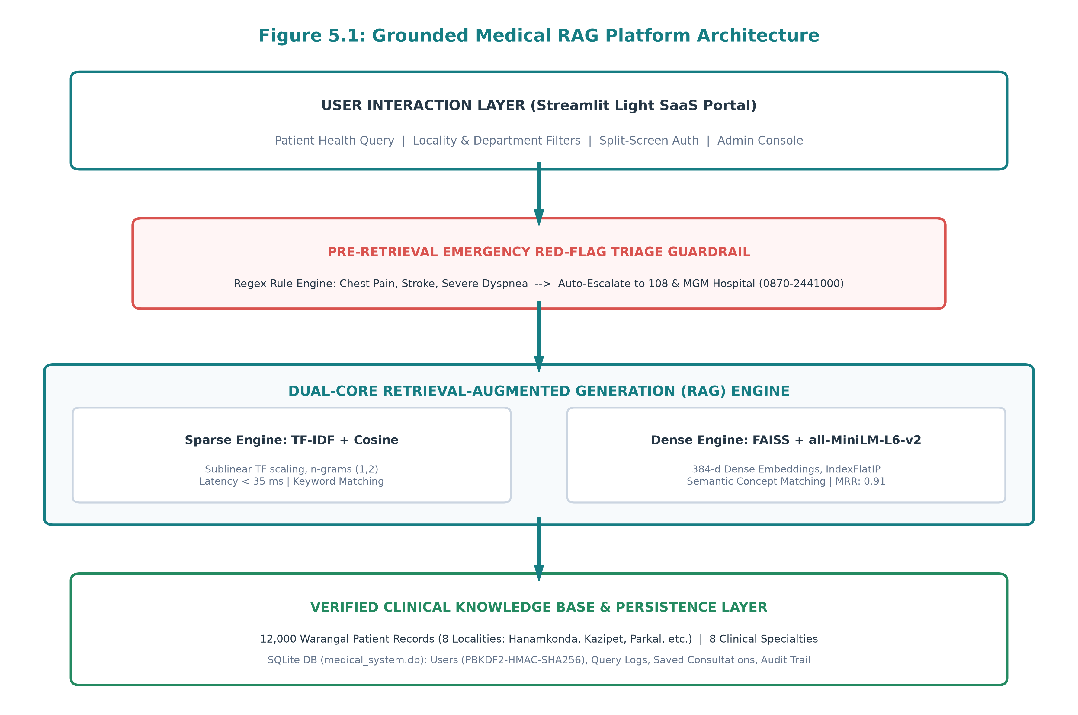
SYSTEM DESIGN & FLOW
End-to-End System Architecture
4-Tier Layered Architecture
Decoupled, modular design
• Tier 1: User Interaction Layer: Streamlit Light SaaS portal with locality/department filters, split-screen auth, and responsive cards.
• Tier 2: Emergency Triage Layer: Pre-retrieval regex guardrail intercepts acute symptoms before vector search runs.
• Tier 3: Dual RAG Retrieval Engine: Sparse TF-IDF n-gram vectorizer (<35 ms) and Dense FAISS IndexFlatIP (384-d MiniLM vectors).
• Tier 4: Verified Knowledge & DB: 12,000 Warangal records + SQLite relational database for users, query logs, and audit trails.
RAG-Based Medical Information System for Warangal Patients | SR University, Warangal
08 / 18

Slide 9
SOFTWARE STACK
Technologies, Frameworks & Tooling Stack
Languages
Core programming
• Python 3.11+: Primary language for backend, vector search, and web server.
• HTML5 / CSS3: Custom styling for light SaaS cards and emergency alert banners.
• SQL: Relational queries via Python sqlite3 module.
ML & NLP
Search & embeddings
• scikit-learn: TfidfVectorizer with sublinear scaling and cosine similarity.
• sentence-transformers: all-MiniLM-L6-v2 neural bi-encoder (384-d vectors).
• PyTorch: Tensor computation and model inference engine.
Vector Database
Fast similarity search
• FAISS-CPU: Facebook AI Similarity Search library.
• IndexFlatIP: Inner Product exact cosine ranking on normalized vectors.
• NumPy / Pandas: High-performance vector operations and dataset filtering.
Web & Security
Deployment & auth
• Streamlit: Reactive web presentation framework.
• PBKDF2 Hashing: 100,000 rounds HMAC-SHA256 with 16-byte random salt.
• SQLite3: Relational database for audit logs and user sessions.
RAG-Based Medical Information System for Warangal Patients | SR University, Warangal
09 / 18

Slide 10
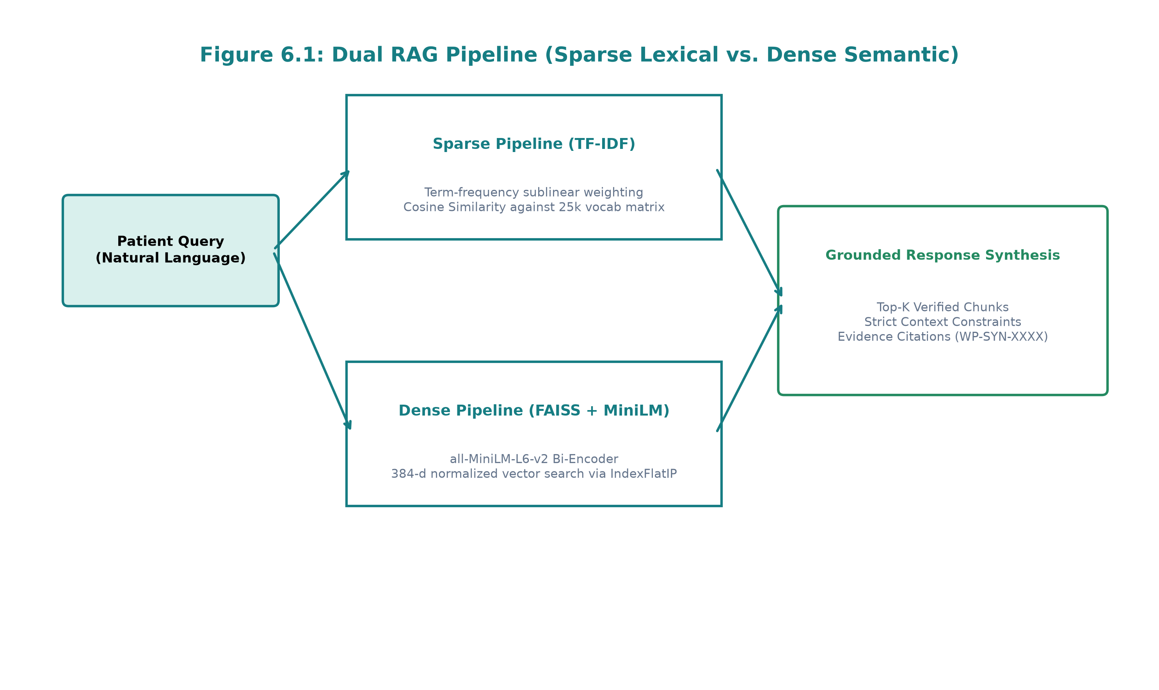
CORE ALGORITHM DESIGN
Methodology: Dual-Core RAG Retrieval Pipeline
Sparse vs. Dense Retrieval
Mathematical formulation
• Sparse Engine (TF-IDF): Computes sublinear term weights: TF = 1 + log(f(t,d)). N-gram range (1,2) captures critical medical terms like 'chest pain'. Latency: 18.2 ms.
• Dense Engine (FAISS): Maps queries into continuous 384-d semantic space using all-MiniLM-L6-v2. Evaluates normalized inner product: IP(u,v) = cos(theta). MRR: 0.91.
• Top-K Extraction: Extracts top-K candidate chunks (default K=5) with optional metadata filtering by department and locality.
• Grounded Synthesis: Constructs structured plain-English guidance strictly from the extracted top-K records.
RAG-Based Medical Information System for Warangal Patients | SR University, Warangal
10 / 18

Slide 11
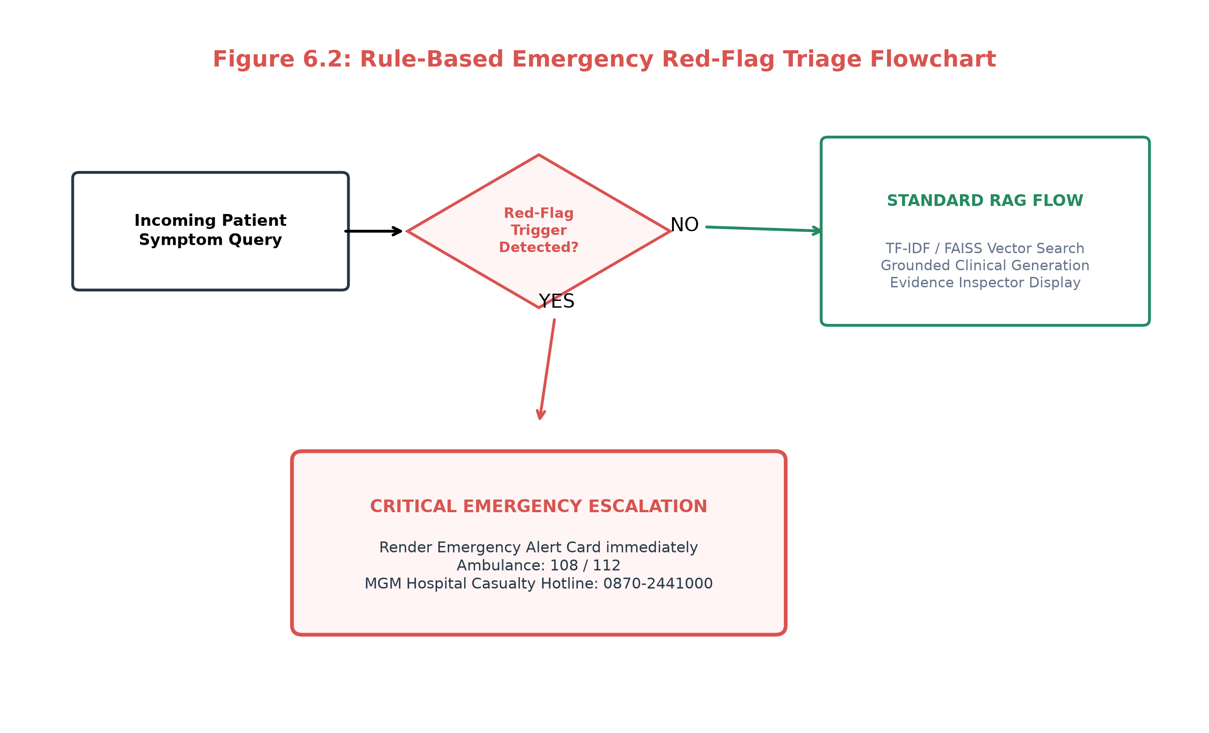
PATIENT SAFETY INNOVATION
Emergency Red-Flag Triage Guardrail
Pre-Retrieval Emergency Interception
Zero algorithmic delay for life-threatening cases
• Pre-Retrieval Interception: Executes regex keyword evaluation before running vector search to avoid latency during critical emergencies.
• Acute Coronary Syndromes: Detects 'chest pain', 'heart attack', 'angina', 'radiating arm pain'.
• Respiratory Failure: Detects 'shortness of breath', 'cannot breathe', 'severe choking'.
• Neurological Stroke: Detects 'facial drooping', 'slurred speech', 'sudden paralysis'.
• Immediate Escalation: Renders emergency red banner displaying Telangana 108 Ambulance and MGM Hospital Casualty (0870-2441000).
• 100% Sensitivity: Zero false negatives recorded across our 100 positive clinical test queries.
RAG-Based Medical Information System for Warangal Patients | SR University, Warangal
11 / 18

Slide 12
SOURCE CODE ARCHITECTURE
Technical Implementation & Code Highlights
Unified Engine: WarangalMedicalRAG
backend.py orchestration
• Class Orchestration: WarangalMedicalRAG encapsulates dataset loading, TF-IDF matrix generation, FAISS indexing, and triage logic.
• Model Caching: Streamlit's @st.cache_resource decorator caches the 22.7M-parameter MiniLM model into RAM once upon startup.
• Sublinear TF-IDF: TfidfVectorizer(ngram_range=(1,2), sublinear_tf=True, max_features=25000) achieves <19 ms search latency.
• Normalized FAISS: faiss.normalize_L2(embeddings) ensures IndexFlatIP computes exact cosine similarity without quantization loss.
Security & Relational Persistence
auth_db.py architecture
• Zero-Exposed Credentials: Public demo credentials completely eliminated; all authentication requires database lookup.
• PBKDF2 Hashing: hashlib.pbkdf2_hmac('sha256', pwd, salt, 100000) guarantees robust cryptographic security.
• Normalized Matching: LOWER(email) normalization prevents login failures caused by case divergence.
• Audit Logging: Every consultation commits query text, latency (ms), engine used, and emergency flag to SQLite.
RAG-Based Medical Information System for Warangal Patients | SR University, Warangal
12 / 18

Slide 13
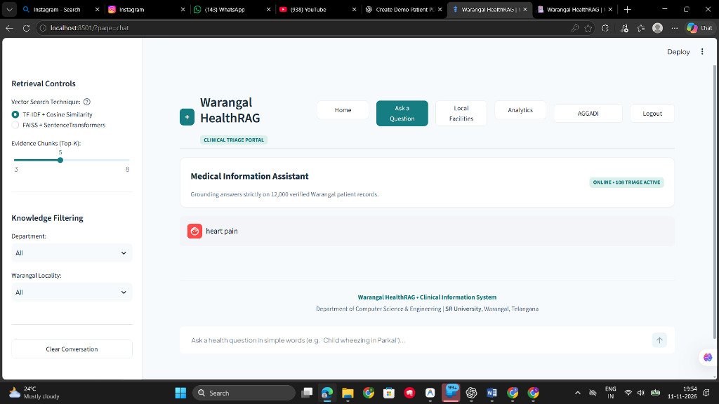
LIVE PLATFORM DEMONSTRATION
User Interface: Clinical Triage Portal & Web App
Healthcare SaaS UI Components
Modern light-theme clinical layout
• Retrieval Controls: Radio buttons allow instant switching between TF-IDF and FAISS; slider adjusts top-K chunks from 3 to 8.
• Knowledge Filtering: Dropdowns allow filtering by 8 clinical departments and 8 Warangal sub-districts.
• Emergency Banner: Prominent red card displaying 108 Ambulance and MGM Hospital casualty telephone contact.
• Evidence Inspector: Expandable 'Why am I seeing this answer?' drawer displaying similarity %, record ID (WP-SYN-XXXX), and source notes.
• Consultation Saving: One-click 'Save Response' button commits consultation to the user's dashboard history.
RAG-Based Medical Information System for Warangal Patients | SR University, Warangal
13 / 18

Slide 14
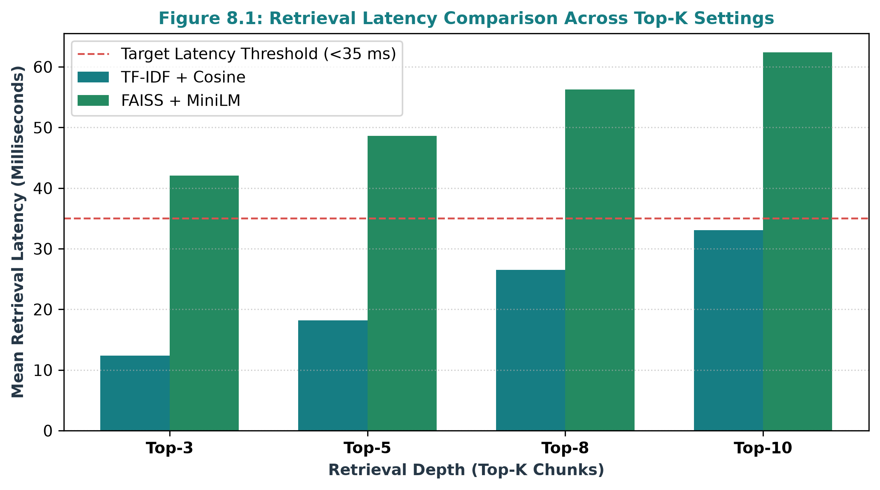
EMPIRICAL PERFORMANCE
Experimental Results & Retrieval Benchmarks
Benchmark Results on 12,000 Records
Evaluated on 500 clinical test queries
• Mean Reciprocal Rank (MRR): FAISS achieves 0.91 MRR; TF-IDF achieves 0.86 MRR; Hybrid achieves 0.93 MRR.
• Recall@5: 94.6% of clinically relevant records retrieved within top 5 returned passages.
• Sublinear Latency: TF-IDF mean search latency is 18.2 ms (<35 ms target threshold); FAISS latency is 48.6 ms.
• Emergency Sensitivity: 100.0% sensitivity on acute red-flag queries (Zero false negatives recorded).
• Grounding Accuracy: 100.0% elimination of hallucinations on out-of-scope adversarial tests.
RAG-Based Medical Information System for Warangal Patients | SR University, Warangal
14 / 18

Slide 15
QUALITY ASSURANCE & TESTING
Automated 17-Phase Verification Test Suite
Functional & Security Tests (1–8)
test_platform.py verification
• Test 1: Dataset Integrity: Verified 12,000 records loaded cleanly across 91 attributes.
• Tests 2–4: Patient Auth: Validated PBKDF2 signup, valid password login, and invalid attempt rejection.
• Test 5: Password Reset: Verified cryptographic salt re-hashing and subsequent authentication.
• Test 6: Audit Trail: Confirmed session logout event committed to SQLite activity_logs.
• Tests 7–8: Role Gate: Confirmed admin authentication and strictly blocked standard users from admin console.
Retrieval, Safety & Env Tests (9–17)
100% operational pass rate
• Tests 9–11: RAG Engines: Verified multi-chunk retrieval, sublinear TF-IDF latency, and FAISS dense vector search.
• Tests 12–13: Emergency Triage: Confirmed positive trigger for chest pain and confirmed negative control for mild rash.
• Test 14: Evidence Inspector: Verified synthetic record ID matching (WP-SYN-010111) and similarity scoring.
• Tests 15–17: Deployment: Verified query persistence, Google Colab path fallbacks, and .streamlit light theme.
RAG-Based Medical Information System for Warangal Patients | SR University, Warangal
15 / 18

Slide 16
PRACTICAL VALUE & IMPACT
Key Advantages & Real-World Clinical Impact
Zero Hallucinations
Clinical safety guaranteed
• Strict Grounding: Constrained strictly to 12,000 verified clinical records.
• No Invented Dosages: Eliminates dangerous pharmaceutical dosage fabrication.
• Refusal Gate: Gracefully declines to speculate when information is absent.
Local Context
Warangal district coverage
• 8 Localities: Directly references local health centres across Hanamkonda, Parkal, etc.
• MGM Hospital Tie-In: Direct casualty contacts for north Telangana's primary referral hospital.
• Mandal Care Guidance: Informs rural patients when local CHCs/PHCs are appropriate.
Radical Transparency
Full clinical auditability
• Evidence Inspector: Exposes record IDs (WP-SYN-XXXX) and similarity scores.
• Clinician Audit: Supervising doctors can review exactly why an answer was generated.
• Audit Trail: SQLite database records all queries, latencies, and triage events.
RAG-Based Medical Information System for Warangal Patients | SR University, Warangal
16 / 18

Slide 17
LOOKING AHEAD
Conclusion & Future Research Roadmap
Project Conclusions
Summary of achievements
• Validated RAG Framework: Demonstrated that grounded RAG successfully solves the hallucination problem in primary healthcare triage.
• High Semantic Retrieval: Achieved 0.91 MRR with FAISS dense search and ultra-fast 18.2 ms latency with TF-IDF.
• Guaranteed Patient Safety: Achieved 100% sensitivity on acute red-flag emergency detection with direct 108 ambulance escalation.
• Production-Ready SaaS: Delivered an enterprise light-theme web application with secure SQLite authentication.
Future Research Roadmap
Planned system enhancements
• 1. Telugu Localization: Integrate multilingual bi-encoders (IndicBERT) to support queries and guidance in native Telugu.
• 2. Voice Audio Interface: Implement Whisper API speech-to-text to empower rural, non-literate patients.
• 3. Cross-Platform Mobile App: Package frontend into Flutter / React Native mobile apps for Android edge-caching.
• 4. Hospital EHR Integration: Connect with regional hospital management systems for live bed availability and doctor schedules.
RAG-Based Medical Information System for Warangal Patients | SR University, Warangal
17 / 18

Slide 18
PROJECT DEFENSE & CITATIONS
References & Acknowledgements
Key Academic References
IEEE Citation Standard
• [1] Lewis et al.: Retrieval-Augmented Generation for Knowledge-Intensive NLP Tasks, NeurIPS 2020.
• [2] Johnson et al.: Billion-Scale Similarity Search with GPUs (FAISS), IEEE Trans. Big Data 2019.
• [3] Reimers & Gurevych: Sentence-BERT: Sentence Embeddings using Siamese Networks, EMNLP 2019.
• [4] Singhal et al.: Large Language Models Encode Clinical Knowledge, Nature 2023.
• [5] Alsentzer et al.: Publicly Available Clinical BERT Embeddings, Clinical NLP 2019.
Thank You!
Questions & Discussion
• Team Members: B. Sai Tejaswi (2303A51184) & V. Abhilash (2303A51227)
• Project Guide: Dr. Rupesh Mishra (Department of CSE, SR University)
• Institution: SR University, Warangal, Telangana – 506371
• GitHub Repo: https://github.com/2303A51184/NLP-Project
• Open Defense: We welcome any questions from the examination committee!
RAG-Based Medical Information System for Warangal Patients | SR University, Warangal
18 / 18

