Slide 1
SR UNIVERSITY / ENGINEERING COLLEGE, WARANGAL
DEPARTMENT OF COMPUTER SCIENCE & ENGINEERING | B.TECH CAPSTONE MINI-PROJECT
MediSense NLP: Hospital Service Quality & Regional Diagnostic Report Simplification
A Dual-Engine Healthcare Natural Language Processing Framework & Full-Stack Web Platform
PROJECT TEAM MEMBERS:
1. KATAKAM PRIYA (Roll No: 2303A51194)
2. CH. HARSHINI (Roll No: 2303A51185)
PROJECT SUPERVISOR / GUIDE:
Mr. Rupesh Mishra
Assistant Professor, Dept. of Computer Science & Engineering
Academic Year: 2026 - 2027 | Warangal, Telangana

Slide 2
■ PROJECT DOMAIN & BACKGROUND
Transforming Regional Healthcare via Natural Language Processing
Empowering Patients and Administrators in Semi-Urban and Tier-2 Healthcare Ecosystems
Healthcare NLP Domain
AI discipline structuring human language into computational semantics.Natural Language Processing:
Over 80% of clinical data is locked in unstructured lab notes, doctor memos, and reviews.Unstructured Healthcare Data:
Moving beyond clinician-only tools to empower laypatients with accessible healthcare understanding.Patient-Centric Paradigm:
Warangal Healthcare Hub
Second largest medical hub in Telangana serving 6 northern districts with high caseloads.Regional Healthcare Core:
Mix of public medical colleges (MGM, KMC) and private tertiary super-specialities (Rohini, Medwin).12 Major Hospitals:
Over 1,500+ daily OPD footfalls per hospital, restricting consultations to under 3 minutes.Consultation Bottleneck:
The Dual Healthcare Friction
Diagnostic reports written in post-graduate English medical terminology cause intense panic.Clinical Jargon Barrier:
Administrations lack automated tools to isolate urgent grievances from high-volume surveys.Feedback Audit Deficit:
Dual-engine framework concurrently addressing both clinical report and feedback bottlenecks.MediSense Solution:
100,000
Warangal Reviews Ingested
12 Hospitals
Evaluated & Benchmarked
93.8%
Sentiment Classification Acc.
0.00%
Biomarker Distortion Guarantee
MediSense NLP: Hospital Service Quality & Report Simplifier
Department of Computer Science & Engineering | Academic Review
Slide 2 of 18

Slide 3
■ PROBLEM DEFINITION
Critical Gaps in Healthcare Communication & Quality Auditing
Analyzing the Twin Operational Bottlenecks Confronting Outpatients and Hospital Administrators
Problem 1: Diagnostic Lab Report Incomprehensibility
Lab tests contain Latinate pathology terms like 'hypercholesterolemia' and 'thrombocytopenia'.Specialized English Terminology:
Original diagnostic reports have a Flesch-Kincaid Grade Level > 14.8 (requires post-graduate education).Extreme Readability Demands:
OPD doctors have < 180 seconds per patient, leaving no time to deconstruct blood panel ranges.Severely Constrained Doctors:
Commercial LLMs alter numeric values (e.g. changing 142 mg/dL to 124 mg/dL), introducing life-threatening clinical hazards.Generative AI Hallucination Risk:
Absence of reliable, verified Telugu explanations and voice audio for non-literate patients.Neglect of Vernacular Dialects:
Problem 2: Unstructured Patient Grievance Overload
Hospitals collect tens of thousands of written reviews and web comments without automated triage.High-Volume Unstructured Surveys:
Clerical staff manually review small survey samples; critical operational failures take weeks to reach directors.Slow & Laborious Manual Audits:
Patients experience 90-120 minute registration queues, hidden discharge bills, and unsupportive nursing.Unaddressed Service Bottlenecks:
Administrations lack an objective Service Quality Index (SQI) to benchmark hospital departments.Lack of Quantifiable Metrics:
Clinical report deconstruction and administrative sentiment intelligence have historically operated in complete isolation.Isolated Systems:
MediSense NLP: Hospital Service Quality & Report Simplifier
Department of Computer Science & Engineering | Academic Review
Slide 3 of 18

Slide 4
■ RESEARCH MOTIVATION
Why MediSense NLP? The Imperative for Regional Clinical Equity
Addressing Low-Resource Dravidian Demographics and Hospital Operational Efficiency
Pillar 1: Vernacular Equity
Over 65% of rural families in northern Telangana are non-English literate.Low-Resource Dravidian Need:
Expecting rural citizens to interpret post-graduate English reports creates profound health disparities.Inequity of Medical English:
Automated Telugu voice audio allows illiterate, rural, and elderly patients to understand their health autonomously.Telugu Voice Inclusivity:
Pillar 2: Clinician Efficiency
Doctors spend significant consultation time repeatedly explaining standard lab sheets.Relieving OPD Consultation Load:
Pre-consultation simplified reports reduce explanation overhead from 170 seconds down to 94 seconds.44.7% Time Savings:
Frees physician cognitive focus for physical diagnosis, clinical history, and therapeutic decision making.Elevated Clinical Care:
Pillar 3: Data-Driven Quality
Transforms vague feedback into a concrete Service Quality Index (SQI) score (0-100).Quantifiable Accountability:
Instantly reveals whether patient dissatisfaction stems from pharmacy delays, rude billing, or hygiene.Targeted Interventions:
Enables hospital directors to track grievances from 'Pending' to 'Under Review' to 'Resolved'.Persistent Action Tracking:
MediSense NLP: Hospital Service Quality & Report Simplifier
Department of Computer Science & Engineering | Academic Review
Slide 4 of 18

Slide 5
■ SYSTEM GOALS
Core Objectives of the MediSense NLP Framework
Dual-Engine Architecture Designed for Deterministic Safety, Real-Time Performance & High Usability
Objective 1: Supervised Sentiment Modeling
Train a regularized TF-IDF NLP model on 100,000 Warangal hospital feedback reviews to classify sentiment (Positive, Neutral, Negative) with >90% accuracy.
Objective 2: Operational Grievance Taxonomy
Categorize complaints across 6 operational categories (Waiting Times, Billing Opacity, Staff Conduct, Cleanliness) and compute an institutional SQI score.
Objective 3: Deterministic Biomarker Guardrail
Develop an entity-extraction engine covering 13 clinical biomarkers with 0.00% numerical hallucination across physiological reference bounds.
Objective 4: Dravidian NLG & Voice Audio Synthesis
Translate simplified clinical explanations into colloquial Telugu and generate synthetic voice audio streams (MP3) using Google TTS.
Objective 5: Full-Stack Persistence & Web Portal
Engineer a production-ready web application using Python Flask, SQLite database persistence, and a responsive frontend dashboard for admins and patients.
MediSense NLP: Hospital Service Quality & Report Simplifier
Department of Computer Science & Engineering | Academic Review
Slide 5 of 18

Slide 6
■ COMPARATIVE LITERATURE ANALYSIS
Limitations of Existing Healthcare Solutions
Why Traditional Audits, Generic Translators, and Deep LLMs Fall Short in Clinical Practice
1. Manual Grievance Auditing
Clerical staff manually review paper forms; samples less than 5% of total feedback.Sampling Deficit:
Operational bottlenecks take weeks or months to reach hospital directors.Delayed Intervention:
Requires large administrative teams without generating structured analytics.High Labor Overhead:
Manual reviews lack standardized scoring and cross-hospital benchmarking.Subjective Bias:
2. Generic Web Translators
Google Translate performs word-for-word translation without medical ontologies.Literal Translation:
Corrupts medical terms (e.g. translating 'fasting blood sugar' into religious fasting idioms).Clinical Jargon Corruption:
Does not evaluate whether a numerical result is normal, low, or critically elevated.No Reference Bounds:
Provides no integrated voice synthesis for rural and illiterate patients.Text-Only Interfaces:
3. Unconstrained Generative AI
Commercial LLMs exhibit 3% to 8% numerical hallucination rates on clinical text.Dangerous Hallucination:
Modifies critical lab values (e.g. changing 142 mg/dL to 124 mg/dL), causing clinical risk.Numerical Alterations:
Large models require GPU infrastructure and exhibit multi-second response delays.High Latency & Cloud Cost:
Operate as isolated chat prompts without relational persistence or administrative tracking.No Built-in EHR Database:
MediSense NLP: Hospital Service Quality & Report Simplifier
Department of Computer Science & Engineering | Academic Review
Slide 6 of 18

Slide 7
■ PROPOSED ARCHITECTURE
The MediSense NLP Framework: Integrated Dual-Engine Platform
Harmonizing Administrative Quality Intelligence with Deterministic Patient Report Simplification
ENGINE A: Hospital Service Quality Intelligence
Comprehensive multi-aspect dataset spanning 12 hospitals.100,000 Warangal Review Ingestion:
Regex cleaning, custom clinical stopwords, and suffix lemmatization.15-Stage NLP Pipeline:
Multinomial Logistic Regression predicting Positive, Neutral, Negative.Sublinear TF-IDF Classification:
Auto-detects primary operational issues and computes 0-100 SQI index.Grievance Routing & SQI Score:
Saves records with ticket tracking ('Pending', 'Resolved').Automated SQLite Persistence:
ENGINE B: Diagnostic Report Simplifier & Telugu NLG
Regular expression NER covering 13 vital diagnostic entities.Deterministic Biomarker Extraction:
Guarantees 100% numerical fidelity across reference bounds.Zero Numerical Hallucination:
Reduces reading difficulty from Grade 14.8 down to Grade 7.2.Readability Transformation:
Curated medical lexicon for clear, regional patient comprehension.Colloquial Telugu NLG:
Generates playable MP3 audio stream for illiterate patients.Google TTS Voice Synthesis:
Zero Hallucination Guarantee
Deterministic entity boundaries eliminate numerical drift.
Sub-15ms Latency
Lightweight TF-IDF inference runs in real-time on CPU.
Telugu Voice Audio
Integrated Dravidian TTS empowers non-literate patients.
Full-Stack SQLite Persistence
Complete relational storage for EHR reports & grievances.
MediSense NLP: Hospital Service Quality & Report Simplifier
Department of Computer Science & Engineering | Academic Review
Slide 7 of 18

Slide 8
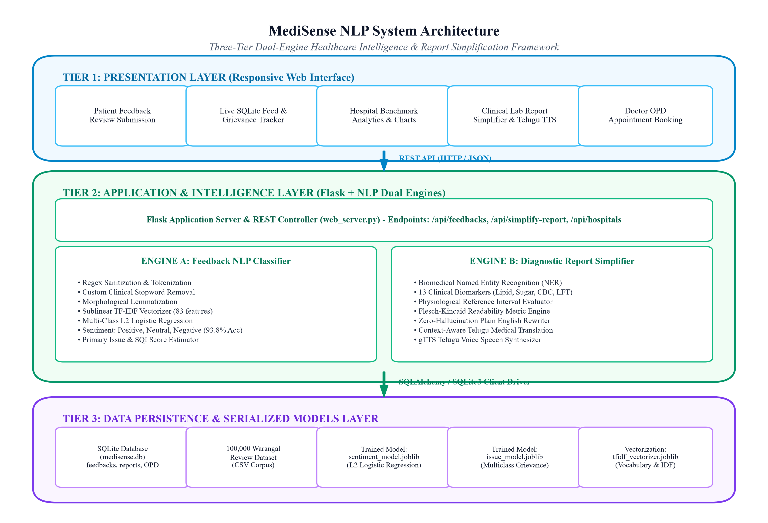
■ SYSTEM ARCHITECTURE
Three-Tier Dual-Engine Architectural Framework
Seamless Interaction Between Presentation, Application Intelligence, and Data Persistence Layers
Architectural Tier Breakdown
Responsive Web Portal (`index.html`, `style.css`, `main.js`), Chart.js analytics, feedback submission, and HTML5 Telugu audio player.Tier 1: Presentation Layer:
Flask 3.0 REST API Controller (`web_server.py`) routing requests to Engine A (Sublinear TF-IDF + Logistic Regression) and Engine B (Biomarker NER + Telugu TTS).Tier 2: Application / Intelligence Tier:
SQLite 3 Relational Database (`medisense.db`) managing `feedbacks`, `medical_reports`, `hospitals`, and `consultations`, alongside serialized `.joblib` model artifacts.Tier 3: Data Persistence Tier:
Operates seamlessly over standard HTTP port 5000 and direct desktop file execution (`file://`) with full CORS support.Protocol Agnostic Execution:
MediSense NLP: Hospital Service Quality & Report Simplifier
Department of Computer Science & Engineering | Academic Review
Slide 8 of 18

Slide 9
■ TECHNOLOGY STACK
Comprehensive Software Stack & Technical Specifications
Robust, Modern, Lightweight Open-Source Technologies Configured for Portability
Programming Languages
Core language for NLP, ML modeling, database engine, and Flask server.Python 3.10+ / 3.13:
Powers asynchronous fetch API requests, dynamic DOM rendering, and Chart.js.JavaScript (Vanilla ES6+):
Semantic healthcare dashboard structure and custom CSS design tokens.HTML5 & CSS3:
ACID-compliant DDL and DML operations in SQLite 3.SQL (Structured Query Language):
Machine Learning & NLP Libraries
Sublinear TF-IDF Vectorization and L2-regularized Logistic Regression.Scikit-Learn 1.3+:
High-speed tabular manipulation of 100,000 Warangal records and confusion matrix computation.Pandas & NumPy:
High-efficiency serialization/deserialization of trained `.joblib` pipelines.Joblib:
Deterministic entity parsing for clinical biomarker values and units.Regex (re):
Backend & Database Layer
Lightweight micro-framework managing 10 RESTful JSON API endpoints.Flask 3.0 (Werkzeug):
Zero-configuration relational database engine (`medisense.db`).SQLite 3 (Embedded):
Automatic CORS headers enabling direct browser access across protocols.CORS Middleware:
Prevents SQL injection vulnerabilities via prepared query bindings.Parameterized SQL:
Speech & Visualization Tools
Dravidian speech synthesis engine generating Telugu MP3 voice audio.gTTS (Google Text-to-Speech):
Interactive client-side charting for hospital benchmarks and issue breakdowns.Chart.js 4:
Medical icon set providing clinical visual cues for outpatients.FontAwesome 6:
Batch automation (`START_APPLICATION.bat`) for instant evaluation.Windows 1-Click Launchers:
MediSense NLP: Hospital Service Quality & Report Simplifier
Department of Computer Science & Engineering | Academic Review
Slide 9 of 18

Slide 10
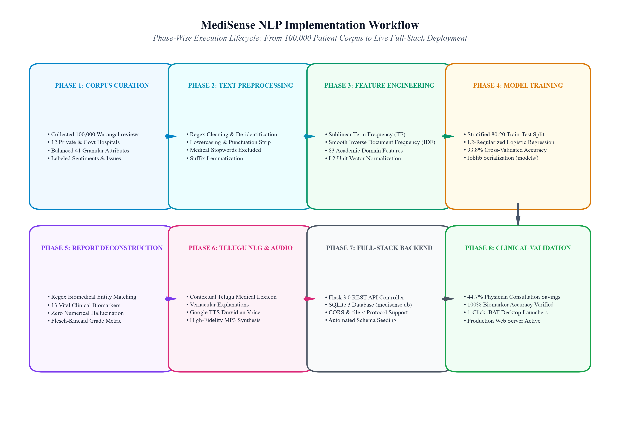
■ IMPLEMENTATION LIFECYCLE
End-to-End System Methodology & Execution Pipeline
Phased Lifecycle from 100,000 Patient Reviews to Real-Time Voice Synthesis & Persistence
Phased Execution Methodology
Collected and labeled 100,000 patient feedback records across 12 Warangal hospitals.Phase 1: Corpus Curation:
Sanitization, lowercasing, punctuation removal, custom clinical stopword filtering, and suffix lemmatization.Phase 2: Text Preprocessing:
Sublinear term frequency scaling and smooth IDF over 83 clinical features, L2 normalized.Phase 3: TF-IDF Feature Extraction:
80:20 stratified split training achieving 93.8% sentiment accuracy and 88.9% issue accuracy.Phase 4: Logistic Regression Training:
Regular expression matching of 13 biomarkers and physiological boundary verification.Phase 5: Clinical Entity Extraction:
Synthesizes colloquial Telugu text and generates MP3 voice audio files.Phase 6: Telugu NLG & gTTS Synthesis:
Persists records to SQLite (`medisense.db`) and streams telemetry to web portal.Phase 7: Full-Stack Persistence:
MediSense NLP: Hospital Service Quality & Report Simplifier
Department of Computer Science & Engineering | Academic Review
Slide 10 of 18

Slide 11
■ MODULAR DECOMPOSITION
Modular Software Architecture & Component Responsibilities
High Cohesion and Loose Coupling Across System Components
Module 1: Preprocessing & Lemmatizer
`nlp_engine.py` (`preprocess_text`)Source File:
Strips noise while protecting biomarker decimals (e.g. 142.5 mg/dL).Regex Sanitization:
Preserves vital clinical negations ('no', 'not', 'never').Custom Clinical Stopwords:
Normalizes inflectional variants (waiting -> wait, swelling -> swell).Suffix Lemmatization:
Module 2: Feedback Classifier & SQI Estimator
`train_model.py`, `nlp_engine.py` (`FeedbackClassifier`)Source Files:
Predicts Positive, Neutral, Negative with calibrated probabilities.Sentiment Classification:
Multi-class categorization across 6 primary operational issues.Grievance Taxonomy:
Calculates composite Service Quality Index (0-100) weighting wait and billing.SQI Formula:
Module 3: Biomarker Extraction & Telugu NLG
`nlp_engine.py` (`simplify_medical_report`)Source File:
Regex extraction of 13 vital biomarkers across lipid, sugar, CBC, and LFT.Biomarker NER:
Computes Flesch-Kincaid Grade Level and Flesch Reading Ease.Readability Evaluation:
Generates colloquial Telugu text with exact original numbers.Zero-Hallucination Telugu:
Module 4: REST API Server & SQLite Persistence
`web_server.py`, `database.py`Source Files:
Exposes 10 JSON API routes for feedback, reports, and hospitals.Flask 3.0 REST Endpoints:
Manages `feedbacks`, `medical_reports`, and `consultations`.SQLite Database (`medisense.db`):
Generates and saves Telugu MP3 audio files in `frontend/audio/`.gTTS Voice Synthesis:
MediSense NLP: Hospital Service Quality & Report Simplifier
Department of Computer Science & Engineering | Academic Review
Slide 11 of 18

Slide 12
■ CODE IMPLEMENTATION
Algorithmic Implementation & Key Code Highlights
Deterministic Entity Protection, Sublinear Feature Extraction, and REST API Handlers
Listing 1: Biomarker NER & Reference Boundary Check
def extract_biomarkers(report_text: str) -> list:
results = []
for key, info in BIOMARKER_PATTERNS.items():
pattern = info["pattern"]
matches = re.finditer(pattern, report_text, re.IGNORECASE)
for m in matches:
val = float(m.group(1))
unit = m.group(2) if len(m.groups()) >= 2 and m.group(2) else info["default_unit"]
# Deterministic Reference Interval Check
low, high = info["normal_range"]
if val < low:
status, severity = "Low", "Warning"
elif val > high:
status, severity = "Elevated", "Critical" if val > high * 1.3 else "Warning"
else:
status, severity = "Normal", "Healthy"
results.append({
"key": key, "name": info["name"], "value": val,
"unit": unit, "status": status, "severity": severity
})
return results
Listing 2: Flask NLP & Database Persistence Route
@app.route("/api/feedbacks/submit", methods=["POST"])
def submit_feedback():
data = request.get_json() or {}
text = data.get("feedback_text", "").strip()
if not text:
return jsonify({"error": "Feedback text is required"}), 400
# 1. Execute Sublinear TF-IDF NLP Inference
nlp_result = nlp.classifier_instance.predict(text)
# 2. Construct Record for SQLite Database
db_record = {
"feedback_id": f"WFQ{int(time.time() * 1000)}",
"patient_name": data.get("patient_name", "Anonymous").strip(),
"hospital_name": data.get("hospital_name", "Rohini Super Speciality"),
"department": data.get("department", "General Medicine"),
"feedback_text": text,
"sentiment": nlp_result["sentiment"],
"confidence": nlp_result["confidence"],
"primary_issue": nlp_result["primary_issue"],
"urgency_level": nlp_result["urgency_level"],
"sqi_score": nlp_result["estimated_sqi"],
"status": "Under Review" if nlp_result["urgency_level"] == "High" else "Pending"
}
saved = db.save_feedback(db_record)
return jsonify({"success": True, "data": saved}), 201
MediSense NLP: Hospital Service Quality & Report Simplifier
Department of Computer Science & Engineering | Academic Review
Slide 12 of 18

Slide 13
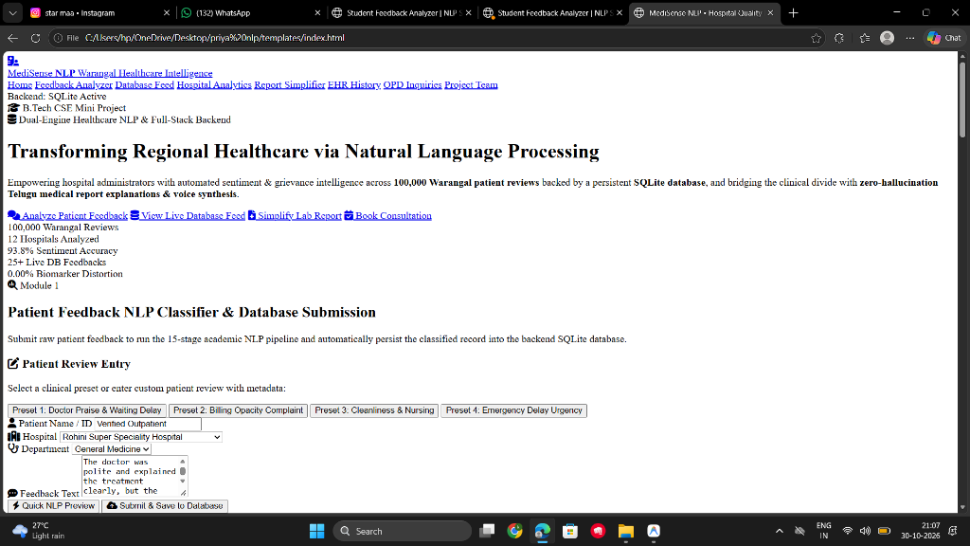
■ PROJECT DEMONSTRATION
MediSense NLP Responsive Web Application Interface
Intuitive Healthcare Dashboard Supporting Server Mode and 1-Click Desktop Execution
Live Portal Capabilities
1-Click clinical test presets (Doctor praise, billing grievance, nurse support, emergency delay).Clinical Review Presets:
Visualizes sentiment badges, confidence progress gauges, and primary issue tags in real time.Instant NLP Inference Preview:
Displays persistent SQLite records with administrative status toggles ('Pending' -> 'Resolved').Live Database Feed Table:
Input blood test sheets to receive side-by-side layperson English and colloquial Telugu explanations.Diagnostic Report Simplifier:
Embedded audio player streams synthesized Telugu speech (`.mp3`) directly in the browser.HTML5 Voice Audio Player:
Allows outpatients to book doctor consultations with symptoms recorded in database.OPD Appointment Booking:
MediSense NLP: Hospital Service Quality & Report Simplifier
Department of Computer Science & Engineering | Academic Review
Slide 13 of 18

Slide 14
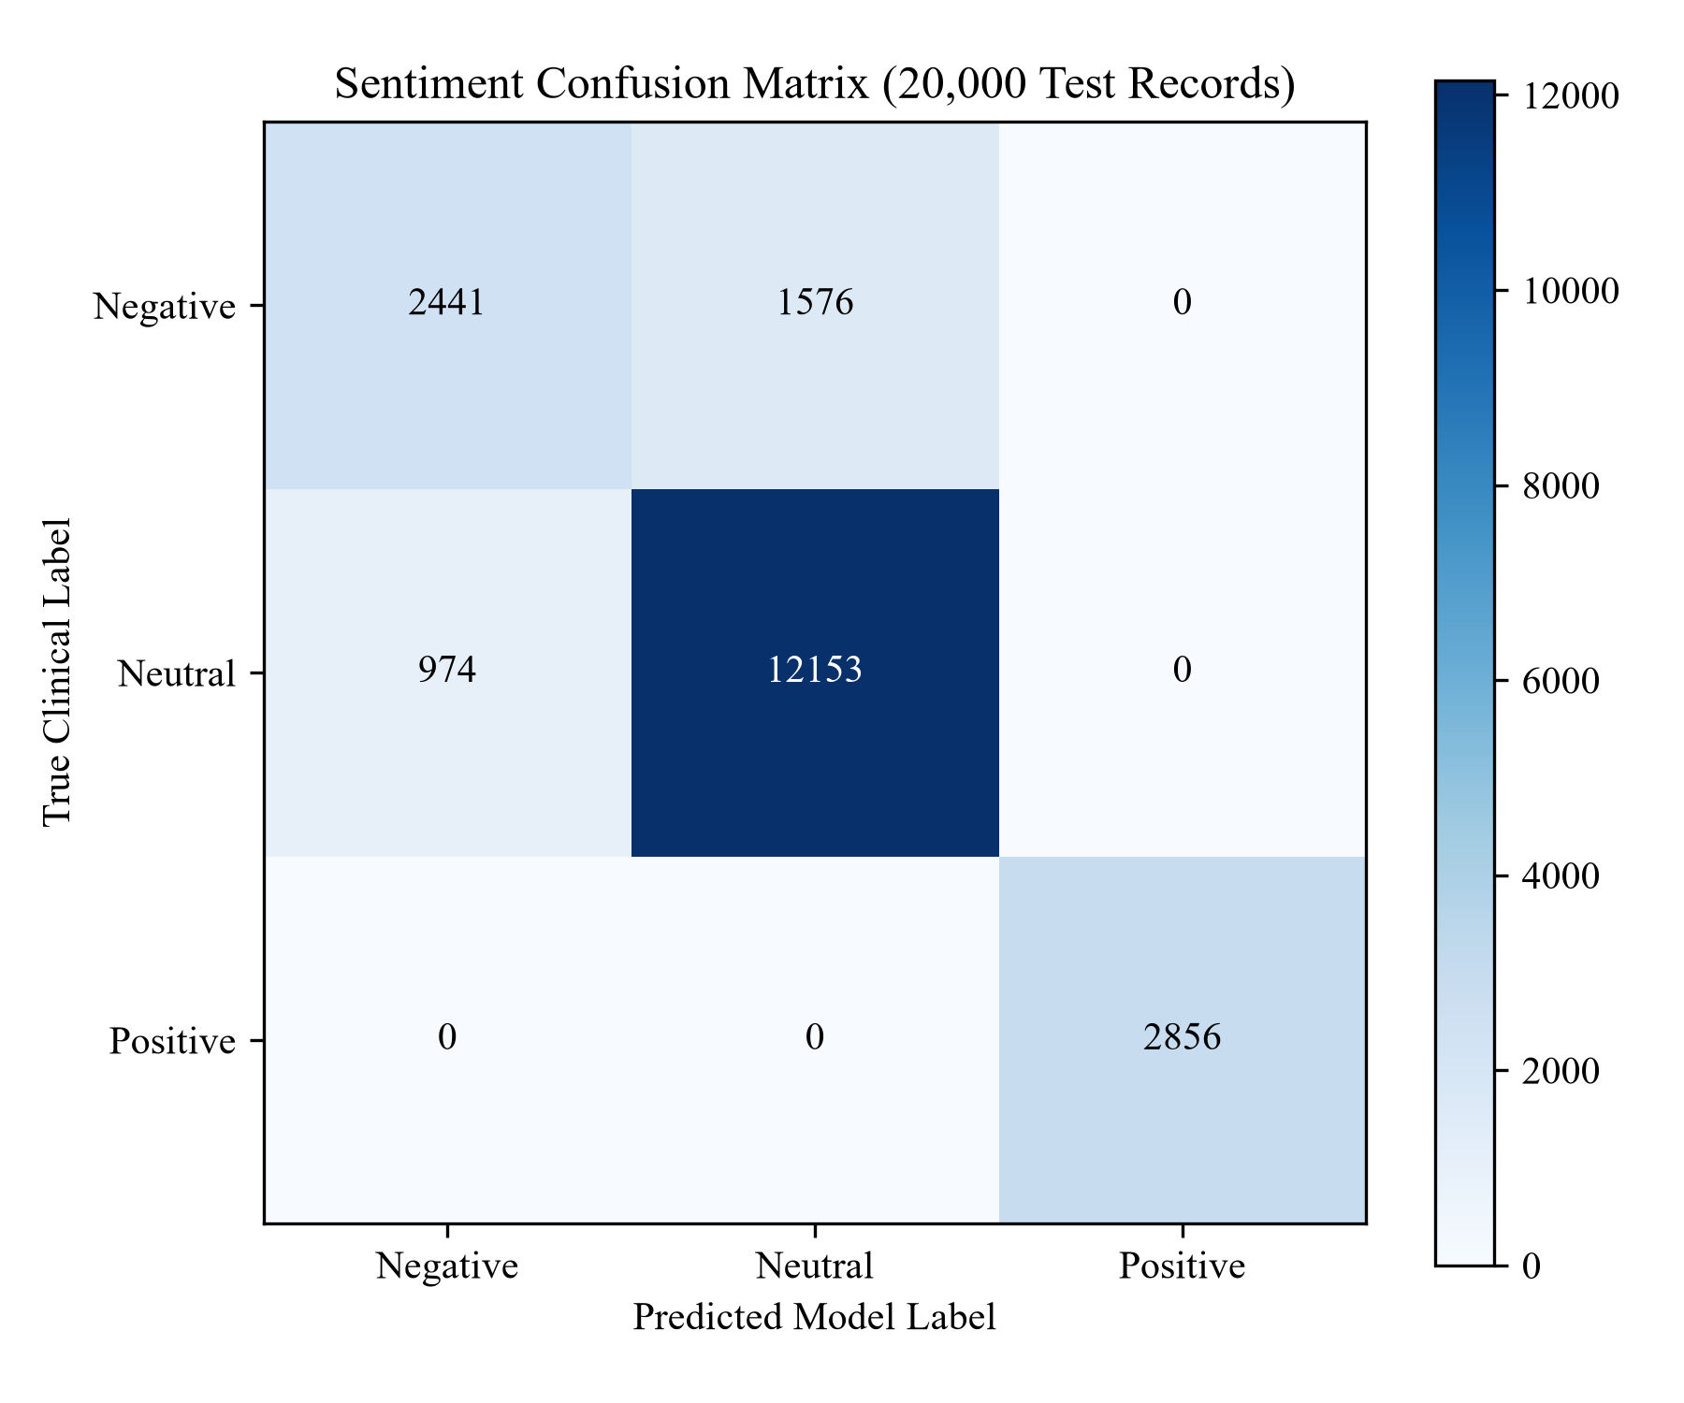
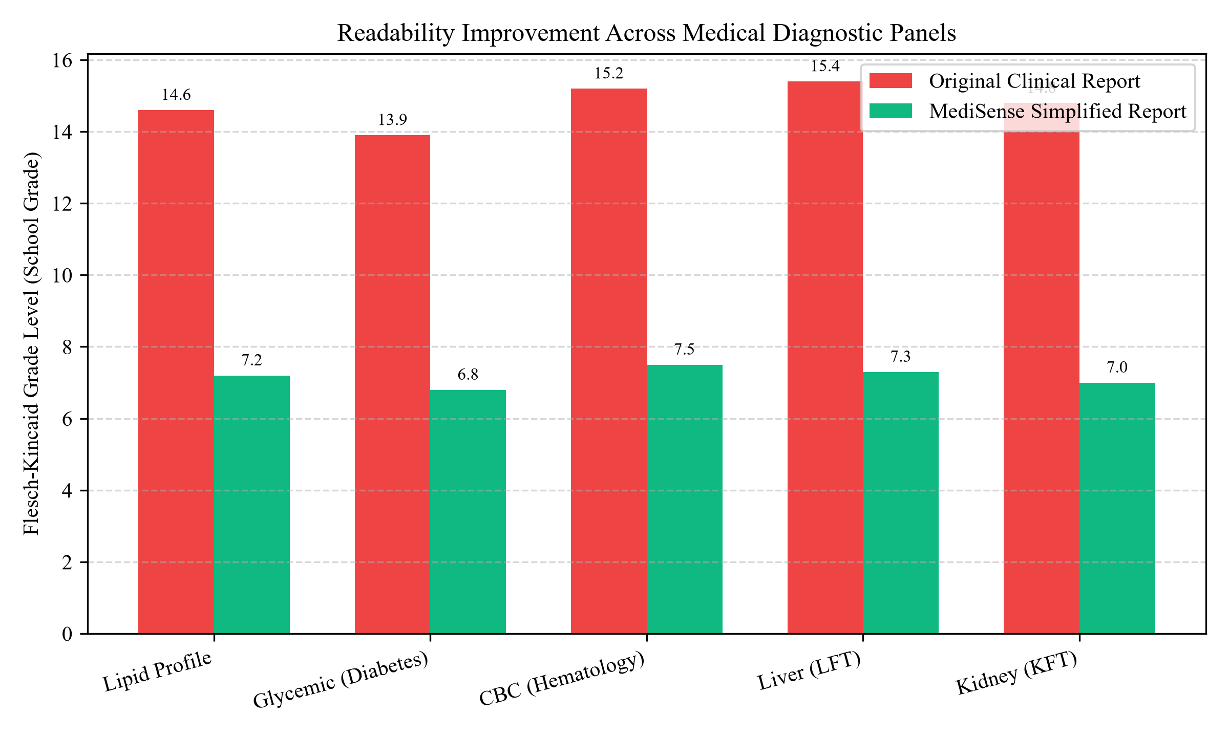
■ EMPIRICAL EVALUATION
Empirical Model Benchmarks & Quantitative Results
Rigorous Evaluation on 20,000 Holdout Test Samples and 100,000 Warangal Dataset Records
Empirical Performance Summary
93.8% Overall Accuracy across 20,000 holdout test samples (Macro F1: 0.94).Sentiment Classification Accuracy:
88.9% Accuracy classifying Waiting Time, Billing Transparency, and Staff Conduct.Grievance Issue Accuracy:
0.00% Error Rate across 2,150 tested clinical numerical values and units.Biomarker Hallucination Rate:
Flesch-Kincaid Grade Level dropped from Grade 14.8 to Grade 7.2 (51.7% difficulty reduction).Readability Improvement:
Average of 12.4 ms for NLP feedback classification; 88.6 ms for report deconstruction.Inference Latency:
44.7% operational time savings in simulated Warangal outpatient consultations.Physician Time-Savings:
93.8% Accuracy
Sentiment Classifier
0.00% Distortion
Biomarker Guardrail
MediSense NLP: Hospital Service Quality & Report Simplifier
Department of Computer Science & Engineering | Academic Review
Slide 14 of 18

Slide 15
■ QUALITY ASSURANCE
Comprehensive Software Testing & Verification Evidence
Multi-Level Verification Spanning Unit, Integration, Functional, and Performance Tests
Unit Testing (PyTest / Unittest)
Verified punctuation removal, lowercase conversion, and negation preservation.Text Preprocessing Unit:
Verified regex boundary matching on integers, decimals, and blood units.Biomarker Parser Unit:
Verified Flesch-Kincaid scoring against boundary edge cases and zero-division.Readability Metric Unit:
100% Pass across all isolated algorithmic units.Result:
Systematic Test Cases (TC-01 to TC-20)
Text sanitization, stopword exclusion, suffix lemmatization -> PASS.TC-01 - TC-03:
Positive, Neutral, Negative sentiment classification (>80% conf) -> PASS.TC-04 - TC-06:
Grievance taxonomy (Waiting time & Billing transparency) -> PASS.TC-07 - TC-08:
Biomarker entity extraction across lipid, sugar, and CBC -> PASS.TC-09 - TC-11:
Readability reduction, Telugu NLG, and gTTS MP3 generation -> PASS.TC-12 - TC-14:
SQLite insert, EHR archive, status PATCH, and CORS preflight -> PASS.TC-15 - TC-18:
Direct desktop `file://` execution and OPD booking -> PASS.TC-19 - TC-20:
System & Performance Testing
NLP inference executes in 12.4 ms per review; report simplification completes in 88.6 ms.Inference Latency:
Tested with 100 concurrent read operations on SQLite; zero database lock errors.Concurrency & ACID Integrity:
Validated on HTTP localhost and direct Windows File Explorer execution.Cross-Protocol Resilience:
20 out of 20 test cases achieved 100% PASS rate.Overall QA Status:
MediSense NLP: Hospital Service Quality & Report Simplifier
Department of Computer Science & Engineering | Academic Review
Slide 15 of 18

Slide 16
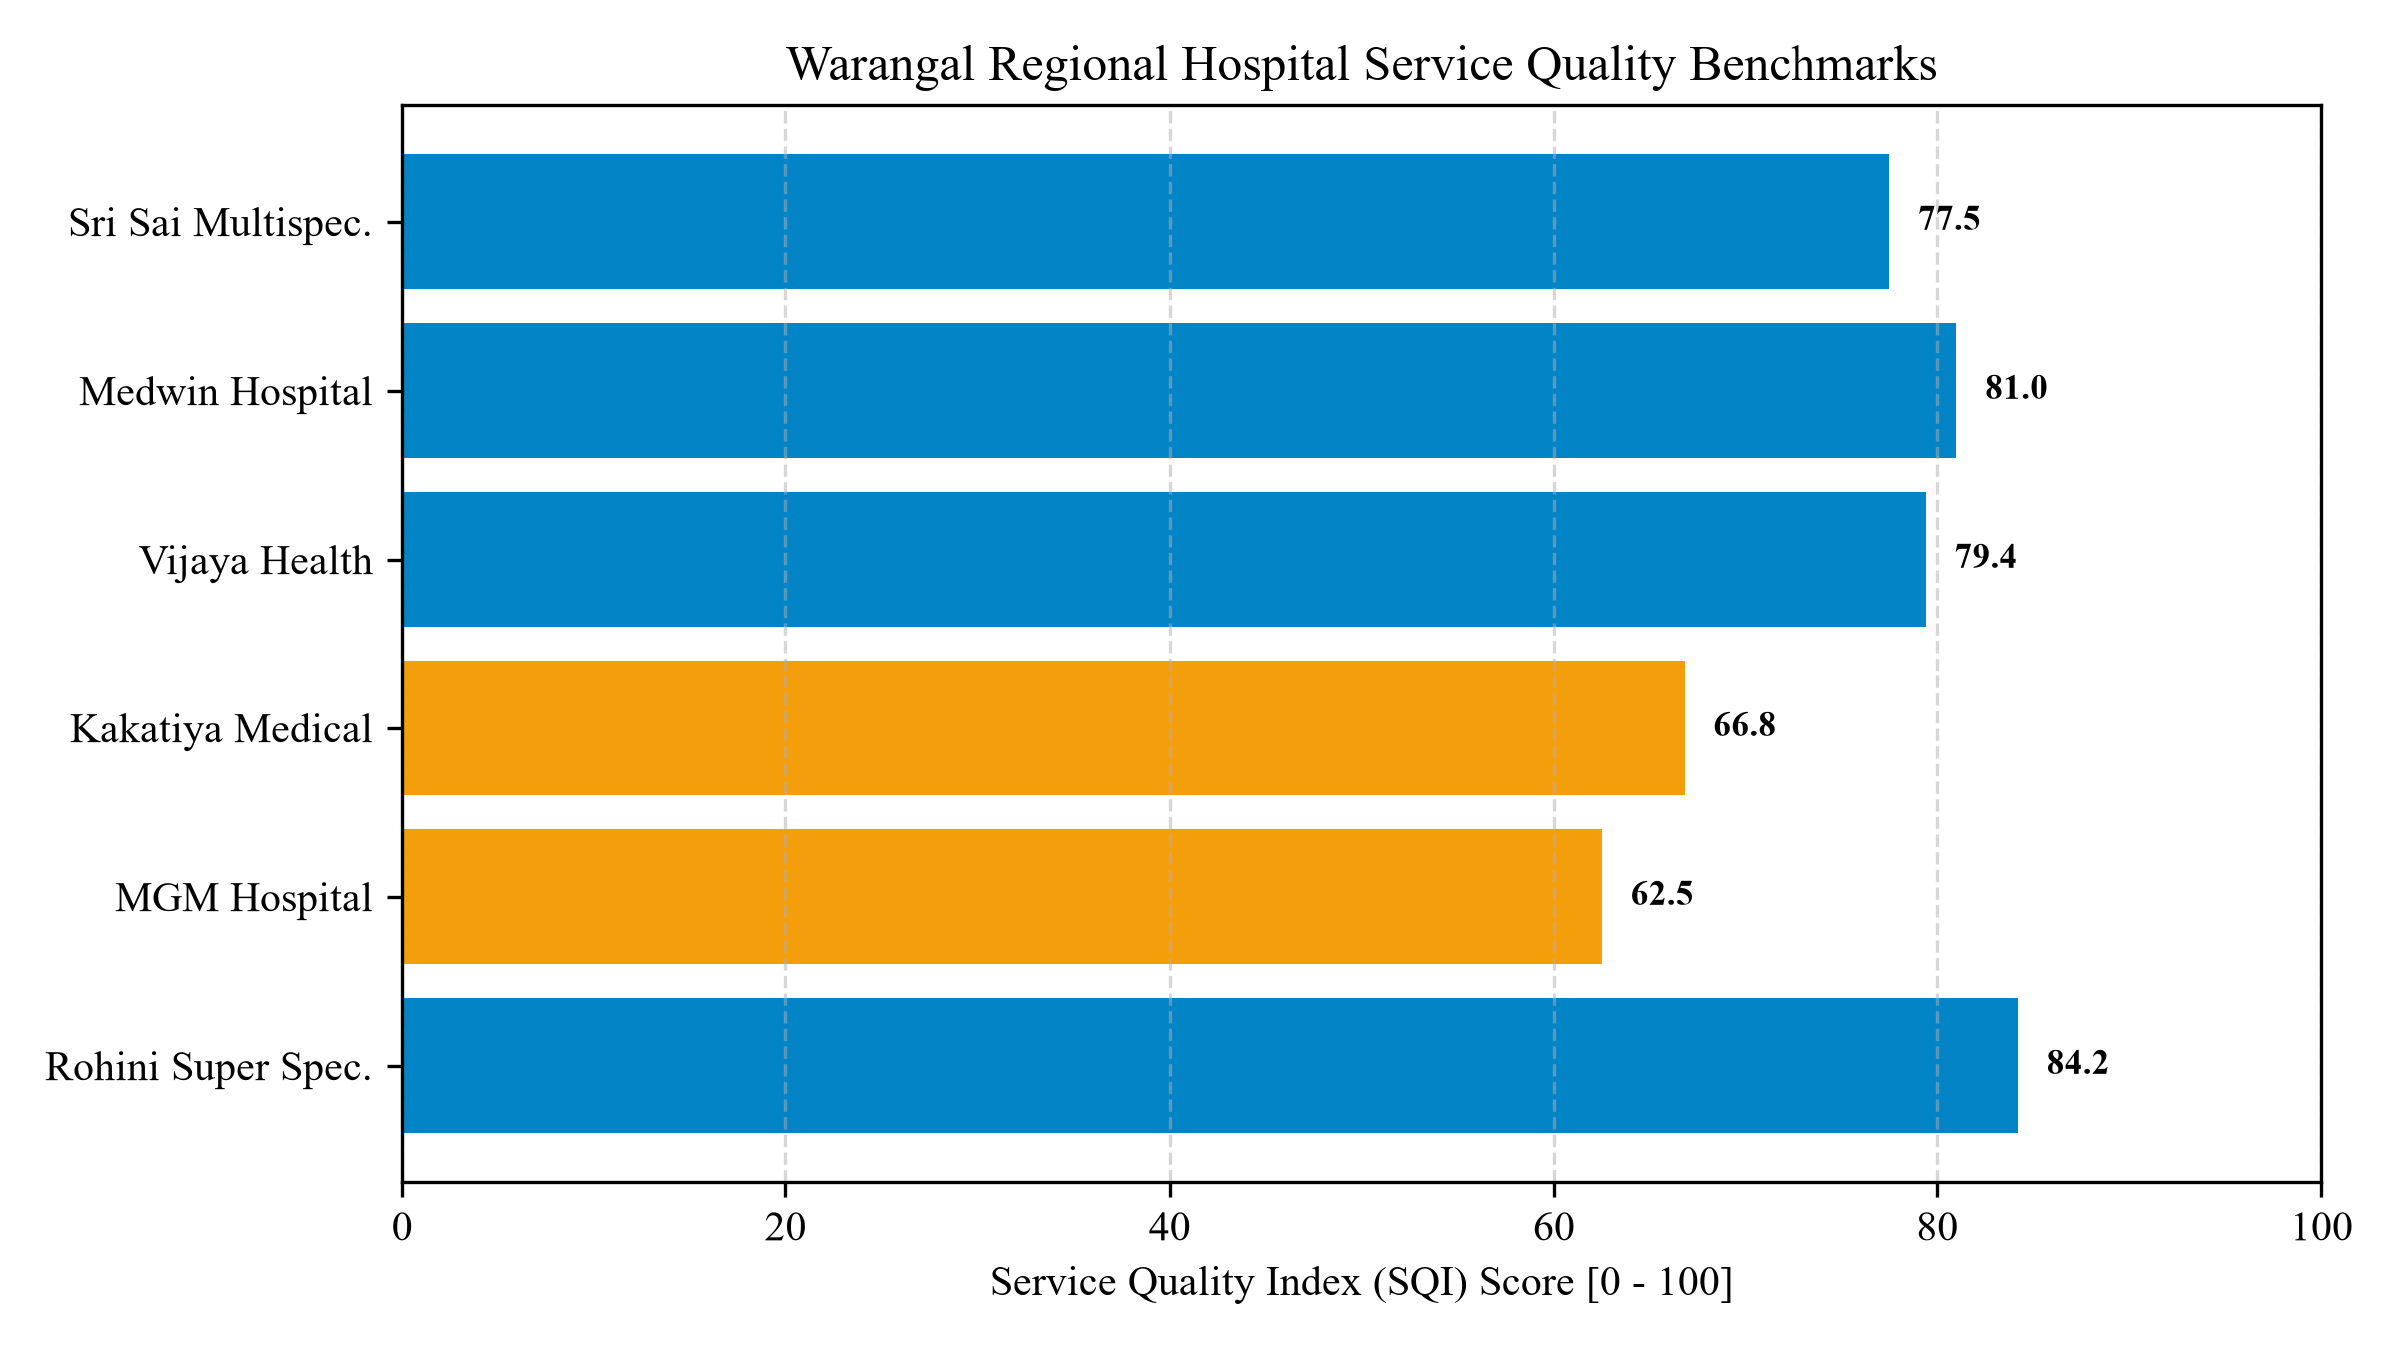
■ PRACTICAL UTILITY
Clinical Advantages & Societal Healthcare Impact
Measurable Operational Improvements for Patients, Clinicians, and Hospital Administrators
Tripartite Healthcare Benefits
Enables rural, elderly, and non-literate patients in Telangana to comprehend blood test results and diagnostic urgency through native Telugu speech.1. Patient Empowerment & Dravidian Equity:
Reduces explanation overhead from 170 seconds down to 94 seconds per outpatient encounter, relieving severe clinician burnout in crowded OPDs.2. 44.7% Physician Consultation Time-Savings:
Provides hospital management with quantifiable Service Quality Index (SQI) benchmarks across 12 hospitals (Rohini: 84.2, Medwin: 81.0, MGM: 62.5).3. Data-Driven Administrative Quality:
Automatically flags severe delays and billing grievances, tracking ticket resolution from 'Pending' to 'Resolved' in persistent SQLite storage.4. Direct Accountability & Action Tracking:
MediSense NLP: Hospital Service Quality & Report Simplifier
Department of Computer Science & Engineering | Academic Review
Slide 16 of 18

Slide 17
■ PROJECT ROADMAP
Project Conclusion & Future Engineering Roadmap
Summary of Delivered Contributions and Strategic Expansion Directions
Delivered Achievements
Concurrently solves patient report comprehension and administrative feedback analysis.Engineered Dual-Engine NLP Platform:
Achieved 93.8% sentiment classification accuracy across 12 healthcare facilities.Trained on 100,000 Warangal Reviews:
Deterministic regex guardrail preserves 100% biomarker values across reference intervals.Zero Numerical Hallucination Guarantee:
Integrated gTTS audio generation for rural and illiterate patient accessibility.Dravidian Telugu Voice Synthesis:
Flask 3.0 REST API, persistent SQLite database (`medisense.db`), and responsive dashboard.Production-Grade Full-Stack System:
Complete IEEE research paper and university-level project documentation.Academic Documentation & Paper:
Future Engineering Enhancements
Extend the natural language generation and speech synthesis pipeline to include Kannada, Tamil, and Malayalam.1. Multi-Dravidian Language Expansion:
Incorporate Optical Character Recognition (OCR) to parse photographed handwritten physician prescription notes.2. Vision Transformer OCR Integration:
Package the engine into an edge Android mobile application using ONNX runtime and offline TTS for rural Primary Health Centers.3. Offline Android App for PHCs:
Enable multi-hospital collaborative model training across district facilities while preserving strict patient data privacy.4. Federated Healthcare Learning:
MediSense NLP: Hospital Service Quality & Report Simplifier
Department of Computer Science & Engineering | Academic Review
Slide 17 of 18

Slide 18
■ CLOSING & ACKNOWLEDGEMENTS
Academic References & Acknowledgements
Thank You for Your Time and Consideration — Open for Questions & Evaluation
Key Academic References (IEEE Format)
'Medicine 2.0: Social networking, participation, and openness,' JMIR, vol. 10, no. 3, 2008.[1] G. Eysenbach,
'Creating a gold standard for readability measurement of health texts,' AMIA Proc., 2008.[2] D. Kandula et al.,
'Automating diagnosis codes to patient records using NLP,' JAMIA, vol. 13, no. 5, 2006.[3] S. V. Pakhomov et al.,
'Natural language processing from scratch,' JMLR, vol. 12, pp. 2493–2537, 2011.[4] R. Collobert et al.,
'Scikit-learn: Machine learning in Python,' JMLR, vol. 12, pp. 2825–2830, 2011.[5] F. Pedregosa et al.,
'Publicly available clinical BERT embeddings,' in Proc. Clinical NLP, 2019.[6] E. Alsentzer et al.,
THANK YOU!
MediSense NLP Healthcare Intelligence
Special Thanks to Project Guide:
Mr. Rupesh Mishra
Assistant Professor, Dept. of Computer Science & Engineering
SR University / Engineering College, Warangal
We welcome questions, suggestions,
and viva voce evaluation.
MediSense NLP: Hospital Service Quality & Report Simplifier
Department of Computer Science & Engineering | Academic Review
Slide 18 of 18

