Slide 1

SR University
Course : AI Assistant Coding
Instructor : Sallauddin Mohammed
Title : Hotel Booking System
Team Details : K. Nagasri Reddy (2303A51247)

Slide 2
SR University
Introduction :
The Hotel Booking Application is a full-stack web application that allows users to:
Browse available hotels and rooms
Book rooms online
View booking history
Search hotels based on location and price
The system also includes an Admin Panel to manage:
Hotels
Rooms
Bookings

Slide 3
SR University
Objective :
Build a full-stack application using MERN stack
Provide a seamless hotel booking experience
Implement secure authentication using JWT
Efficiently manage hotel and room data
Use AI tools to speed up development

Slide 4
SR University
Stakeholders :
Users: Search and book hotels
Admin: Manage hotels, rooms, bookings
Developers: Maintain and update system
Business Owner: Earn revenue from bookings

Slide 5
SR University
Technologies Used :
Frontend:
React.js
CSS (inline styling)
Backend:
Node.js
Express.js
Database:
MongoDB
Tools:
GitHub
VS Code
Authentication:
JWT (JSON Web Token)

Slide 6
SR University
AI Prompts Used :
Key Features:
User Registration & Login
Hotel Search & Filters
Room Availability Check
Online Booking System
Booking History
Admin Dashboard
Secure Authentication

Slide 7
SR University
Modules:
User Module
Register/Login
Search Hotels
Book Rooms
Admin Module
Add/Edit Hotels
Manage Rooms
View Bookings

Slide 8
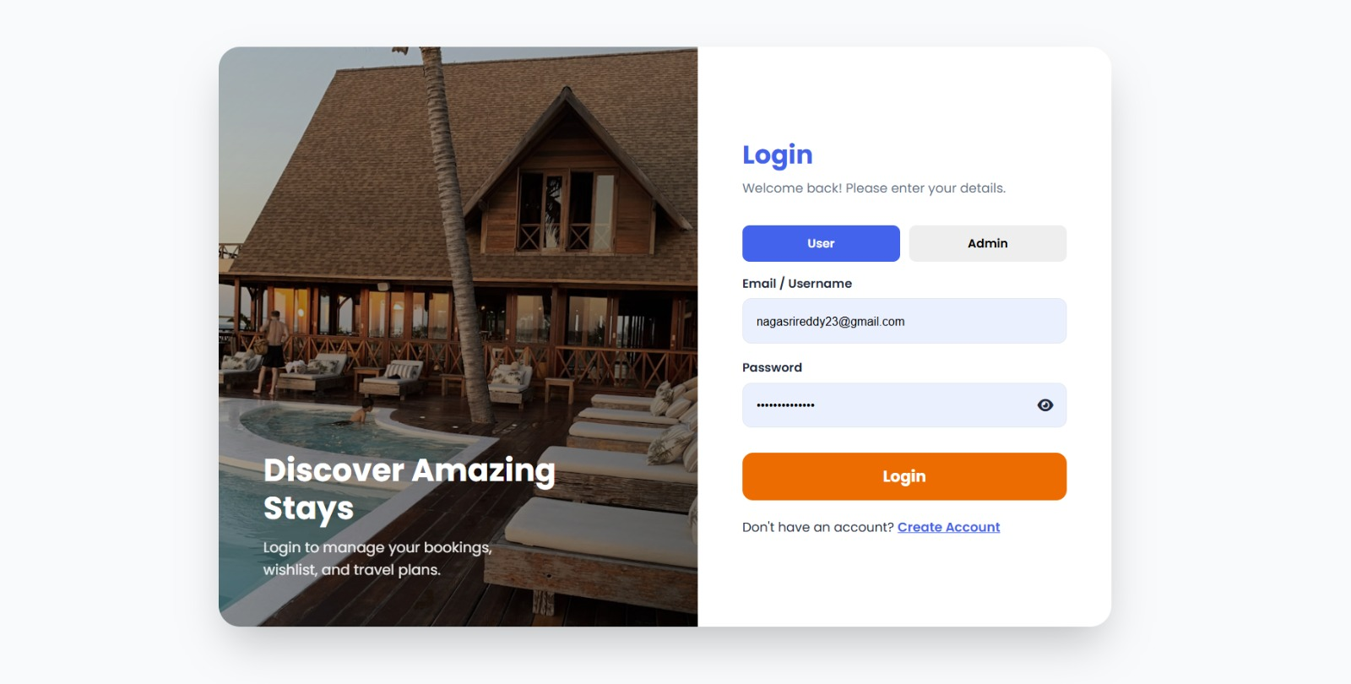
SR University

Slide 9
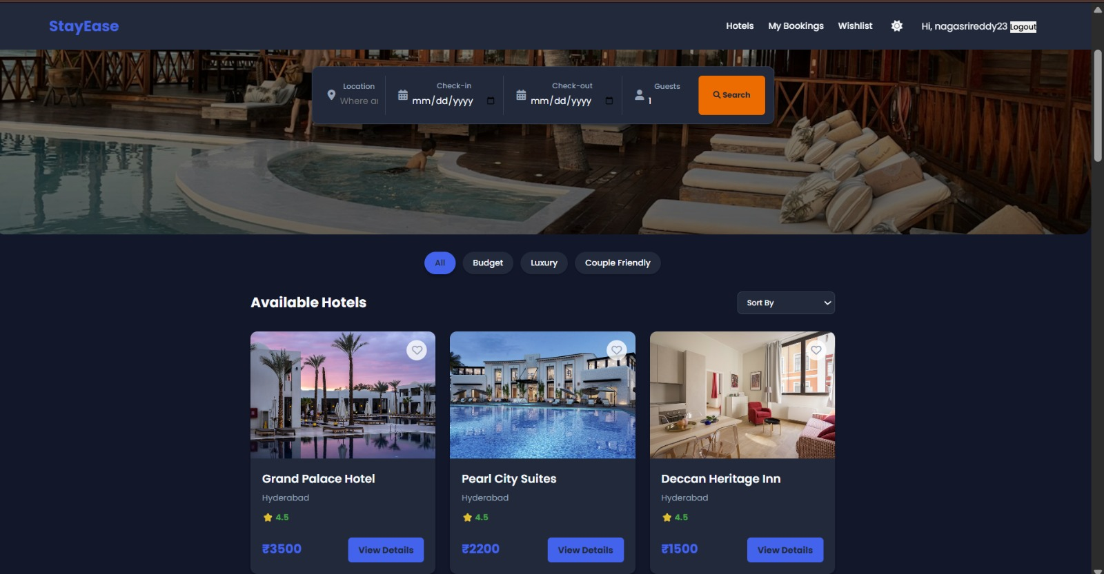
SR University

Slide 10
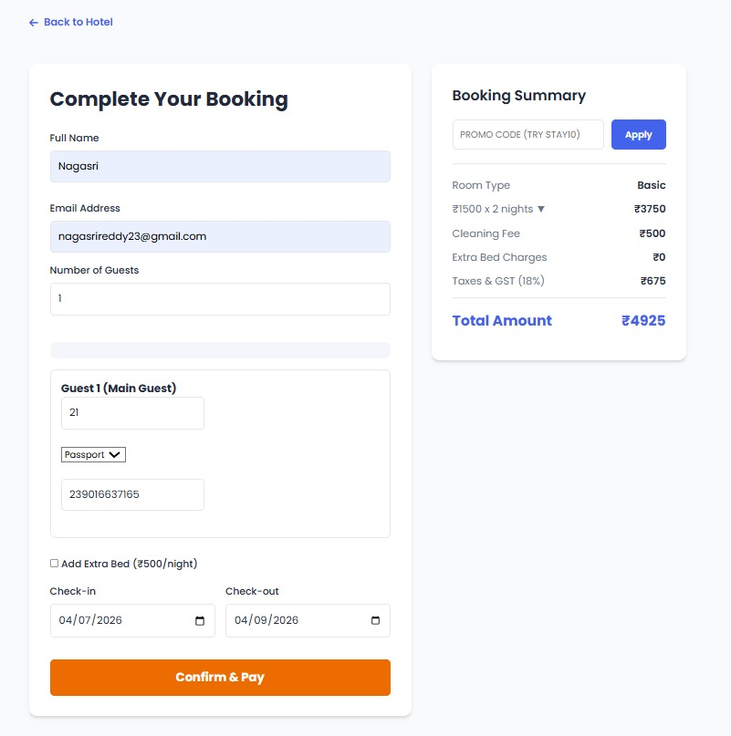

Slide 11
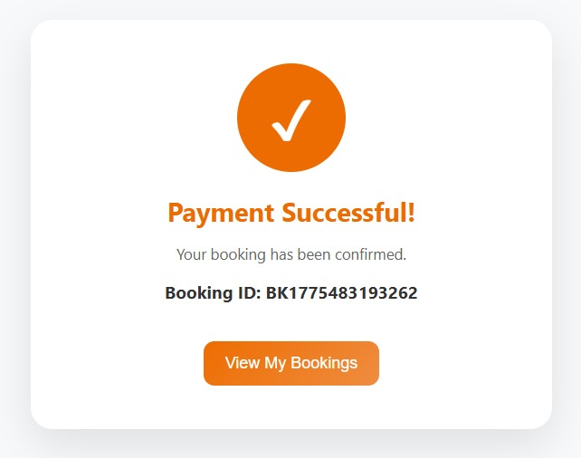
SR University

Slide 12
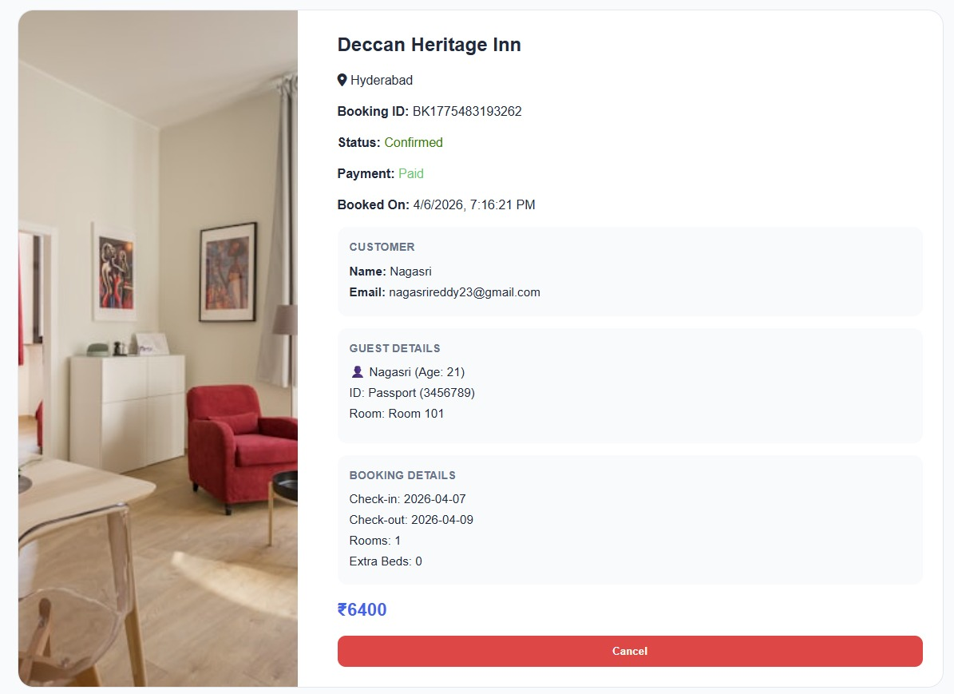
SR University

Slide 13
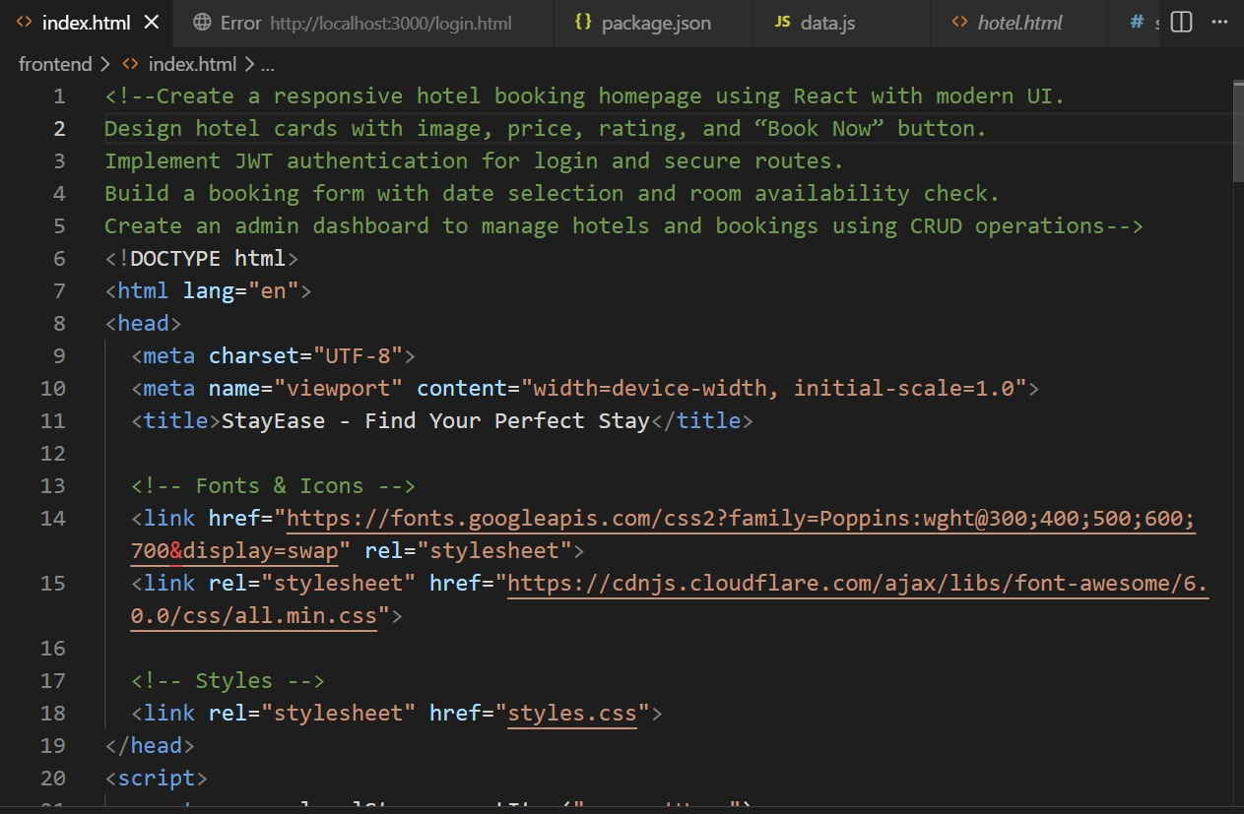
SR University
Proof Of AI Prompts :

Slide 14
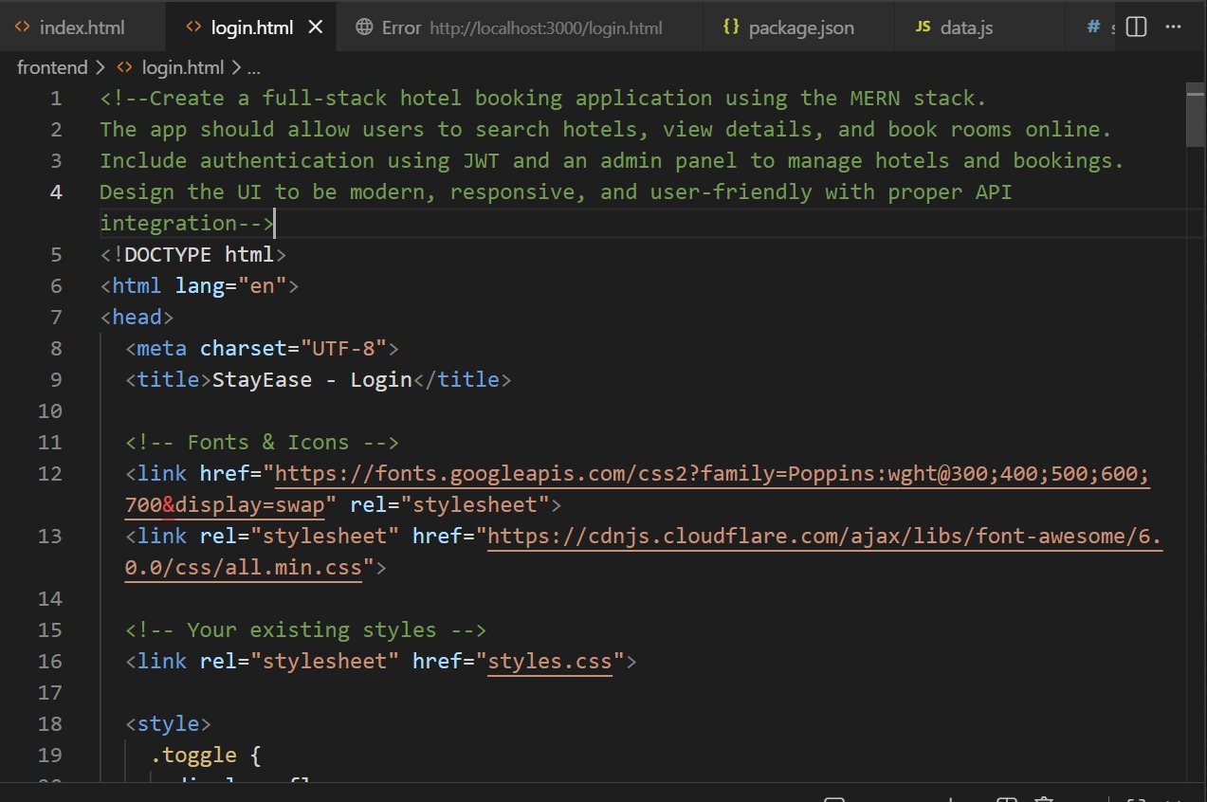
SR University

Slide 15
SR University
References
React Documentation
MongoDB Docs
Node.js Docs
Express.js Docs
ChatGPT (OpenAI)
Stack Overflow

Slide 16
SR University
THANK YOU!

