Slide 1

SR University
Course : AI Assistant Coding
Instructor : Dr.Mathivanan D
Title : Restaurant Booking System
Team Details :Jukanti Lohith(2303A51528)&S.Uday Varma(2303A51257)

Slide 2
SR University
Introduction :
The Restaurant Booking System is a full-stack web application that allows users to:
Browse available restaurants and menus
Book tables online
Reserve slots for events or special occasions
View booking history and details
The system also includes an Admin Panel to manage:
Restaurants
Tables & seating capacity
Reservations & bookings

Slide 3
SR University
Objective :
Build a full-stack application using MERN stack
Provide a seamless hotel booking experience
Implement secure authentication using JWT
Efficiently manage hotel and room data
Use AI tools to speed up development

Slide 4
SR University
Stakeholders :
Users: Search restaurants and book tables
Admin: Manage restaurants, bookings
Developers: Maintain and update system
Business Owner: Earn availability and increase revenue

Slide 5
SR University
Technologies Used :
Frontend:
React.js
CSS (inline styling)
Backend:
Node.js
Express.js
Database:
MongoDB
Tools:
GitHub
VS Code
Authentication:
JWT (JSON Web Token)

Slide 6
SR University
AI Prompts Used :
Key Features:
User Registration & Login
Restaurants Search & Filters
Table Availability Check
Online Table Booking System
Booking History
Admin Dashboard
Secure Authentication

Slide 7
SR University
Modules:
User Module
Register/Login
Search Restaurant
Book Table
Admin Module
Add/Edit Restaurant
Manage Tables
View Bookings

Slide 8
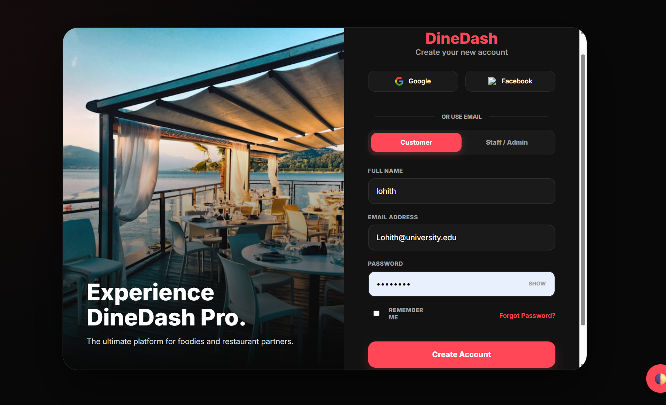
SR University

Slide 9
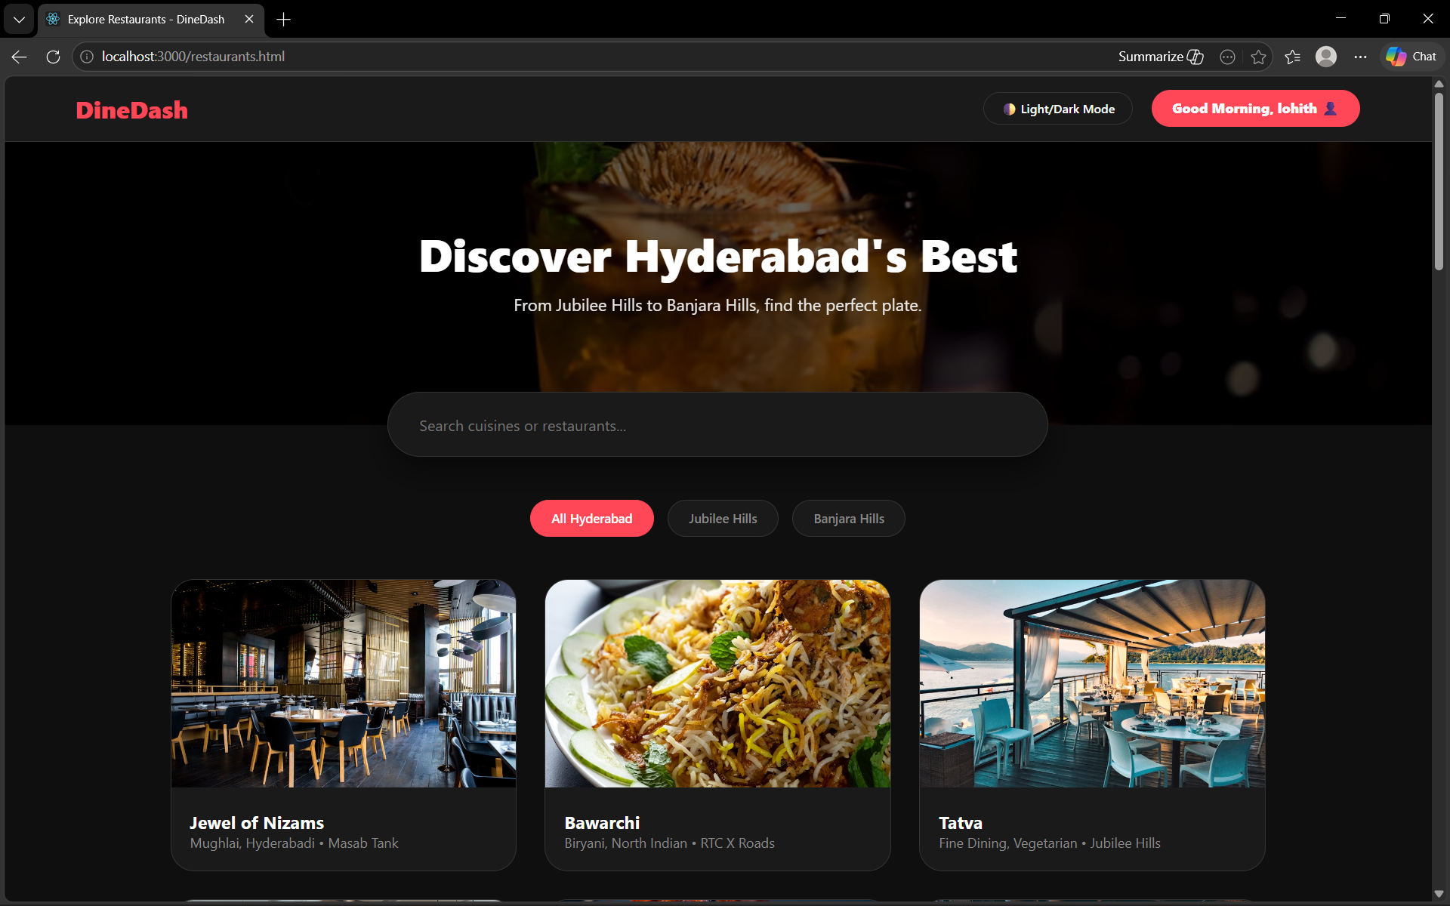
SR University

Slide 10
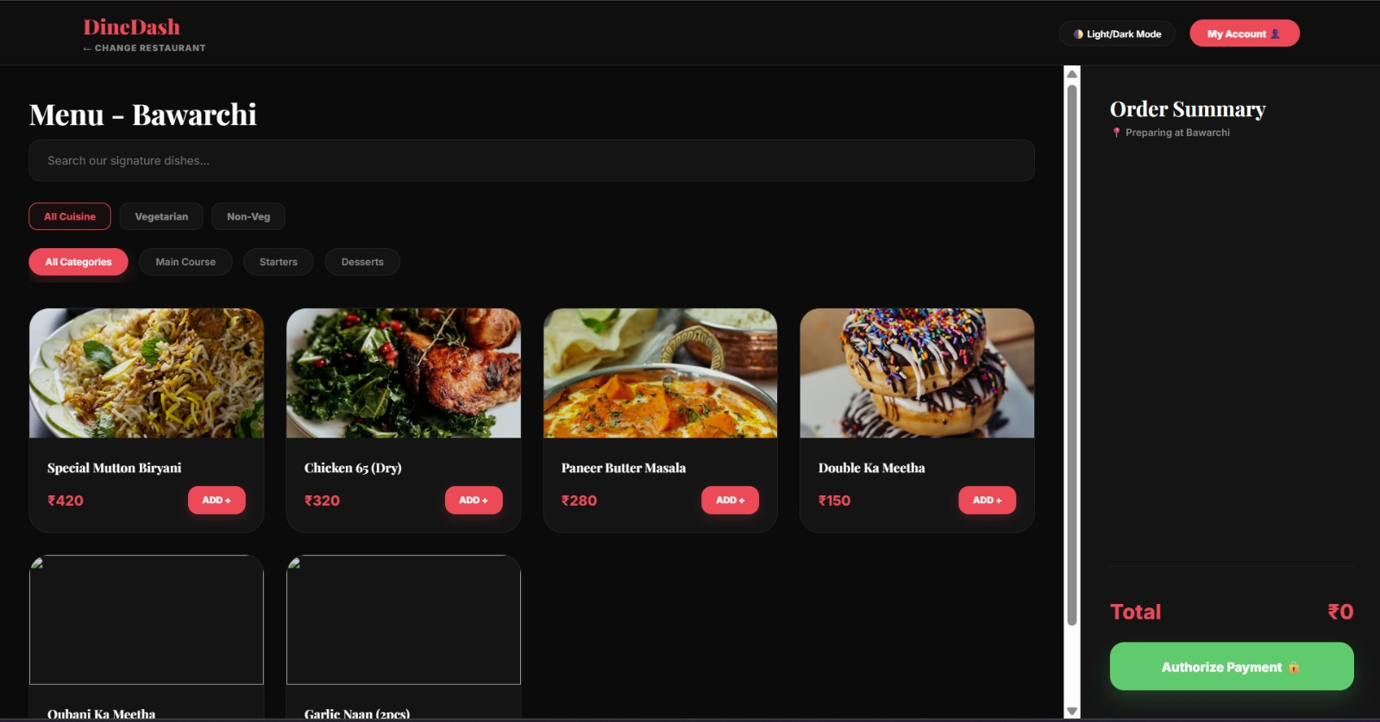

Slide 11
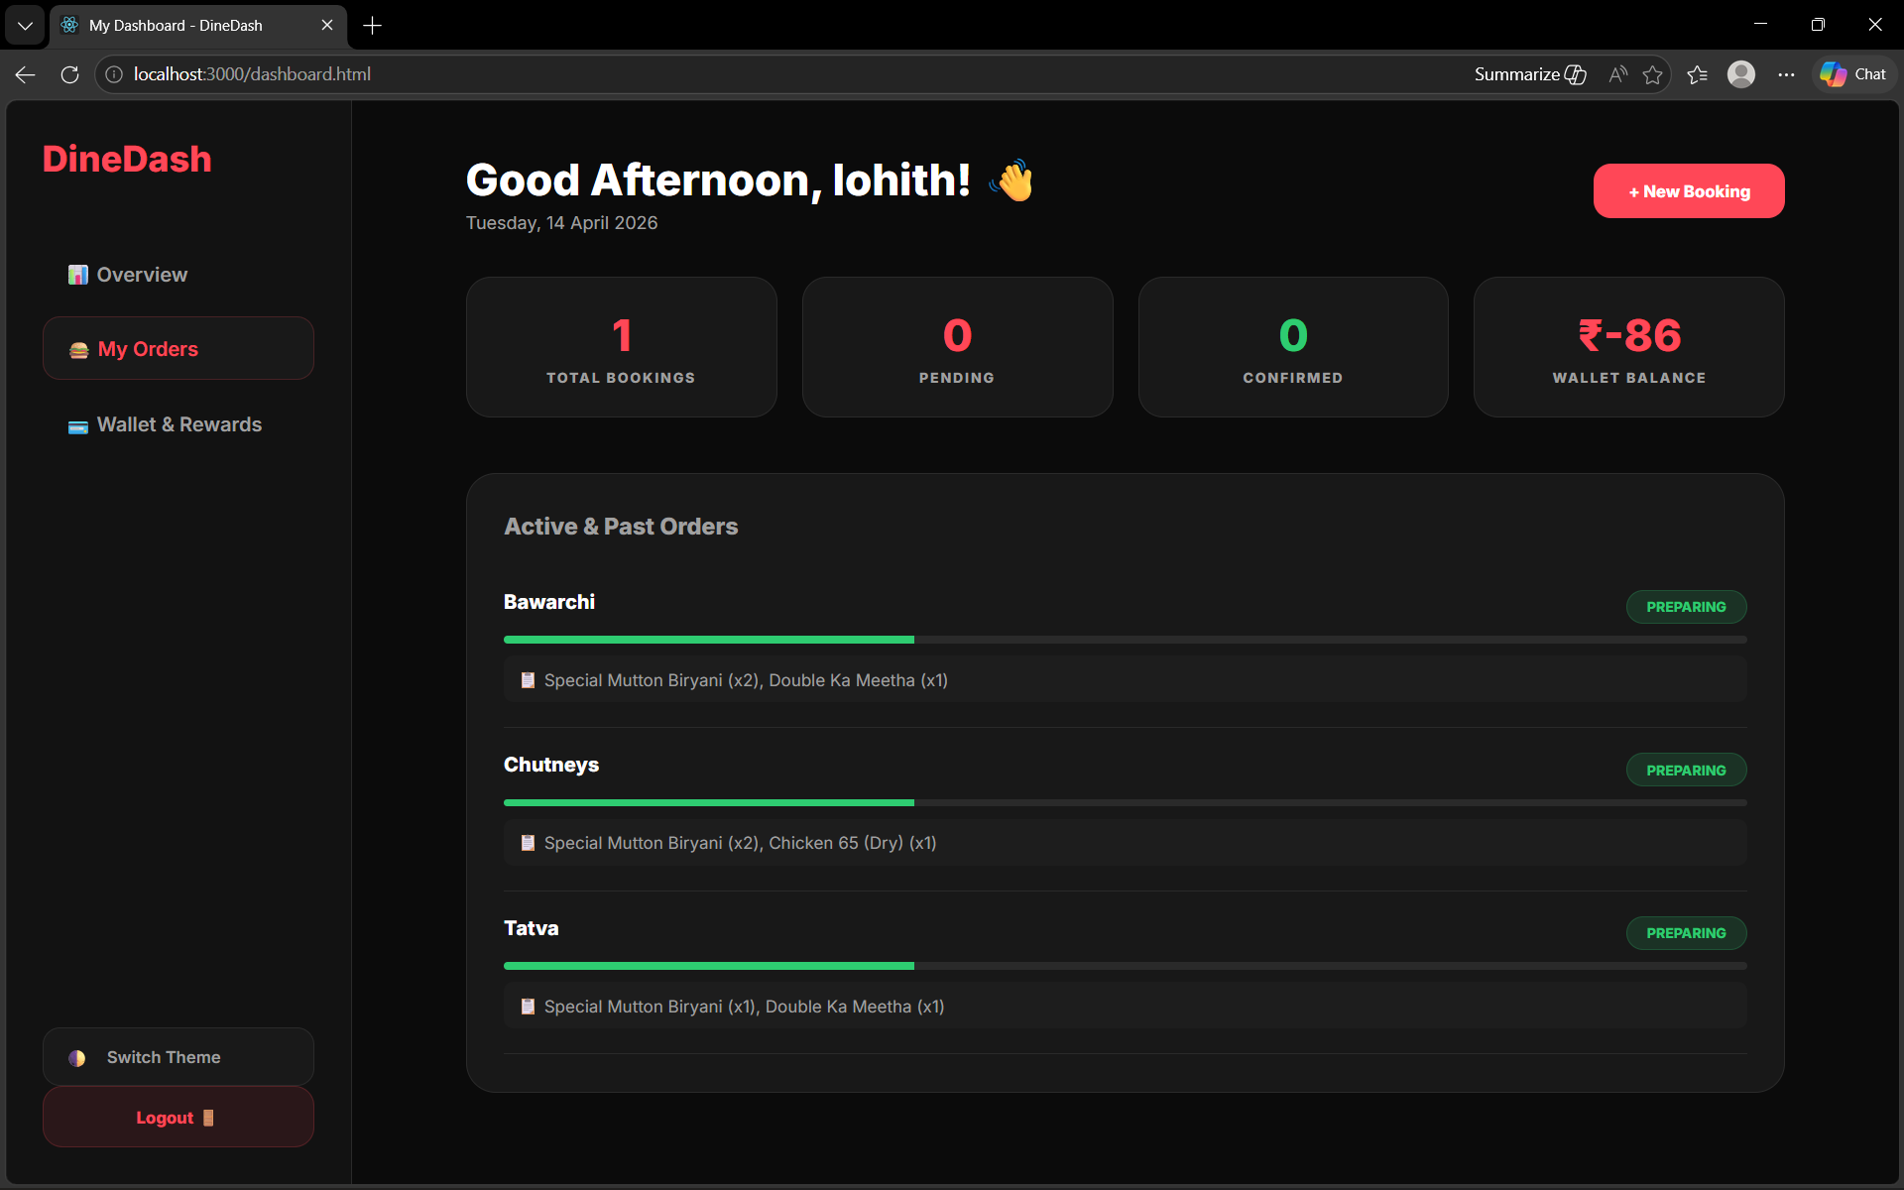
SR University

Slide 12
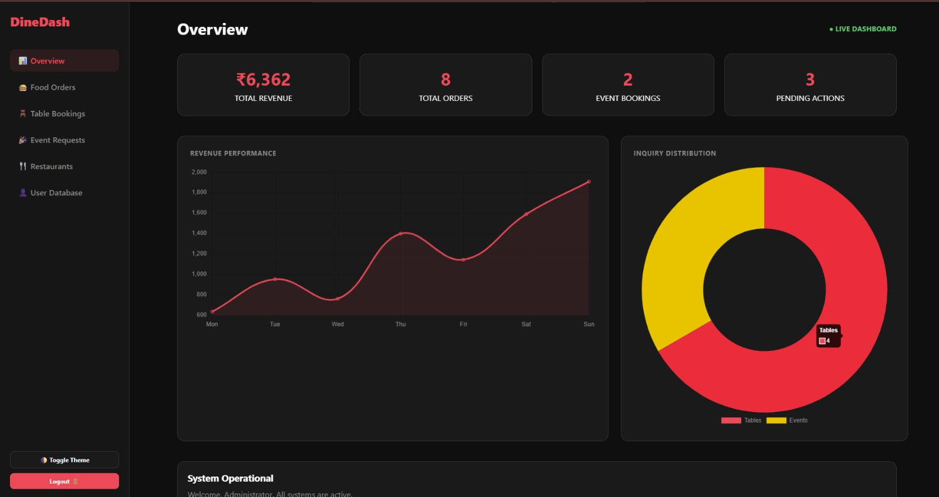
SR University

Slide 13
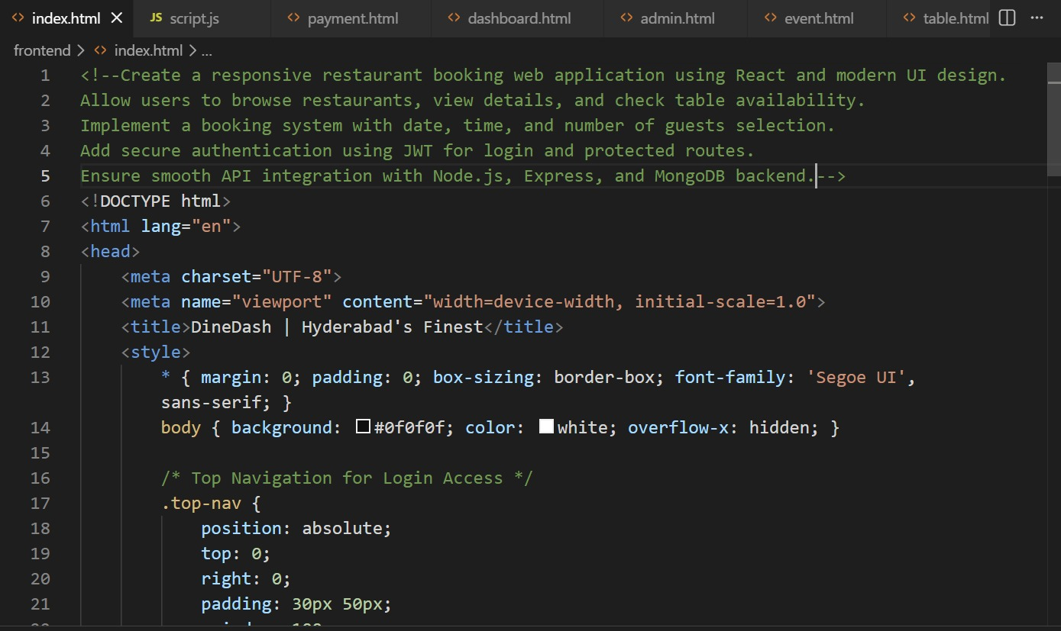
SR University
Proof Of AI Prompts :

Slide 14
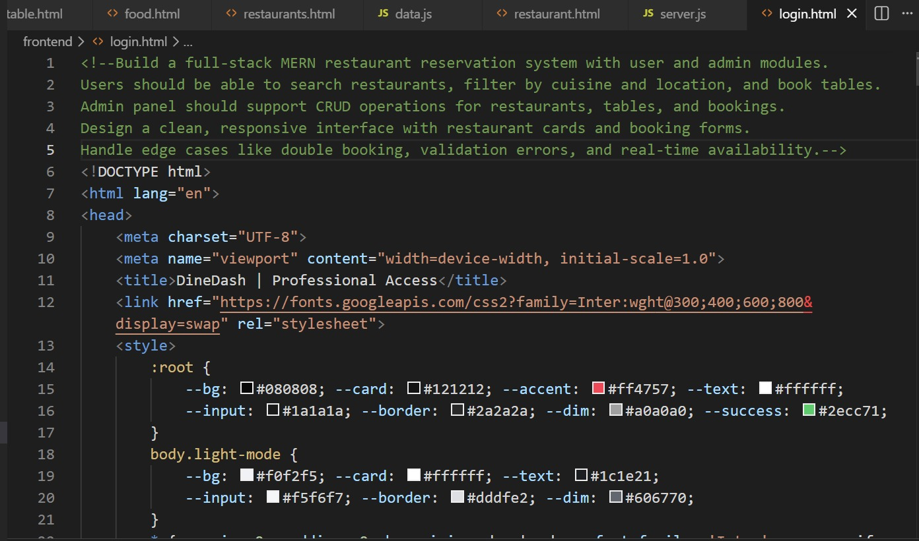
SR University

Slide 15
SR University
References
React Documentation
MongoDB Docs
Node.js Docs
Express.js Docs
ChatGPT (OpenAI)
Stack Overflow

Slide 16
SR University
THANK YOU!

