Slide 1

1
CINEBOOK
Movie Booking Platform
🎓 Course / Module
👨‍🏫 Instructor
👤 Student
Assistant AI
Salauddin Sir
M. Dakshinya
🎫 Hall Ticket No.
📅 Submission Date
🤖 AI Tool Used
2303A51553
02 / 04 / 2026
Claude AI (Anthropic)
Submitted for Academic Evaluation — AI-Assisted Software Development Project

Slide 2
2
Introduction to CineBook
A modern, AI-assisted movie ticket booking web application
🔴 THE PROBLEM
🟢 THE SOLUTION
✗ Long queues at cinema box offices waste time
→
✓ Streamlined digital movie discovery interface
✗ Fragmented booking experiences across platforms
✓ Interactive theatre-style seat selection grid
✗ No real-time seat availability visibility
✓ Real-time booking with instant QR ticket
✗ Manual booking prone to errors and duplication
✓ Admin dashboard for booking management
💡 THE APPROACH
🤖 AI-Assisted Dev
⚙️ Full-Stack
🌏 Regional Focus
Claude AI (Anthropic) used to generate, debug & refine all code
Node.js + Express · HTML/CSS/JS · JSON file storage
Telugu movies prioritised · 8 Indian languages supported
🎬 CineBook — AI-Assisted Movie Booking Platform | M.Dakshinya | 2303A51553 | 2026

Slide 3
3
Project Objectives
Four core goals defined at project inception and measured at evaluation
🎯
Functional Booking Interface
01
🤖
AI-Assisted Development
02
Develop a working web application where users can browse movies, select showtimes, choose seats interactively, and receive a digital QR ticket upon booking completion.
Leverage Claude AI (Anthropic) to generate, debug, and refine all source code. Document every prompt used to demonstrate intentional and structured use of AI tools.
📱
Responsive UI / UX Design
03
🧠
Technical Competency
04
Deliver a visually polished, mobile-friendly interface accessible across screen sizes — from mobile (375px) to desktop (1440px) — with smooth animations and transitions.
Demonstrate knowledge of HTML5, CSS3, JavaScript ES6+, Node.js, Express.js, JSON storage, QR code generation, and UPI payment simulation.
🎬 CineBook — AI-Assisted Movie Booking Platform | M.Dakshinya | 2303A51553 | 2026

Slide 4
4
Stakeholders
Key parties with a vested interest in CineBook's success
👨‍💻
Student Developer
👩‍🏫
Course Instructors
🎬
End Users (Public)
🏛️
Cinema Operators
Design, develop, test & present the application
Evaluate code quality, functionality & presentation
Browse movies across 8 Indian languages
Digitised seat booking reduces queue pressure
All code generation & prompt documentation
Assess responsible AI usage & prompt transparency
Select seats and showtimes interactively
Admin dashboard gives real-time booking overview
Sole team member: M.Dakshinya — 2303A51553
Verify working demo of the live application
Receive instant QR ticket after payment
Filter and export booking data by date/movie/status
🎬 CineBook — AI-Assisted Movie Booking Platform | M.Dakshinya | 2303A51553 | 2026

Slide 5
5
Programming Languages, Tools & Software
Full-stack technology choices with clear rationale
🌐
HTML5
🎨
CSS3
⚡
JavaScript ES6+
Frontend
Frontend
Frontend
Semantic structure, forms, canvas for QR code generation
Flexbox/Grid, animations, dark/light theme system
Seat logic, API calls, booking flow, validation
🟢
Node.js + Express
🤖
Claude AI
💻
VS Code
Backend
AI Tool
Dev Tool
Backend server, REST API, JSON file storage, sessions
All code generated via structured prompts — Anthropic
Primary IDE with Live Server & GitHub extensions
📁
Git / GitHub
🎬
TMDB / YouTube
🌍
Netlify / Render
Dev Tool
Data Source
Hosting
Version control & source code repository
Movie poster images & trailer search links
Free hosting for frontend & backend deployment
🎬 CineBook — AI-Assisted Movie Booking Platform | M.Dakshinya | 2303A51553 | 2026

Slide 6
6
AI Prompts Used — Part 1 of 3
All prompts submitted to Claude AI (Anthropic) during development
01
Prompt 01 — Page Structure & Layout
"Create an HTML and CSS layout for a movie booking homepage with a navigation bar, hero section with a featured movie banner, and a responsive grid of movie cards showing title, genre, rating, and a Book Now button."
02
Prompt 02 — Seat Selection Interface
"Generate a movie booking interface with seat selection grid, showing available and booked seats with different color coding. Seats should toggle between available, selected, and booked states. Show total price based on selected seats."
03
Prompt 03 — Booking Confirmation Modal
"Generate a booking confirmation modal in HTML/CSS/JS that displays the movie title, selected seats, showtime, and total amount. Include a Confirm Booking button, a QR code canvas, and a download ticket option."
04
Prompt 04 — Responsive Design (Mobile-First)
"Refactor the existing CSS to make the movie booking site fully responsive using media queries. Ensure it works on mobile (375px), tablet (768px), and desktop (1440px) breakpoints with proper font scaling."
🎬 CineBook — AI-Assisted Movie Booking Platform | M.Dakshinya | 2303A51553 | 2026

Slide 7
7
AI Prompts Used — Part 2 of 3
Continued documentation of all structured AI prompts used in development
05
Prompt 05 — Backend API — Node.js + Express
"Build backend authentication API endpoints for user registration, login, session management, and logout using Node.js and Express. Store data in JSON files — no MongoDB. Include CORS headers."
06
Prompt 06 — Admin Dashboard
"Create admin dashboard displaying all bookings with filters for date, movie, and status, ensuring no duplicate entries. Use a Map keyed on bookingId to guarantee uniqueness before rendering the table."
07
Prompt 07 — Regional Language Filter
"Build regional content filter allowing users to select language preference (including Telugu) and display filtered movie list. Telugu movies must appear first for Telangana users."
08
Prompt 08 — Multilingual Database Schema
"Create database schema with language and region fields to support multilingual content, prioritising Telugu movies for Telangana users. Include posterUrl, trailerUrl, cast, director, and genre fields."
🎬 CineBook — AI-Assisted Movie Booking Platform | M.Dakshinya | 2303A51553 | 2026

Slide 8
8
AI Prompts Used — Part 3 of 3
Final prompts covering payment, validation and QR code generation
09
Prompt 09 — Language Selection Component
"Generate frontend component for language selection with Telugu, Hindi, English, Tamil, Kannada, Marathi, Malayalam, and Bengali options. Store user preference in localStorage and apply on every page load."
10
Prompt 10 — UPI Payment Validation
"Implement UPI ID validation — format must be prefix@handle where prefix is at least 3 chars and handle is a valid UPI provider (paytm, gpay, phonepe, oksbi, etc.). Block booking if UPI is empty or invalid."
11
Prompt 11 — QR Code Ticket Generator
"Generate a QR code on HTML canvas element for booking confirmation. Encode booking ID, movie name, seats, showtime and date. Add a download as PNG button and display booking details next to the QR code."
12
Prompt 12 — Weak Password Detection
"Add real-time password strength indicator during registration. Check for minimum 8 characters, uppercase, lowercase, number and special character. Show strength meter with colors: red = weak, yellow = medium, green = strong."
🎬 CineBook — AI-Assisted Movie Booking Platform | M.Dakshinya | 2303A51553 | 2026

Slide 9
9
Application Workflow Flowchart
Complete user journey from sign-up to ticket confirmation
Sign Up / Login
Language Preference
Browse Movies
Watch Trailer
Book Movie
Email + Password
Weak password check
▶
8 Indian languages
Telugu priority
▶
Filter by language
Genre/Search
▶
YouTube search
Movie details
▶
Select showtime
Movie details page
▼
Select Seats
Choose Payment
Payment Confirmed
QR Ticket
My Tickets
Recliner/Prime/Classic
Color-coded grid
◀
UPI/Card/Net Banking
/Wallet
◀
Simulated payment
2s processing
◀
Download PNG
Scan at theatre
◀
View all bookings
Booked movies list
👑 ADMIN FLOW: Admin Login → View Dashboard → Manage Bookings → Export CSV → Logout
🔐 Sign-in validates: email format · password strength (weak/medium/strong) · existing account check | 🌐 Language saved in localStorage & applied on every page load
🎬 CineBook — AI-Assisted Movie Booking Platform | M.Dakshinya | 2303A51553 | 2026

Slide 10
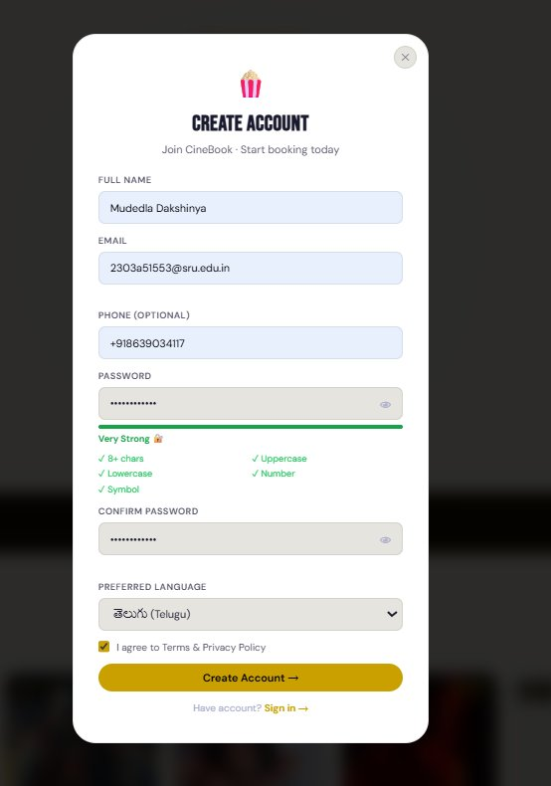
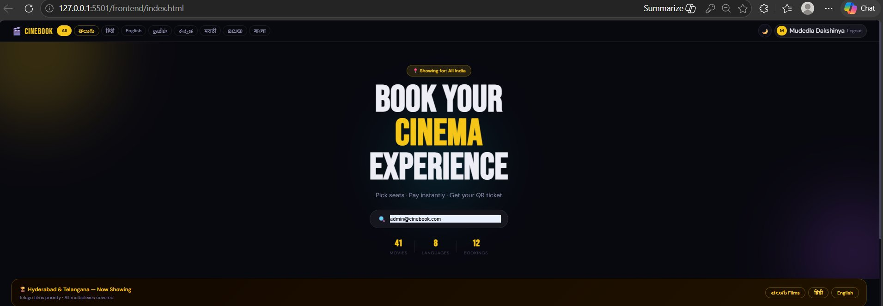
10
Frontend View — Sign In & Language Preference
Step 1 & 2: User authentication with weak password detection + language selection
→
Step 1: Create Account — Password strength meter (Weak / Medium / Very Strong 🔒)
Step 2: Homepage — 'BOOK YOUR CINEMA EXPERIENCE' | Language tabs | 41 Movies · 8 Languages
🎬 CineBook — AI-Assisted Movie Booking Platform | M.Dakshinya | 2303A51553 | 2026

Slide 11
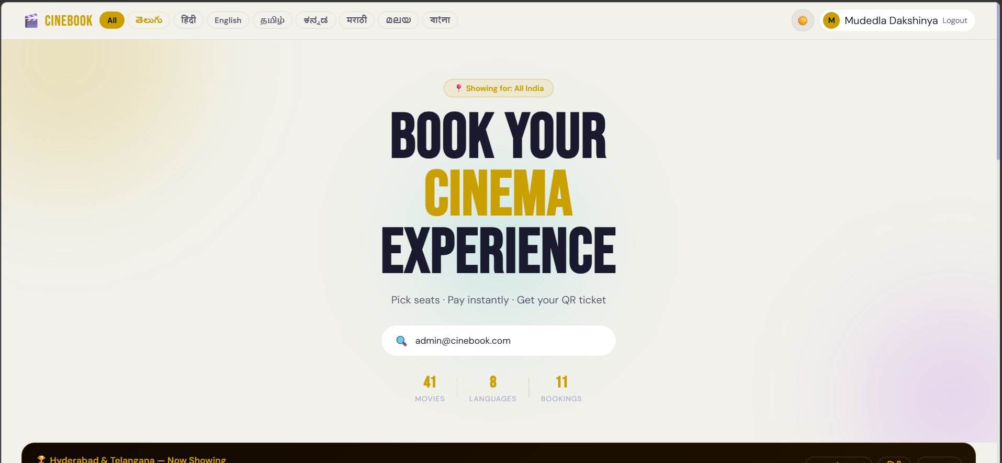
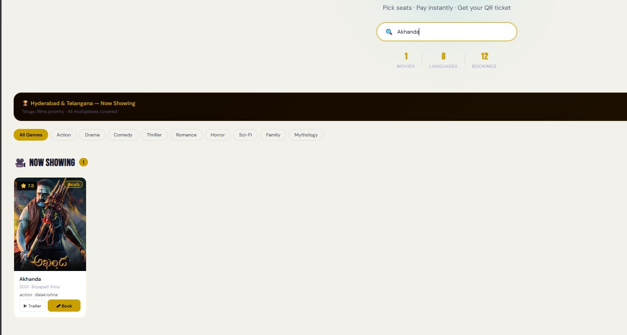
11
Frontend View — Movies & Genre Filtering
Step 3: Browse movies by language, genre (Action, Drama, Comedy, Sci-Fi, Thriller...)
Now Showing — 41 Movies, Multilingual, Sorted by Regional Priority
Live Search — Type 'Akhanda' → instant filtered results | Genre pills: Action / Drama / Comedy...
🎬 CineBook — AI-Assisted Movie Booking Platform | M.Dakshinya | 2303A51553 | 2026

Slide 12
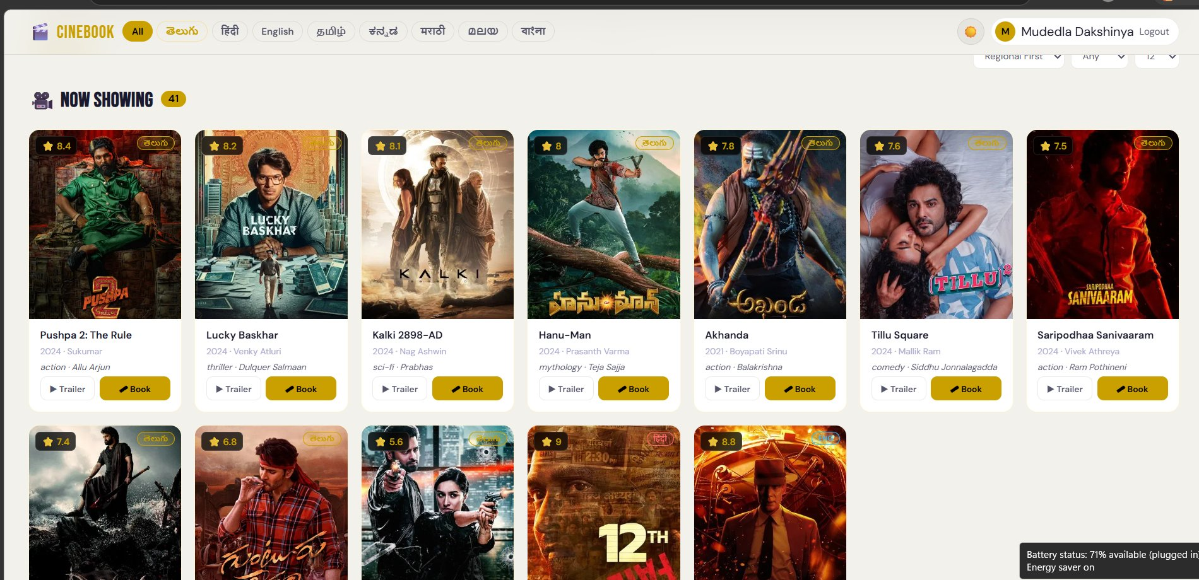
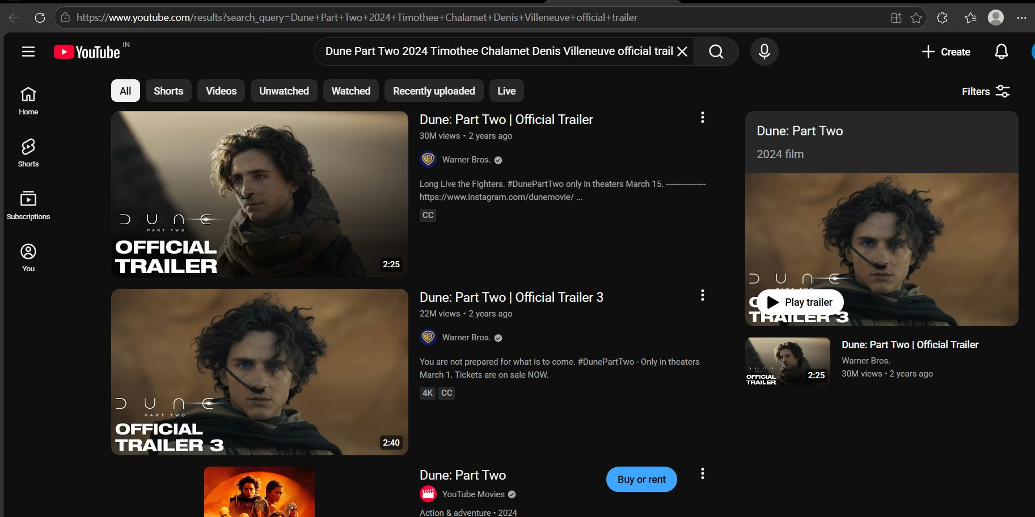
12
Frontend View — Select Movie & Watch Trailer
Step 4: Hover to Book or watch Trailer on YouTube — 12th Fail example
🎬
Trailer → YouTube: 12th Fail (Vikrant Massey · Vidhu Vinod Chopra)
Trailer → YouTube: Dune: Part Two (Timothée Chalamet · Denis Villeneuve)
🎬 CineBook — AI-Assisted Movie Booking Platform | M.Dakshinya | 2303A51553 | 2026

Slide 13
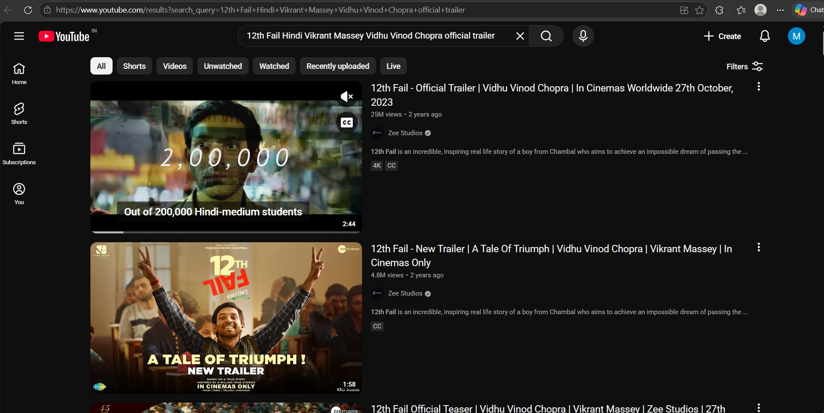
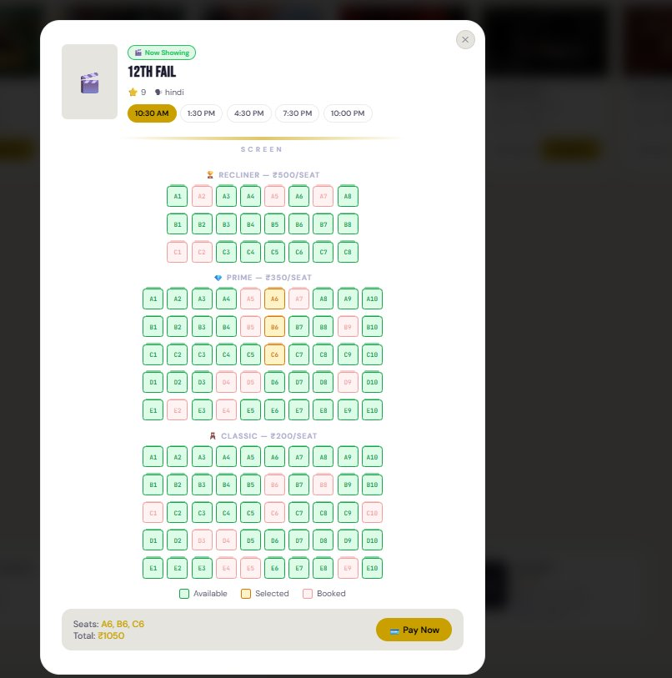
13
Frontend View — Seat Selection Grid
Step 5: Theatre-style grid — Recliner ₹500 | Prime ₹350 | Classic ₹200
Seat grid: Green = Available | Gold = Selected | Red = Booked
12th Fail Seat Selection — 5 showtimes: 10:30AM to 10:00PM
🎬 CineBook — AI-Assisted Movie Booking Platform | M.Dakshinya | 2303A51553 | 2026

Slide 14
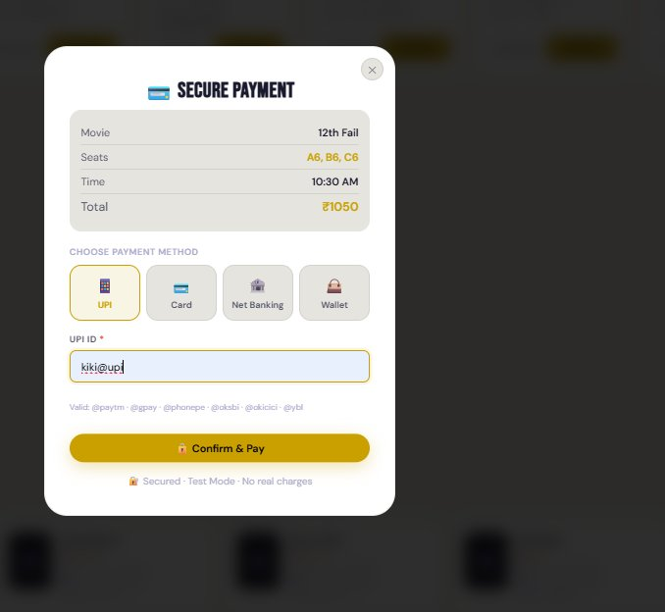
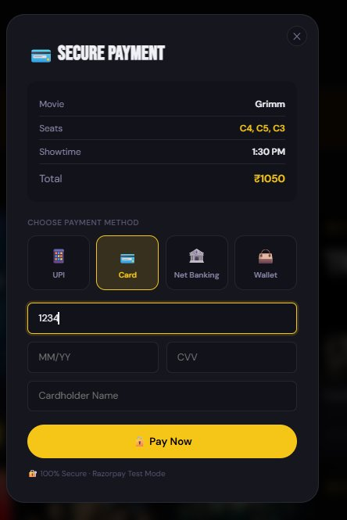
14
Frontend View — Secure Payment Gateway
Step 6: UPI / Card / Net Banking / Wallet — Test Mode (No Real Charges)
UPI Payment — Validates format: prefix@handle (paytm, gpay, phonepe...)
Card Payment — 16-digit number, MM/YY expiry, CVV, Cardholder Name
🎬 CineBook — AI-Assisted Movie Booking Platform | M.Dakshinya | 2303A51553 | 2026

Slide 15
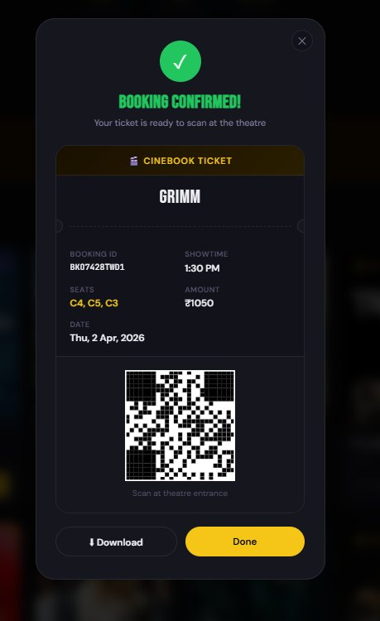
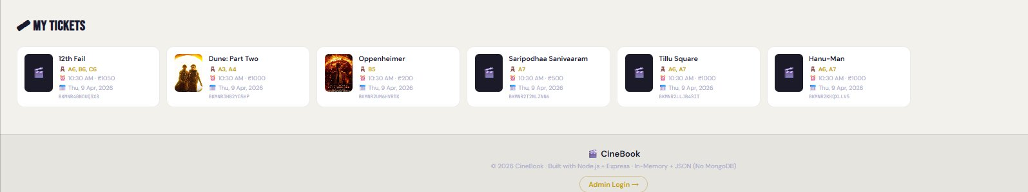
15
Frontend View — Booking Confirmed & QR Ticket
Step 7: Instant QR code generated — Download PNG — Scan at theatre entrance
BOOKING CONFIRMED! — Movie, Seats, Time, Amount, Booking ID + QR Code
MY TICKETS — 12th Fail · Dune: Part Two · Oppenheimer · Saripodhaa · Tillu Square · Hanu-Man
🎬 CineBook — AI-Assisted Movie Booking Platform | M.Dakshinya | 2303A51553 | 2026

Slide 16
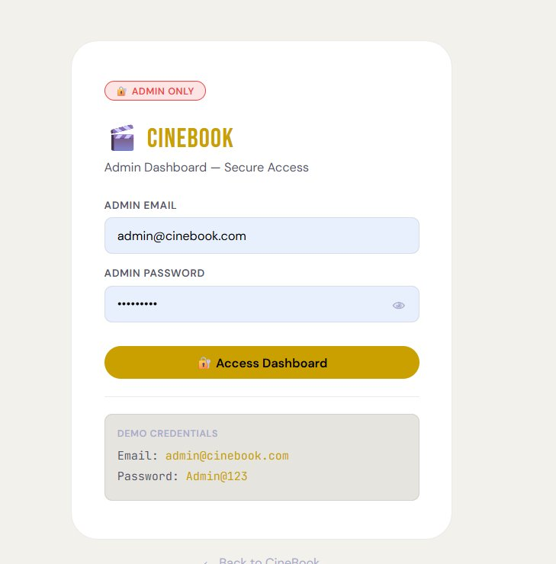
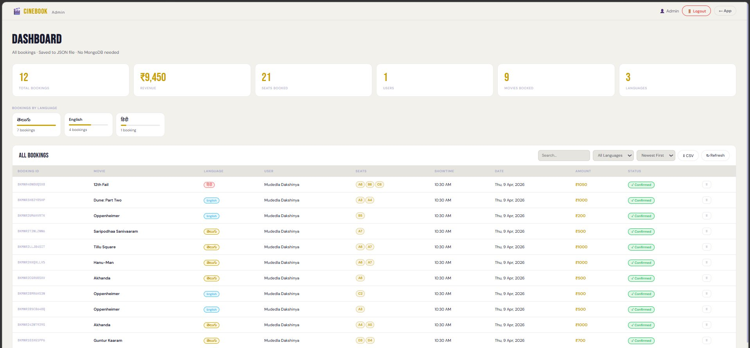
16
Admin Login & Dashboard
Step 8: Admin-only access — Secure login → Full booking analytics + Logout
→
Admin Login — Credentials: admin@cinebook.com / Admin@123
Admin Dashboard — 12 Bookings | ₹9,450 Revenue | 21 Seats | 9 Movies | 3 Languages | CSV Export
🎬 CineBook — AI-Assisted Movie Booking Platform | M.Dakshinya | 2303A51553 | 2026

Slide 17
17
Proof of AI Prompts Generating Code
Screenshots from Claude AI (Anthropic) session showing actual code generation
Prompt 01 → Homepage Layout: 'BOOK YOUR CINEMA EXPERIENCE' Dark Theme Generated
Prompt 12 → Weak Password Detection: 'Very Strong 🔒' strength meter + language preference
Prompt 03 → Booking Confirmation Modal + QR Code Canvas + Download PNG
Prompt 06 → Admin Dashboard: Bookings table, filters, CSV export, revenue stats
🎬 CineBook — AI-Assisted Movie Booking Platform | M.Dakshinya | 2303A51553 | 2026

Slide 18
18
Frontend View — Sign Up & Live Search
Create Account with password strength meter | Real-time movie search
🔐 Very Strong password — 8+ chars · Uppercase · Lowercase · Number · Symbol
🔍 Live Search — filters movies in real-time as you type (Akhanda shown)
🎬 CineBook — AI-Assisted Movie Booking Platform | M.Dakshinya | 2303A51553 | 2026

Slide 19
19
Admin Dashboard — Full Booking Management
12 Bookings | ₹9,450 Revenue | 21 Seats | 9 Movies | 3 Languages | Export CSV
12
₹9,450
21
9
3
CSV
TOTAL BOOKINGS
REVENUE
SEATS BOOKED
MOVIES
LANGUAGES
EXPORT

Slide 20
20
References
All resources, tools, and documentation used throughout the project
📚 Technical Documentation
🤖 AI Tools & Resources
→ MDN Web Docs — developer.mozilla.org
→ Claude AI — claude.ai (Anthropic)
→ W3Schools — w3schools.com
→ Anthropic Docs — docs.anthropic.com
→ Express.js Docs — expressjs.com
→ GitHub Copilot — github.com/features/copilot
→ Node.js Docs — nodejs.org/docs
🎨 Design & Assets
☁️ Deployment Platforms
→ Google Fonts — fonts.google.com
→ Netlify — netlify.com (frontend)
→ TMDB — themoviedb.org (posters)
→ Render — render.com (backend)
→ Font Awesome — Icons
→ GitHub — Source code & commit history
🎬 CineBook — Built with Node.js · Express · HTML · CSS · JavaScript · Claude AI | 2026
🎬 CineBook — AI-Assisted Movie Booking Platform | M.Dakshinya | 2303A51553 | 2026

