Slide 1


Topic : Automated system for career advancements of the faculties of higher education Domain : Student Innovation Team ID : T263 Team name : Data Dragons Team members : 2303A52394 2303A52304 2303A52310 2303A52300 2303A52253

Slide 2

Objective
Purpose of the System/Project: The project aims to develop an Automated System for Career Advancements of the Faculties of Higher Education to streamline and modernize faculty self-appraisal. It enhances efficiency, transparency, and accessibility for faculty members and administrators.
Main Goals and Expected Outcomes:
Automate faculty self-appraisal by tracking research, seminars, and academic activities.
Provide a secure web-based platform for faculty and administrators.
Enable real-time data entry for research publications, events, and lectures.
Support decision-making with easy data sorting and PDF reports for administrators.
Promote a paperless evaluation system aligned with modern education practices.

Slide 3
Problem Statement
Traditional faculty self-appraisal in higher education is time-consuming, paper-based, and inefficient. The lack of automation leads to errors, difficulty in tracking faculty contributions, and delays in evaluation.
Challenges in the Current Scenario:
Manual Process: Faculty members fill out paper-based or unstructured digital forms.
Data Management Issues: Difficulties in tracking research publications, events, and projects.
Lack of Transparency: Faculty have limited access to their appraisal records.
Time-Consuming: Administrators manually sort, verify, and analyze faculty contributions.
Limited Decision Support: No consolidated reports for easy decision-making.
Key Pain Points:
Time Delays: Paper-based appraisals take weeks to process.
Errors & Inconsistencies: Manual data entry leads to mistakes.
No Real-Time Tracking: Faculty cannot update their records dynamically.
Difficult Data Retrieval: Admins struggle to sort and analyze faculty submissions.

Slide 4
Existing system
Current System and Its Limitations
1. Existing System / Method:
Faculty self-appraisal is currently paper-based or uses basic digital forms.
Manual data entry and evaluation by administrators.
Lack of real-time tracking of faculty activities.
2. Limitations & Inefficiencies:
Time-Consuming – Faculty and admins spend excessive time on data entry and verification.
Lack of Transparency – No real-time access to faculty contributions.
Data Inaccuracy – Risk of errors in manual submissions.
Limited Insights – No automated tracking of research publications, seminars, or projects.
3. Need for a New System:
Automate the process for efficiency and accuracy.
Enable real-time updates and seamless tracking of faculty progress.
Provide a centralized dashboard for easy evaluation by administrators.
Support data-driven decision-making for career advancements.

Slide 5
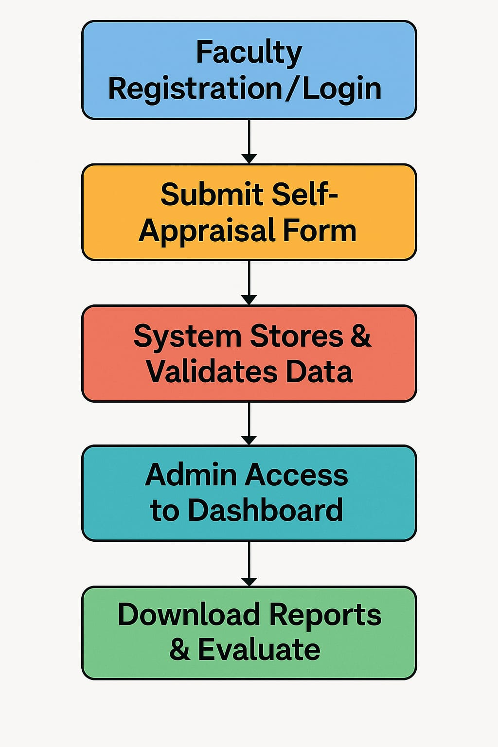
Proposed system
Introducing the Automated System for Career Advancements
Overview of the New System
A web-based Automated Faculty Self-Appraisal System designed to streamline faculty evaluation.
Captures research publications, seminars, projects, lectures, and academic contributions in real-time.
Provides secure login, automated tracking, and centralized data management.
Advantages Over the Existing System
✅ Time-Saving: Reduces manual effort with automation.
✅ Transparency: Real-time updates and easy accessibility.
✅ Accuracy: Minimizes human errors in appraisal data.
Key Features & Functionalities
Secure User Authentication: Role-based access for faculty & administrators.
Automated Research Tracking: Integration with Google Scholar for real-time
updates.

Slide 6
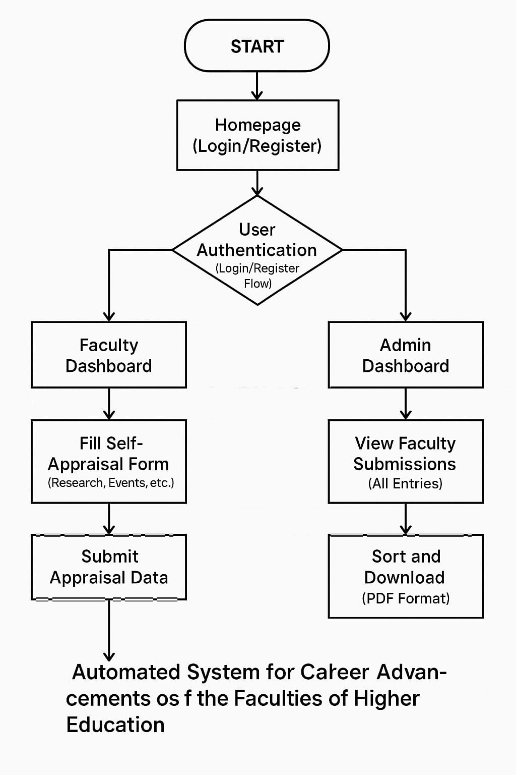
Workflow

Slide 7
System Architecture
Key points to cover
Tech Stack
Front-end: HTML, CSS, Java,C
Back-end: Node.js, Python
Web-Based Architecture – Faculty update activities via a web interface, while data is securely processed and stored.
Layered Structure – Presentation (UI), Application (Backend logic), Database (Secure storage), and Admin Panel (Data access).
Component Roles – Faculty input data → Backend processes → Database stores securely → Admin Panel retrieves for reporting.
Efficient Workflow – Enables real-time updates, centralized tracking, and quick report generation.
User-Friendly Design – Clean dashboard with sorting/filtering ensures fast and organized data access.
SQL DATABASE
Encryption and access control mechanisms to ensure data confidentialitySecure authentication system for faculty and admin access
Data sorting, filtering, and PDF export
features for streamlined reporting

Slide 8
Conclusion & Future Scope
🔑 Key Takeaways
A comprehensive, web-based platform for faculty self-appraisal.
Replaces manual paperwork with digital forms and automated data tracking.
Improves transparency, accountability, and decision-making in faculty evaluations.\
🌟 Impact and Benefits
Significant reduction in administrative workload.
Supports paperless governance and sustainability goals.
Enhances the quality of academic evaluations.
Future Enhancements
Integration with external academic databases (Scopus, IEEE, etc.).
AI-based recommendations and analytics for performance reviews.
Mobile application for on-the-go access and updates.
Our Final Thought
“This project is not just a system upgrade—it's a step toward a smarter, transparent,
and future-ready academic environment.”

