Slide 1

B.TECH CSE PROJECT
A Context-Aware Multi-Page Reasoning System Using Hierarchical PageIndex Architecture for Efficient Knowledge Retrieval
AI-Powered Document Reasoning & Contextual Q&A System
Team Members:
P.Thrishank(2303A52013) | P.Lalith(2303A52012) | B.Kowshik Reddy(2303A52002) |
V.Rohith Reddy(2303A52215)
Course:
AI Assisted Coding
Faculty:
Mr. Naresh Kumar Sripada
College:
SR University
2025–26 | Department of CS&AI

Slide 2

Introduction
🔴 The Problem
🟢 DeepReasoner Solution
AI systems struggle to reason over large, structured documents
Traditional Q&A fails to understand document context & hierarchy
Page-level indexing is underutilized in current AI pipelines
Retrieving accurate answers from multi-page PDFs is a major challenge
Lack of explainability in document-based AI responses
PageIndex: Assigns unique index to every document page
DeepReasoner: AI engine that reasons across indexed pages
Combines LLM power with structured document navigation
Delivers precise, page-aware answers with source citations
Clean web interface for seamless user interaction

Slide 3

Objectives
1
🤖 AI-Based Reasoning System
2
📖 Improve Contextual Understanding
Build a reasoning engine that understands and navigates document structure using page-level indexing.
Enable the AI to grasp multi-page context, section hierarchy, and semantic relationships within documents.
3
✅ Accurate Document-Based Q&A
4
🖥️ User-Friendly Interface
Provide precise, verifiable answers with page citations, reducing hallucination in LLM responses.
Develop an intuitive web UI for uploading documents, entering queries, and viewing structured results.

Slide 4

Stakeholders
🎓
🔬
💻
🏢
Students
Researchers
Developers
Organizations
Access AI-driven Q&A for research papers, study materials, and academic content — saves hours of manual reading.
Quickly extract insights from lengthy research papers and journals using intelligent document reasoning.
Leverage open-source APIs and project architecture to build AI-powered document tools and integrations.
Automate internal document queries — HR policies, legal contracts, technical manuals — improving efficiency.

Slide 5

Technologies Used
🌐 Frontend
⚙️ Backend
🤖 AI / APIs
🚀 Dev & Deploy
HTML5
Python 3.10+
OpenAI GPT API
GitHub (Version Ctrl)
CSS3
Flask / FastAPI
NVIDIA NIM API
Netlify (Hosting)
JavaScript (ES6+)
REST API
Prompt Engineering
VS Code
Responsive Design
JSON Handling
LLM Integration
Postman (API Testing)

Slide 6

Prompts Used
⚙️ Backend Development Prompts
Create a Flask web app that allows users to upload PDF documents and ask questions. The app should extract text from PDFs, split it into sections, find relevant sections using AI, and generate answers with reasoning. Include file upload, question input, and result display.
Create a function to split extracted PDF text into logical sections, detecting headers for SEC forms and financial documents, with fallback chunking if needed.
Create Python functions to extract text from PDF files using pdfplumber, store extracted text to files, load text from files, and manage text storage cleanup.
🤖 AI Integration Prompts
Prompt sent to the NVIDIA OpenAI-compatible API to choose the most relevant sections. The model should read the question, review the listed document sections, and return. the titles of the sections that are most useful for answering the question.

Slide 7

System Workflow
System Workflow
1
2
3
4
5
6
User
Upload Doc
PageIndex
AI Model
Answer Gen
Output
Initiates Query
PDF / Text File
Index by Page No.
LLM Reasoning
Extract Response
Display + Cite Page
Detailed Workflow Description
① User submits a natural language question via the web interface
② Document (PDF/TXT) is uploaded and sent to the backend server
③ PageIndex module processes the document — each page is extracted, cleaned, and assigned a unique index ID with metadata
④ The AI Model (LLM) receives the query + relevant indexed pages and performs deep contextual reasoning
⑤ Answer Generation extracts the precise response with confidence scoring
⑥ Output is displayed to the user with the answer, page citation, and relevant excerpts

Slide 8

Frontend UI Screens
🏠 Home Page
📤 Upload Page
Project title & hero section
Navigation: Upload | Query | About
Animated CTA button
Feature highlights grid
Drag-and-drop PDF zone
File validation (type/size)
Upload progress indicator
Success/error notification
🔍 Query Interface
📊 Results Page
Search bar with auto-suggest
Submit button with loading spinner
Document context selector
Recent queries history
Answer card with confidence %
Page citation badge
Relevant excerpt highlight
Copy & export options

Slide 9

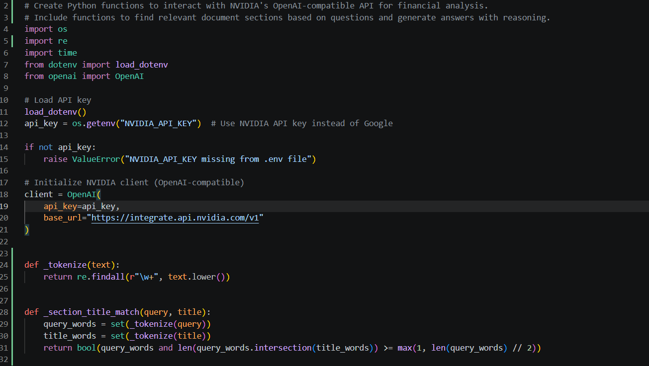
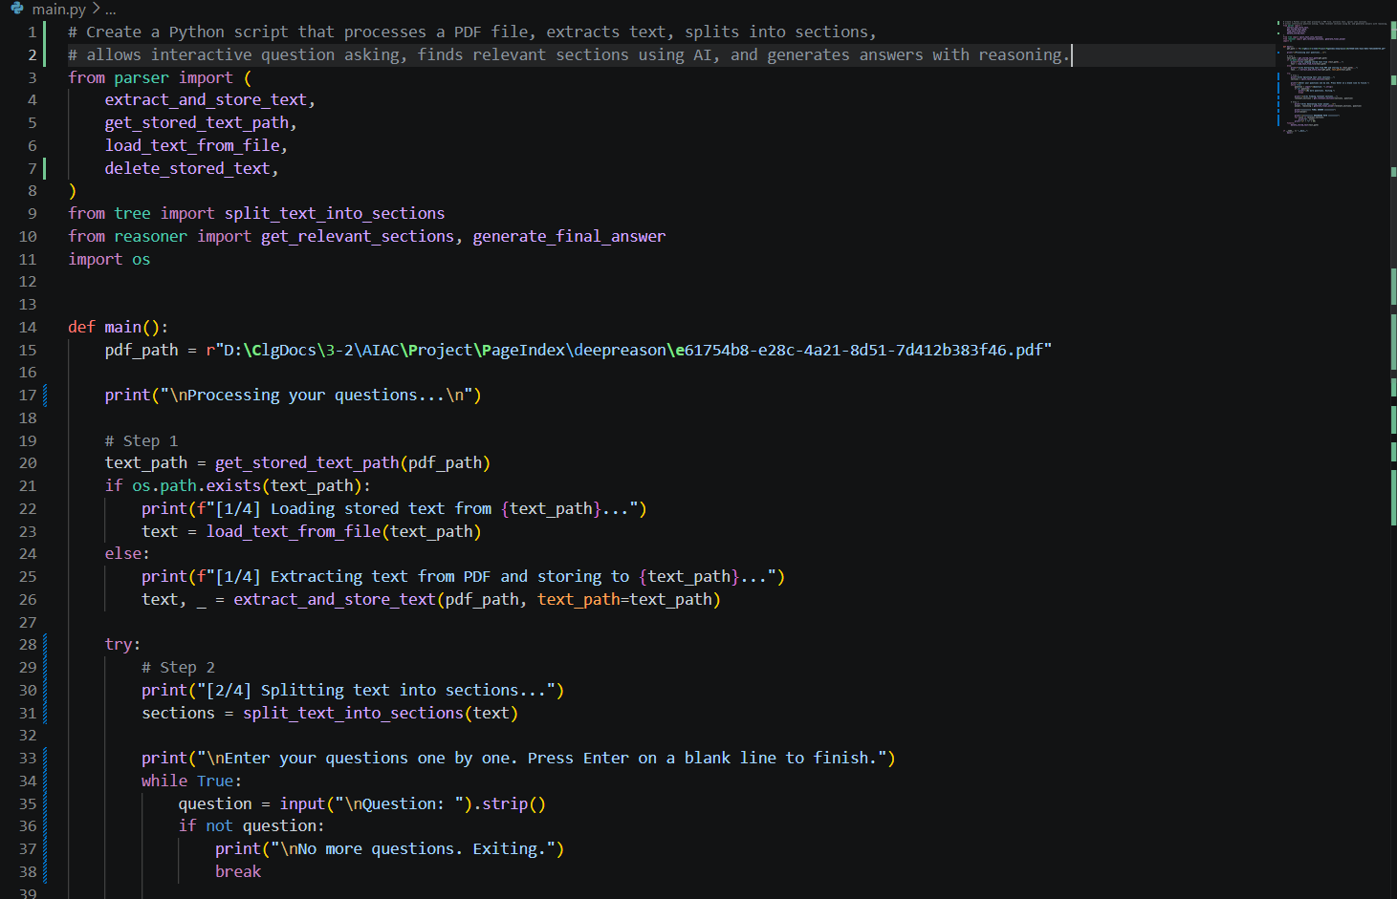
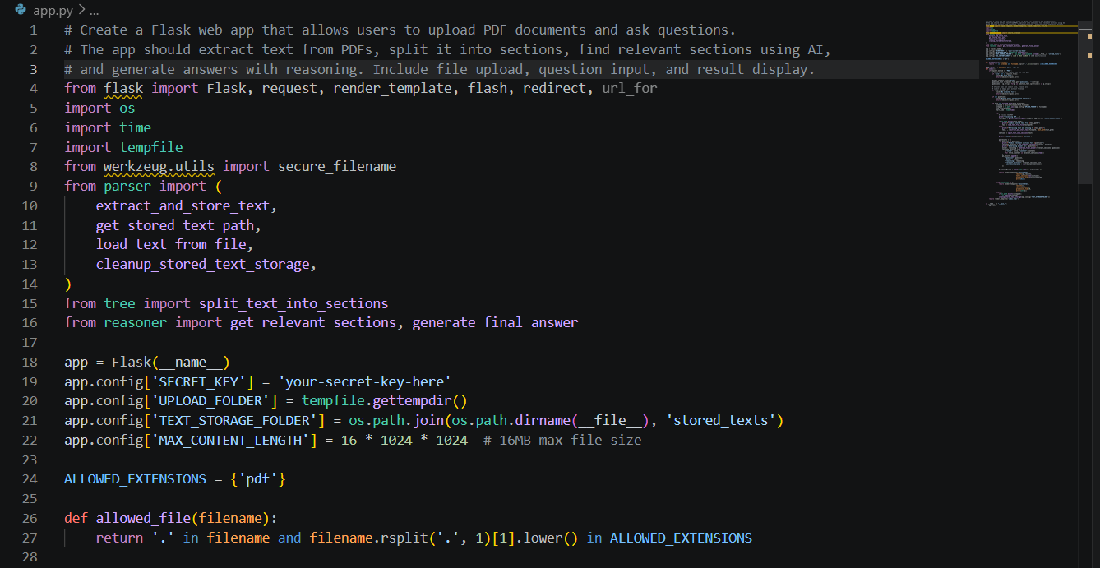
Proof of Prompts & Outputs

Slide 10

References
🤖 AI Tools & Models
📚 Documentation
🌐 Websites & Research
OpenAI Platform — platform.openai.com
Python Flask Docs — flask.palletsprojects.com
arXiv — arxiv.org (AI/ML papers)
NVIDIA NIM API — build.nvidia.com
PptxGenJS Docs — gitbrent.github.io/PptxGenJS
Papers With Code — paperswithcode.com
LangChain Documentation — langchain.readthedocs.io
MDN Web Docs — developer.mozilla.org
Netlify Docs — docs.netlify.com
Hugging Face Transformers — huggingface.co/docs
GitHub Docs — docs.github.com
Towards Data Science — towardsdatascience.com
DeepReasoner using PageIndex | B.Tech CSE | AIAC Project | 2025–26

