Slide 1


Topic : Healthcare Management System Domain : Health Care Team ID : T194 Team name : 5 Coders Team members : KEERTHI SURYA TEJA (2303A52007) BIJJALA VRINDHA (2303A52003) BOGA SIRICHANDANA (2303A52004) THAKUR AKSHAYA (2303A52017) BANOTH TEJASHWINI (2303A52001)

Slide 2

Objective
Project Purpose: To develop a Healthcare Management System to streamline clinic operations.
Main Goals:
Create a centralized system for managing patient information securely.
Simplify and organize the appointment scheduling process.
Enable quick and authorized access to basic patient records.
Reduce errors associated with manual, paper-based systems.
Expected Outcome: A functional prototype demonstrating core features like patient registration, appointment booking, and basic record viewing.

Slide 3
Problem Statement
Current manual or outdated systems for managing patient records are often inefficient and prone to errors.
Difficulty in quickly accessing complete patient history, especially in emergencies.
Appointment scheduling can be chaotic, leading to long waiting times or double bookings.
Risk of data loss or breaches with physical records or insecure digital methods.

Slide 4
Existing system
Current Methods: Often involve manual registers, individual paper files, basic spreadsheets (like Excel), or standalone, non-integrated simple software.
Limitations:
Slow Retrieval: Finding specific patient information takes significant time.
Data Silos: Information isn't easily shared or cross-referenced.
Error Prone: High chance of manual data entry errors, lost documents.
Insecure: Physical records are vulnerable to damage, loss, or unauthorized access.
Poor Scheduling: Difficult to get an overview of appointments; prone to clashes.
Need for New System: To improve efficiency, accuracy, security, and overall management of clinic operations.

Slide 5
Proposed system
Introduction: We propose Healthcare Management System built using java
Advantages:
Centralized database for all patient and appointment information.
Secure login for different user roles (e.g., Admin, Receptionist, Doctor).
Streamlined, digital appointment booking and management.
Easy search and retrieval of patient data.
Reduced paperwork and potential for errors.
Key Features:
User Authentication & Role Management
Patient Registration & Profile Management
Appointment Scheduling & Viewing
Basic Electronic Record Keeping (e.g., storing visit notes, diagnosis - be specific about what you implemented)

Slide 6
Workflow
Flowchart Description:
Step 1: User (e.g., Receptionist) Logs In.
Step 2: Navigates to 'Appointments' Module.
Step 3: Selects 'Book New Appointment'.
Step 4: Searches for Existing Patient OR Registers New Patient.
Step 5: Selects Doctor, Date, and Available Time Slot.
Step 6: Enters Reason for Visit (Optional).
Step 7: Confirms Booking.
Step 8: System Saves Appointment to Database & Updates Calendar View.
Explanation: This workflow demonstrates how the system simplifies booking appointments, ensuring details are captured accurately and stored centrally.

Slide 7
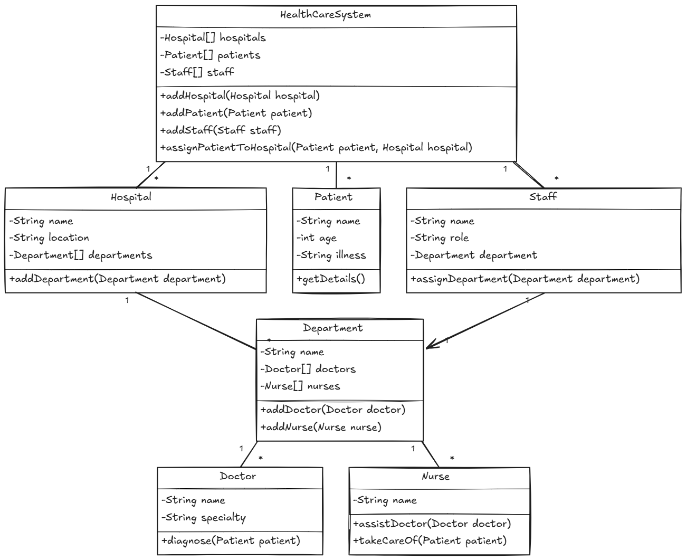
System Architecture

Slide 8
Conclusion & Future Scope
The Healthcare Management System, developed using Java, successfully provides a foundational platform for streamlining critical administrative and operational tasks within a healthcare facility. By leveraging Java's robustness, platform independence, and extensive libraries, the system offers core functionalities such as:
Patient Registration and Management: Centralizing patient demographic and basic medical information.
Appointment Scheduling: Enabling efficient booking, viewing, and management of appointments for doctors and patients.

