Slide 1


VARSHAPAY
SMART DIGITAL PAYMENT WEB APPLICATION
Student Name: Gangula Varshitha
Branch: CSE (AIML)
Batch No: 39
Hall Ticket No: 2303A52054

Slide 2
INTRODUCTION
VarshaPay is a web-based digital payment application designed to simulate the working of modern UPI payment systems.
This project demonstrates:
Basic digital wallet functionality
Interaction between frontend and backend
User-friendly payment interface
It helps understand how real-world payment apps function.

Slide 3
OBJECTIVES
To design a digital payment web application
To understand frontend and backend integration
To simulate UPI payment system behavior
To build a responsive user interface
To gain knowledge in full-stack development

Slide 4
STAKEHOLDERS
End Users: People using the app for transactions
Developer: Gangula Varshitha
Faculty/Evaluators: Project reviewers
Organizations: Potential fintech companies

Slide 5
PROGRAMMING LANGUAGES, TOOLS, AND SOFTWARE
Programming Languages | Backend Technologies | Tools Used | Software / Platform
HTML | Node.js | VS Code | Web Browser
CSS | Express.js | GitHub | Localhost Server
JavaScript | - | - | -

Slide 6
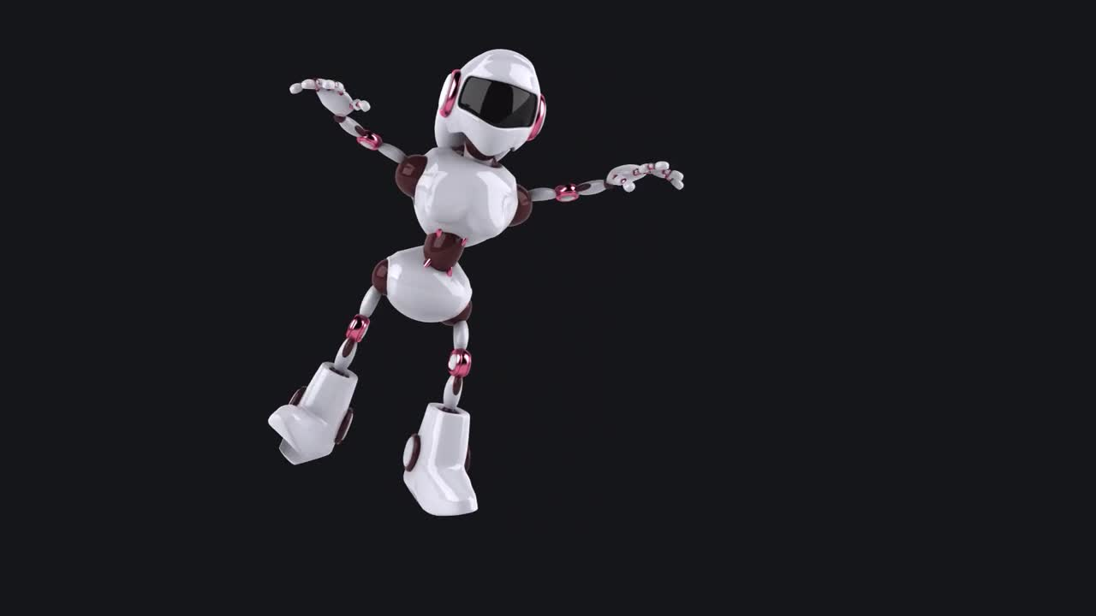
PROMPTS USED TO GENERATE CODE
Create a full-stack web application for a digital payment system called VarshaPay using Node.js and Express.
Design a responsive frontend using HTML, CSS, and JavaScript with a wallet dashboard and payment interface.
Implement basic API endpoints for server health and user interaction.
Ensure the application runs on localhost and follows a clean, user-friendly UI structure.

Slide 7
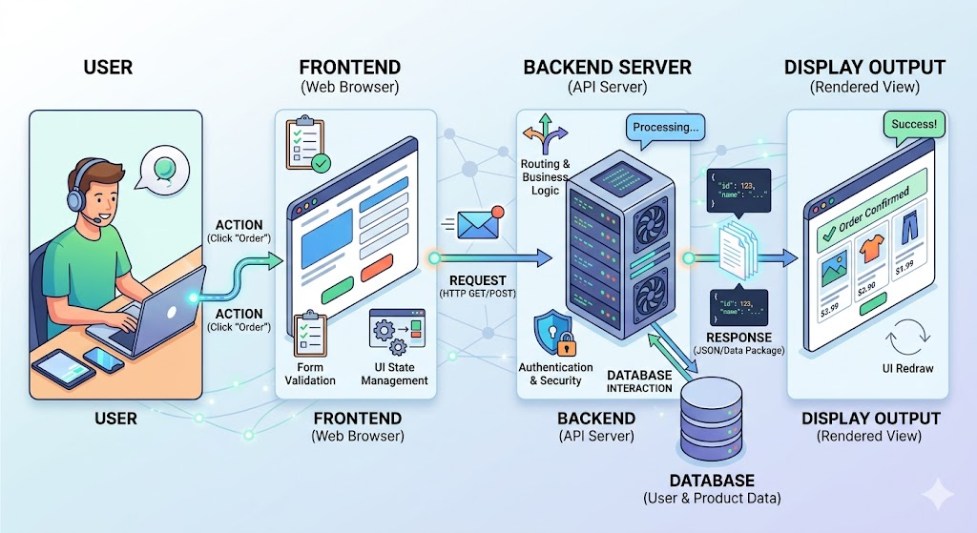
WORKFLOW

Slide 8
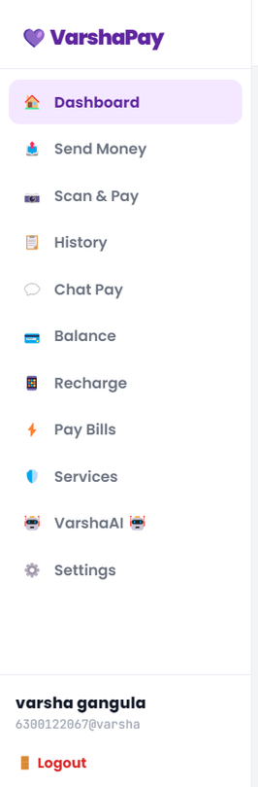
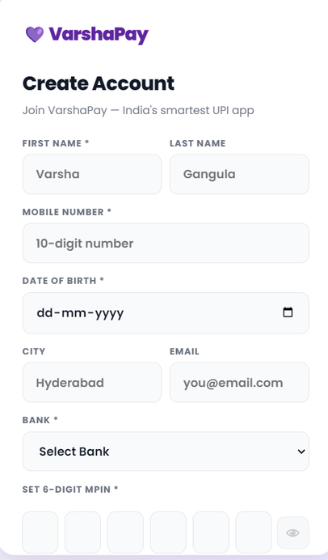
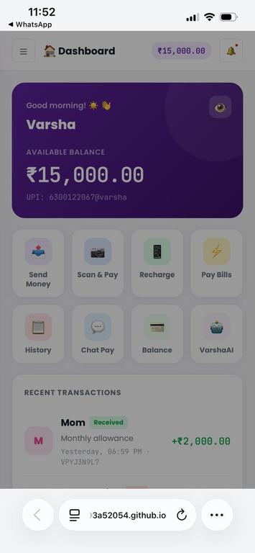
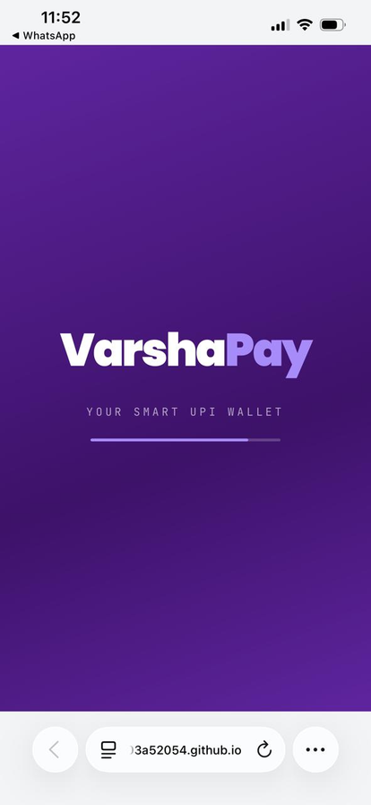
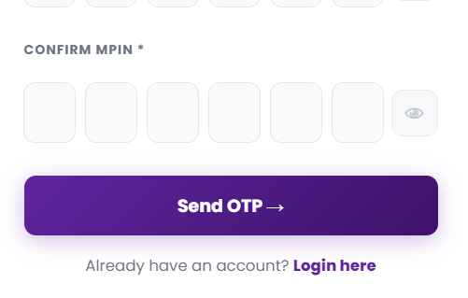
FRONT-END VIEW

Slide 9
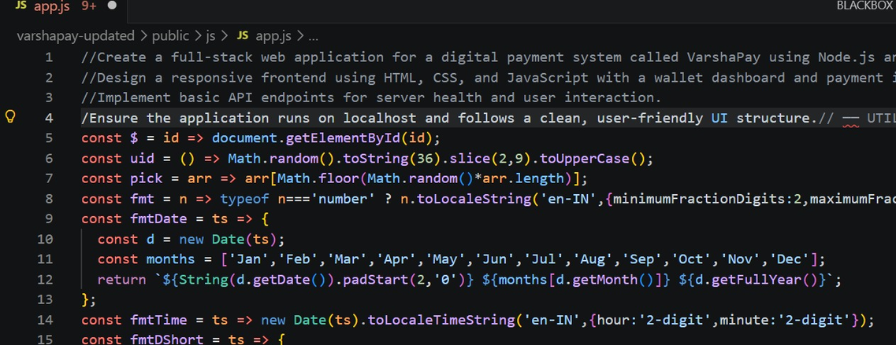
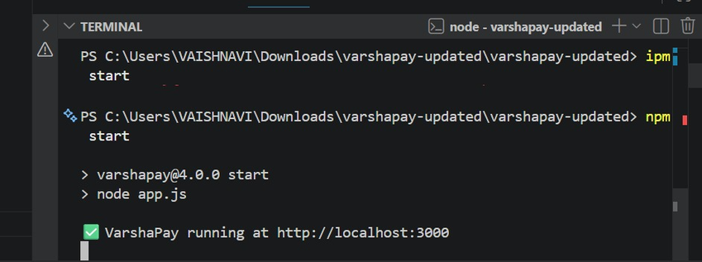
PROOF OF PROMPTS GENERATING CODE

Slide 10
THANK YOU

