Slide 1



AI-BASED CAREER GUIDANCE AND SKILL GAP ANALYZER
Team members
K.Ruchitha - 2303A52069
G.Nithya - 2303A52066

Slide 2

INTRODUCTION
Career selection is challenging for students
Lack of awareness about required skills
Traditional guidance is not personalized
AI helps provide smart career recommendations
01

Slide 3
OBJECTIVES
1)To suggest suitable career roles based on user skills
2)To analyze skill gaps for each rol
3)To provide a structured learning roadmap
4)To support resume-based skill extraction
5)To build a simple and user-friendly web application
02

Slide 4

STAKEHOLDERS
1)Students → to identify career paths
2)Job seekers → to improve skillsets
3)Educational institutions → to guide students
4)Developers → to enhance system further
03

Slide 5
PROGRAMMING LANGUAGES & TOOLS
Python
HTML
CSS
JavaScript
Framework:
Flask
Libraries:
PyPDF2 (for resume reading)
Tools Used:
VS Code
Browser (Chrome)
04

Slide 6


PROMPTS USED
Generate a Flask backend application that accepts user skills as input and recommends suitable career roles based on skill matching
Create a simple and clean HTML, CSS user interface with a white theme for entering skills and displaying career prediction results
Implement skill gap analysis logic in Python to identify missing skills required for each recommended career role
Develop JavaScript code to send user input to the Flask backend and dynamically display career roles, match score, and skill gaps.
Add functionality to generate a learning roadmap for each career role based on required skills
05

Slide 7
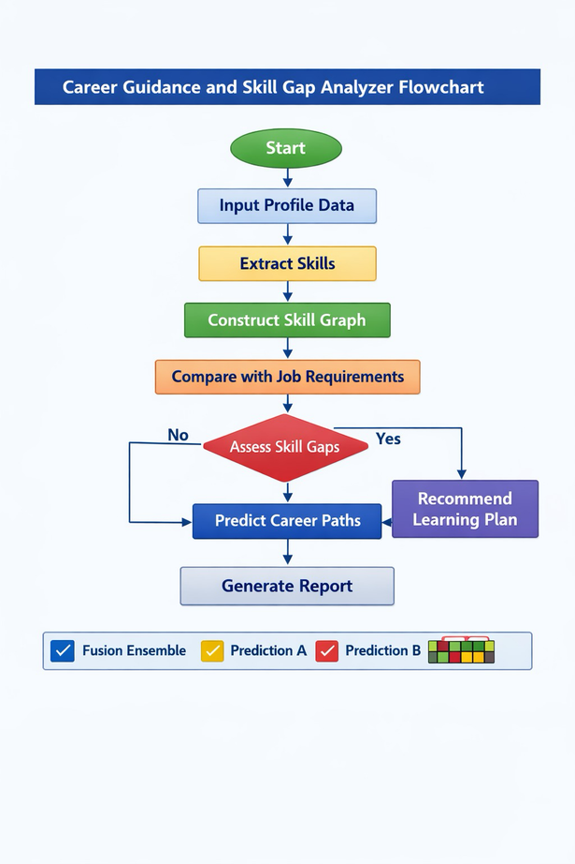
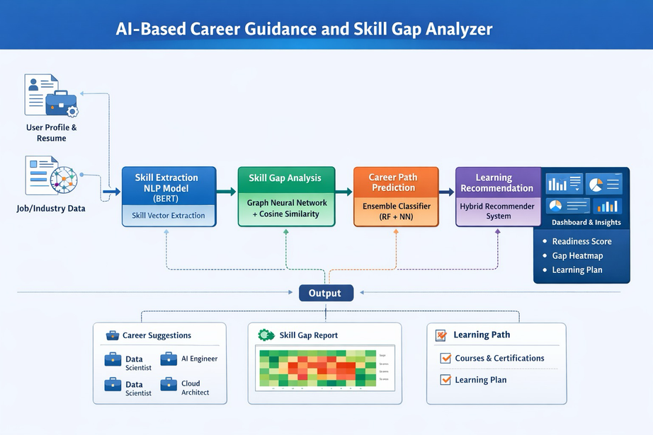
WORK FLOW
06

Slide 8
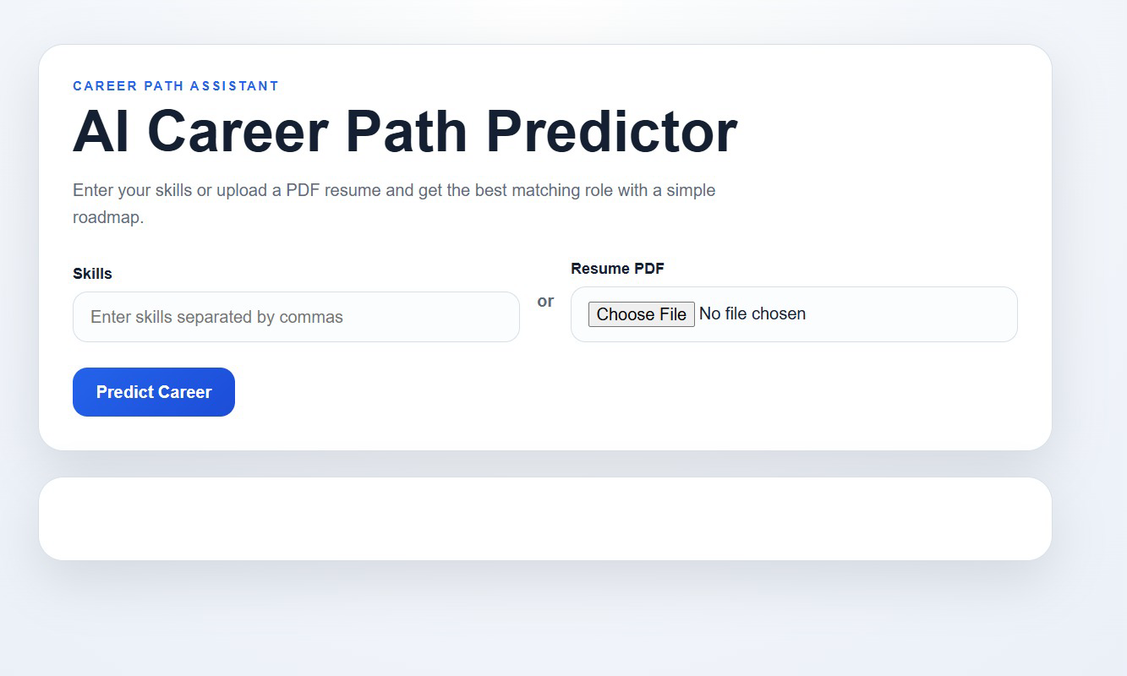
FRONT-END VIEW
07

Slide 9
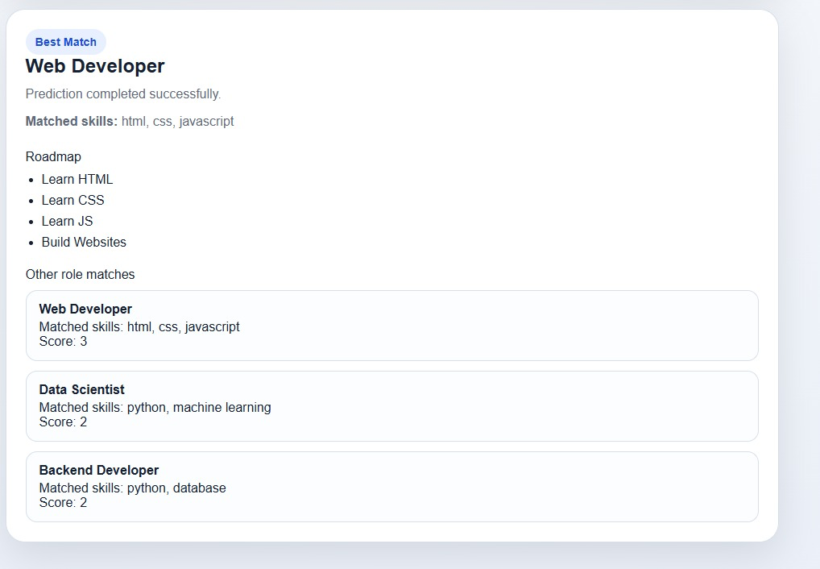

Slide 10
REFERENCES
ChatGPT – used for AI-assisted code generation, logic design, and debugging
OpenAI – for natural language processing and prompt-based development
Flask – for building backend server and API endpoints
PyPDF2 – for extracting text from uploaded resume files
Visual Studio Code – used for development and debugging
GitHub – for version control and project management
Google Chrome – for testing and running the application
08

Slide 11
THANK YOU
10

