Slide 1
AI Personal Finance Tracker
Team Details:
Your Name:R. Abhinav Reddy
Your ID:2303A52348

Slide 2
Introduction
AI Personal Finance Tracker is a web application that helps users manage income, expenses, and budgets.
It provides AI-based insights.

Slide 3
Objectives
• Track income & expenses
• AI insights
• Budget management
• Multi-currency support

Slide 4
Technologies Used
Frontend: React.js
Backend: Node.js, Express.js
Database: MongoDB

Slide 5
Prompt Used for Frontend Development
Generate a React-based UI for a personal finance tracker with dashboard, transactions, budget, and AI insights.
Include API integration with backend at localhost:5000.

Slide 6
Prompt Used for Backend Development
Generate a Node.js Express backend with routes for auth, transactions, budget, and AI insights.
Use MongoDB and JWT authentication.

Slide 7
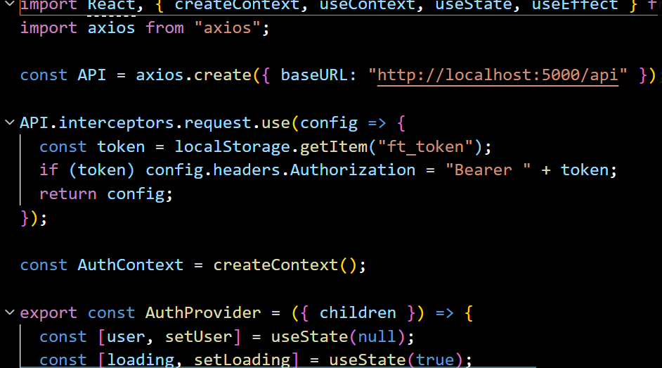
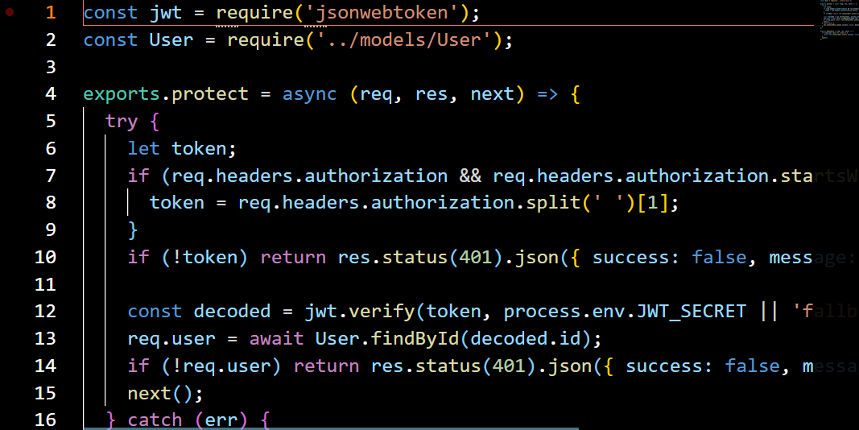
Proof of Prompts Generating Code
• Generated frontend code:
Generated backend code:

Slide 8
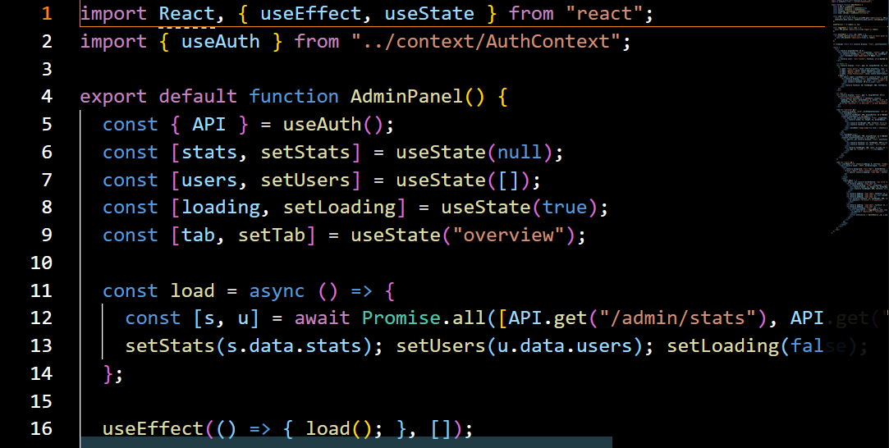
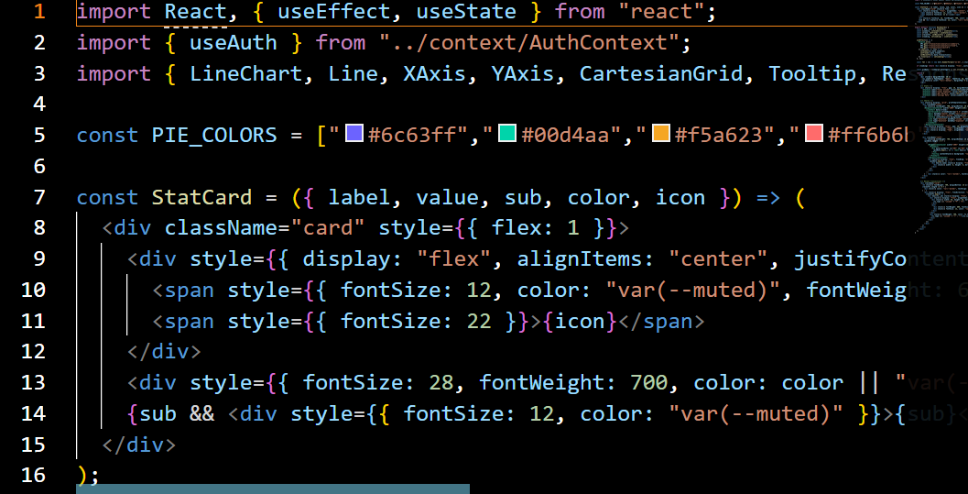

Slide 9
Workflow
User Login → Add Transactions → AI Analysis → Dashboard Display

Slide 10
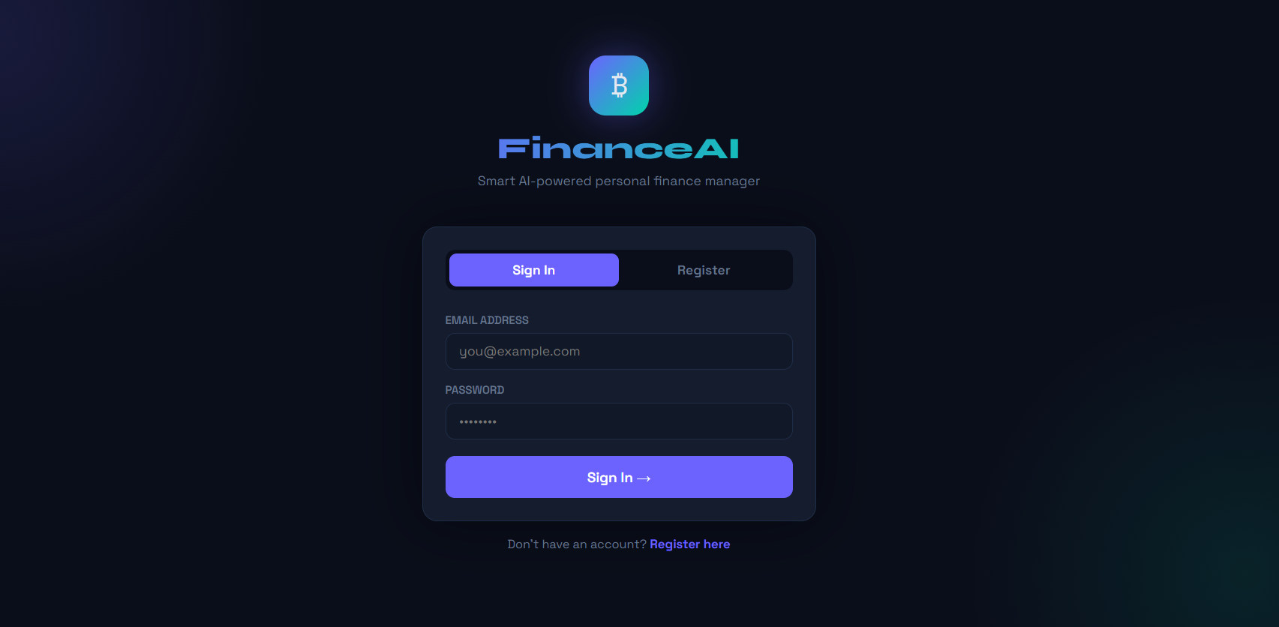
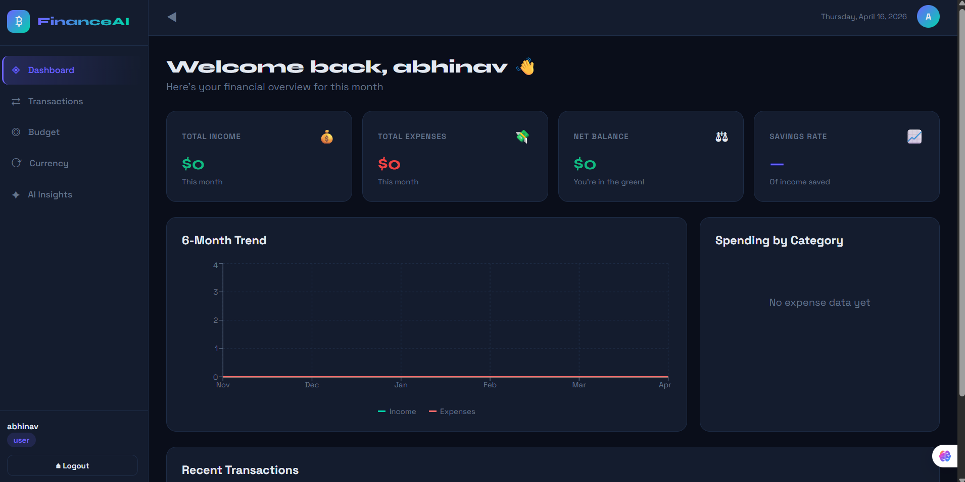
INTERFACE:

Slide 11
References
Node.js Docs
React Docs
MongoDB Docs
ChatGPT

