Slide 1
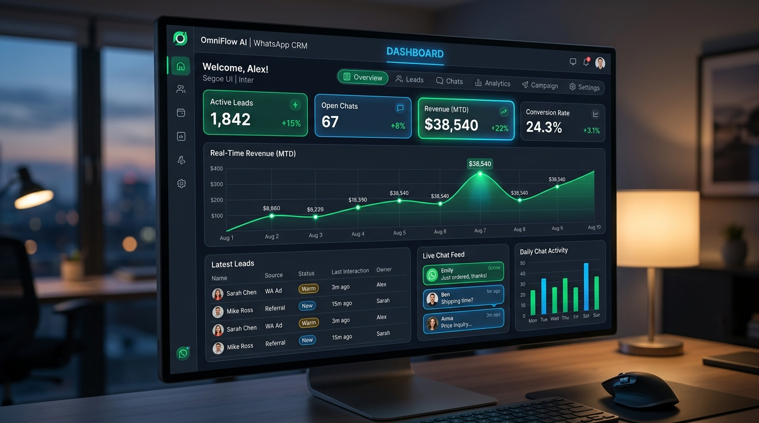
HACK DEVENGERS 2.0 SUBMISSION
OmniFlow AI
Autonomous Multimodal WhatsApp CRM &
Real-Time UPI Billing Engine
👤 Presenter: Seetharam Ravula
🚀 Build • Learn • Lead • Impact

Slide 2
HACK DEVENGERS 2.0 PROJECT PITCH
The Real-World Problem Facing Indian MSMEs
🔴 High Lead Drop-off Rates
Inquiries on WhatsApp go unaddressed for hours because manual customer support reps cannot respond fast enough, causing potential buyers to switch to competitors.
🔴 Payment Friction & Abandonment
Sharing bank details or generic payment links manually creates trust issues and delays, leading customers to abandon purchase decisions before checkout.
🔴 Fragmented Lead Tracking
Customer chat histories, unpaid Khatas, and transaction receipts stay trapped inside personal phone screens without a unified CRM or payment reconciliation tool.

Slide 3
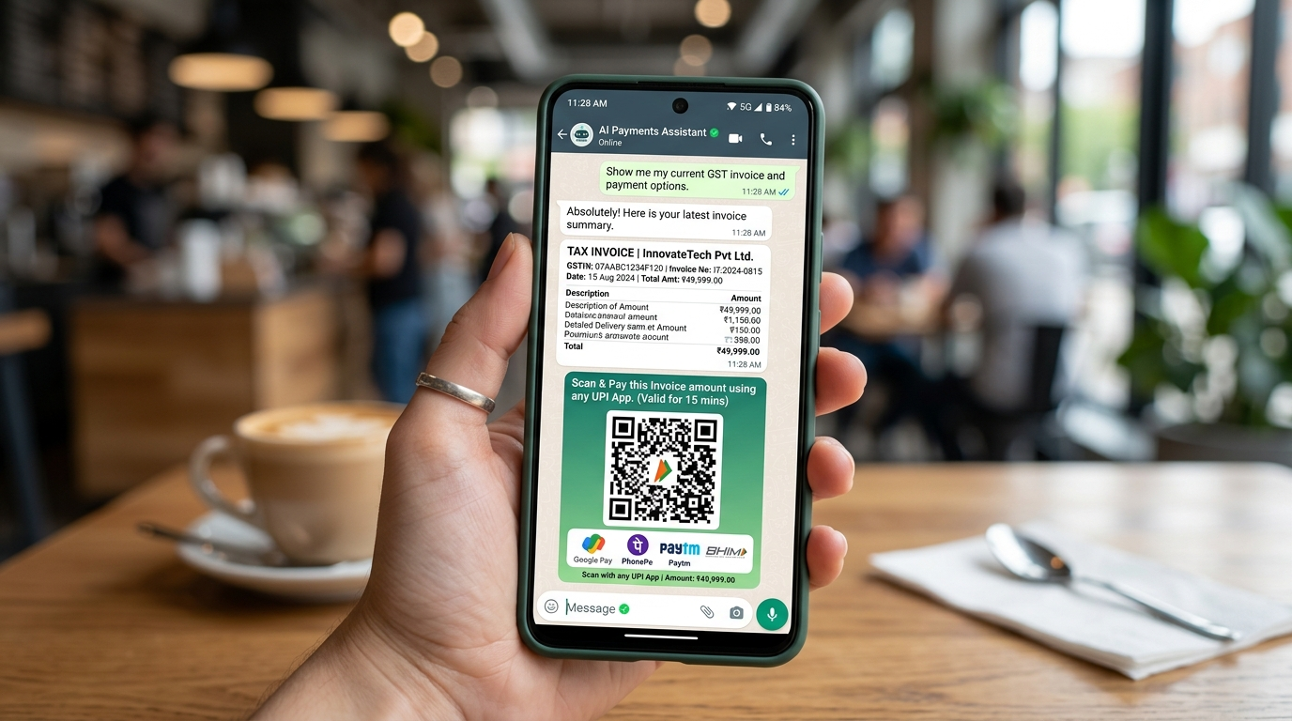
HACK DEVENGERS 2.0 PROJECT PITCH
OmniFlow AI: Solution Overview & Mobile Experience
🎙️ Multimodal & Multilingual AI
Processes text messages and voice notes in English, Hindi, Hinglish, and regional code-switching languages.
⚡ NPCI-Compliant UPI Invoicing
Generates dynamic GST invoices with scannable UPI QR images and instant payment deep links (GPay, PhonePe, Paytm, BHIM).
📊 Real-Time Web CRM Dashboard
Sleek dark-mode dashboard displaying lead statuses (NEW, INVOICED, CONVERTED), sentiment analytics, and payment reminders.

Slide 4
HACK DEVENGERS 2.0 PROJECT PITCH
Technical Stack & Web Dashboard Workspace
Backend Framework: Python 3.10, FastAPI, Uvicorn (Async REST API)
Database Layer: SQLite, SQLAlchemy ORM (Leads & Invoices)
AI & Voice Engine: VoiceAudioProcessor, Keyword Intent Router
Payment Generator: NPCI UPI URI Spec, qrcode matrix, Pillow
Admin Dashboard: HTML5, Tailwind CSS, Alpine.js, Live Sandbox

Slide 5
HACK DEVENGERS 2.0 PROJECT PITCH
Why OmniFlow AI Stands Out (Innovation Factor)
✨ Multilingual Voice Speech Parser
Solves the literacy and speed barrier for Indian buyers by parsing voice recordings into structured intent queries.
✨ Zero-Friction Instant UPI Checkout
Eliminates typing bank account numbers; buyers simply scan the auto-generated QR code or tap the UPI payment link.
✨ Automated Status Sync & Reminders
Automatically converts lead status upon payment detection and dispatches single-click payment reminders.
✨ Modular India-First Architecture
Tailored specifically for Indian coaching institutes, retail vendors, and local service providers.

Slide 6
HACK DEVENGERS 2.0 PROJECT PITCH
Project Resources & Access Links
🐙 GitHub Source Code Repository:
https://github.com/2303A52440/Hack-Devengers-2.0.git
🌐 Live Public Web Deployment Link:
https://shaky-clubs-pump.loca.lt/dashboard
Thank You! Hack Devengers 2.0 | Build • Learn • Lead • Impact

