Slide 1


CS&AI · UNIVERSITY
MedOrigin AI
Micro-Texture-Based Pharmaceutical
Source Identification & Authenticity Verification
Guide: Mr. Naresh Kumar Sripada | Asst. Professor, CS&AI
M. Akhila(2303A52442)
K. Sri Priya(2303A52334)
D. Shruthi(2303A52407)

Slide 2
Introduction
1M+
100K+
0
Counterfeit drugs
circulate globally/yr
Deaths linked to
fake pharmaceuticals
Existing systems with
factory-level source ID
What is MedOrigin AI?
MedOrigin AI is an AI-powered pharmaceutical authentication system that identifies the manufacturing origin and authenticity of drug products by analysing microscopic surface texture patterns formed involuntarily during production — patterns that cannot be replicated or faked.
Non-Destructive
Factory-Level Tracing
No Packaging Needed
AI-Powered · Fast

Slide 3






Objectives
Micro-Texture Extraction
Authenticity Verification
Source Identification
Extract involuntary surface patterns from tablet/capsule images using multi-scale CNN.
Classify pharmaceutical products as Genuine, Suspicious, or Counterfeit with confidence scoring.
Identify the exact manufacturing factory using signature vector similarity matching.
Supply Chain Security
Scalable & Non-Destructive
Counterfeit Detection
Provide traceability infrastructure for regulators, manufacturers, and distributors.
Fast, label-free, imaging-based verification requiring no chemical testing.
Detect unknown or suspicious products beyond known database entries via open-set recognition.

Slide 4





Stakeholders — For Whom Is This Built?
Hospitals &
Pharmacies
Pharma
Manufacturers
Regulatory
Bodies (CDSCO)
Forensic &
Law Enforcement
General
Public / Patients
Verify drug authenticity at point of dispensing.
Protect brand integrity and detect grey-market diversion.
Enforce compliance and audit manufacturing sources.
Investigate counterfeit drug seizures and trace origins.
Ensure the medicine they consume is genuine and safe.
Projected Impact

Slide 5
Programming Languages, Tools & Software
Programming Languages
AI / ML Frameworks
Python 3.10+ — Core AI/ML development
JavaScript / React — Frontend prototype
SQL — Reference database queries
TensorFlow / Keras — CNN model training
OpenCV — Image preprocessing & texture analysis
scikit-learn — Similarity metrics & evaluation
Tools & Infrastructure
AI Tools Used
Jupyter Notebook — Experimentation & prototyping
Google Colab — GPU-accelerated training
Git / GitHub — Version control & collaboration
Claude AI (Anthropic) — Code generation & review
ChatGPT — Documentation & prompt engineering
Copilot — IDE code completion

Slide 6

Prompts Used to Generate Code
CNN Model
Preprocessing
"Build a multi-scale CNN in TensorFlow/Keras for micro-texture feature extraction from pharmaceutical tablet images. Use multiple convolutional blocks with varying kernel sizes."
"Write an OpenCV pipeline to preprocess tablet images: Gaussian blur for noise reduction, CLAHE for contrast enhancement, and normalization to [0,1]."
Signature Enc
Similarity
"Create a bottleneck encoder that compresses CNN feature maps into a 256-dimensional signature vector using fully connected layers with L2 normalization."
"Implement a similarity matching engine using cosine similarity and Euclidean distance to compare a query signature vector against a database of manufacturing signatures."
API Backend
Frontend UI
"Build a Flask REST API endpoint /verify that accepts an uploaded image, runs it through the CNN pipeline, and returns source label, authenticity class, and confidence score."
"Create a React web interface where users upload a drug tablet photo and see the authenticity result — Genuine / Suspicious / Counterfeit — with a confidence gauge."

Slide 7






Workflow Flowchart
Image
Capture
Preprocessing
CNN Feature
Extraction
Signature
Encoding
Similarity
Matching
Output
Result
High-res macro
imaging
Noise reduction
CLAHE, Normalize
Multi-scale
convolutions
256-D compact
vector
Cosine + Euclidean
vs database
Source ID +
Authenticity
Similarity Score?
GENUINE
SUSPICIOUS
COUNTERFEIT
Score ≥ 0.90
0.60 – 0.89
Score < 0.60
Action: Pass ✓
Action: Manual Review ⚠
Action: Quarantine ✗

Slide 8
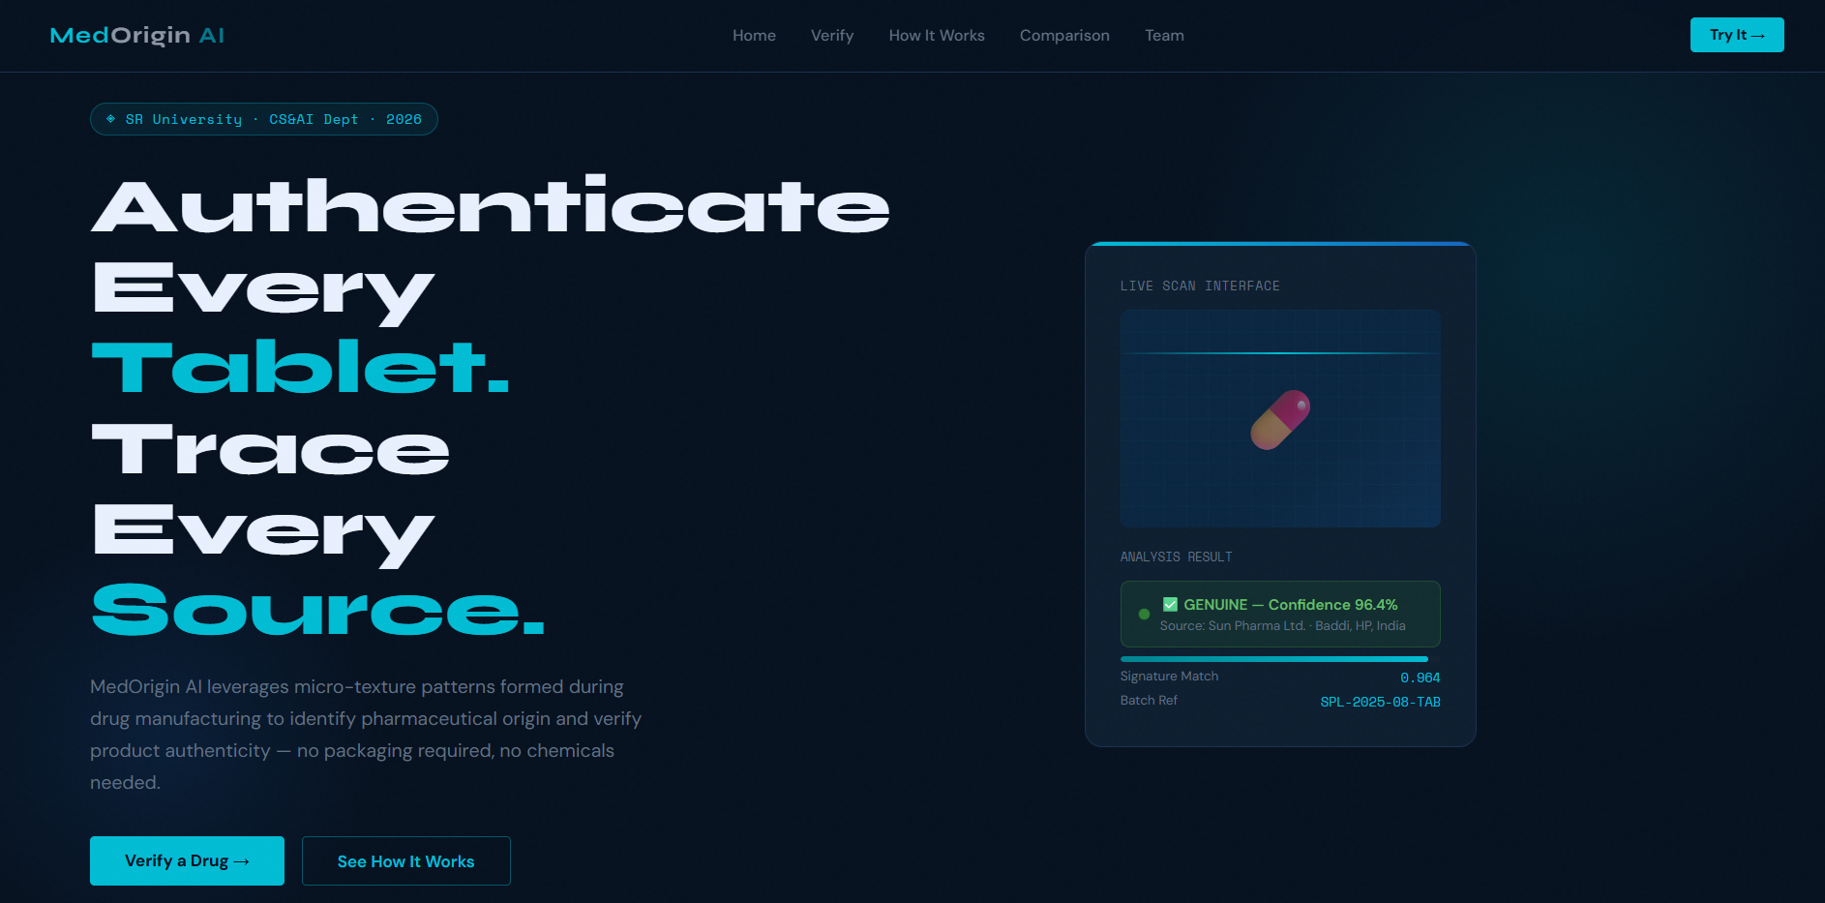
Front-End View — MedOrigin AI Web Application

Slide 9
Proof of Prompts Generating Code
Terminal — Claude AI
Terminal — Claude AI
Terminal — ChatGPT
> Prompt: Build CNN feature extractor for micro-texture analysis
> Prompt: Create similarity matching with cosine distance
> Prompt: Build Flask API endpoint for image verification
model = Sequential([
Conv2D(64, (3,3), activation='relu'),
MaxPooling2D(2,2),
Conv2D(128, (5,5), activation='relu'),
GlobalAvgPooling2D(),
Dense(256, activation='relu') # signature vector
])
def match_signature(query_vec, db):
sims = cosine_similarity(
[query_vec], db['vectors']
)[0]
best = np.argmax(sims)
return db['labels'][best], sims[best]
@app.route('/verify', methods=['POST'])
def verify():
img = preprocess(request.files['image'])
sig = encoder.predict(img)
src, conf = match_signature(sig, DB)
cls = classify(conf) # Genuine/Suspicious/..
return jsonify({source:src, confidence:conf})

Slide 10
References
[1] He, K., Zhang, X., Ren, S., & Sun, J. (2016). Deep Residual Learning for Image Recognition. CVPR.
[2] World Health Organization. (2023). Substandard and Falsified Medical Products. WHO Report.
[3] Chen, T., & Guestrin, C. (2016). XGBoost: A Scalable Tree Boosting System. KDD.
[4] LeCun, Y., Bengio, Y., & Hinton, G. (2015). Deep Learning. Nature, 521, 436–444.
[5] CDSCO India. (2024). Guidelines for Pharmaceutical Product Authentication. Ministry of Health.
[6] Daugman, J. (2004). How Iris Recognition Works. IEEE TCSVT — basis for texture biometrics.
[7] Jain, A., Flynn, P., Ross, A. (2007). Handbook of Biometrics. Springer — texture fingerprinting.
[8] Google Patents & WIPO Database — Patent Search Report (2026), conducted by inventors.
[9] TensorFlow Documentation. https://www.tensorflow.org/
[10] OpenCV Documentation. https://docs.opencv.org/
MedOrigin AI · SR University, Warangal · CS&AI Dept · 2026

