Slide 1

WasteSeg: AI-Powered Waste Segregation Platform
A Web Application for Smart Waste Classification and Tracking
Team Members: 2303A54002 Course Name: AI Assistant
2303A54061
2303A54069
2303A54071

Slide 2
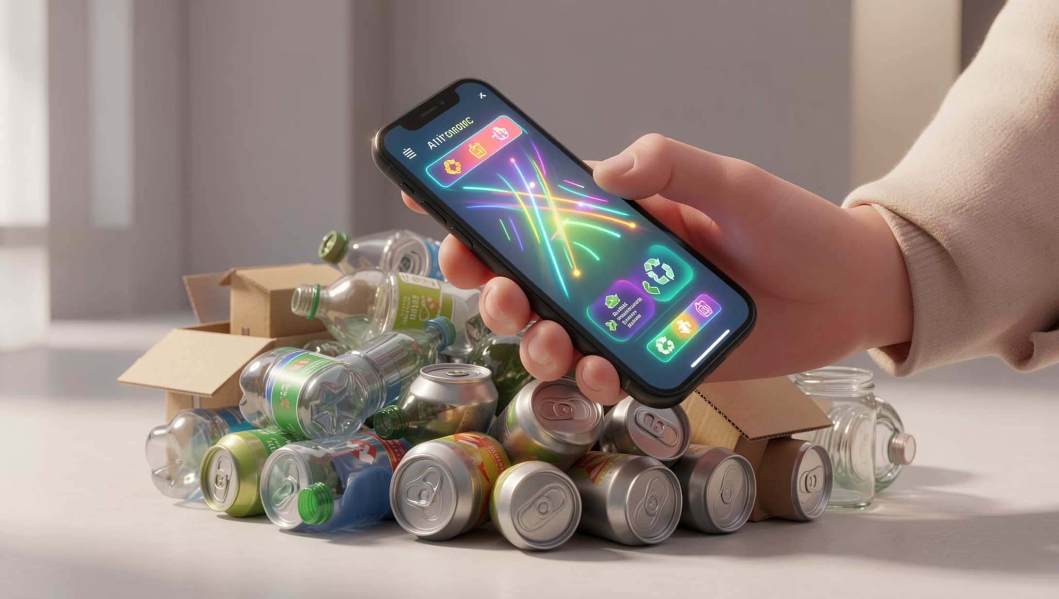
Project Introduction
WasteSeg is a web application designed to simplify waste segregation through AI-powered image recognition. The platform enables users to classify waste items instantly using their smartphone camera or photo library, receiving real-time guidance on proper disposal methods.
The system categorizes waste into three main types: reusable items, general waste, and recyclable materials. Each classification comes with actionable suggestions to help users make environmentally responsible decisions about their waste.

Slide 3
Project Objectives
Accurate Classification
User-Friendly Interface
Develop an AI model that correctly identifies waste types with high precision using computer vision
Create an intuitive web platform accessible via mobile devices for seamless waste management
Data Tracking
Educational Tool
Enable users to monitor their waste disposal habits over time through activity history
Provide actionable suggestions to educate users about proper waste segregation practices

Slide 4

Key Stakeholders
01
End Users
Individuals and households seeking to improve their waste segregation habits
02
Environmental Organizations
NGOs and green initiatives promoting sustainable waste management practices
03
Local Municipalities
City waste management departments looking to reduce landfill burden
04
Project Team
Developers, designers, and AI specialists building the platform

Slide 5
Technology Stack
Programming Languages
Web Development Tools
Python (AI backend)
JavaScript (Frontend)
HTML/CSS (UI design)
React.js (Component library)
Node.js (Server)
MongoDB (Database)
AI Frameworks
APIs & Services
TensorFlow/Keras (Image classification)
OpenCV (Image processing)
Twilio (SMS verification)
Cloud Storage (Image hosting)

Slide 6
AI Prompts and Code Generation
Image Classification Model
User Authentication
Design a convolutional neural network to classify waste into reusable, waste, and recyclable categories using TensorFlow. Include data preprocessing and model evaluation steps.
Create a mobile number verification system using Twilio API with OTP generation and session management in Node.js.
Activity Tracking System
Frontend Interface
Build a database schema to store user uploads, classification results, and timestamps. Include queries to generate activity history reports.
Develop a responsive React component with camera integration, image upload, and results display sections using Material UI components.

Slide 7
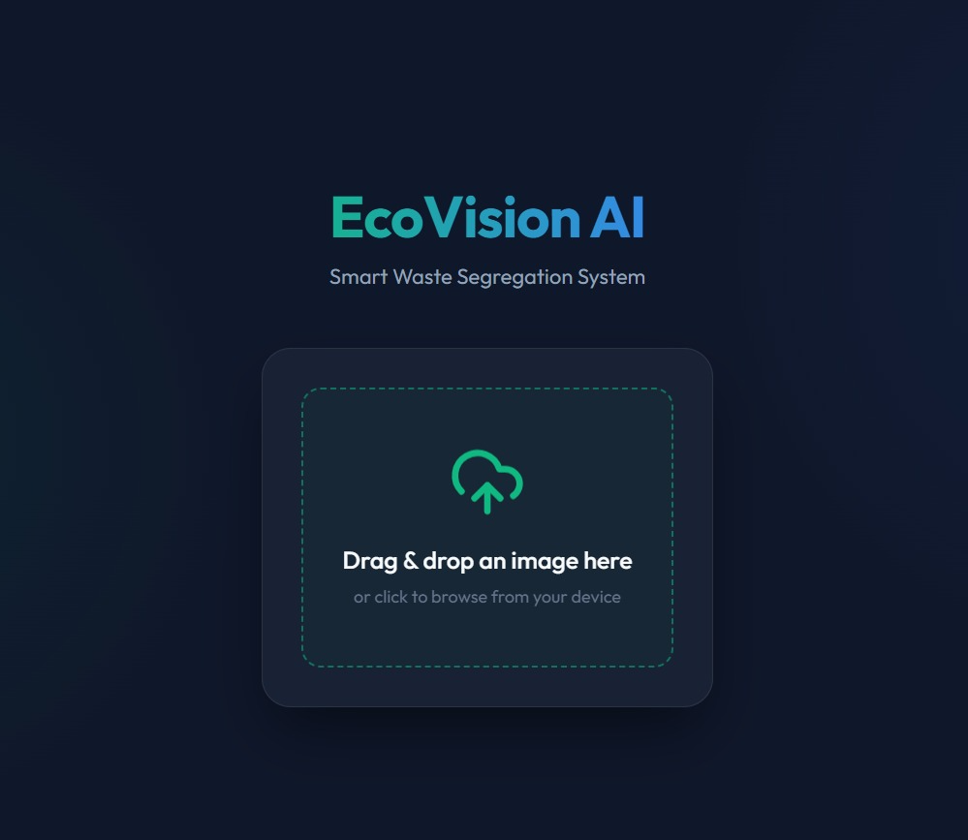
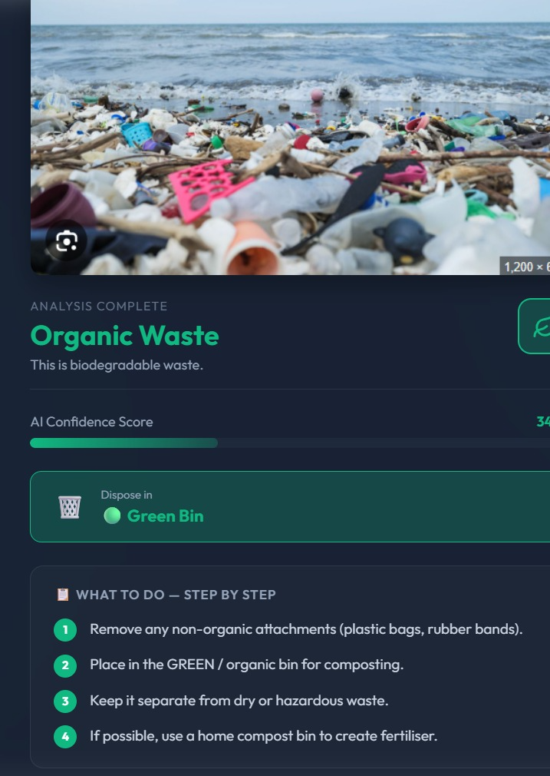
Front-End Interface
Login Screen

Slide 8
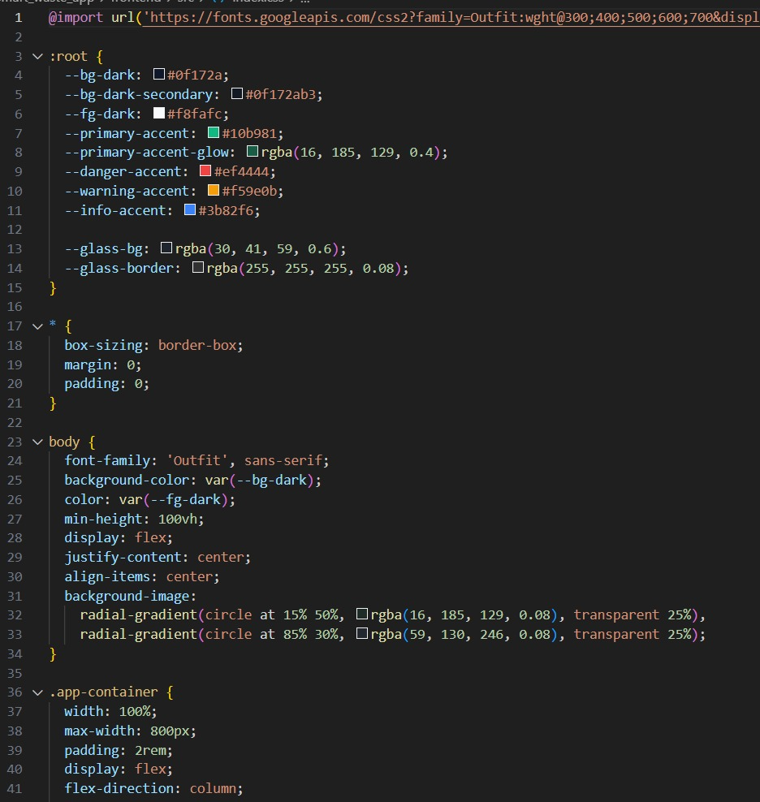
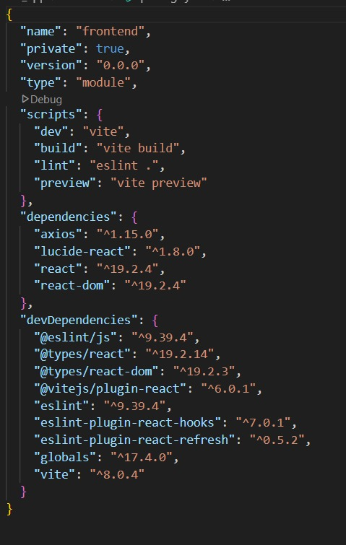

Implementation Evidence
Note: Screenshots above represent typical implementation artifacts. Replace with actual project screenshots showing your code, UI designs, and testing results.

Slide 9
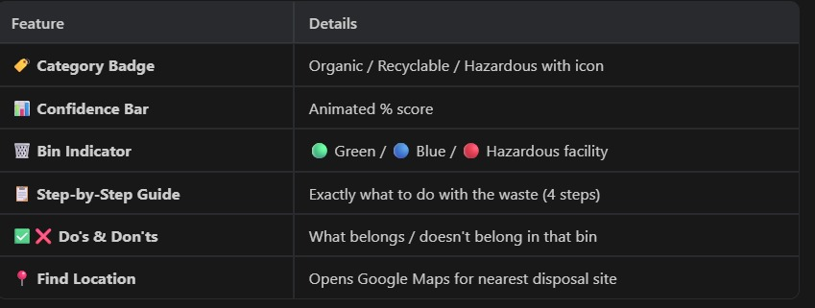

Slide 10

References and Resources
AI & Machine Learning
APIs & Services
Twilio SMS API Documentation
Cloud Storage Solutions Guide
Image Upload Best Practices
TensorFlow Documentation - tensorflow.org
OpenCV Image Processing Guide
Deep Learning for Computer Vision (Goodfellow et al.)
Environmental Standards
Web Development
EPA Waste Management Guidelines
Recycling Industry Standards
Sustainable Waste Practices Research
React Official Documentation
Node.js API Reference

