Slide 1
SHERISE
EMPOWER · PROTECT · RISE
Women's Safety & Empowerment Web Application
PROJECT DETAILS
Project Name: SHERISE – Empower & Protect
Team Members
Ch.Pooja -2303A51186
Nishath -2303A51212
Vrahsitha -2303A51187
Sriram -2303A51191

Slide 2
INTRODUCTION
What is SHERISE?
SHERISE is an women's safety and empowerment web application It provides a comprehensive digital hub for women to access emergency help, safety resources, community support, and self-defense knowledge.
SOS
GPS
AI
Emergency
Alert
Live
Tracking
Problem Statement
Women face increasing threats of harassment, assault, and domestic violence globally.
Lack of a centralized, easy-to-access digital platform for emergency resources and community support.
SHERISE bridges this gap by combining AI technology with women-centric safety features in one web app.
Existing emergency systems are reactive and slow; women need discreet, one-tap tools that work instantly on any device without app installation
Fear of judgment and social stigma prevent women from seeking help openly — there is no safe digital space for sharing safety experiences.

Slide 3
OBJECTIVES
01
Emergency Assistance
02
Empower Women
Provide one-tap SOS alerts with GPS location sharing to trusted contacts and emergency services.
Deliver self-defense tips, legal rights awareness, and motivational resources to build confidence.
03
Community Support
04
Information Hub
Create a safe digital space where women can share experiences, find peer support, and access help.
Centralize helpline numbers, shelter locations, legal aid contacts, and crisis resources.
05
AI-Powered Experience
06
Accessibility
Leverage AI chatbot to resolve your queries and guide you through every step.
Ensure the platform is mobile-friendly, free-to-use, and accessible to women of all backgrounds.

Slide 4
STAKEHOLDERS
For Whom Is SHERISE Built?
♀ Women & Girls
🏠 NGOs & Shelters
⚖ Law Enforcement
👨‍👩‍👧 Families & Friends
Primary users — women of all ages seeking safety resources, emergency help, and community support.
Organizations providing refuge and support that can list resources on the platform.
Police and legal authorities notified via emergency alerts for rapid response.
Trusted contacts who receive SOS alerts and live location during emergencies.
🏥 Healthcare Workers
🎓 Educators & Institutions
🏛 Government Bodies
💻 Tech Community
Medical professionals linked through crisis helplines and emergency resource listings.
Schools, colleges using SHERISE for campus safety awareness and student protection.
Policymakers who benefit from aggregated safety data to shape women-centric legislation.
Developers and AI researchers advancing women's safety through ethical technology.

Slide 5
PROGRAMMING LANGUAGES, TOOLS & SOFTWARE
Frontend
AI Platform
React.js – Component-based UI library
TypeScript – Typed JavaScript
HTML5 & CSS3 – Structure & Styling
Tailwind CSS – Utility-first styling
Lovable.dev – AI-powered app builder
Gemini / Claude AI – Prompt-to-code generation
AI Chat Interface – Iterative development
Natural Language Prompts – Code logic
Backend / DB
Tools & Deploy
Supabase – Backend-as-a-Service
PostgreSQL – Relational database
RESTful APIs – Data communication
Authentication – Supabase Auth
GitHub – Version control & hosting
Lovable Deploy – One-click deployment
Browser DevTools – Debugging
Figma – UI/UX wireframing

Slide 6
PROMPTS USED TO GENERATE CODE | Part 1
P1
Create a women's safety web app called SHERISE with a landing page featuring an emergency SOS button, navigation menu, and hero section with tagline 'Empower. Protect. Connect.'
P2
[SOS & GPS feature]
Add an SOS Emergency Alert feature where clicking a button shares the user's GPS location with pre-saved emergency contacts via a message notification system.
P3
Build a Resources section listing national women's helpline numbers, nearby shelter locations, legal aid contacts, and crisis support centers in a card layout.
P4
[Community forum]
Create a Community Forum page where users can post stories, share safety tips, comment, and upvote posts – with user authentication using Supabase.
P5
[Self-defense content]
Design a Self-Defense Tips page with categorized safety tips, step-by-step guides, and embedded video resource links for women's personal safety training.

Slide 7
PROMPTS USED TO GENERATE CODE | Part 2
P6
[Auth & user profile]
Add a user authentication system with login/signup pages, protected routes, and user profile dashboard showing their saved emergency contacts and activity.
P7
[Mobile responsiveness]
Make the entire app mobile-responsive using Tailwind CSS with hamburger menu navigation, responsive card grids, and touch-friendly SOS button.
P8
[UI theming]
Integrate a dark/light mode toggle and apply a consistent purple-rose color theme throughout all pages for SHERISE branding.
P9
[Footer design]
Create a footer with social media links, about section, privacy policy link, and emergency contacts hotline prominently displayed.
P10
[Deployment & GitHub]
Deploy the app to a public URL using Lovable's built-in deployment and connect it to a GitHub repository for version control and code backup.

Slide 8
WORKFLOW FLOWCHART
USER JOURNEY
DEVELOPMENT WORKFLOW
User visits
SHERISE website
AI Prompt
entered
Sign Up /
Login
Lovable.dev
generates code
Dashboard:
Choose Feature
Code reviewed
& refined
SOS Alert
(GPS + Contacts)
Deployed via
Lovable + GitHub
Also Accessed: Resources Hub → Community Forum → Self-Defense Tips → Legal Rights Info → Helplines

Slide 9
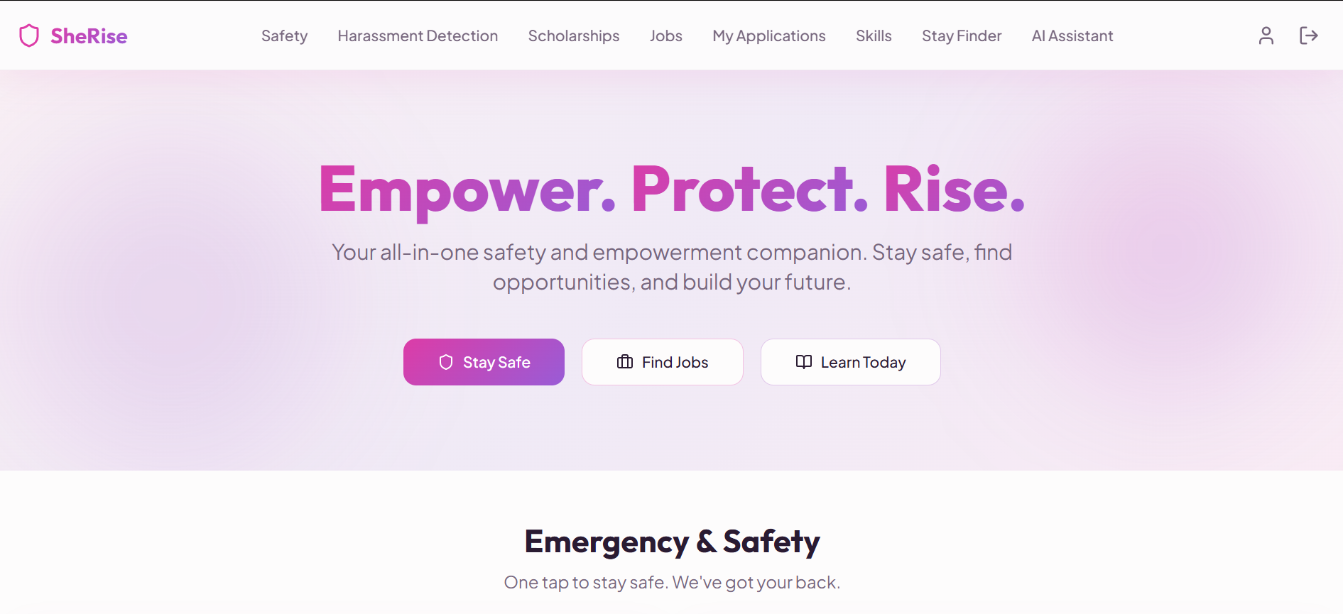
FRONT-END VIEW OF WEB APPLICATION

Slide 10
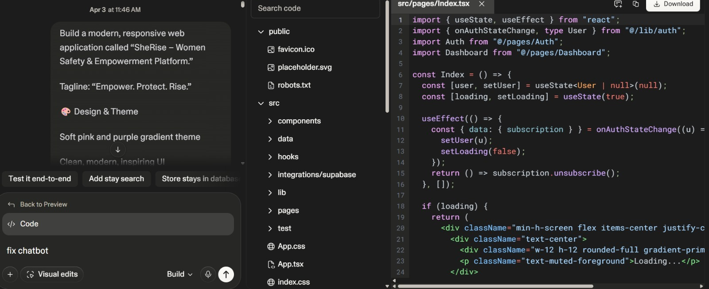
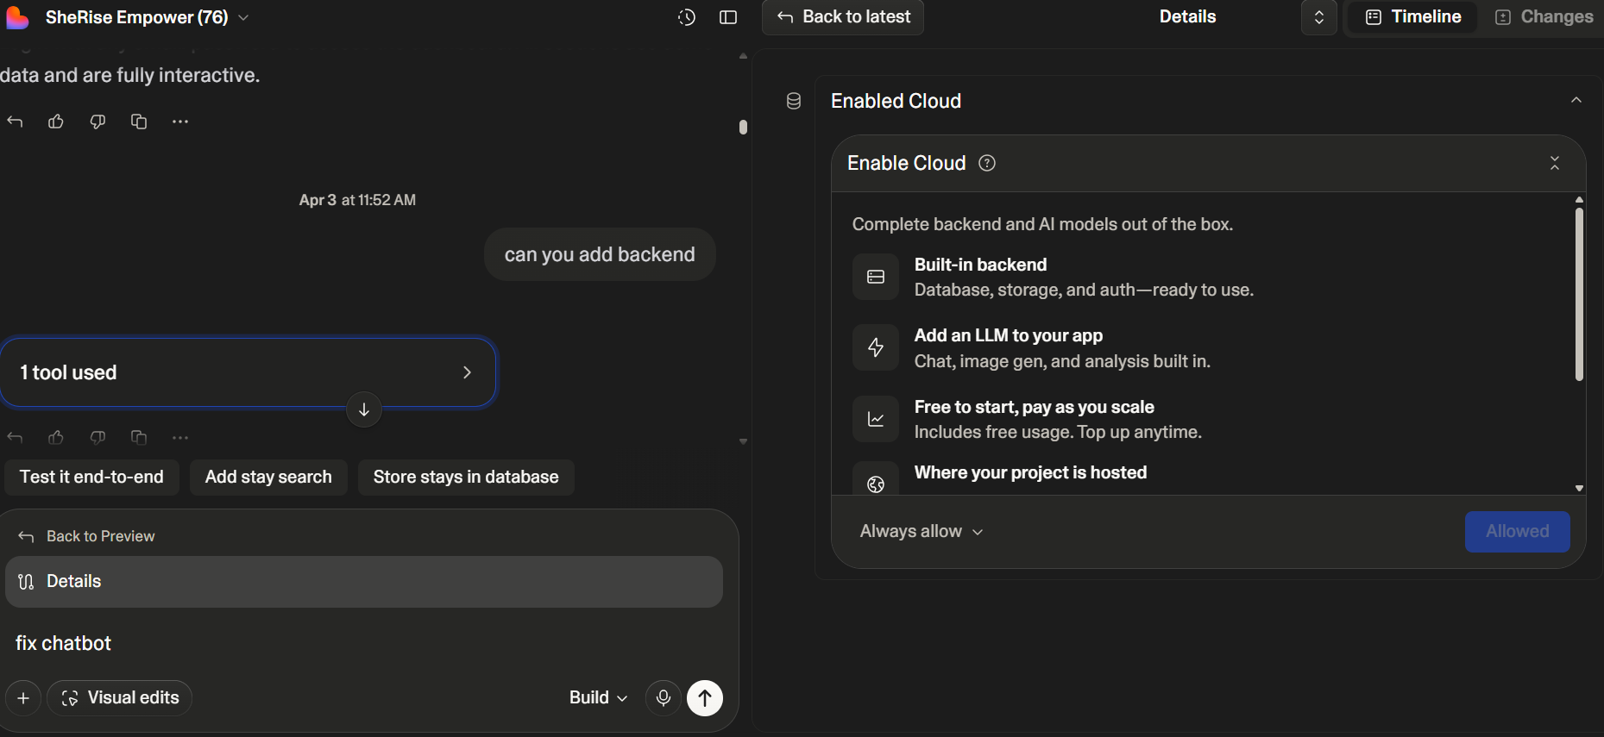
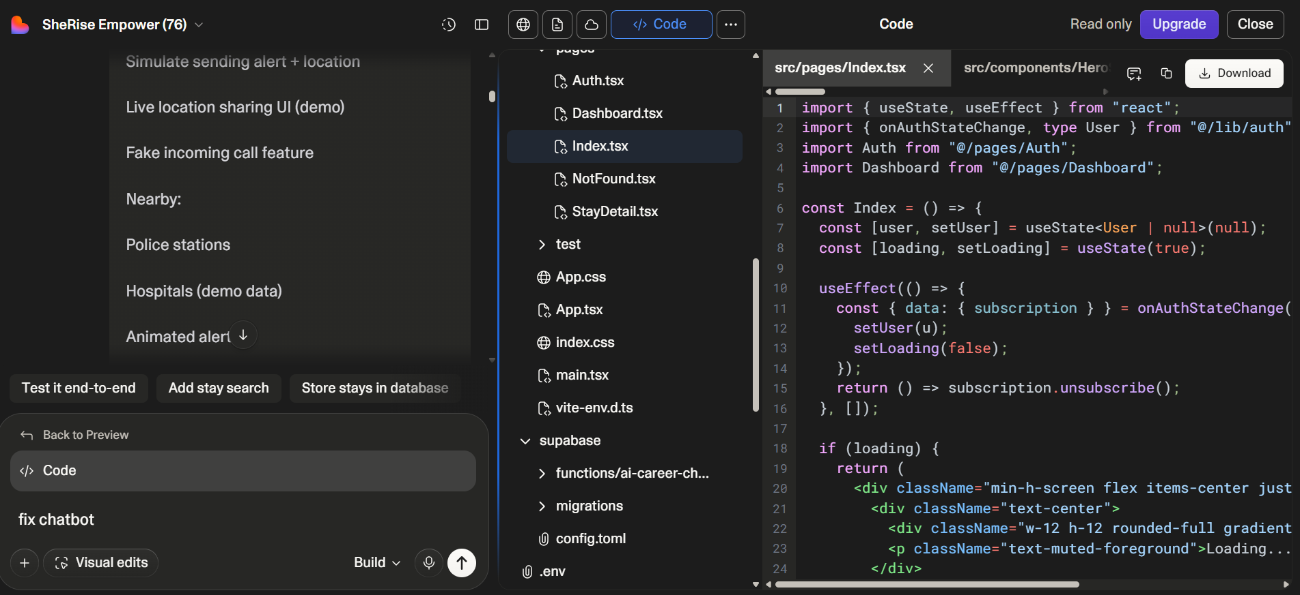
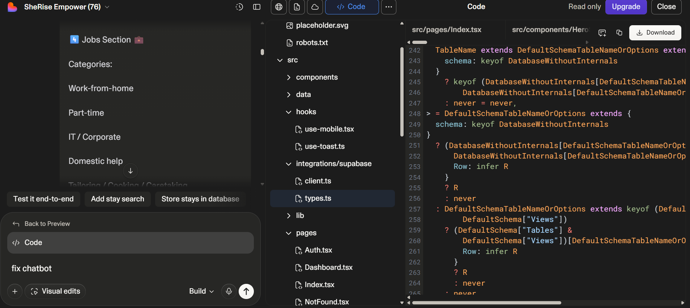
PROOF OF PROMPTS GENERATING CODE (Screenshots)
Screenshot 1: Prompt Input in Sherise
Screenshot 2: Connection of backend
[ INSERT SCREENSHOT HERE ]
[ INSERT SCREENSHOT HERE ]
Screenshot 3: Live Location prompt and code
Screenshot 4: Scholarships & jobs code and prompt
[ INSERT SCREENSHOT HERE ]
[ INSERT SCREENSHOT HERE ]

Slide 11
REFERENCES
[1] Lovable.dev – AI-powered app development platform. https://lovable.dev
[2] Supabase – Open Source Firebase Alternative. https://supabase.com
[3] React.js – A JavaScript library for building user interfaces. https://reactjs.org
[4] Tailwind CSS – A utility-first CSS framework. https://tailwindcss.com
[5] Patel, A. & Gupta, R. (2020). Exploring Mobile Safety Apps for Women. Journal of Womens Safety Tech.
[6] National Commission for Women, India – Women Helpline 181. https://ncw.nic.in
[7] GitHub – Version control and code hosting. https://github.com
[8] IRJMETS (2024). EMPOWER HER: Women Safety Hub. Vol. 6, Issue 6.
[9] TypeScript – Typed JavaScript. https://www.typescriptlang.org
[10] SHERISE App URL: https://sherise-empower-protect.lovable.app
SHERISE · Empower. Protect. Connect.

Slide 12
Thank you!!
A stronger world starts with safer women🌍💪✨

