Slide 1
Pet
🐾
💬
Connect
Buy & Sell
Live Chat
Pet Listings
Direct Messaging
Buy & Adopt Pets — Marketplace Web Application
🔐
👤
Secure Auth
User Dashboard
Project By:
Login + Reset Pwd
My Ads + Account
[K.shiva]
Department of Computer Science
Built with Node.js · MongoDB · Express · EJS

Slide 2
SLIDE 2 | INTRODUCTION
Introduction to the Project
PetConnect is a full-stack web marketplace platform that enables users to buy, sell, and adopt pets online — built entirely using Claude AI (Anthropic) as the coding assistant.
13
Web Pages
Key Features:
3
DB Models
User registration, login, forgot password with reset token
Post pet ads with up to 6 photos — full-screen gallery view
REST
API Architecture
Buyer-seller chat system with message inbox
Wishlist, budget filter, category search
My Ads dashboard — edit, delete, mark as sold/adopted
100%
GITHUB COPILOT
Admin panel — manage users, listings, feature ads
2

Slide 3
SLIDE 3 | OBJECTIVES
Project Objectives
01
AI-Driven Development
02
Full-Stack Implementation
Build a complete full-stack pet marketplace using only GITHUB COPILOT prompts — no manual code writing.
Node.js + Express backend, MongoDB database, REST APIs, EJS templating, and custom CSS.
03
User Authentication
04
Complete Pet Marketplace
Email login, signup, forgot password with reset token, bcrypt hashing, session management.
Multi-image listings with gallery, wishlist, budget filter, category search, live chat.
05
Admin Control Panel
06
Prompt Engineering
Manage all users and listings, feature/delete ads, monitor activity from admin dashboard.
Demonstrate how to craft effective AI prompts to generate working, production-ready code.
3

Slide 4
SLIDE 4 | STAKEHOLDERS
Project Stakeholders
🛒
Buyers / Adopters
Browse pet listings by category or budget, search pets, add to wishlist, and message sellers directly through the chat system.
🐾
Sellers / Pet Owners
Register and post pet ads with multiple photos, manage their listings (edit/delete/mark sold), and respond to buyer messages.
👑
Administrator
Access the admin panel to manage all users (view/delete), moderate listings (feature/delete), and monitor all activity.
🎓
Evaluators / Faculty
Review the project for AI tool usage, prompt quality, technical depth, UI design, and overall functionality of the platform.
4

Slide 5
SLIDE 5 | TECH STACK
Languages, Tools & Software
Backend
Frontend
Node.js (Runtime Environment)
EJS (Server-side Templating)
Express.js (Web Framework)
Custom CSS3 (800+ lines)
bcryptjs (Password Hashing)
Vanilla JavaScript
Multer (Image File Upload)
Google Fonts — Inter + Poppins
connect-flash (Flash Messages)
Responsive Design (Mobile-first)
Database
AI & Tools
MongoDB (NoSQL Database)
Github copilot (Code Generation)
Mongoose ODM (Schema + Queries)
Prompt Engineering Techniques
3 Models: User, Listing, Message
VS Code (Code Editor)
connect-mongo (Session Store)
Git & GitHub (Version Control)
dotenv (Environment Config)
MongoDB Compass (DB GUI)
5

Slide 6
SLIDE 6 | PROMPTS (1 of 2)
Prompts Used to Generate the Code
P1
Project Setup
"Provide a fully functional, production-level full-stack web application for a Pet Adoption & Marketplace System using Node.js (Express) and MongoDB. Support two user types (Admin and Customer) with authentication, role-based access, and complete CRUD operations."
P2
OLX-style Redesign
"I want the website like an OLX app where if they want they can sell them and buy the pets like their wish. First the login page with forgot password option, home page with all options of pets displayed, budget page, wishlist page, add pets, chat page, my ads page, account page."
P3
Feature Fixes — Photos & Gallery
"When I add 2 to 3 photos it should be added and should show full image with left right buttons and remove WhatsApp call option and make budget price range work and rename website as PetConnect."
P4
Error Debugging
"I am getting this error: MongooseError: The uri parameter to openUri() must be a string, got undefined. Make sure the first parameter to mongoose.connect() or mongoose.createConnection() is a string."
6

Slide 7
SLIDE 6 | PROMPTS (2 of 2)
More Prompts — Setup & Running
P5
Run Instructions
"Tell me each step how to run it — I have downloaded the file and have MongoDB Compass installed. Give me step by step PowerShell instructions from creating .env to npm install to node seed.js to node server.js."
P6
Forgot Password Fix
"Forgot password is not working make sure to work it. When the user enters their email, generate a reset token and show the clickable reset link directly on screen since we don't have email server configured."
P7
Seed Script Fix
"ok i fixed this — the error was the .env file was not created. I ran the PowerShell command to create it properly and now node seed.js works and shows Connected to MongoDB and Created 3 accounts."
P8
PPT Generation
"I need to prepare a PPT for project evaluation. Slides: Title & Team, Introduction, Objectives, Stakeholders, Programming Languages/Tools/Software, All prompts used, Flowchart, Frontend view, Proof of prompts, References."
7

Slide 8
SLIDE 7 | WORKFLOW
System Workflow Flowchart
Visit Site
Sign Up / Login
Forgot Password?
Admin Panel
Feature / Delete
Browser → localhost:3000
Email & Password
Token → Reset Link
Users & Listings
Manage All Ads
Home Page
Search / Filter
View Pet Ad
Wishlist
Message Seller
Browse Listings
Category or Budget
Gallery + Info
Save for Later
Chat System
Post Ad
Upload Images
Ad Goes Live
Mark as Sold
My Ads Panel
Title, Price, Photos
Up to 6 Photos
MongoDB Stored
Status Update
Edit / Delete
Chat Inbox
Budget Filter
Account Page
Admin Dashboard
Logout
All Conversations
Price Ranges
Edit Profile + Pwd
Charts + Stats
Session Destroyed
Auth / Setup
Browse / Post
Key Actions
Seller Control
Admin Only
9

Slide 9
SLIDE 8 | FRONTEND VIEWS
Application Frontend — Page Overview
🔐
Login Page
🏠
Home / Browse
🐾
Pet Detail Page
Login / Signup + Forgot Password with reset token link displayed on screen
Hero banner, category filter bar, search, pet grid with wishlist toggle
Multi-image gallery ◄ ►, full-screen lightbox, owner-only edit/delete controls
➕
Post Ad
💬
Chat / Messages
📊
My Ads Dashboard
Upload up to 6 photos, pet details, price type, health info, location fields
Message inbox with all conversations, WhatsApp-style chat window per listing
Active/Sold listings, edit, delete, mark as sold/adopted, view count shown
💰
Budget Filter
❤️
Wishlist
👑
Admin Panel
6 price ranges with sample pet thumbnails, each links to filtered results
Saved pet ads, heart toggle to remove, browse all saved in one place
All listings with feature/delete, all users, Charts.js stats dashboard
10

Slide 10
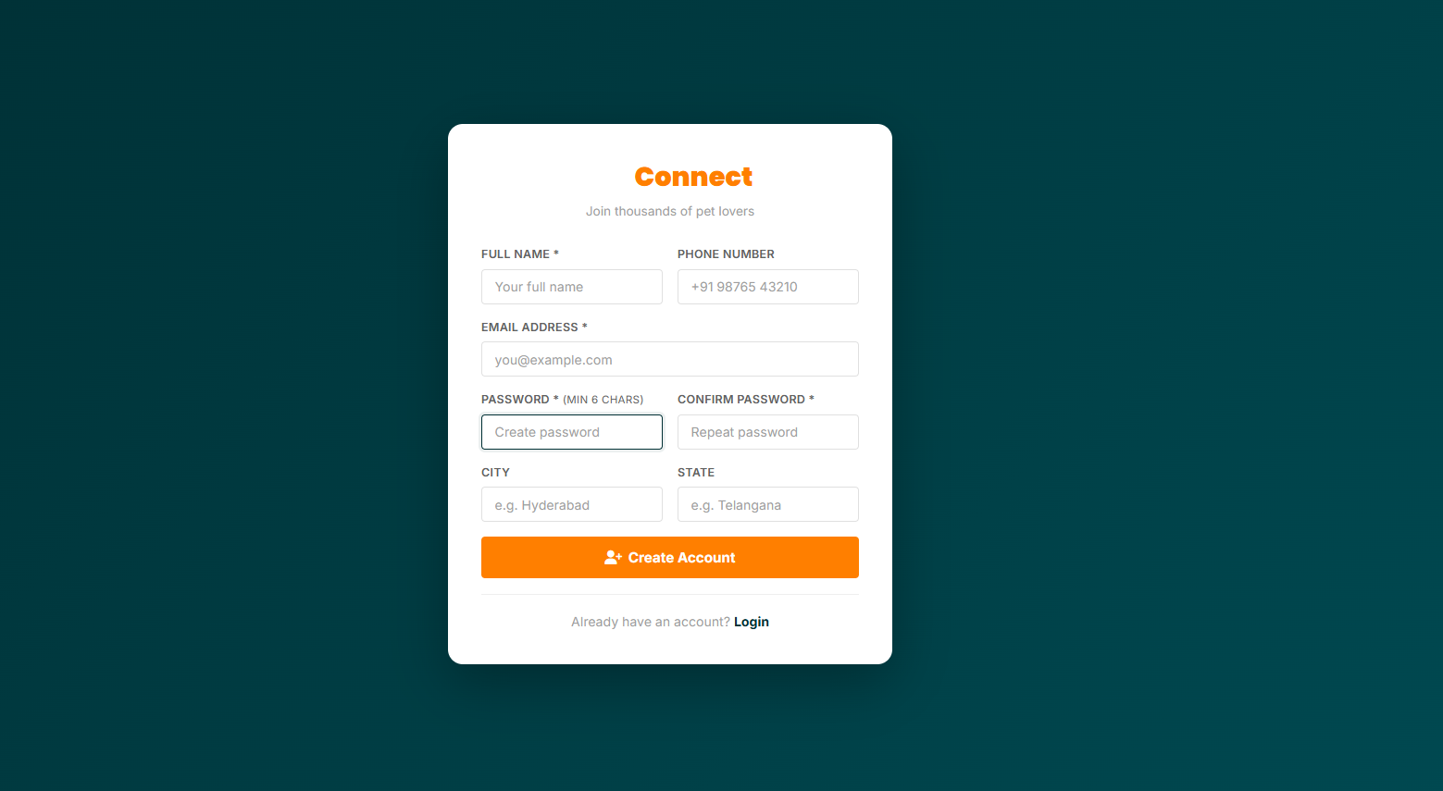
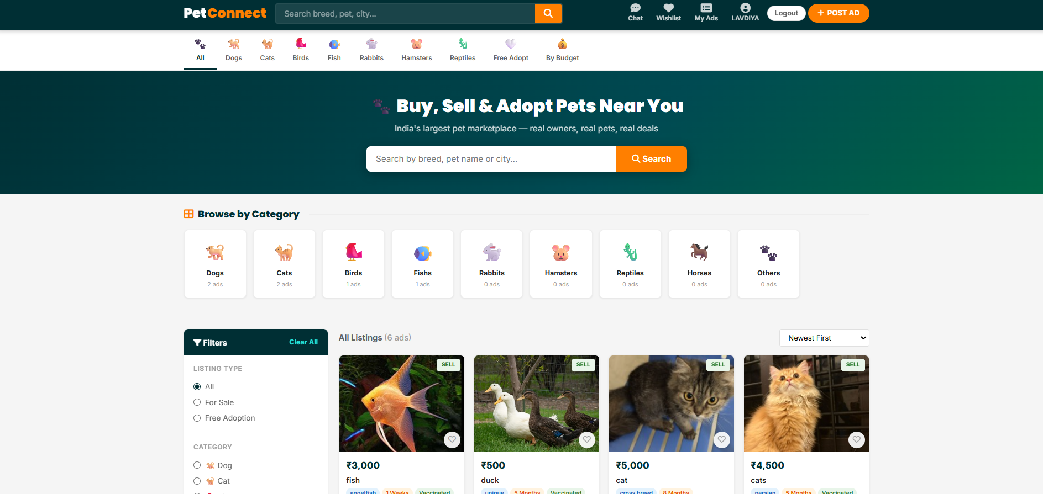
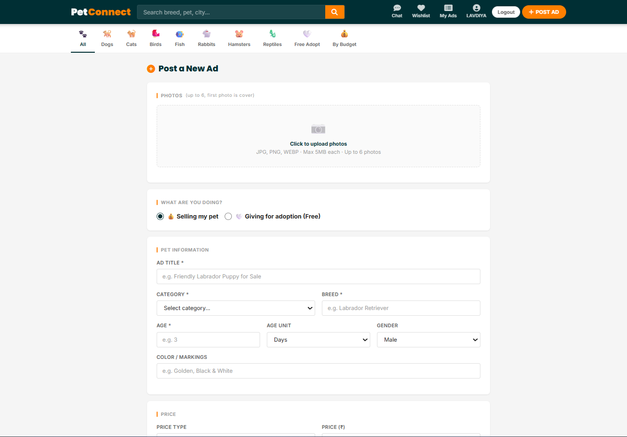
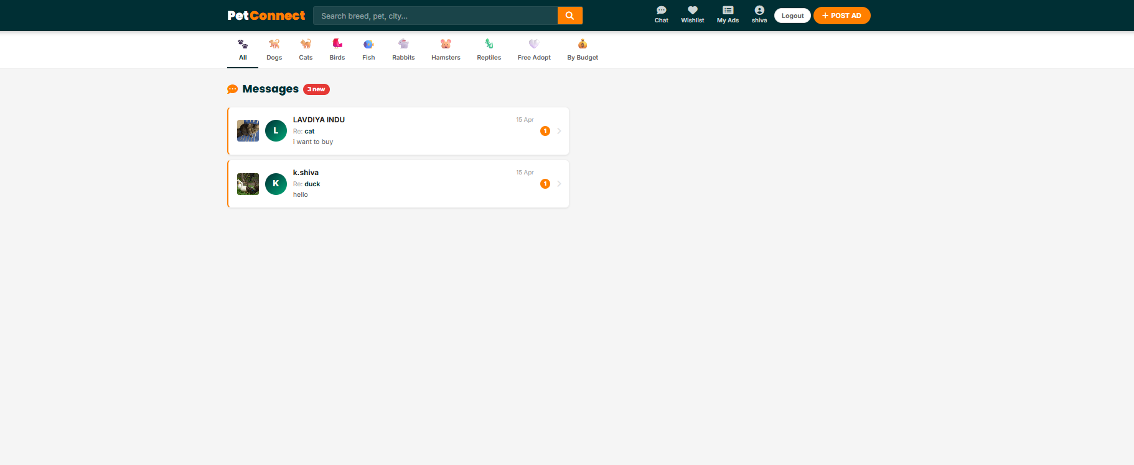
SLIDE 9 | PROOF OF PROMPTS
Proof of Prompts Generating Code
📷
📷
Screenshot 1
Screenshot 2
Initial project prompt → full code generation
OLX redesign prompt → all pages rebuilt
📷
📷
Screenshot 3
Screenshot 4
Photo gallery + fix prompts → working lightbox
Final fixes → forgot password, budget, PetConnect name
How to add screenshots: Open this file in PowerPoint → Insert → Pictures → select your claude.ai conversation screenshots.
11

Slide 11
SLIDE 10 | REFERENCES
References
[1]
Github copilot— Anthropic
https://claude.ai
[AI Tool]
Primary AI tool used to generate all code through prompt engineering.
[2]
Node.js Official Documentation
https://nodejs.org
[Backend]
Runtime and Express.js framework used for server and API routes.
[3]
MongoDB & Mongoose Docs
https://mongodb.com
[Database]
NoSQL database and ODM for User, Listing, and Message models.
[4]
EJS Templating Engine
https://ejs.co
[Frontend]
Server-side templating used to render dynamic HTML pages.
[5]
Google Fonts
https://fonts.google.com
[Design]
Inter and Poppins fonts used throughout the PetConnect UI.
[6]
OLX India
https://olx.in
[Reference]
Inspiration for marketplace features, UI patterns, and user experience.
12

Slide 12
Thank You
PetConnect · Pet Adoption & Marketplace
Node.js · MongoDB · Express · EJS · github
http://localhost:3000
[K.shiva] · Department of Computer Science

