Slide 1
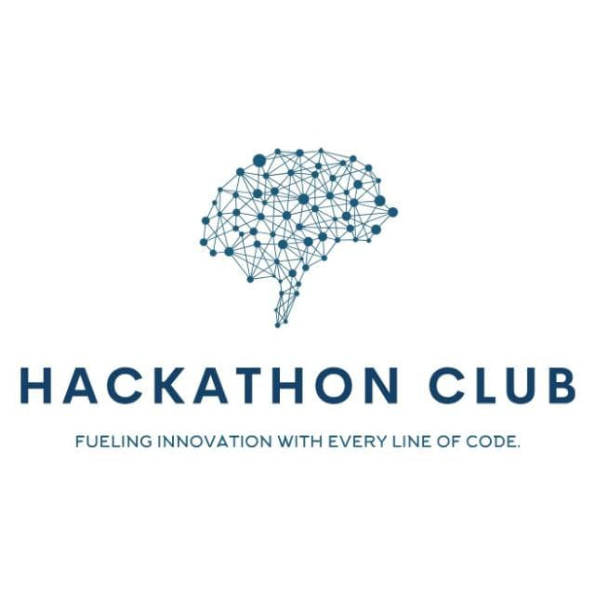

Topic : Voice-Controlled Gaming Tools for Enhanced Learning in the Skill Ecosystem Domain : Student Innovation Team ID : T062 Team name : Code Crackers Team members : M.Hindu(2303A51296) S.Arthi(2303A51595) K.Harshitha(2303A51588) P.Sri Nithya(2303A51546)

Slide 2


Objective
To develop voice-controlled gaming tools that enhance skill-based learning through interactive, immersive, and accessible experiences tailored for the skill ecosystem.
Goals
Voice-controlled, hands-free interaction
Real-world skill simulation through games
Instant feedback for better learning
Inclusive and accessible for all learners
AI-powered personalized learning
Outcomes
Improved engagement & retention
Practical, job-ready skill development
Inclusive learning experience
Gamified progress tracking
Scalable across skill programs

Slide 3
Problem Statement
Problem Statement :Traditional skill training methods are often boring, non-interactive, and inaccessible. They lack real-time feedback, don't adapt to individual needs, and offer limited engagement, especially for learners with disabilities or diverse skill levels.
Challenges in the Current Scenario
Voice-controlled, hands-free interaction
Real-world skill simulation through games
Instant feedback for better learning
Inclusive and accessible for all learners
AI-powered personalized learning
✅ Boosts engagement & retention
✅ Builds practical, job-ready skills
✅ Supports inclusive education
✅ Adds fun, gamified assessments
✅ Works across multiple training programs

Slide 4
Existing system
Career Counseling – People get basic advice from counselors, but it's not always personalized.
Online Tests –Quizzes that give general career ideas, not based on your full profile.
Manual Job Research – You have to search on your own to understand job trends and required skills.

Slide 5
Proposed system
What is the New System?
An AI-based platform that gives personalized career suggestions based on
your skills, interests, strengths, and experience. It helps you plan your future
career in a smart and easy way.
The main advantage of this system is its personalized approach, which ensures that
each user receives career suggestions tailored to their unique profile.
It also provides insights into future job trends, making it easier to plan long-term goals.
The platform includes features such as skill gap analysis, career growth roadmaps, and a user-friendly interface that simplifies the decision-making process.
This modern system not only improves career satisfaction but also helps users stay
competitive in a rapidly changing job market.

Slide 6
Workflow
Design Voice-Controlled Games – Create interactive, hands-on learning experiences.
Gamified Assessments – Provide real-time feedback and skill tracking.
Step 02
Step 04
Step 01
Step 03
Step 05
Identify Learning Needs – Find skill gaps and areas for improvement.
Implement AI Personalization – Adjust difficulty based on learner progress.
Gamified Assessments – Provide real-time feedback and skill tracking.

Slide 7
System Architecture
Key points to cover
Tech Stack
Show the System’s Technical Structure – Present the architecture of voice-controlled gaming tools..
Use a Layered or Block Diagram – Clearly visualize how different components interact..
Label Different Components & Interactions – Identify AI, voice recognition, game logic, and user interface..
Keep Explanations Brief & To the Point – Focus on essential details without complexity..
Maintain a Clean, Organized Layout – Ensure clarity and readability for better understanding..
Languages used (C, C++, python, html, CSS, Js,
java etc)
Database: Firebase / MongoDB / SQL
Security: Data encryption & authentication
Cloud Services: AWS / Google Cloud for hosting
APIs Used: Speech-to-text, AI processing
Diagram Analysis: System flow & interactions

Slide 8
Conclusion & Future Scope
Interactive Learning – Voice-controlled games make learning fun and engaging.
Inclusive & Accessible – Helps all learners, including those with disabilities.
Skill Development – Simulates real-world tasks to build practical skills.
Gamified Assessments – Tracks progress and gives instant feedback.
Scalable & Versatile – Can be used across different skill areas.
Future Improvements
🔹 AI-Powered Personalization – Games adapt to each learner’s progress. 🔹 Multilingual Support – Add more languages for wider accessibility.
🔹 AR/VR Integration – Create more immersive learning experiences.
🔹 Industry Collaboration – Work with real-world experts to improve training.

