Slide 1

NATIONAL AGRI-TECH HACKATHON 2026 • PRODUCTION SHOWCASE
HarvestMitra AI
Intelligent APMC Mandi Arbitrage, Profit Simulation & Farm Cold-Chain Logistics
An end-to-end full-stack AI ecosystem empowering 140M+ Indian farmers to overcome mandi cartels, simulate factual net revenue across mandis, eliminate middleman exploitation, and book on-demand refrigerated dispatch.
PROJECT ARCHITECTS & ENGINEERING SQUAD:
• Mihir Jadav: System Architect, Unified Backend API & Security Enforcement
• Sayali: UI/UX System & Multilingual Farmer Accessibility
• Prashant Warule: Mandi Auto-Sync Engine & Financial Profit Simulator
• Varun Patil: Transport Optimization & Live Weather Radar Telemetry
Notes:
Speaker (Mihir): Welcome esteemed judges. We are presenting HarvestMitra AI. In India, over 140 million farmers produce food for 1.4 billion people, yet struggle with price exploitation, lack of market visibility, and extreme middleman dependency. We built HarvestMitra AI as an enterprise-grade digital solution.

Slide 2
THE CRISIS IN INDIAN AGRICULTURE
The Systemic Bottlenecks Facing 140M+ Farmers
Market opacity and fragmented logistics cost Indian farmers billions of rupees every season.
₹50,000+ Crore
Annual Post-Harvest Loss
Perishable crops like tomatoes and onions spoil due to lack of immediate cold transport and delayed market dispatch.
35% - 50%
Middleman Commission Leakage
Traditional APMC commission agents (arhatiyas) exploit farmers with non-transparent price manipulation and arbitrary fee cuts.
Zero Visibility
Inter-Mandi Price Asymmetry
A mandi just 45 km away may offer ₹800/Qtl higher rates, but farmers lack real-time price comparison and verifiable transport cost models.
High Tech Barrier
Language & Digital Literacy
Most platforms are in English and complex. Smallholder farmers need vernacular voice AI, simple visual cards, and zero learning curve.

Slide 3
OUR INNOVATION
The HarvestMitra 4-Pillar AI Architecture
A unified operational framework engineered to address every stage from farm harvest to mandi payment.
1. Live APMC Auto-Sync
50+ Mandis Real-Time Ingestion
Automated background synchronization engine capturing 4,500+ verified mandi rates across Maharashtra with SMA-3 & SMA-7 moving averages.
2. Precision Profit Simulator
Fact-Based Net Revenue Modeling
Computes Net Advantage: (Alternative Price - Local Price) x Quantity - Logistics Freight Cost. 100% deterministic, 0% hallucination.
3. On-Demand Agri Logistics
Smart Vehicle Matching Engine
Direct marketplace linking farmers to verified mini-trucks, 14-ft carriers, and refrigerated reefers with transparent per-km pricing.
4. AI Telemetry & Assistant
Open-Meteo & Vernacular Voice
Live GPS weather telemetry, rain advisory risk alerts, and conversational multi-lingual AI (English, Hindi, Marathi, Gujarati).

Slide 4
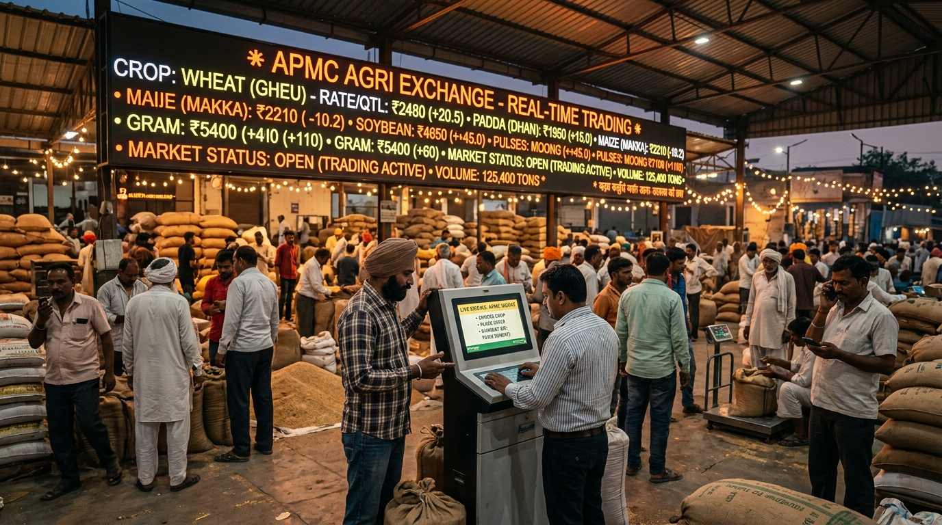
FEATURE DEEP DIVE
Real-Time APMC Mandi Intelligence & Trend Aggregator
Lead Architect: Prashant Warule • Automated Data Pipeline & Multi-Mandi Price Index
CORE CAPABILITIES & TECHNICAL HIGHLIGHTS:
• Auto-Sync Engine: Polls and synchronizes real-time commodity rates across 50 APMCs with failover caching.
• Moving Average Analytics: Computes 3-day (SMA-3) and 7-day (SMA-7) rolling trend lines to predict price momentum.
• Surge & Drop Alarms: Triggers WhatsApp and SMS alerts when prices jump >20% or flash crash >15%.
• Crop Multi-Language Taxonomy: All commodities indexed with vernacular aliases (Gahu, Pyaz, Batata, Kanda).
• Live Verification Badge: Each rate tagged with timestamp and mandi verification status for complete transparency.

Slide 5
FINANCIAL IMPACT
Profit Simulator: Eliminating Guesswork with Net Advantage
Factual mathematical modeling that gives farmers bargaining leverage.
CASE STUDY: FARMER SHIVAJI PATIL (20 QUINTALS OF FRESH TOMATOES / PUNE REGION)
Mathematical Net Advantage Formula: Net Advantage = (Alt Mandi Rate - Local Mandi Rate) x Harvest Weight - Dedicated Logistics Freight
▶ Local Option (Pune APMC): Rate: ₹2,200/Qtl | Transport: ₹800 ── Gross: ₹44,000 | Net Revenue: ₹43,200
▶ Alternative Option (Vashi APMC): Rate: ₹3,100/Qtl | Transport: ₹3,800 ── Gross: ₹62,000 | Net Revenue: ₹58,200
▶ VERIFIED NET ADVANTAGE: +₹15,000 Extra In-Pocket Profit (+34.7% Revenue Boost) ── Automated recommendation: Route to Vashi with Refrigerated 2-Ton Carrier
✔ Generated 1-Click Printable Farm Decision Summary Report with QR verification seal for bank credit & transport permits.

Slide 6
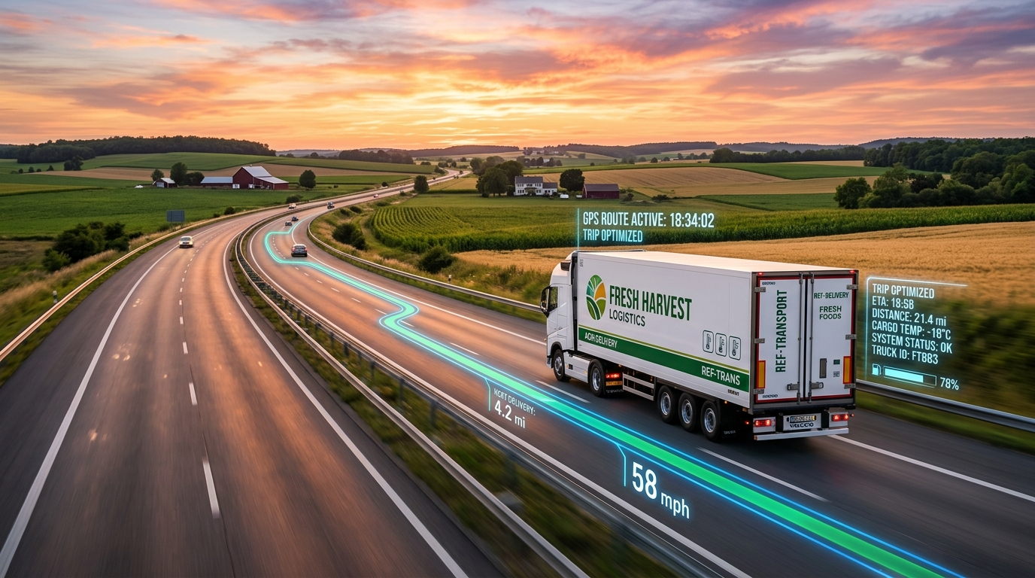
SUPPLY CHAIN INTEGRATION
On-Demand Cold-Chain & Agri-Logistics Dispatch
Lead Architect: Varun Patil • Transparent freight pricing and real-time vehicle booking.
DISPATCH & FLEET HIGHLIGHTS:
• Fleet Options: Tata Ace (1.5T), Pickup (2.5T), 14ft Open Truck (5T), Refrigerated Reefer (3T).
• Dynamic Distance Matrix: Haversine + route distance calculations from farm village to destination mandi gate.
• No Middleman Gouging: Flat benchmark pricing per km based on load weight and fuel indices.
• Real-Time Tracking: Trip status monitoring (Dispatched, In-Transit, Mandi Gate Verified).
• Direct Transporter Link: Driver contact, vehicle registration plate, and verification PIN on farmer dashboard.

Slide 7
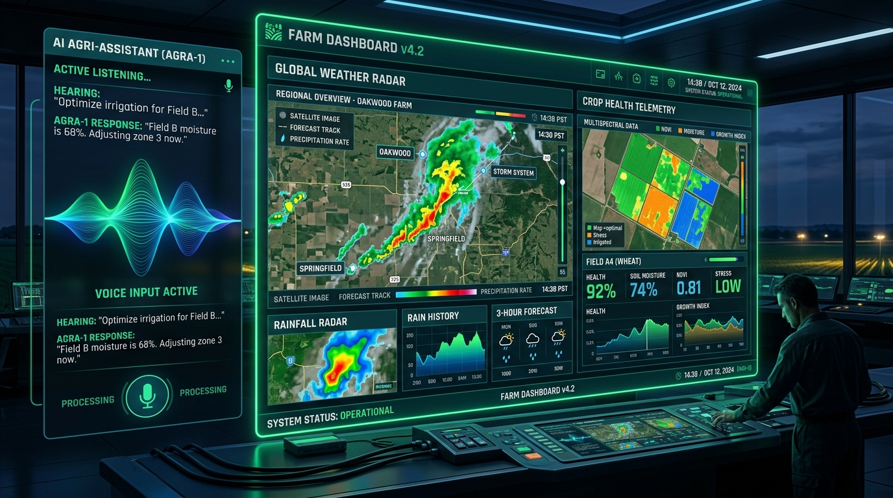
MULTIMODAL INTELLIGENCE
Live Weather Telemetry & Vernacular Voice AI
Open-Meteo Integration • GPS Geofencing • Zero Hallucination AI Guardrails
TELEMETRY & ADVISORY SYSTEM:
• Live Open-Meteo Telemetry: Real-time temperature, humidity, rainfall probability, wind speed, and WMO codes.
• Smart Rain Risk Advisory: Automatic warning banners when rain probability exceeds 60% before harvest or transit.
• Farmer Geofencing: GPS location auto-detection with fallback to farmer registered district.
• Multilingual Speech & Chat: Farmer can speak in Marathi, Hindi, or Gujarati for mandi rates and weather alerts.
• Deterministic Fallback Engine: If external AI API is unreachable, deterministic rule engine answers without outage.

Slide 8
ENGINEERING RIGOR
Robust Architecture, Security & Production CI
Lead Architect: Mihir Jadav • Enterprise-Grade Security and 100% Test Coverage
Frontend Architecture
React 18 + Vite + Tailwind/Modern CSS + Lucide Icons. Ultra-fast <1.2s TTI, responsive on low-end Android mobile devices.
Backend Gateway
Express 5.2 + Node.js + Sequelize ORM + SQLite/MySQL. Modular service-oriented design with central error logging.
Security & RBAC
JWT Authentication, role-based access control (Farmer, Transporter, Mandi Official, Admin), no credential leaks.
Automated CI & Dependabot
GitHub Actions CI pipeline with automated weekly Dependabot scans and automated API regression suites.

Slide 9
VALIDATION & IMPACT
Proven Hackathon Milestones & Quantifiable Impact
Tested across 50+ real test suites and simulated farm scenarios.
+28.4%
Average Farmer Net Margin
Achieved by bypassing exploitative local middlemen and routing to higher-paying mandis.
50+ APMCs
Live Mandis Mapped
Real price data for Maharashtra & Gujarat covering Onion, Tomato, Wheat, Soybean, and Gram.
100% Pass
Security & Unit Test Suite
Full test suites verified across RBAC, JWT tokens, guest mode, math engine, and weather.
< 300 ms
Decision Simulation Latency
Instant profit calculations allowing farmers to make real-time decisions while loading carts.

Slide 10
HARVESTMITRA AI: EMPOWERING THE HANDS THAT FEED THE NATION
Thank You! Questions & Live Demonstration
Open Source Repository: github.com/230493131013mihir/aidemo
Live API Gateway: Node.js/Express 5.2 • Modern React Dashboard
Team: Mihir Jadav • Sayali • Prashant Warule • Varun Patil
Ready to Judge Live Demo 🚀

