Slide 1
SMART BACKPACK FOR CONTEXTUAL REMINDERS AND CONTENT MONITORING

Slide 2
Agenda
OBJECTIVE
EXISTING SYSTEM
PROPOSED SYSTEM
COMPONENTS
DESIGN METHODOLOGY

Slide 3
Objective
The IoT-based Smart Backpack (NeoPack) enhances user convenience and security by integrating smart technology. It provides real-time notifications for essential items, monitors battery levels of electronic devices, and ensures security against unauthorized access. By leveraging IoT and sensor-based automation, the system helps users stay organized and prepared for daily activities efficiently.

Slide 4
EXISTING SYSTEM
Traditional backpacks serve only as storage solutions and lack intelligent features to assist users. The absence of smart functionalities leads to several challenges:
🔹 No Weather Awareness – Users often forget to check the weather forecast, leading to inconvenience during unexpected rain.
🔹 No Book Tracking System – There is no way to detect missing books before leaving, causing disruptions in academic or work schedules.
🔹 No Battery Monitoring – Users may not realize their devices (laptops, power banks) have low battery until it's too late.
🔹 No Security Alerts – Unauthorized access or theft of items inside the bag goes unnoticed due to a lack of security measures.

Slide 5
COMPARSION TABLE
Feature | Traditional Backpack | Smart Backpack (NeoPack)
Weather Awareness | No alerts for weather changes | Provides real-time weather alerts
Book Tracking | No way to detect missing books | Uses NFC to identify missing books
Battery Monitoring | No tracking of device battery levels | Sends low battery alerts
Security Features | No security measures for bag opening | Detects unauthorized access and sends alerts
User Notifications | Manual checking required | Automatic alerts and reminders via mobile app
IoT Integration | No smart technology used | Uses ESP32 and sensors for automation

Slide 6
Proposed System
The IoT-based Smart Backpack (NeoPack) is designed to provide an intelligent solution for everyday challenges faced by students and professionals. Traditional backpacks lack smart features, requiring users to manually check for essential items, monitor weather conditions, and ensure device batteries are charged. This system enhances convenience, security, and efficiency by integrating IoT technology, sensors, and a mobile application(NeoPulse) to automate these tasks.

Slide 7
KEY FEATURES
1️⃣ Rail Track-Based Book Detection Efficient identification of missing or packed books without the need for RFID or NFC tags.
2️⃣ Haptic Feedback System Instantly alerts users via vibrations when required items are missing or misaligned.
3️⃣ Cloud Sync with Supabase Real-time data syncing between the backpack and the NeoPulse mobile app for seamless monitoring.

Slide 8
KEY FEATURES
4️⃣ Contextual Smart Reminders Sends intelligent alerts based on timetable and user schedule to ensure the right content is packed.
5️⃣ Optimized Power Management Sleep cycles and smart logic reduce power consumption during idle states.
6️⃣NeoPulse Companion App React Native-based mobile app with user-friendly UI to display backpack status and reminder notifications.

Slide 9







HARDWARE Components
Component | Purpose
ESP32-S3 | Acts as the central processing unit, handling all sensor inputs and communication.
PN532 NFC Module | Detects and verifies books inside the bag.
Load Sensor | Detects weight changes inside the bag to track missing books.
Battery Monitoring Sensor (INA219/ACS712) | Tracks the charge levels of electronic devices.
Haptic Feedback Module | Provides vibration alerts for security warnings or reminders.
Buzzer/LED Indicator | Provides sound or visual alerts for security notifications.
Rechargeable Battery Pack | Powers the ESP32-S3 and connected components.

Slide 10




SOFTWARE Components
Software | Purpose
Arduino IDE | Used for programming the ESP32-S3 microcontroller.
Supabase | Manages cloud database storage and authentication.
Mobile Application (React Native) | Displays real-time notifications and provides an interactive interface.
Weather API | Fetches real-time weather data for umbrella recommendations.
Push Notification Service (Using ESP32 HTTP Requests) | Sends real-time alerts to the mobile app via Supabase.

Slide 11
DESIGN METHODOLOGY
Step 1 - Purpose & Requirements
Purpose:
A smart backpack system that helps users pack the right books using like rail-track system, provides battery monitoring, and recommends an umbrella based on weather data.
Behavior:
Auto Mode: Detects books via rail track and matches them with the timetable.
Manual Mode: User manually confirms packed items via the mobile app.
Additional Features: Battery alerts, real-time monitoring, and weight tracking.
System Requirements:
Real-time item tracking via the mobile app.
Push notifications for missing books, battery low, and heavy bag alerts.
Offline functionality with cloud syncing via Supabase.
Secure access with authentication and data encryption.

Slide 12
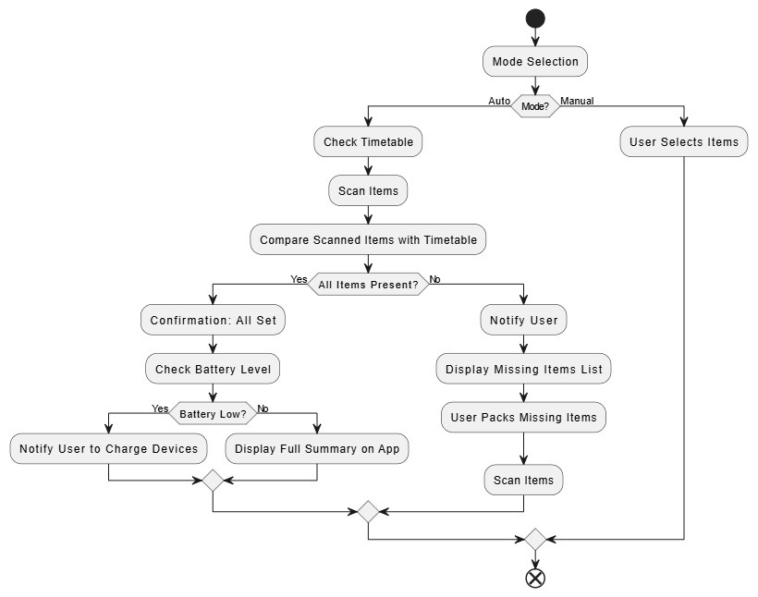
Step 2 – Process Model Specification
The flowchart represents the Working Process of the Smart Backpack System, which operates in two modes – Auto mode and Manual Mode.

Slide 13
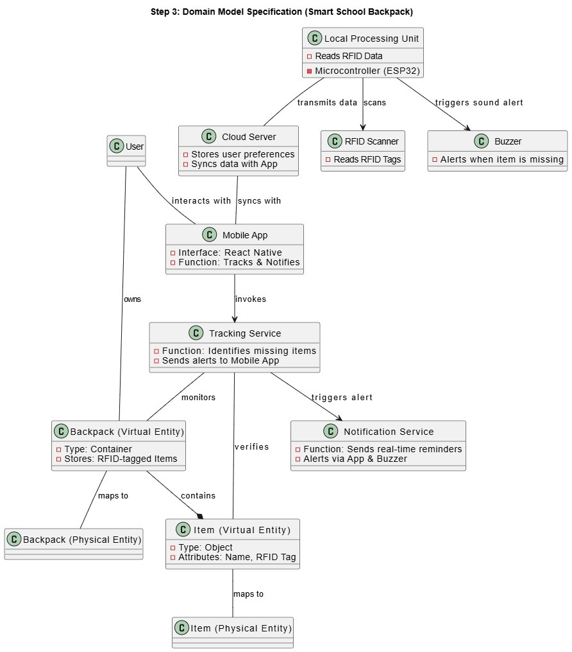
Step 3 – Domain Model Specification
The system connects users, a smart backpack, an RFID scanner, ESP32-S3, a cloud server, a tracking service, and a mobile app to ensure item tracking, alerts, and real-time notifications via the app and buzzer.

Slide 14
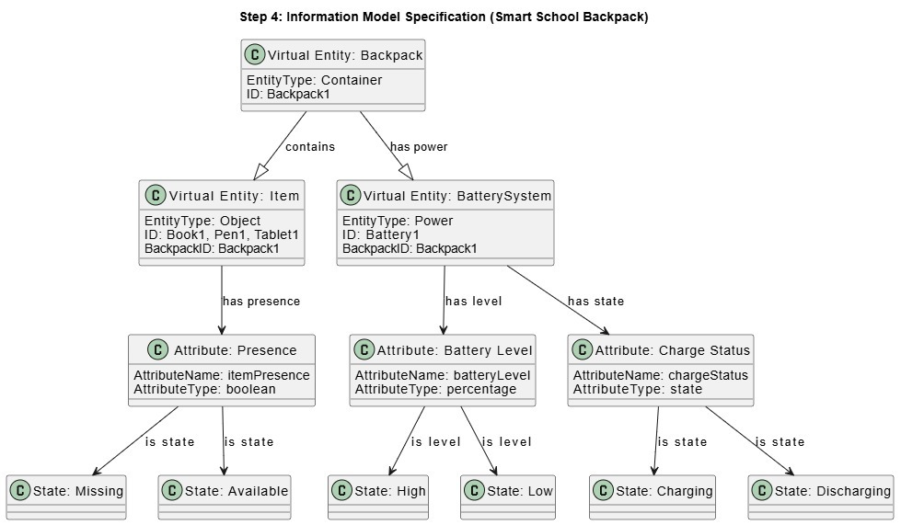
Step 4 – Information Model Specification
Defines Backpack (Container), Items (Objects), and Battery System (Power) with attributes like Presence (Item Availability), Battery Level (Percentage), and Charge Status (State: Charging / Discharging).

Slide 15
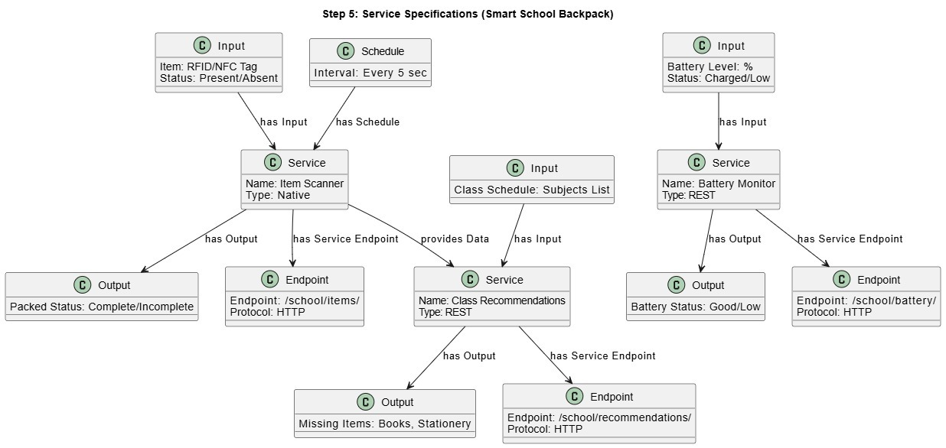
Step 5 – Service Specification
Defines Item Scanning, Class Recommendations, and Battery Monitoring services with RFID/NFC, schedules, and battery levels, outputting packing status, missing items, and battery status via REST APIs

Slide 16
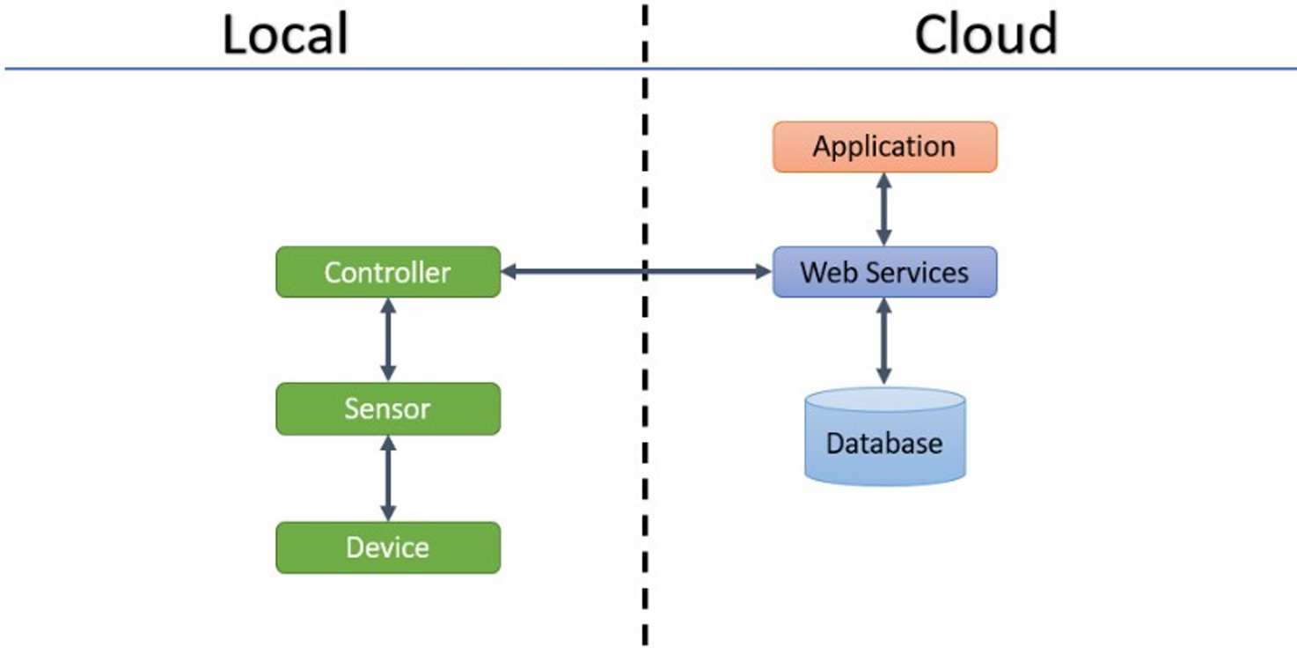
Step 6 – IoT Level Specification
IoT Level 2 cloud data storage and local data analysis

Slide 17
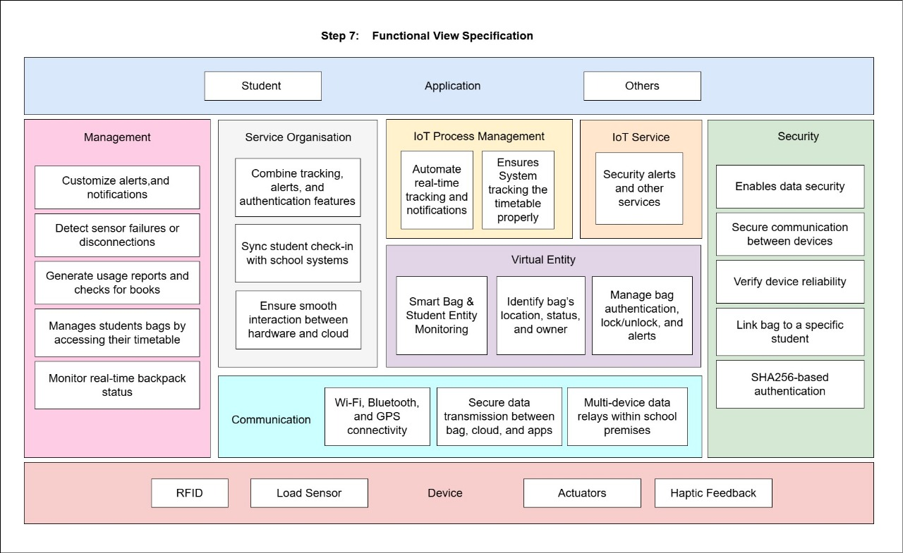
Step 7 – Functional View Specification
Defines Management, IoT Process, Security and Communication for the Smart School Backpack, integrating RFID, Load Sensors, Actuators and Haptic Feedback
with Wi-Fi, Bluetooth, GPS, and SHA256 authentication for real-time tracking, alerts, and authentication.

Slide 18
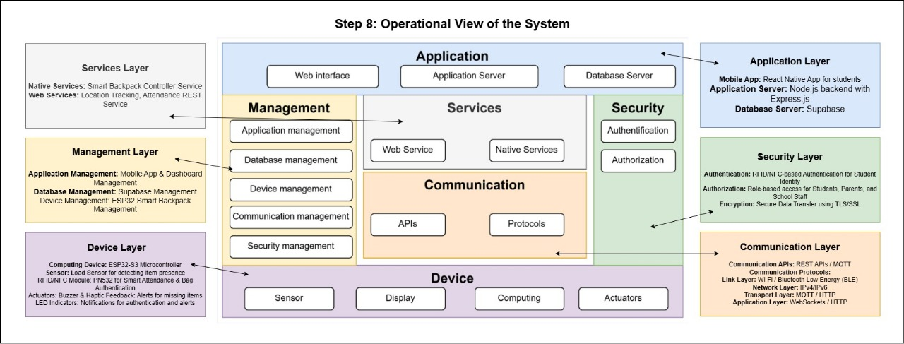
Step 8 – Operational View Specification
Defines Management, IoT Process, Security, and Communication for the Smart School Backpack, integrating RFID, Load Sensors, Actuators, and Haptic Feedback with Wi-Fi, Bluetooth, GPS, and SHA256 authentication for real-time tracking, alerts, and authentication.

Slide 19
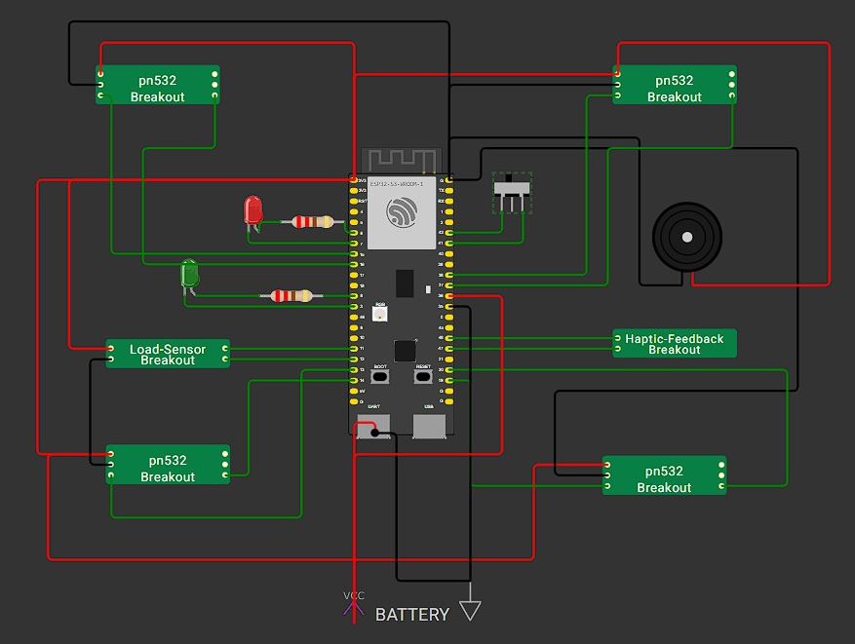
Step 9 – Device and Components Integration
Integrates ESP32-S3 with PN532 NFC modules, Load Sensor, Haptic Feedback, LEDs, and Battery, enabling seamless communication, sensing, and actuation for Smart Backpack operations

Slide 20
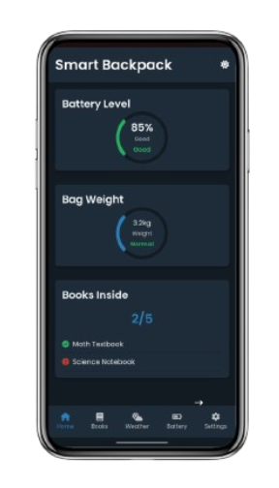
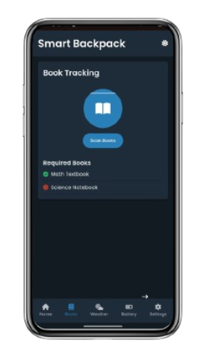
Home Page
Books Page
Step 10 – Application Development
The Smart Backpack app features dark and light themes with sections for Home, Nooks, Weather, Battery, and Settings, ensuring seamless user experience and real-time data management.

Slide 21
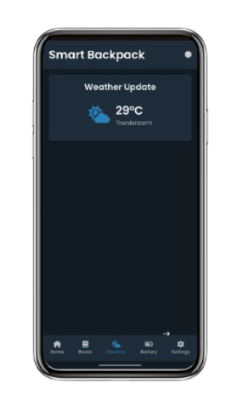
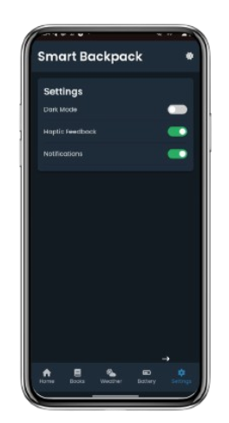
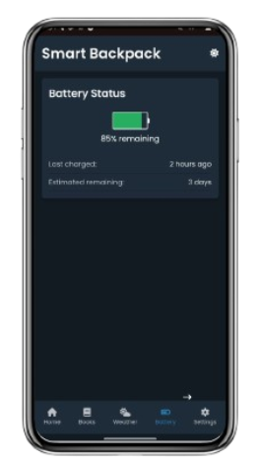
Weather Page
Battery Page
Settings Page

Slide 22
THANK YOU DONE BY MANOHARAN K (230701177) MONIC AUDITYA a (230701194) MONISH DY (230701195)

