Slide 1


LEARN DEEP: PLACEMENT PREPARATION
AI-Inspired Android Application for Structured Interview Mastery
· Android · Firebase · Kotlin
Presented By
Department
Institution
RAKESH R
Computer Science and Engineering
Rajalakshmi Engineering College
A production-grade Android application combining AI-inspired recommendations, real-time analytics, structured quizzes, and personalized learning roadmaps — engineered for scale.

Slide 2

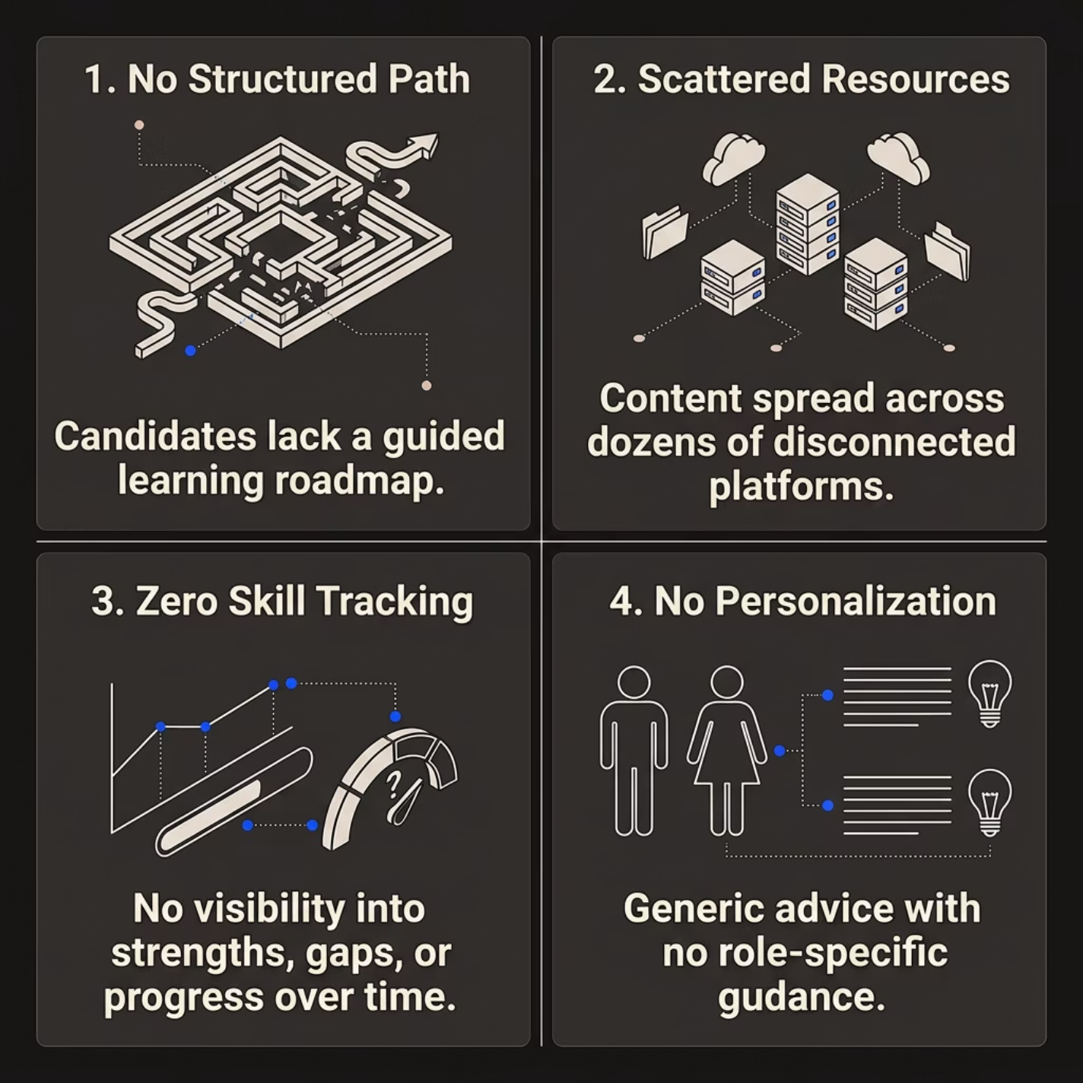


PROBLEM SPACE
Interview Preparation Is Broken
Candidates face fragmented tools, zero personalization, and no measurable progress — leading to unstructured preparation and preventable failures.
The Result: Most candidates walk into interviews underprepared — not from lack of effort, but from lack of direction.
Existing tools like LeetCode, Glassdoor, and YouTube are powerful in isolation but operate in silos. There is no unified platform that tracks skill growth, recommends personalized content, and measures readiness in real time.

Slide 3
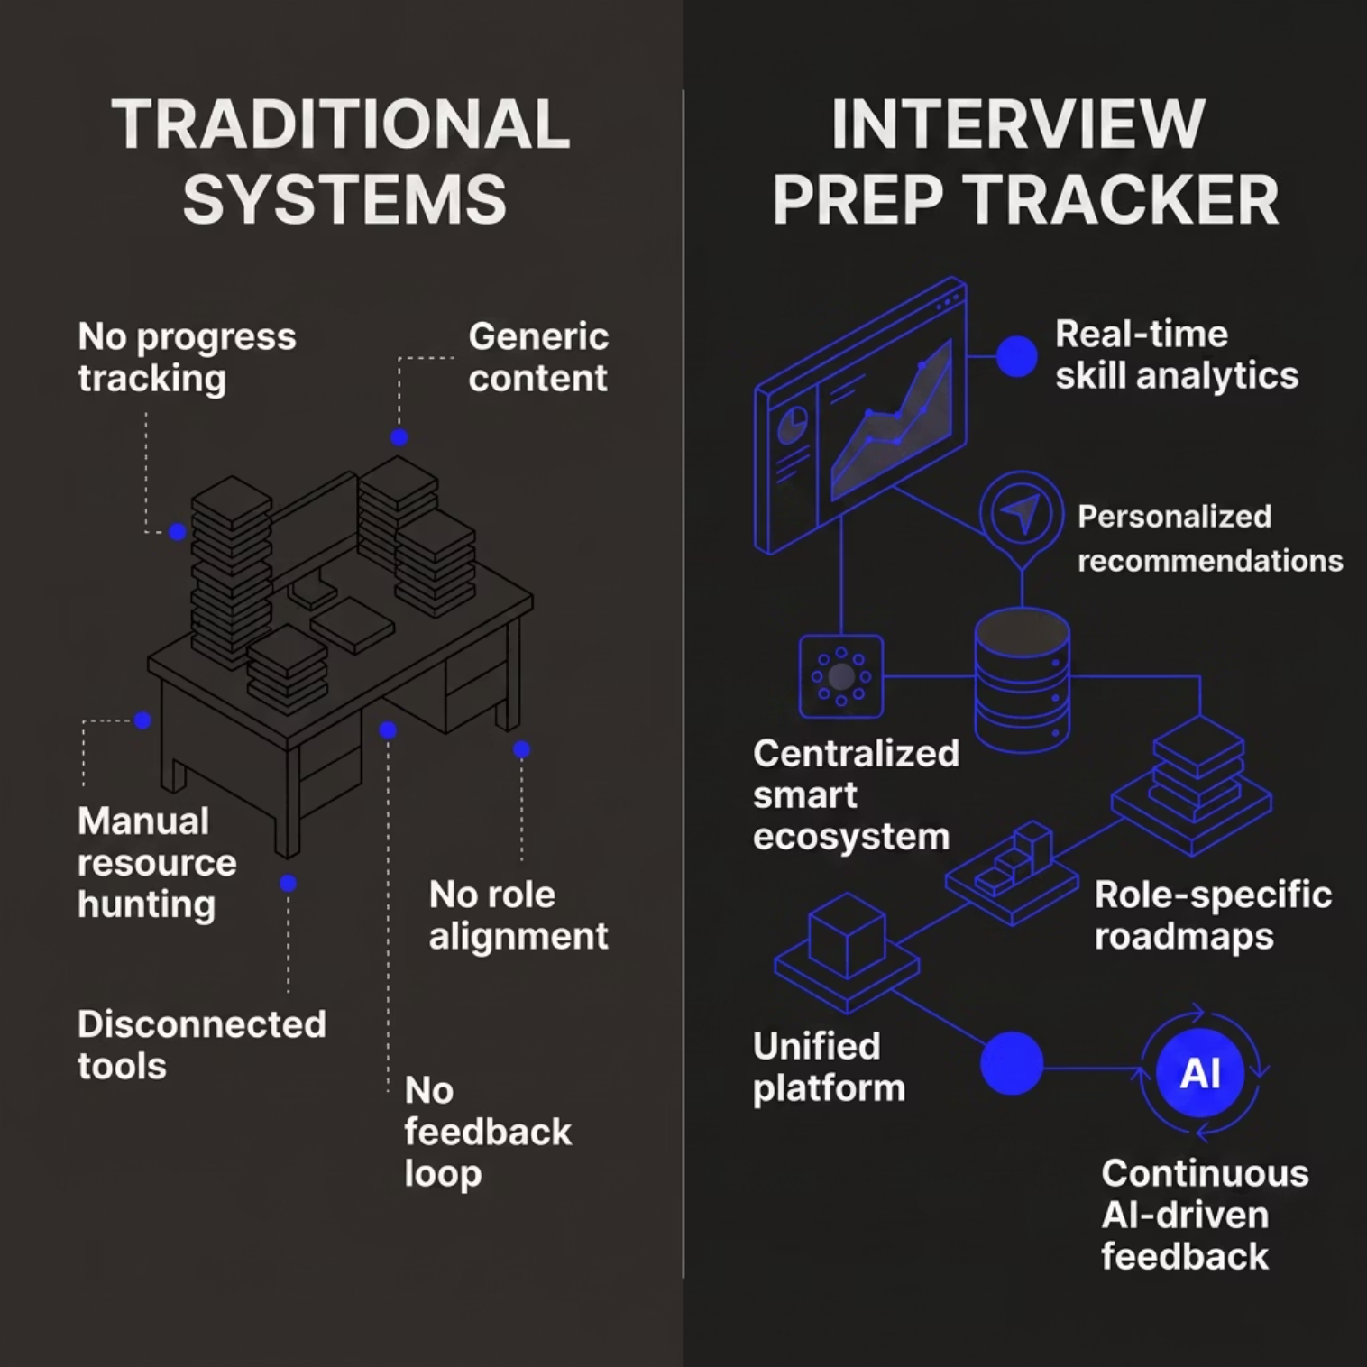


EXISTING SYSTEMS
Where Current Tools Fall Short
The Gap is Structural
Platforms like LeetCode focus on coding practice. LinkedIn Learning focuses on courses. Neither connects performance data to personalized next steps.
Interview Prep Tracker closes this loop — turning raw practice into measurable, role-aligned readiness.

Slide 4
OBJECTIVES
What Interview Prep Tracker Sets Out to Solve
Secure Authentication
Skill Analytics
Firebase-backed login and session management with role-aware onboarding.
Real-time dashboards tracking topic mastery, quiz performance, and growth trends.
AI Recommendations
Learning Roadmaps
Intelligent role-based suggestions powered by user performance data and Firestore.
Structured, curated paths aligned to target roles — frontend, backend, mobile, and more.
Adaptive Quizzes
Unified Dashboard
Topic-focused assessments with instant feedback and performance history.
A single command center aggregating all metrics, tasks, and progress at a glance.

Slide 5
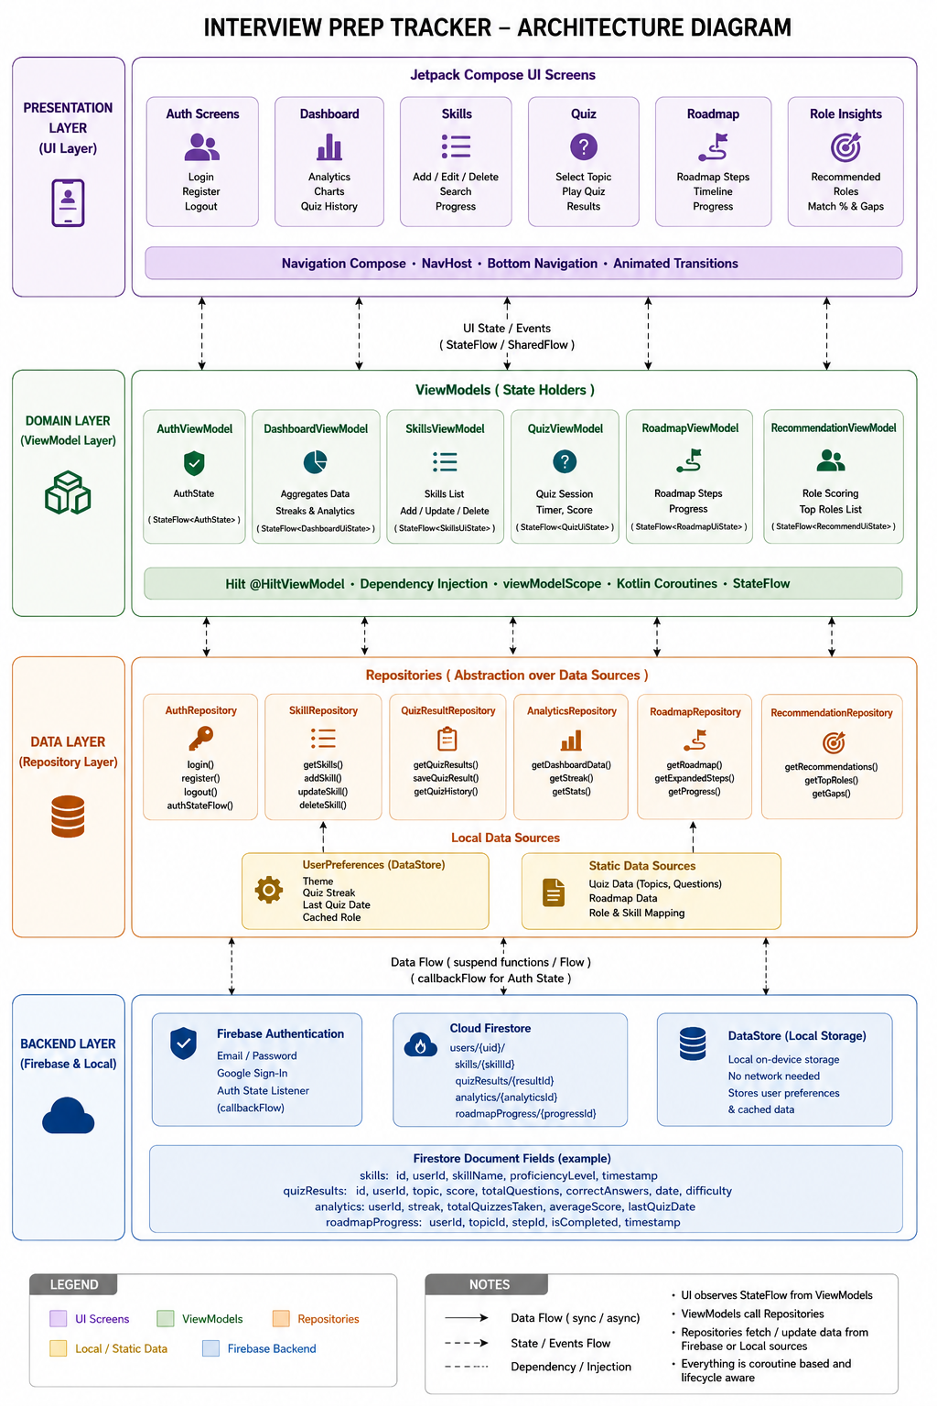
Architecture Diagram

Slide 6
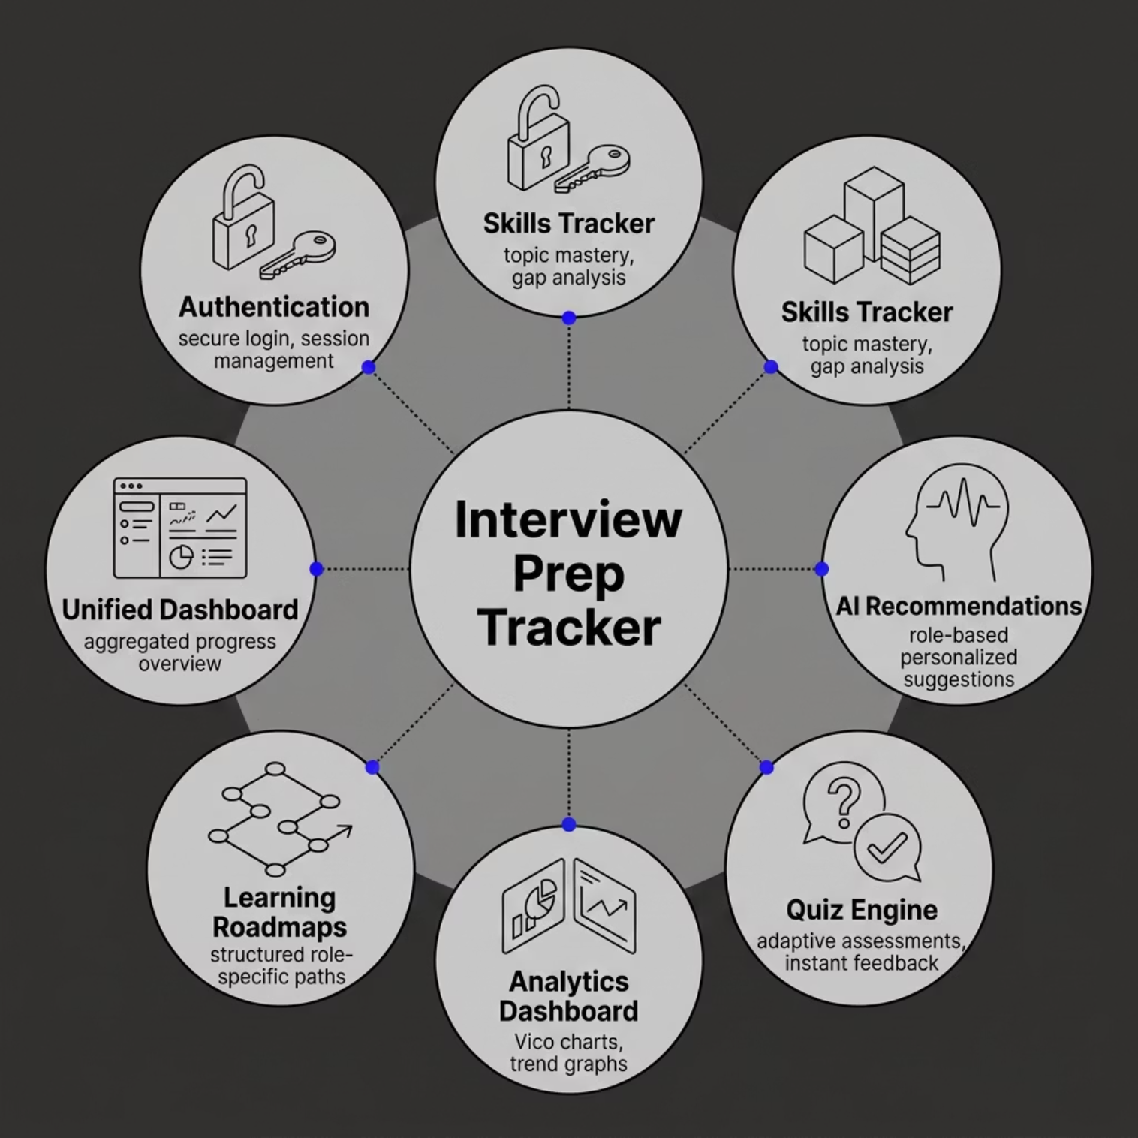

FEATURE OVERVIEW
Core Feature Modules
Modular by Design
Each feature module is independently scoped, Hilt-injected, and Compose-navigated — enabling clean separation and isolated testing.
Navigation Compose manages the full backstack across all modules with type-safe argument passing and deep link support.

Slide 7
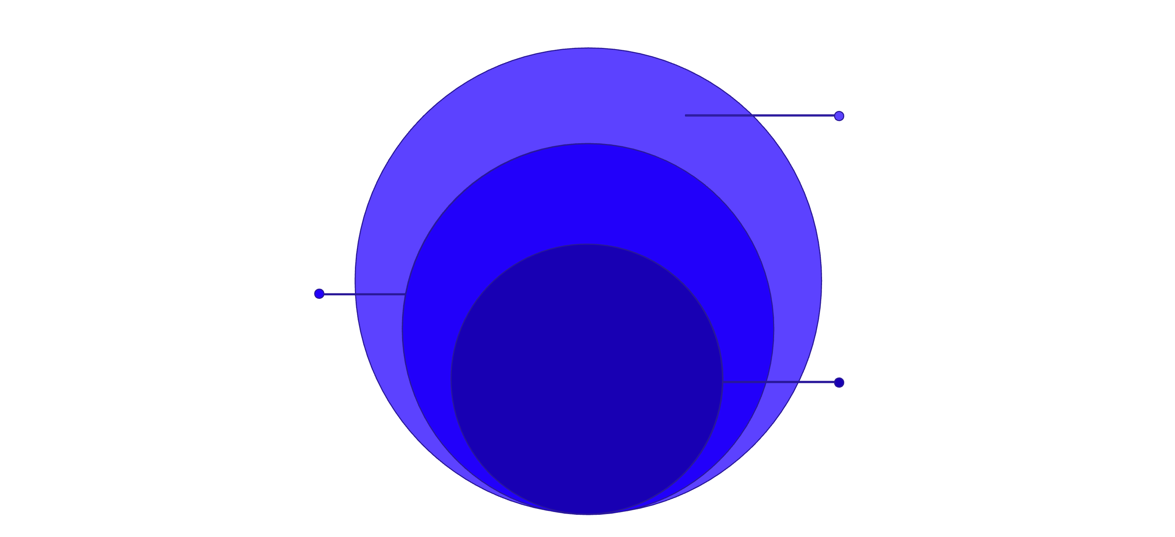
PROPOSED SOLUTION
A Centralized Smart Ecosystem
Interview Prep Tracker unifies every preparation touchpoint into one intelligent, cloud-connected Android application.
Intelligence Layer
Recommendations, Analytics, Roadmap generation
Firebase Cloud
Authentication, Firestore, Real-time Sync
Android App
Jetpack Compose UI, MVVM, Material 3
The architecture enables bidirectional real-time data flow — user actions on-device instantly update cloud state, which feeds the recommendation engine and reflects back in the analytics dashboard.

Slide 8
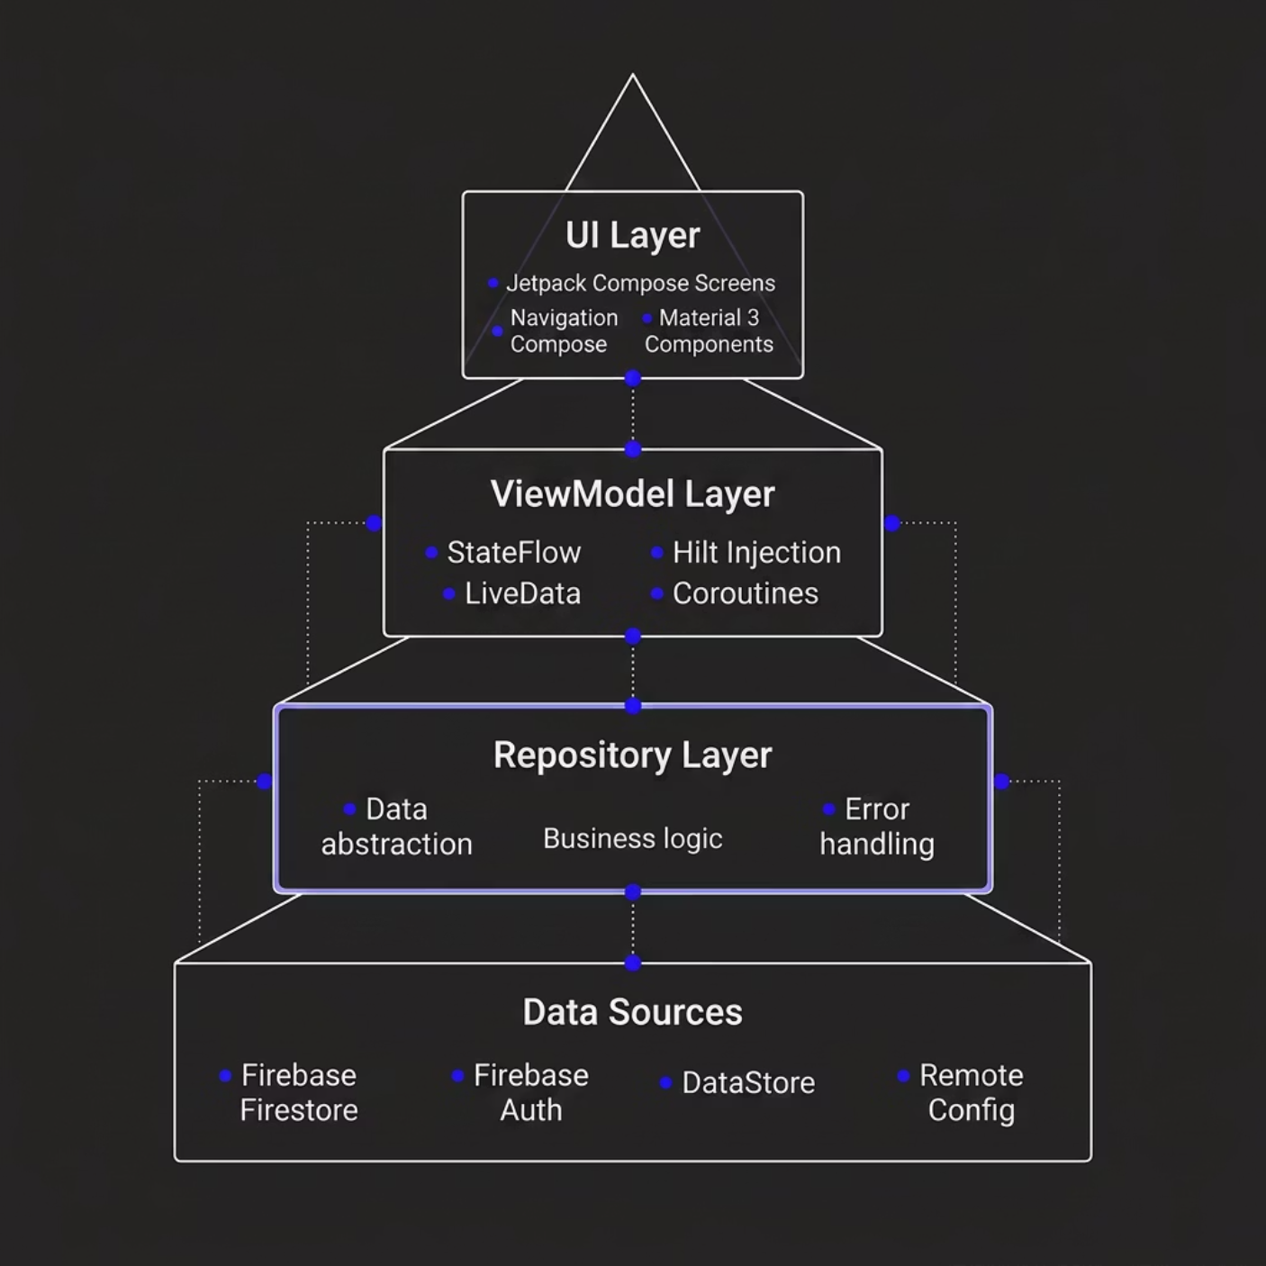

SYSTEM ARCHITECTURE
Layered System Architecture
Separation of Concerns
Each layer has a single, well-defined responsibility. The UI never directly touches data sources — all state flows unidirectionally through ViewModels.
UI Layer
Repository
Compose screens observe StateFlow — pure reactive rendering.
Single source of truth, abstracting Firebase from business logic.

Slide 9
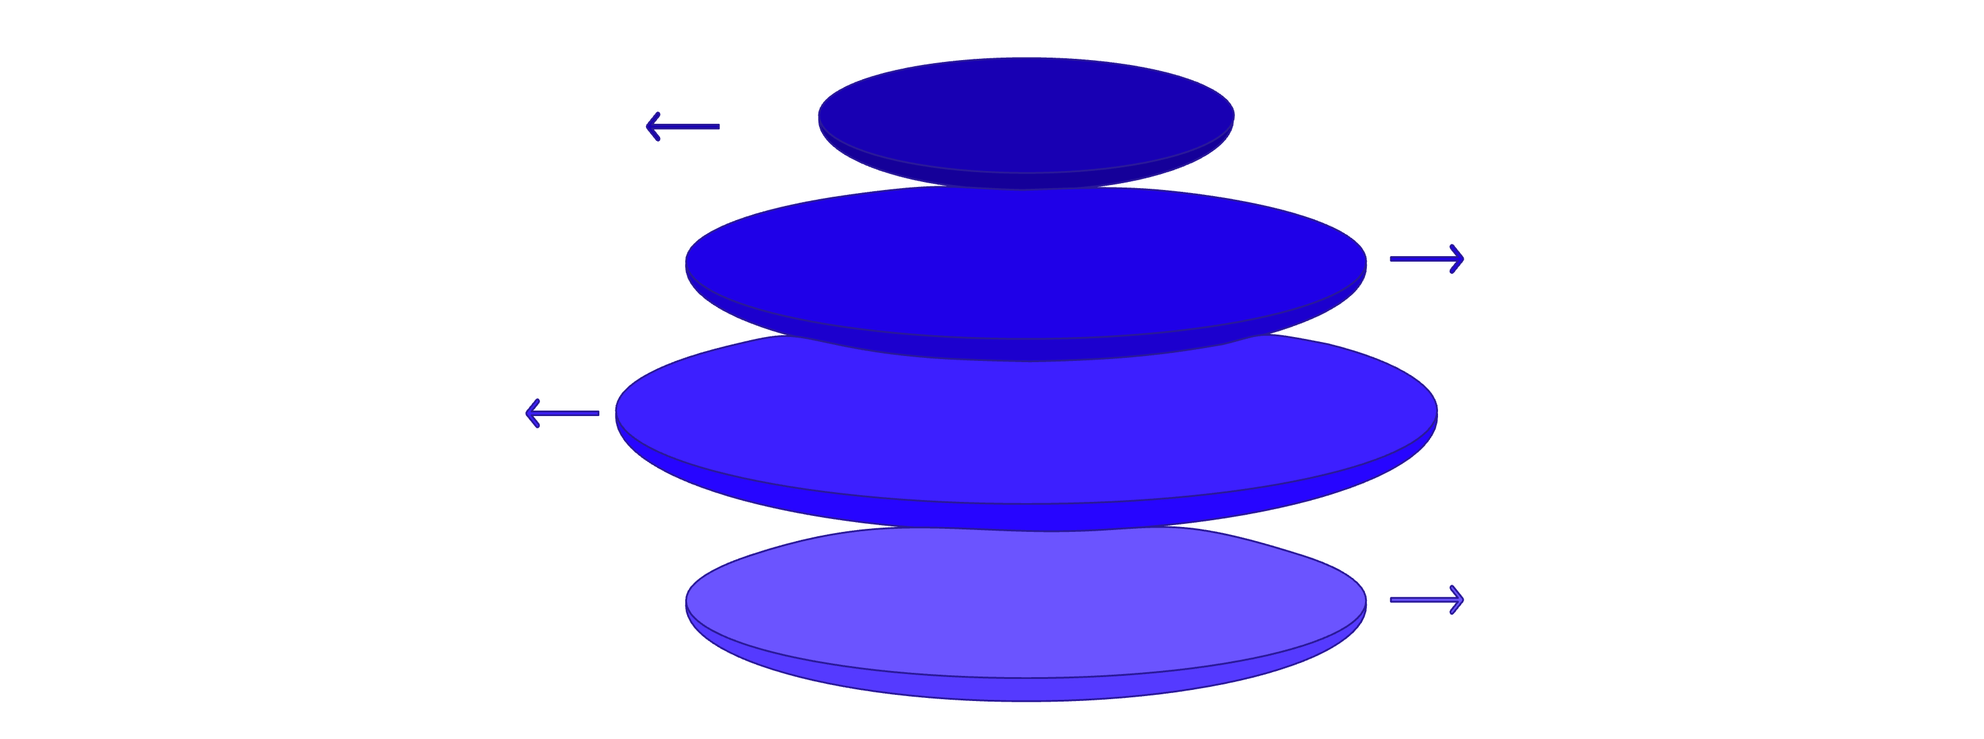
MVVM ARCHITECTURE
Clean Architecture with MVVM
View
Compose observes StateFlow, handles events
ViewModel
Holds StateFlow, launches Coroutines
Repository
Abstracts sources, mapping and caching
Firebase
Firestore listener, Auth, DataStore
StateFlow
Coroutines
Hilt DI
Hot stream of UI state. Compose collects reactively — no manual lifecycle handling.
Structured concurrency for async Firebase operations without callback hell.
Compile-time dependency injection. Scoped ViewModels, testable repositories.

Slide 10
TECH STACK
Engineering-Grade Technology Stack
Kotlin
Jetpack Compose
100% Kotlin codebase. Null-safety, extension functions, coroutine-native.
Declarative UI with Material 3 theming and smooth animated transitions.
Firebase
Hilt DI
Authentication, Firestore real-time DB, and Remote Config for cloud-driven features.
Google-recommended DI built on Dagger. Scoped, testable, compile-safe.
Vico Charts
DataStore
Beautiful, performant Compose-native charts for analytics dashboards.
Jetpack DataStore replaces SharedPreferences for type-safe local preferences.

Slide 11
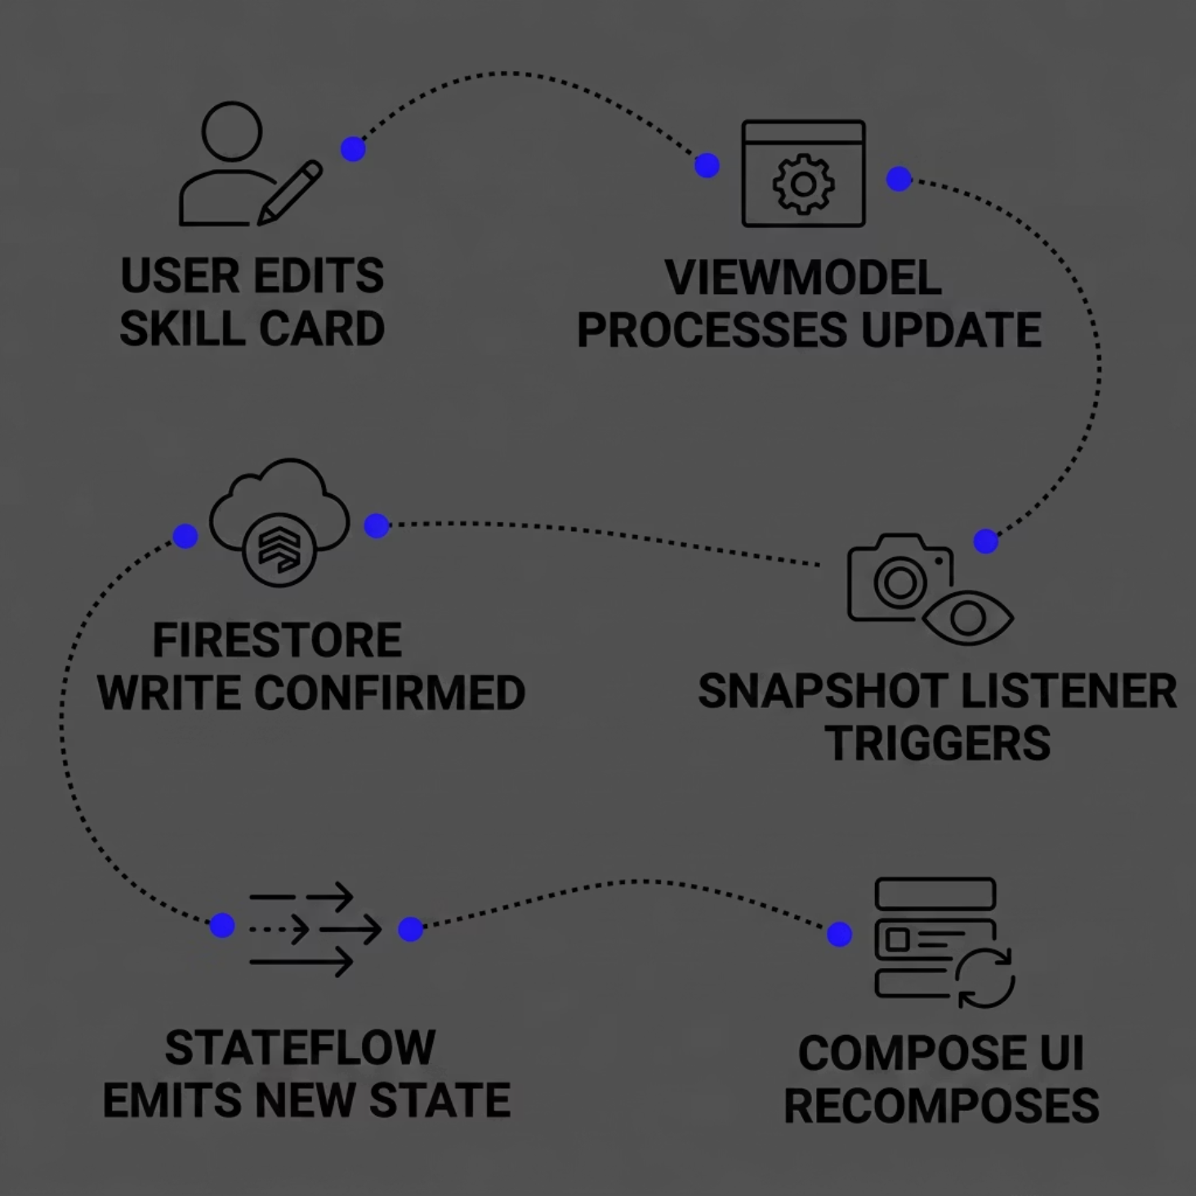

Skill Tracking Module
Full CRUD Operations
Create, read, update, and delete skills seamlessly. Each skill record carries a name, category, and proficiency level persisted in Firestore.
Proficiency Levels
Skills are graded across four tiers — Beginner · Intermediate · Advanced · Expert — rendered as animated progress bars in Compose UI.
Real-Time Sync via Firestore
Snapshot listeners push delta updates instantly. UI state is managed through StateFlow, ensuring zero-latency reflection of cloud changes.

Slide 12
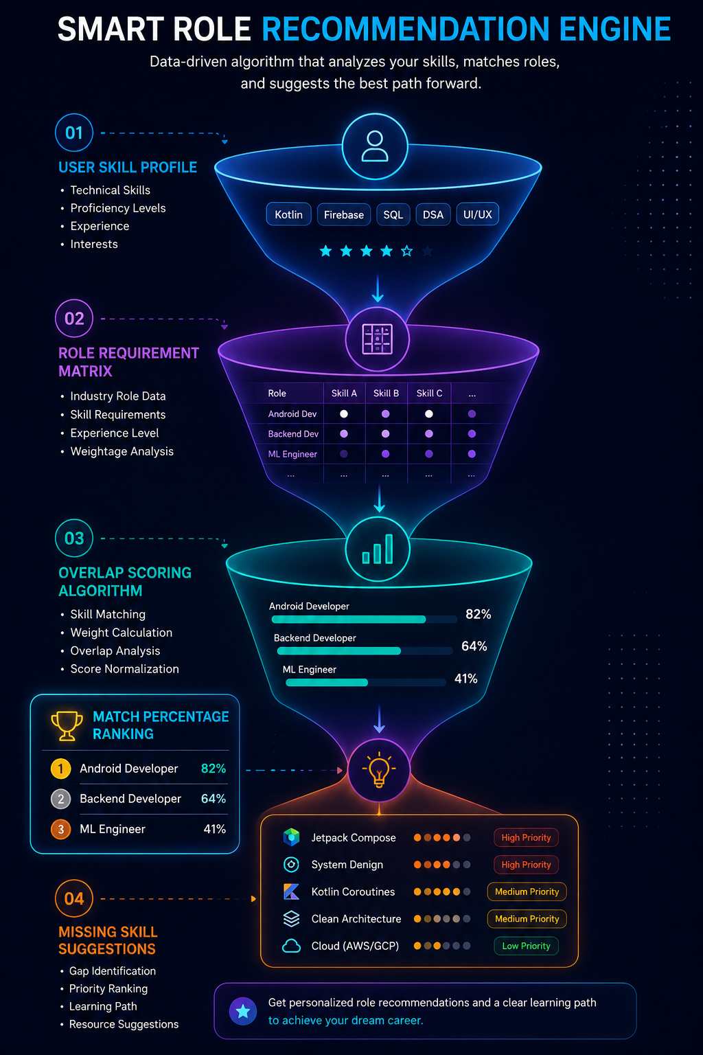
Role Recommendation Engine
An AI-inspired matching system that maps current skills against role requirements to
surface personalized career paths.
Skill-Role Mapping
Match % Logic
Each role carries a weighted requirement set. Matched against the user's proficiency matrix to produce a compatibility score.
Score = (matched skill weight sum) ÷ (total role weight) × 100. Displayed as a ranked card list with progress indicators.
Gap Analysis
Missing skills are flagged with priority labels, driving targeted roadmap suggestions directly tied to the recommendation result.

Slide 13
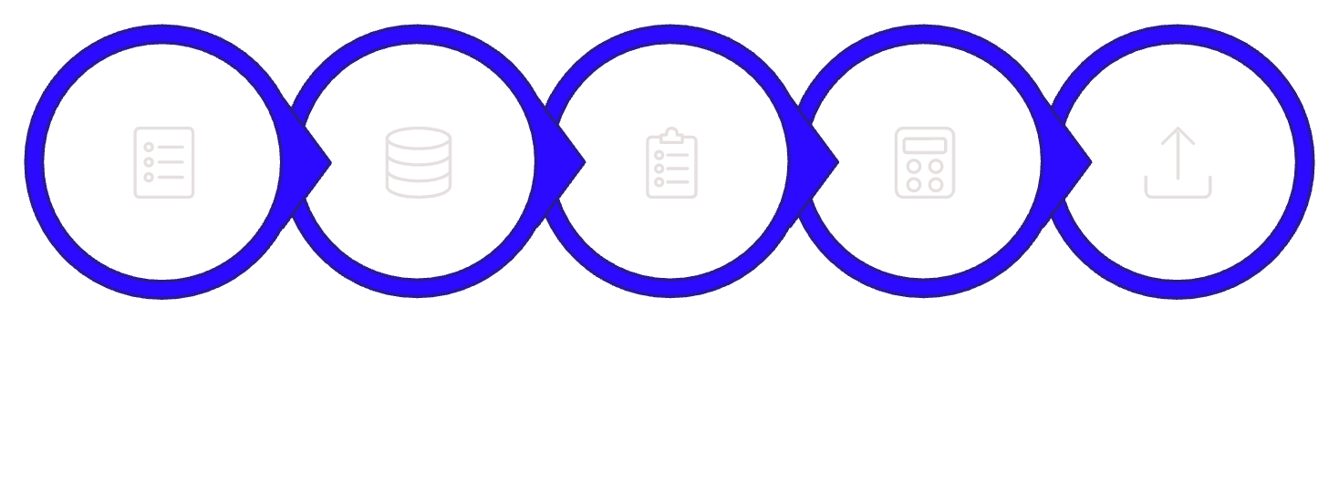
Quiz System
Topic-Wise Quizzes
Organized by domain — Data Structures, System Design, Kotlin, Android — with per-topic scoring history.
Difficulty Tiers
Load Questions
Track Answers
Calculate Score
Persist Results
Easy · Medium · Hard. Adaptive selection surfaces harder questions as user performance improves over sessions.
Select Topic
Questions are fetched per topic and difficulty tier. Scores are computed immediately post-submission and written back to Firestore for longitudinal tracking.
Result Persistence
Every attempt is stored with timestamp, score, and topic tag — enabling trend analysis inside the analytics dashboard.

Slide 14

Roadmap System
Structured, milestone-driven learning paths generated from skill gaps and role targets — turning recommendation output into actionable guidance.
Gap Assessment
Progress Tracking
Role recommendation output seeds the roadmap with prioritized missing skills.
Users mark steps complete. Completion percentage is computed and stored in real time via Firestore.
1
2
3
4
Step Generation
Milestone Review
Each skill gap becomes an ordered learning step with curated resource links and estimated hours.
At each milestone, the system re-evaluates role match score and surfaces updated recommendations.
Roadmap data is persisted in Firestore under the user's document, enabling cross-device continuity and historical milestone visualization.

Slide 15

AUTHENTICATION MODULE
Firebase Authentication Flow
User Input
Firebase Auth
Session Management
Role-Aware Navigation
1
2
3
Credential Validation
Persistent Sessions
Reactive Auth State
Firebase handles server-side auth — no passwords stored on-device.
DataStore preserves auth tokens across app restarts with encrypted storage.
StateFlow emits auth changes — UI reacts instantly without polling.

Slide 16
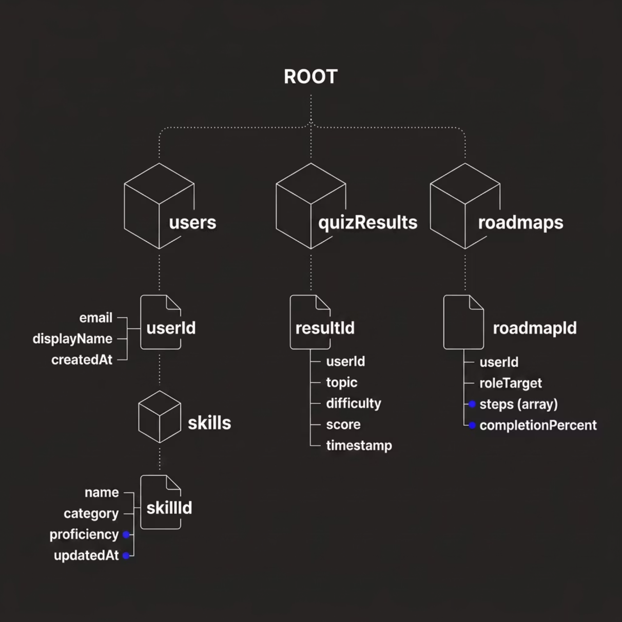
Firebase Database Structure
users
skills
Root user document. Holds profile metadata and serves as the parent for all user-scoped subcollections.
Subcollection under each user. Documents represent individual skills with proficiency and category fields.
quizResults
Top-level collection storing timestamped quiz attempts. Indexed by userId for efficient per-user queries.
Security Rules enforce that each user can only read and write documents where userId == request.auth.uid.

Slide 17

Real-Time Data Flow
Snapshot Listener
Repository Map
ViewModel Flow
Compose UI
Snapshot Listeners
StateFlow in ViewModel
Firestore addSnapshotListener streams document changes. No polling — pure push-based architecture.
Repository flows are collected into MutableStateFlow. UI observes via collectAsStateWithLifecycle().
Coroutines + Flow
Scoped Lifecycle Safety
Listeners are wrapped in callbackFlow, converting Firestore callbacks into cold Kotlin Flow streams.
Coroutines launched in viewModelScope cancel automatically on ViewModel teardown, preventing memory leaks.

Slide 18

Security & Performance
SECURITY IMPLEMENTATION
PERFORMANCE OPTIMIZATION
Firebase Auth
Async with Coroutines
Email/password and Google Sign-In via Firebase Authentication. JWT tokens managed transparently by the SDK.
All I/O operations run on Dispatchers.IO. UI thread is never blocked. Structured concurrency prevents leaks.
Data Isolation
Compose Smart Recomposition
Firestore Security Rules enforce request.auth.uid == userId. No cross-user data access is architecturally possible.
remember, derivedStateOf, and key() minimize unnecessary recompositions. Stable data classes preserve Compose stability contracts.
Session Management
Hilt DI Efficiency
Auth state persisted via DataStore. Session invalidation triggers automatic NavGraph redirect to login screen.
Singleton-scoped repositories and ViewModels injected via Hilt eliminate redundant object creation across the component lifecycle.
The combined security and performance architecture ensures the app is production-ready — safe, fast, and maintainable at scale.

Slide 19
WHAT'S NEXT
Future Enhancements
The roadmap extends Interview Prep Tracker into an intelligent, full-stack preparation platform.
Resume Parser & Gap Analyzer
AI-Powered Recommendations
Upload a resume and receive role-fit scoring, missing skill identification, and targeted roadmap generation.
On-device ML models (TensorFlow Lite) delivering personalized study paths based on performance history.
Gamification & ML Prediction
Interview Simulation Chatbot
Streaks, badges, and leaderboards — paired with ML-based interview readiness score prediction per company target.
Conversational AI conducts mock technical interviews, evaluates answers, and delivers structured feedback.

Slide 20

Thank You
Interview Prep Tracker
A modern Android engineering project — built with precision, designed for scale, and crafted for real-world impact.
Source Code
Contact
https://github.com/230701257/InterviewPrepTracker1
230701257@rajalakshmi.edu.in
Built with Kotlin · Kotlin · Firebase · Hilt · Material 3

