Slide 1
Hassle-Free Express Checkout System
AI-Powered Retail Automation using Computer Vision
Ganeshan M
Syed Aslam S
230701514 | 230701522
AI23331 – Fundamentals of Machine Learning

Slide 2
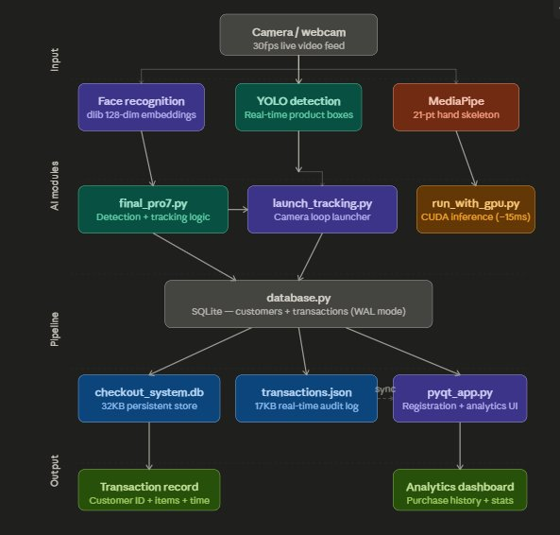
System Architecture

Slide 3
Key Modules
Face Recognition
YOLO Detection
MediaPipe
dlib 128-dim embeddings
Customer ID assignment
Real-time product boxes
mAP@0.5 = 94.2%
21-point hand skeleton
Gesture confirmation
final_pro7.py
database.py
pyqt_app.py
Core detection logic
Pickup/return tracking
SQLite WAL mode
Customers + transactions
PyQt5 desktop UI
Registration + analytics

Slide 4
Performance Results
97.4%
94.2%
98.1%
~15ms
Face ID Accuracy
Product Detection
Transaction Logging
GPU Inference
dlib ResNet embeddings
YOLO mAP@0.5
End-to-end accuracy
vs ~80ms on CPU
Tech Stack:
PyQt5
OpenCV
YOLO
MediaPipe
PyTorch
SQLite
face-recognition

