Slide 1
Q-LogiOpt
Quantum Approximate Optimization for Intelligent Logistics Route and Delivery Optimization
Technologies:
Python | Qiskit | QAOA | QUBO | Streamlit | Machine Learning
Visual:
Use an image/diagram showing:
Depot → Multiple Delivery Locations → Optimized Route
Presented By:
Avutu Nikhil Sai Ram Reddy

Slide 2
Introduction
What is Q-LogiOpt?
Q-LogiOpt is a software Quantum Artificial Intelligence platform that aims to optimize logistic delivery routes through Quantum Approximation Optimization Algorithm (QAOA).
It is a method of transforming the problem of logistics routing to a QUBO problem and solves it by quantum circuit simulation.

Slide 3
Core Idea
Real-world logistics problem
↓
Mathematical optimization model
↓
QUBO formulation
↓
Ising Hamiltonian
↓
QAOA quantum circuit
↓
Optimized delivery route

Slide 4
Key Feature:
The full system could be implemented using quantum simulators without requiring physical quantum computers.

Slide 5
Problem Statement
Existing Problem
Logistics companies need to determine efficient routes for vehicles visiting multiple delivery locations.
A poor route can result in:
Higher transportation cost
Longer delivery distance
Increased delivery time
Increased fuel consumption
Poor utilization of vehicles
Difficulty handling multiple constraints
Computational Challenge
As the number of delivery locations increases, the number of possible routes grows rapidly.
For n locations, the number of possible permutations can approach:
(n−1)!

Slide 6
Therefore, finding the optimal route becomes computationally difficult for larger problems.
Our Approach
Use Quantum Optimization + Classical Optimization + AI-based analysis to investigate better routing solutions.

Slide 7
Motivation
Why Quantum Computing for Logistics?
Traditional optimization methods work well for small and medium-sized problems, but combinatorial optimization can become expensive as problem size increases.
Quantum optimization provides an alternative computational framework.

Slide 8
Motivation for the Project
Study Quantum Artificial Intelligence
Apply QAOA to a real-world optimization problem
Convert logistics routing into QUBO
Compare quantum and classical optimization
Analyze solution quality and feasibility
Build an interactive research dashboard
Investigate the effect of QAOA parameters
Study robustness under simulated noise
Important
This project does not claim that quantum computing currently beats classical logistics solvers.
Instead, it provides an experimental framework for studying quantum optimization.

Slide 9
Project Objectives
Primary Objectives
Model a logistics routing problem mathematically.
Convert the routing problem into a QUBO formulation.
Map the QUBO into an Ising Hamiltonian.
Implement QAOA using Qiskit.
Execute quantum circuits using Qiskit Aer simulator.
Decode quantum measurement results into routes.
Introduce the proposed Quantum Logistics Distribution Objective (QLDO).
Compare QAOA against classical algorithms.
Analyze solution quality and feasibility.
Build an interactive Streamlit dashboard.

Slide 10
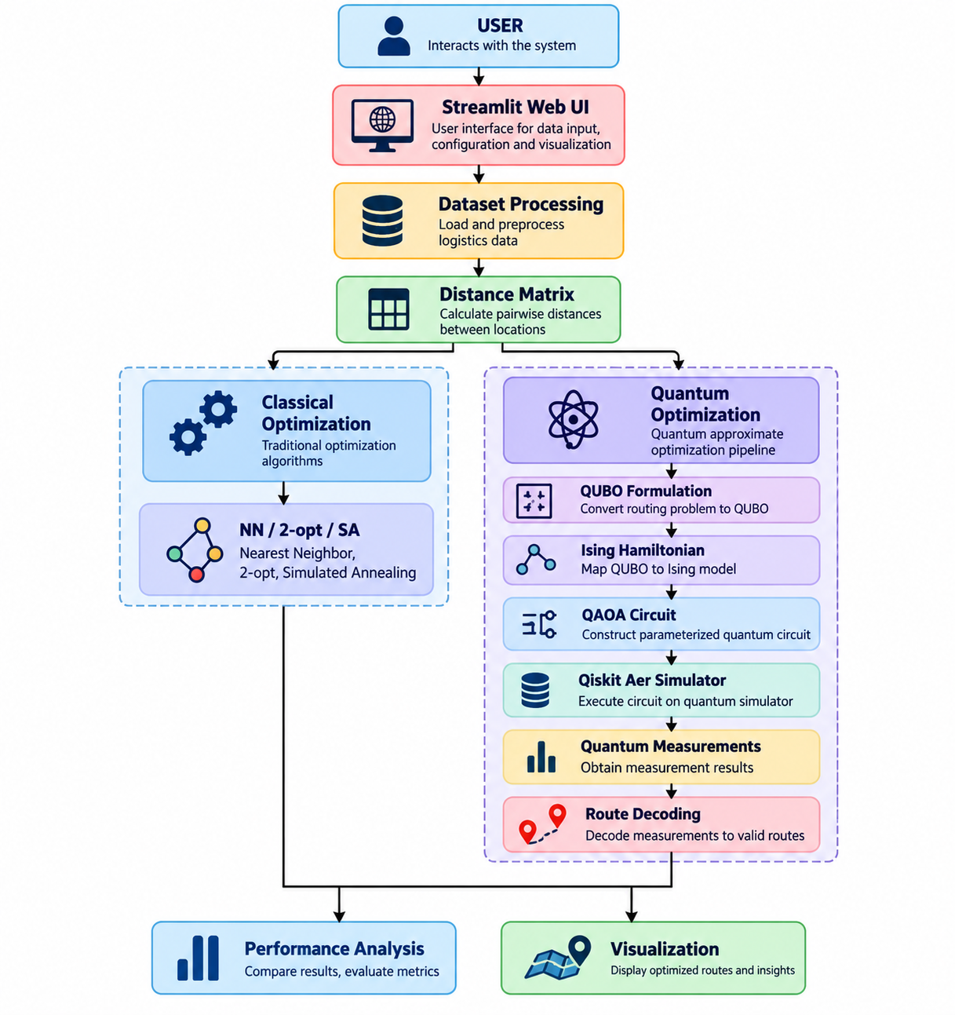
Proposed System Architecture

Slide 11
Dataset
Input Dataset
The system accepts logistics data containing:
Field | Description
Location ID | Delivery location
Latitude | Geographic latitude
Longitude | Geographic longitude
Demand | Delivery requirement
Priority | Delivery priority

Slide 12
Sample Dataset
Your project contains a sample dataset with:
Depot
C1
C2
C3
C4
C5
C6
C7
Example
DEPOT → C1 → C2 → C3 → C4 → C5 → C6 → C7 → DEPOT
The actual optimized order is determined by the optimization algorithm.
Visual
Show a map with:
Depot + Customer Locations + Route

Slide 13
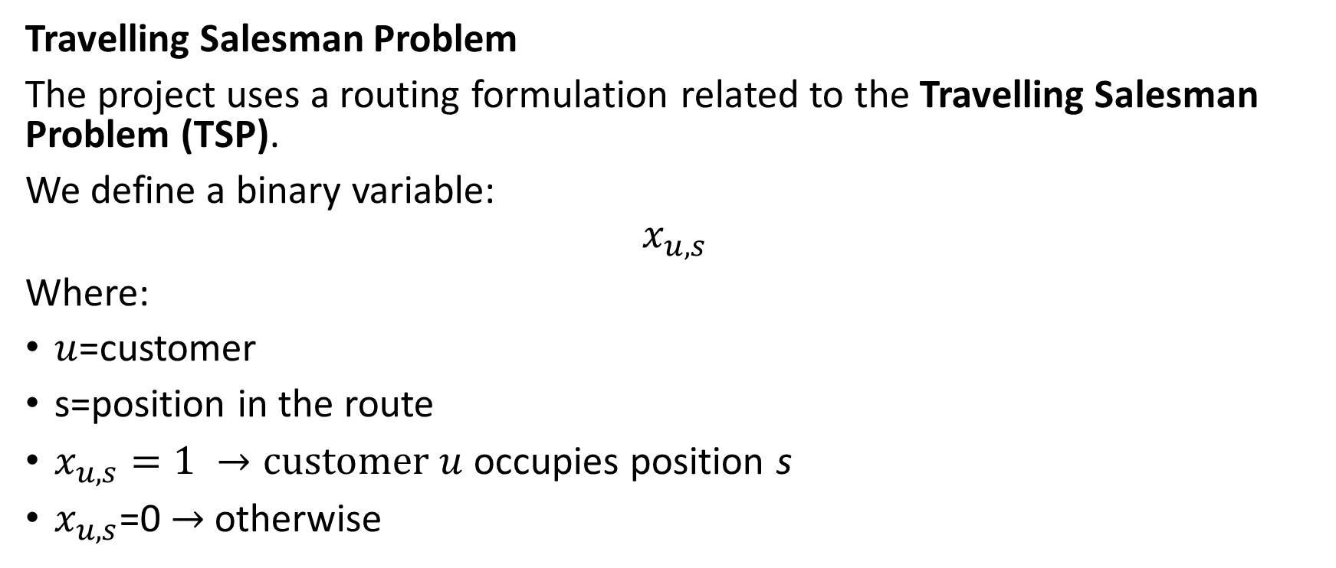
Mathematical Formulation
Travelling Salesman Problem
The project uses a routing formulation related to the Travelling Salesman Problem (TSP).
We define a binary variable:
$$x_{u,s}$$
Where:
$u$=customer
s=position in the route
$x_{u,s}=1 →customer u$occupies position s
$x_{u,s}$=0 $→$ otherwise

Slide 14

Constraints
Each customer must appear exactly once:
$$\sum_{s}{x_{u,s}}=1$$
Each route position must contain exactly one customer:
$\sum_{u}{x_{u,s}}=1$

Slide 15
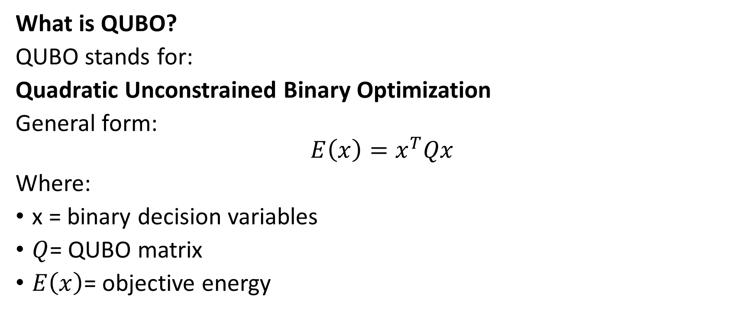
QUBO Formulation
What is QUBO?
QUBO stands for:
Quadratic Unconstrained Binary Optimization
General form:
$$E\left(x\right)=x^{T}Qx$$
Where:
x = binary decision variables
$Q$= QUBO matrix
$E\left(x\right)$= objective energy

Slide 16
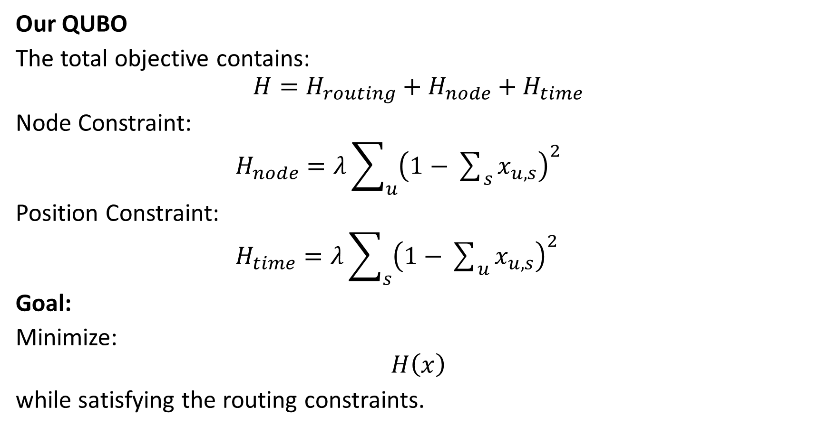
Our QUBO
The total objective contains:
$$H=H_{routing}+H_{node}+H_{time}$$
Node Constraint:
$H_{node}=λ\sum_{u}{{\left(1−\sum_{s}{x_{u,s}}\right)}^{2}}$
Position Constraint:
$H_{time}=λ\sum_{s}{{\left(1−\sum_{u}{x_{u,s}}\right)}^{2}}$
Goal:
Minimize:
$$H\left(x\right)$$
while satisfying the routing constraints.

Slide 17
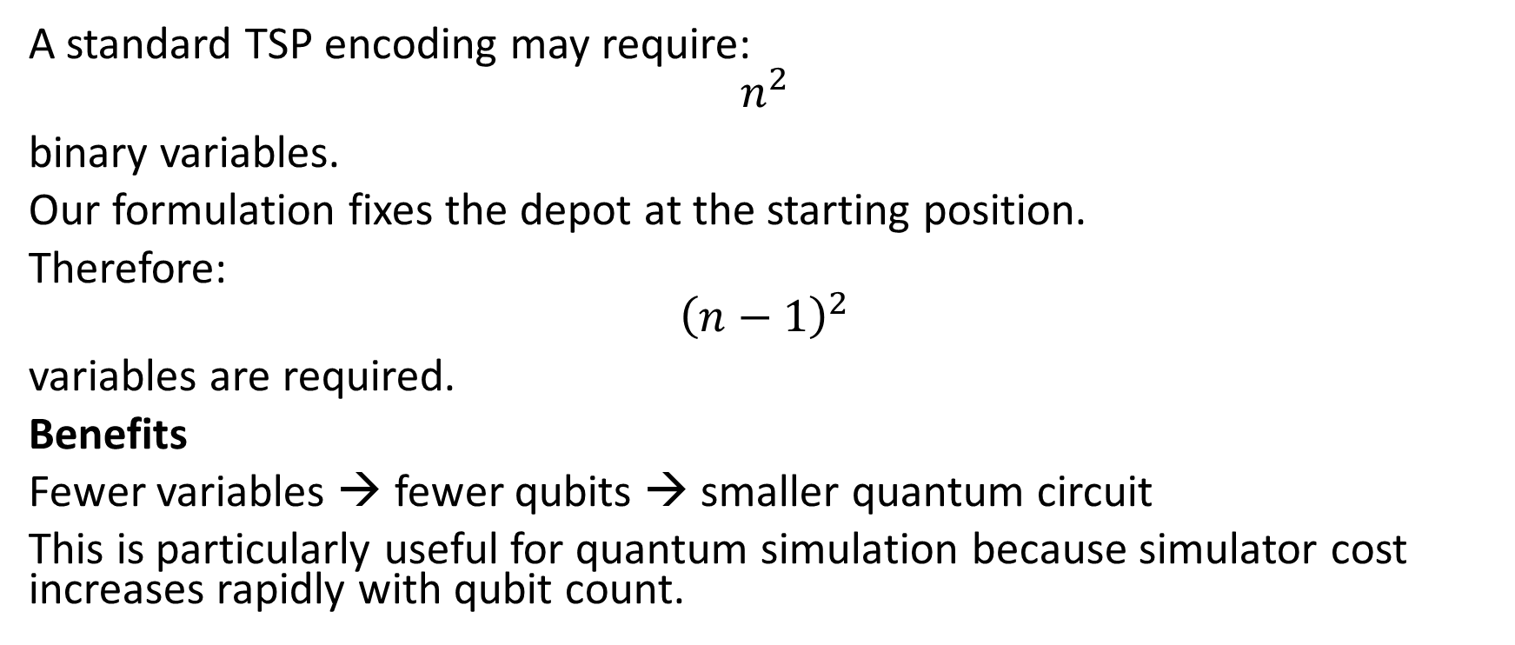
Anchored Depot Formulation
A standard TSP encoding may require:
$$n^{2}$$
binary variables.
Our formulation fixes the depot at the starting position.
Therefore:
$${\left(n−1\right)}^{2}$$
variables are required.
Benefits
Fewer variables → fewer qubits → smaller quantum circuit
This is particularly useful for quantum simulation because simulator cost increases rapidly with qubit count.

Slide 18
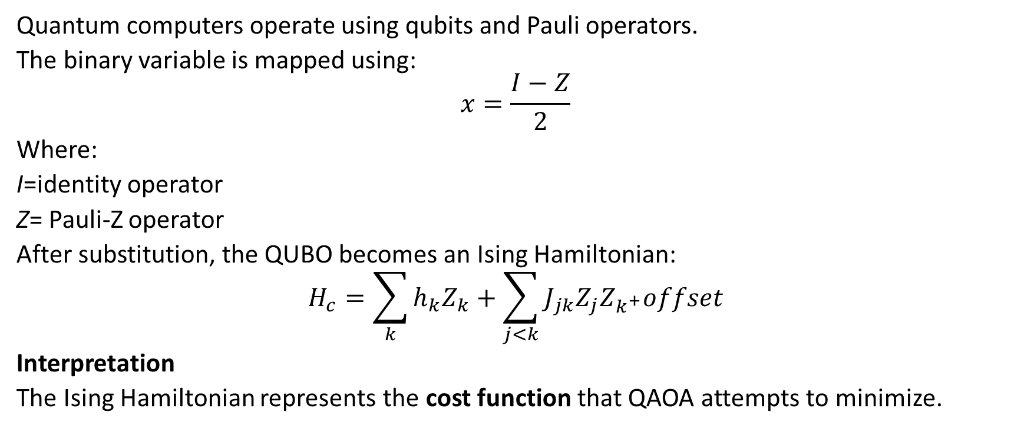
QUBO to Ising Model
Quantum computers operate using qubits and Pauli operators.
The binary variable is mapped using:
$$x=\frac{I−Z}{2}$$
Where:
I=identity operator
Z= Pauli-Z operator
After substitution, the QUBO becomes an Ising Hamiltonian:
$$H_{c}=\sum_{k}{h_{k}Z_{k}}+\sum_{j<k}{J_{jk}Z_{j}Z_{k^{+}}offset}$$
Interpretation
The Ising Hamiltonian represents the cost function that QAOA attempts to minimize.

Slide 19

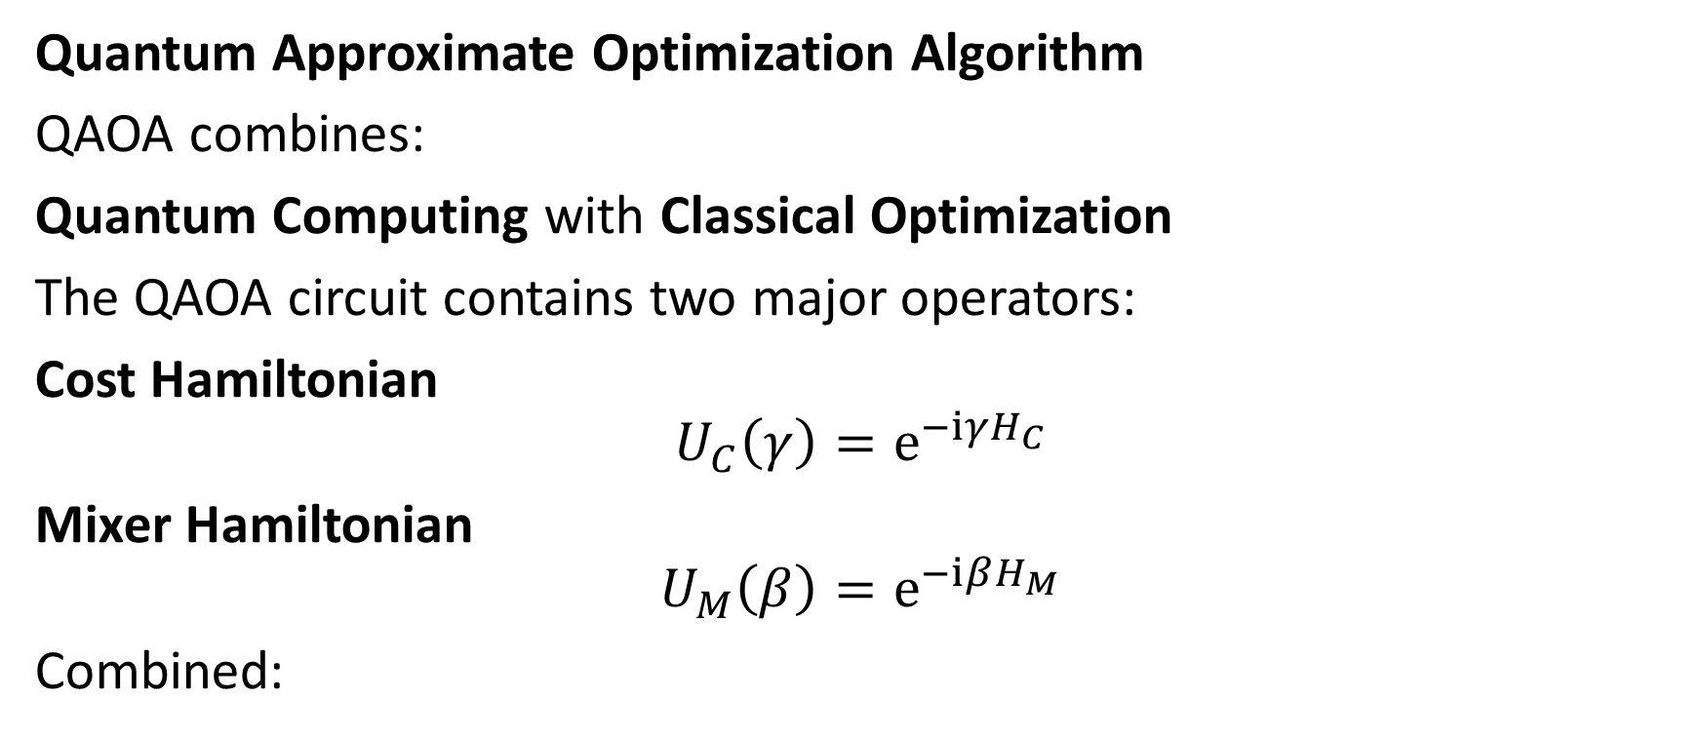
QAOA
Quantum Approximate Optimization Algorithm
QAOA combines:
Quantum Computing with Classical Optimization
The QAOA circuit contains two major operators:
Cost Hamiltonian
$$U_{C}\left(γ\right)=ⅇ^{−ⅈγH_{C}}$$
Mixer Hamiltonian
$$U_{M}\left(β\right)=ⅇ^{−ⅈβH_{M}}$$
Combined:
$$U\left(γ,β\right)=ⅇ^{−ⅈβH_{M}}ⅇ^{−ⅈγH_{c}}$$

Slide 20
Optimization Loop
Initialize Parameters
↓
Build Quantum Circuit
↓
Run Quantum Simulator
↓
Measure Qubits
↓
Calculate Objective
↓
Classical Optimizer
↓
Update γ and β
↓
Repeat

Slide 21
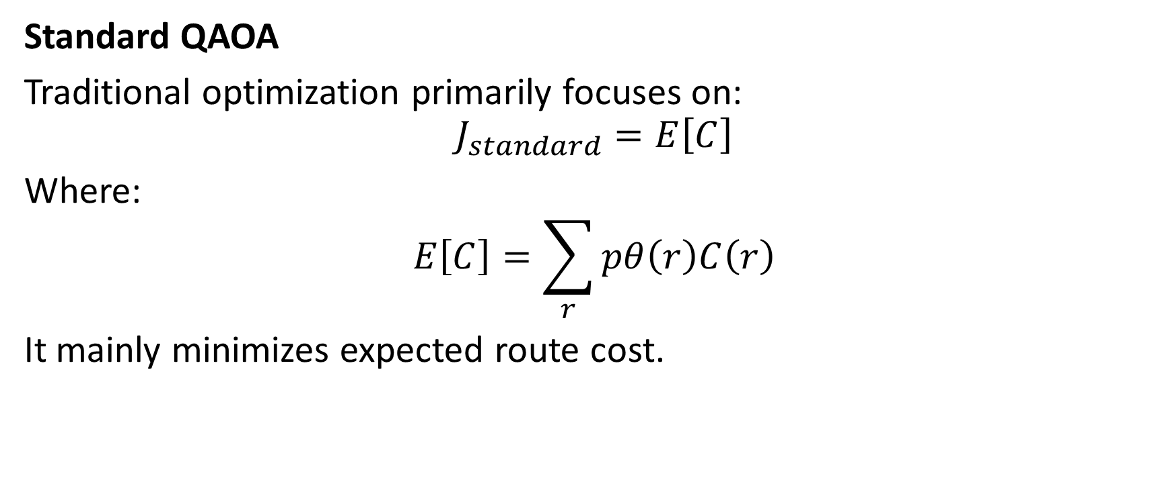
Standard QAOA vs Proposed QLDO
Standard QAOA
Traditional optimization primarily focuses on:
$$J_{standard}=E\left[C\right]$$
Where:
$$E\left[C\right]=\sum_{r}{pθ\left(r\right)C\left(r\right)}$$
It mainly minimizes expected route cost.

Slide 22
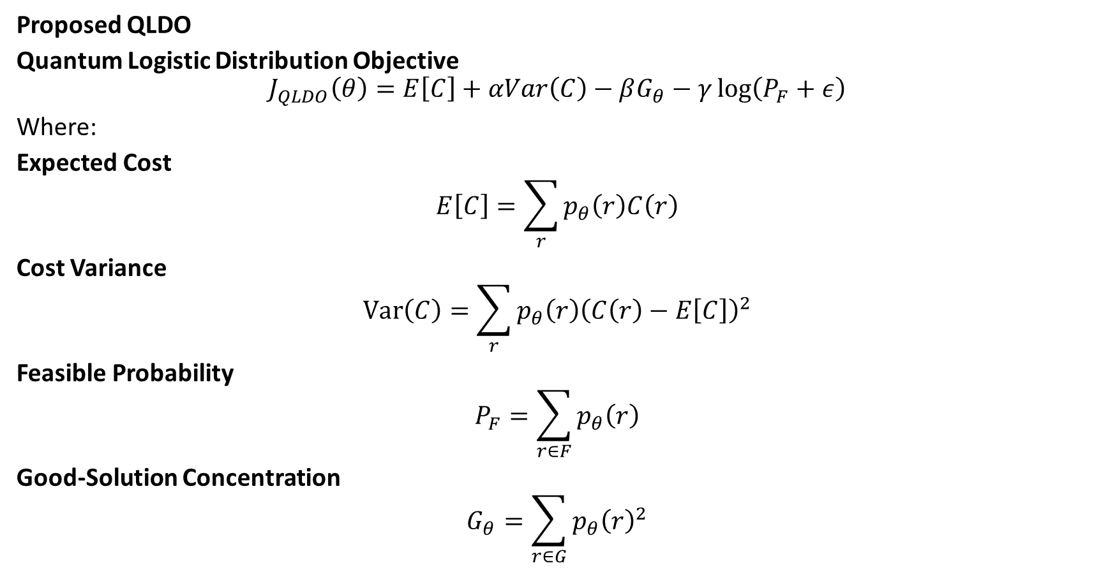
Proposed QLDO
Quantum Logistic Distribution Objective
$$J_{QLDO}\left(θ\right)=E\left[C\right]+αVar\left(C\right)−βG_{θ}−γ\log\left(P_{F}+ε\right)$$
Where:
Expected Cost
$$E\left[C\right]=\sum_{r}{p_{θ}\left(r\right)C\left(r\right)}$$
Cost Variance
$$\operatorname{Var}\left(C\right)=\sum_{r}{p_{θ}\left(r\right){\left(C\left(r\right)−E\left[C\right]\right)}^{2}}$$
Feasible Probability
$$P_{F}=\sum_{r∈F}{p_{θ}\left(r\right)}$$
Good-Solution Concentration
$$G_{θ}=\sum_{r∈G}{p_{θ}{\left(r\right)}^{2}}$$

Slide 23
Why QLDO
Standard Objective
Quantum Distribution
│
▼
Expected Cost
│
▼
Minimum Expected Cost

Slide 24
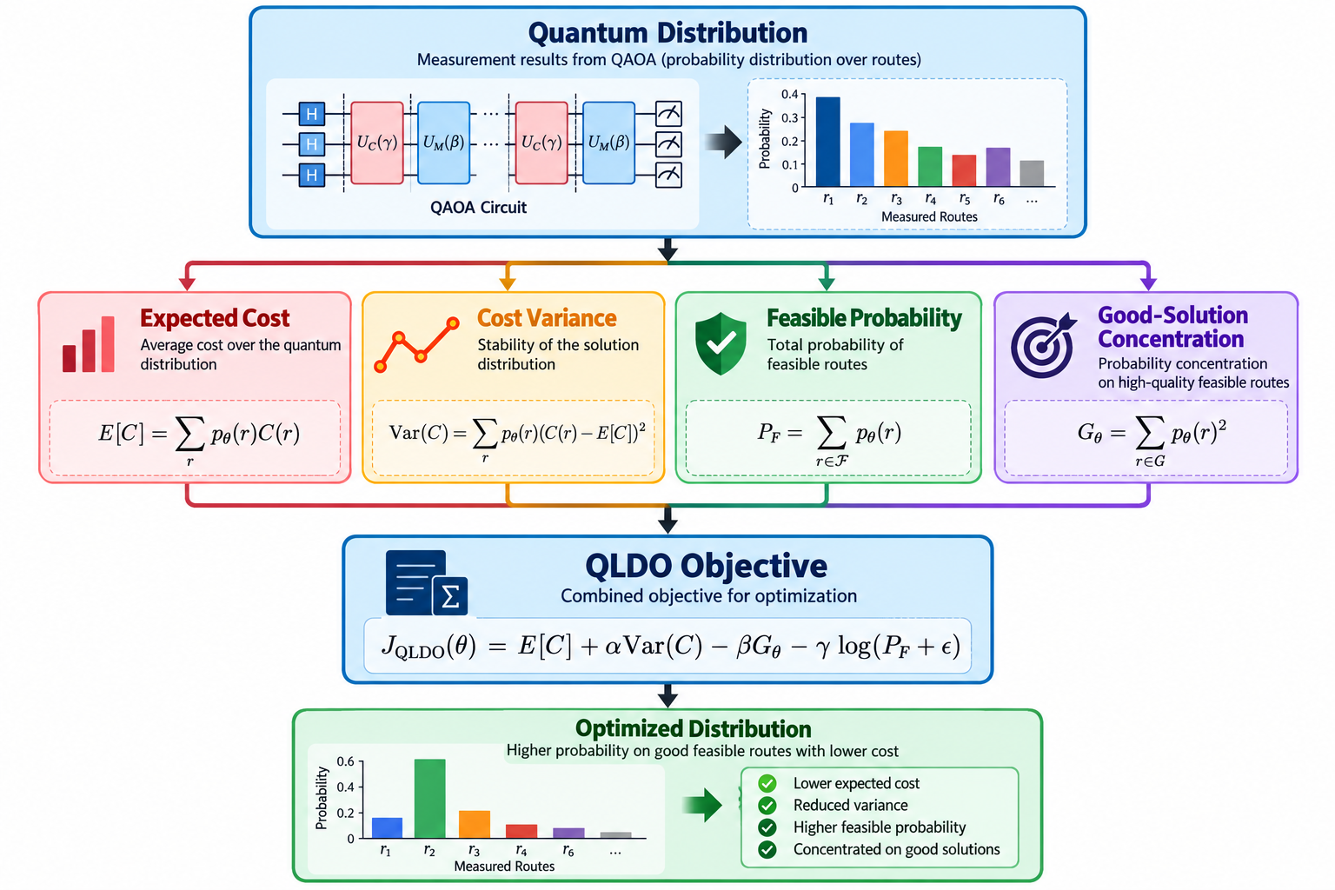
QLDO

Slide 25
Concept
QLDO attempts to evaluate the entire output distribution, rather than only looking at the expected route cost.
This allows the research to study:
Cost
Stability
Feasibility
Probability concentration
Important: Present QLDO as a proposed research objective, not as an established superior method, unless your experiments demonstrate that result.

Slide 26
Classical Algorithms
The quantum approach should be compared with classical optimization methods.
1. Nearest Neighbor
Starts from the depot and repeatedly chooses the nearest unvisited customer.
2. 2-opt
Improves an existing route by replacing two edges when the replacement reduces total distance.
3. Simulated Annealing
Uses probabilistic exploration to escape local optima.
Optional
4. Exact Solver
For small instances, an exact method can provide a reference optimum.

Slide 27
Quantum vs Classical Comparison
Parameter | Classical | QAOA
Representation | Algorithms | Quantum circuit
Search | Deterministic / stochastic | Parameterized quantum distribution
Optimization | Classical | Quantum + classical
Hardware | CPU | Simulator / quantum hardware
Output | Route | Measurement distribution
Main Metric | Route cost | Cost + distribution metrics
Scalability | Problem dependent | Qubit limited

Slide 28
Evaluation Metrices
Route distance
Route cost
Feasibility rate
Best solution
Average solution cost
Runtime
Number of qubits
Circuit depth
Approximation quality

Slide 29
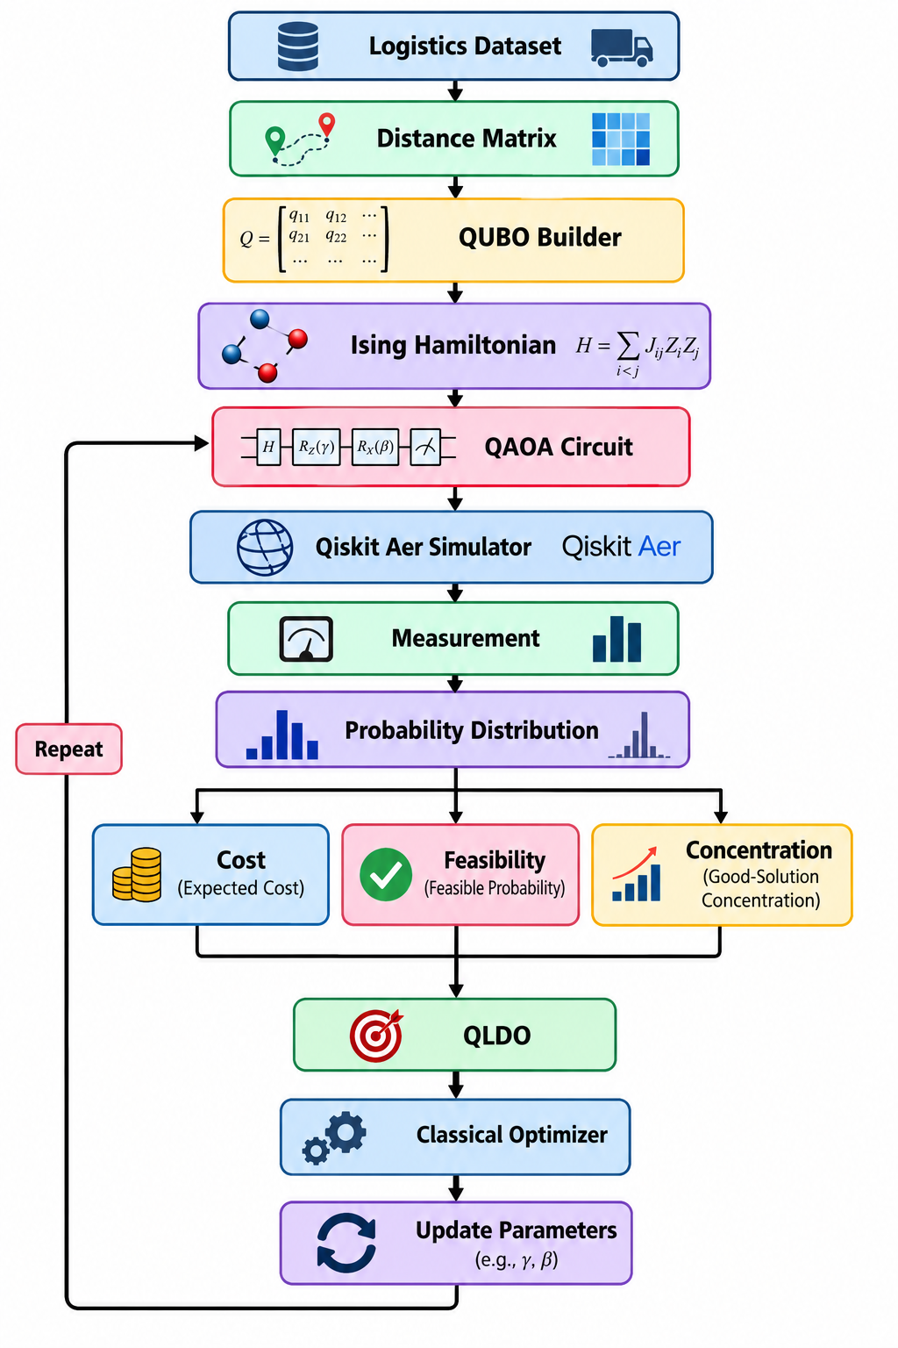
QLDO-QAOA Workflow

Slide 30
Streamlit Dashboard
Interactive Web Application
The project uses Python + Streamlit.
Dashboard Modules
Dashboard
Dataset
Route Configuration
Classical Optimization
QUBO Matrix
QAOA Optimization
Quantum Circuit
Experiments
Performance Analysis
Research / About

Slide 31
Dashboard Capabilities
Users can:
Upload datasets
Select depot
Configure customers
Generate distance matrix
Run classical algorithms
Generate QUBO
Configure QAOA depth
Run quantum simulation
View measurement probabilities
Visualize routes
Compare algorithms
Analyze QLDO parameters

Slide 32
Experimental Design
Experiment 1 — Problem Size
Test different numbers of customers:
4 customers
5 customers
6 customers
7 customers
...
Measure:
Qubits
Circuit depth
Runtime
Solution quality

Slide 33
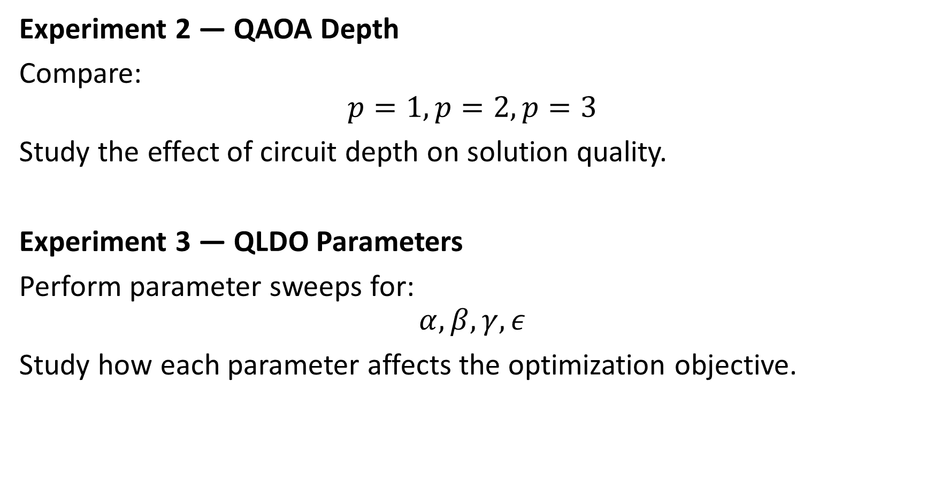
Experiment 2 — QAOA Depth
Compare:
$$p=1,p=2,p=3$$
Study the effect of circuit depth on solution quality.
Experiment 3 — QLDO Parameters
Perform parameter sweeps for:
$$α,β,γ,ε$$
Study how each parameter affects the optimization objective.

Slide 34
Noise Experiment
Why Noise Analysis?
Real quantum computers contain noise.
Although this project uses a simulator, we can introduce simulated noise.
Comparison
Ideal Simulator
VS
Noisy Simulator
Evaluate:
Feasibility
Route cost
Probability distribution
QLDO value
Solution degradation
Purpose
Study the robustness of the proposed QAOA/QLDO approach under realistic quantum noise assumptions.

Slide 35
Results and Performance
Since your current project does not yet have verified experimental numerical results, don't invent values.
Instead, structure the slide like this:
Performance Metrics
Metric | Classical | QAOA | QLDO-QAOA
Best Route Cost | Run Experiment | Run Experiment | Run Experiment
Average Cost | Run Experiment | Run Experiment | Run Experiment
Feasibility | Run Experiment | Run Experiment | Run Experiment
Runtime | Run Experiment | Run Experiment | Run Experiment
Qubit Count | N/A | Experimental | Experimental
Circuit Depth | N/A | Experimental | Experimental

Slide 36
Graphs to Generate
Graph 1: Route distance vs number of customers
Graph 2: QAOA depth vs objective value
Graph 3: QLDO parameter vs performance
Graph 4: Ideal vs noisy simulation

Slide 37
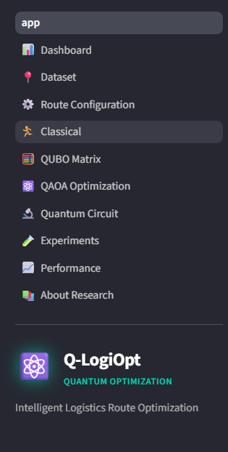
Sample Expected Dashboard

Slide 38
Main Panel
Optimized Route
↓
Route Map
↓
Cost Distribution
↓
QAOA Results
↓
Classical Comparison

Slide 39
Research Contribution
Proposed Contribution
The project investigates a new objective formulation:
Quantum Logistics Distribution Objective — QLDO
Instead of considering only expected cost, QLDO incorporates:
Expected cost
Cost variance
Feasible probability
Good-solution concentration
Research Question
Can optimizing a richer quantum output distribution objective provide useful improvements in feasibility, stability, or solution concentration compared with a standard expectation-based QAOA objective?

Slide 40
Experimental Validation
The claim should be validated through:
Benchmark datasets
Multiple random seeds
Multiple QAOA depths
Classical baselines
Parameter sweeps
Noise experiments

Slide 41
Advantages
Advantages of Q-LogiOpt
Pure software implementation
No physical quantum hardware required
Uses Qiskit Aer quantum simulation
Interactive Streamlit dashboard
Combines classical and quantum optimization
QUBO-based formulation
Anchored-depot qubit reduction
Distribution-aware QLDO objective
Visualization of routes and quantum results
Reproducible experimental framework

Slide 42
Limitations
Current Limitations
Quantum simulation becomes expensive as qubit count increases.
QAOA performance depends on parameter optimization.
Current implementation uses simulated quantum hardware.
Classical algorithms can outperform QAOA on small instances.
Real-world logistics involves additional constraints.
Noise can reduce solution quality.
QLDO requires empirical validation.
The project does not yet establish quantum advantage.
Important Research Statement
The objective of this project is to experimentally investigate quantum optimization for logistics rather than claim practical quantum advantage.

Slide 43
Future Scope
Future Improvements
1. Real Quantum Hardware
Run the optimized circuits on IBM Quantum hardware.
2. Larger Problems
Investigate decomposition and hybrid approaches for larger routing problems.
3. Vehicle Routing Problem
Extend from TSP to:
Vehicle Routing Problem (VRP)
4. Time Windows
Add:
Delivery deadlines
Customer availability
Priority constraints

Slide 44
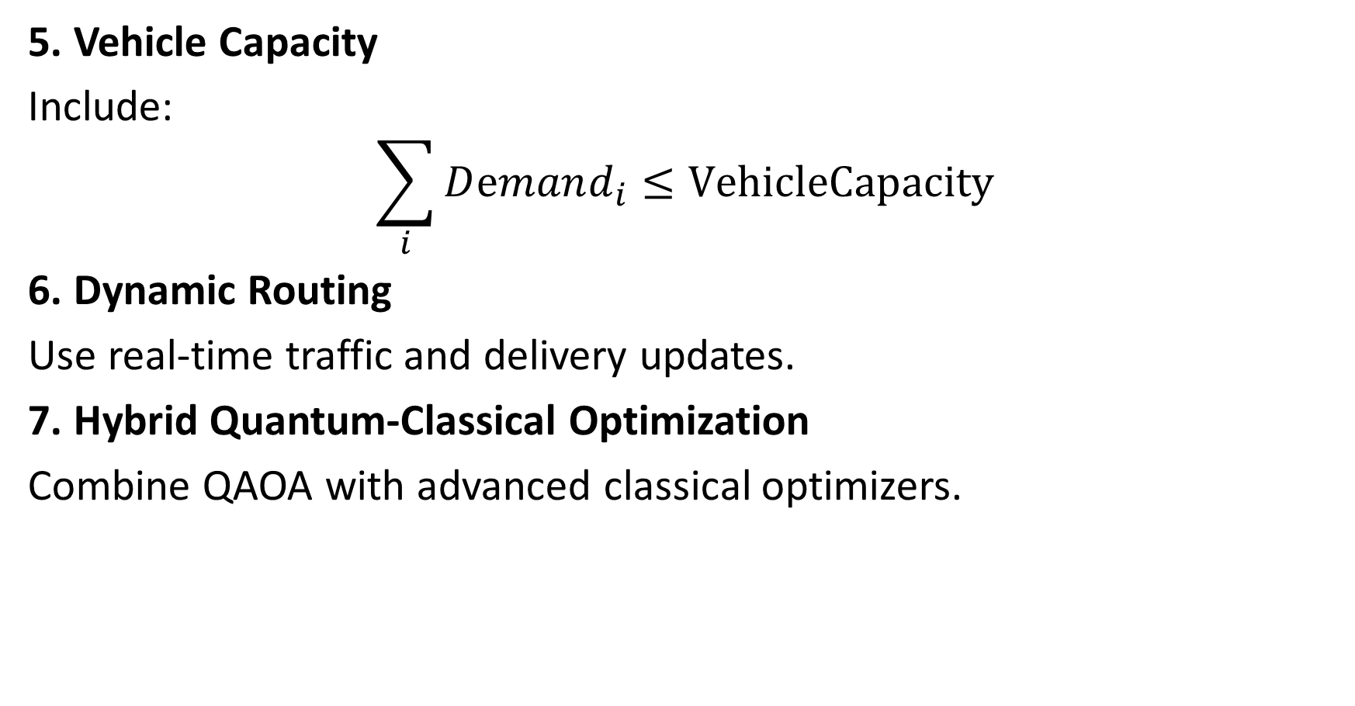
5. Vehicle Capacity
Include:
$$\sum_{i}{Dⅇmand_{i}}≤VehicleCapacity$$
6. Dynamic Routing
Use real-time traffic and delivery updates.
7. Hybrid Quantum-Classical Optimization
Combine QAOA with advanced classical optimizers.

Slide 45
Technologies Used
Programming: Python
Quantum Computing: Qiskit, Qiskit Aer, Qiskit Optimization
Optimization: QUBO
Ising Model: QAOA, COBYLA / Classical Optimizers
Classical Algorithms: Nearest Neighbor, 2-opt, Simulated Annealing
Frontend: Streamlit
Visualization: Plotly, Matplotlib
Data Processing: NumPy, Pandas, SciPy, NetworkX

Slide 46
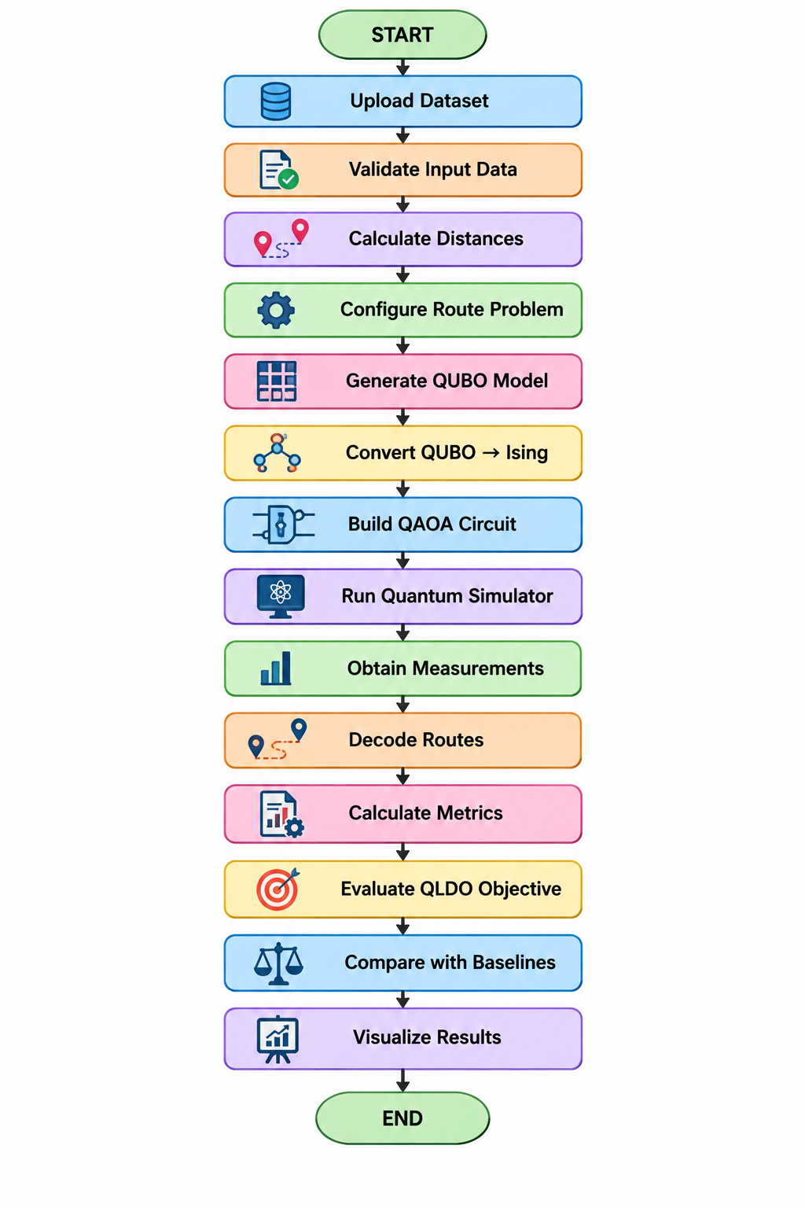
Project Workflow

Slide 47
Demonstration Workflow
Open the Streamlit application.
Upload sample_routes.csv
Display customer locations on the map
Generate the distance matrix
Run Nearest Neighbor
Run 2-opt
Generate QUBO matrix
Display Ising Hamiltonian
Configure QAOA Depth=p, Shots=N, Optimizer=COBYLA
Run QAOA using Qiskit Aer
Display quantum measurement distribution
Decode the best feasible route
Run QLDO-QAOA
Compare Classical vs Standard QAOA vs QLDO-QAOA
Display final route and performance metrices

Slide 48
Conclusion
Q-LogiOpt presents a software-based Quantum AI framework for logistics route optimization.
The system:
Models logistics routing as a combinatorial optimization problem.
Converts the problem into a QUBO.
Maps QUBO to an Ising Hamiltonian.
Uses QAOA for quantum optimization.
Executes quantum circuits through simulation.
Introduces the proposed QLDO objective.
Compares quantum optimization with classical approaches.
Provides an interactive Streamlit dashboard.
Final Statement
Q-LogiOpt provides an experimental platform for studying how quantum optimization and distribution-aware objectives can be applied to intelligent logistics routing.

Slide 49
Thank You
Thank You
Questions?
Q-LogiOpt
Quantum Approximate Optimization for Intelligent Logistics Route and Delivery Optimization
Technologies:
Python | Qiskit | QAOA | QUBO | Streamlit

