Slide 1
Q-TrafficAI
Adaptive Quantum Signal Allocation for AI-Driven Intelligent Traffic Optimization
AI Predicts → AQSA Selects → Quantum Optimizes → Traffic Improves
Technology: Python • Streamlit • Machine Learning • QUBO • QAOA • Quantum Simulation
Presented By:
Avutu Nikhil Sai Ram Reddy

Slide 2
Introduction
Urban traffic congestion is a major challenge caused by:
Rapid growth in vehicle density
Unbalanced traffic flow
Fixed-time traffic signals
Long waiting queues
Inefficient signal coordination
Difficulty handling sudden traffic changes
Traditional optimization becomes increasingly difficult as the number of intersections and signal combinations grows.

Slide 3
Our approach
Q-TrafficAI combines Artificial Intelligence and Quantum Optimization to dynamically identify critical intersections and optimize their signal configurations.
Visual:
Traffic Data
↓
AI Prediction
↓
AQSA Prioritization
↓
QUBO
↓
QAOA
↓
Optimized Signals

Slide 4
Problem statement
Existing traffic-control approaches face three major challenges:
1. Static Optimization
Fixed-time signals cannot dynamically respond to changing traffic.
2. Large Optimization Search Space
Optimizing every intersection simultaneously creates a rapidly growing search space.
For N binary variables:
Search Space = 2ᴺ
3. Quantum Resource Constraints
Current quantum simulators and NISQ-era systems have limited practical qubit budgets.
Therefore:
How can AI identify the most critical traffic-signal decisions and use quantum optimization only where it provides the greatest optimization value?

Slide 5
Existing Systems
Fixed-Time Signals
Fixed Traffic Pattern
↓
Fixed Signal Timing
Cannot adapt dynamically
Greedy Optimization
Current Traffic
↓
Local Optimization
May not consider global coordination

Slide 6
Standard QAOA
All Variables
↓
Large QUBO
↓
QAOA
Larger search space
Higher quantum resource requirements
Feasibility challenges
Key Gap
The optimization problem itself should adapt to the traffic state before entering the quantum stage.

Slide 7
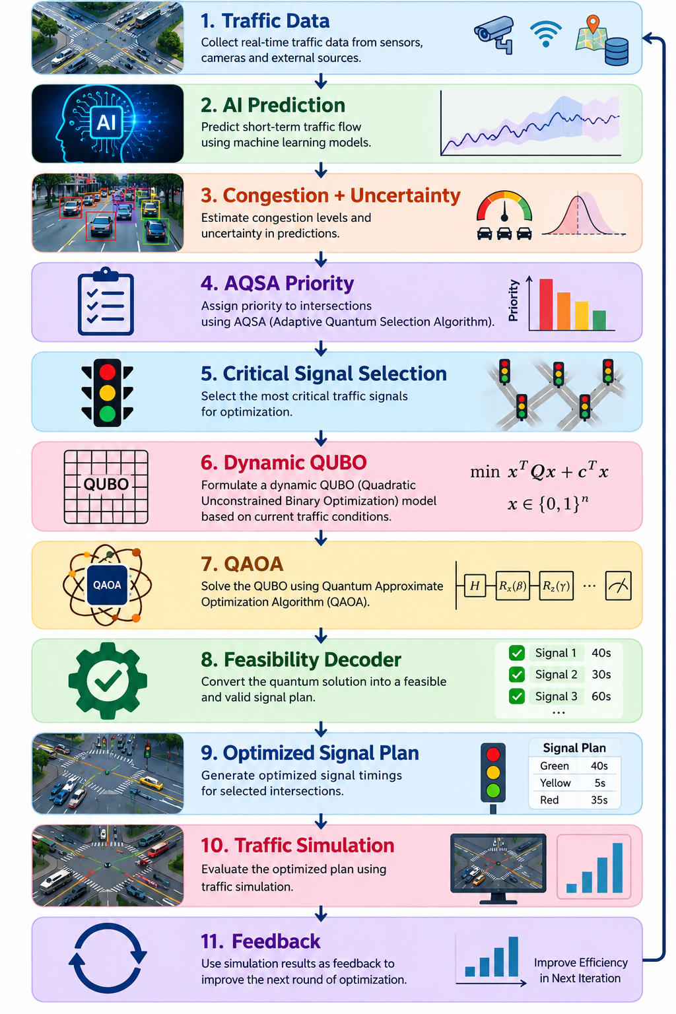
Proposed System
Our system introduces:
AQSA — Adaptive Quantum Signal Allocation
Instead of sending the complete traffic network directly to QAOA:
Core idea
AI decides where optimization is most needed before quantum optimization begins.

Slide 8
Objectives
Primary Objective
Develop a hybrid AI–quantum framework for adaptive traffic signal optimization.
Specific Objectives
Predict future traffic conditions using Machine Learning.
Estimate congestion and prediction uncertainty.
Calculate adaptive priority scores for intersections.
Select critical traffic signals under a limited qubit budget.
Dynamically construct the QUBO problem.
Optimize the QUBO using QAOA.
Decode and validate quantum solutions.
Compare AQSA against classical and standard quantum approaches.
Evaluate the system through traffic simulation.
Provide an interactive Streamlit smart-city dashboard.

Slide 9
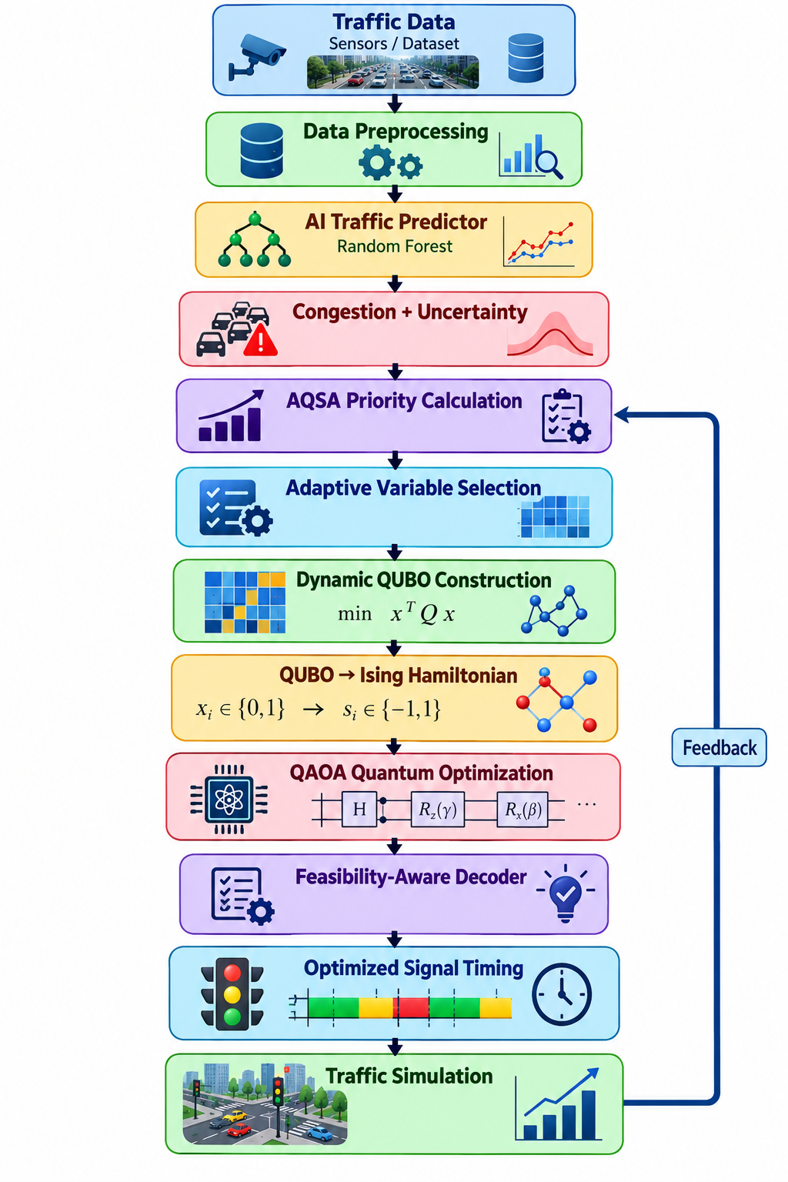
System Architecture

Slide 10
AI Traffic Prediction
Model Used
Random Forest Regressor
The implemented model uses 40 decision trees with multi-target prediction.
Predicts
Traffic Volume
Queue Length
Congestion index

Slide 11
Input Features
Time
Hour
Intersection
Vehicle Volume
Queue Length
Waiting Time
Occupancy
Density
Average Speed
Congestion Indicators
Uncertainty
The system estimates prediction uncertainty using the variation across ensemble trees.
95% confidence margin:
Prediction ± 1.96σ

Slide 12
AQSA Algorithm
Step 1 — Traffic Intelligence
Calculate:
Congestion
Queue
Waiting time
Density
Prediction uncertainty
Step 2 — Adaptive Weighting
The importance of these factors changes according to current network conditions.

Slide 13
Step 3 — Priority Score
Priorityᵢ = w₁Cᵢ + w₂Qᵢ + w₃Wᵢ + w₄Dᵢ + w₅Uᵢ
Where:
C = Congestion
Q = Queue
w = Waiting time
D = Density
U = Uncertainty
Step 4 — Variable Selection
Only high-priority intersections are mapped into the quantum problem.

Slide 14
Dynamic QUBO & QAOA
Dynamic QUBO
The objective minimizes:
Traffic Delay
+
Queue Length
+
Signal Switching Cost
+
Coordination Cost
+
Constraint Penalty

Slide 15
Mathematically:
min xᵀQx
The QUBO matrix changes according to the current traffic state.
QUBO → Ising
QUBO
↓
Binary Variables
↓
Ising Hamiltonian
↓
QAOA Circuit

Slide 16
QAOA
The project uses:
Qiskit
Qiskit Aer
COBYLA optimizer
4–8 qubit configurations
1–3 QAOA layers

Slide 17
Feasibility-Aware Solution Selection
Quantum Solution Decoding
QAOA produces multiple candidate bitstrings:
101010
101000
001010
111001
...

Slide 18
Instead of selecting only the highest-probability result:
AQSA evaluates each candidate based on:
Signal feasibility
Constraint violations
QUBO objective
Queue reduction
Waiting-time reduction
Congestion

Slide 19
Final Decision
Quantum Measurements
↓
Candidate Solutions
↓
Constraint Checking
↓
Objective Evaluation
↓
Best Feasible Configuration
↓
Traffic Signal Plan
This makes the quantum output usable as a traffic-control decision.

Slide 20
Technology Stack
Category | Technology
Programming | Python
Frontend | Streamlit
ML | Scikit-learn
ML Model | Random Forest
Quantum Framework | Qiskit
Quantum Simulator | Qiskit Aer
Optimization | SciPy / COBYLA
Data Processing | Pandas, NumPy
Visualization | Plotly
Network Modeling | NetworkX
Model Storage | Joblib
Testing | Pytest

Slide 21
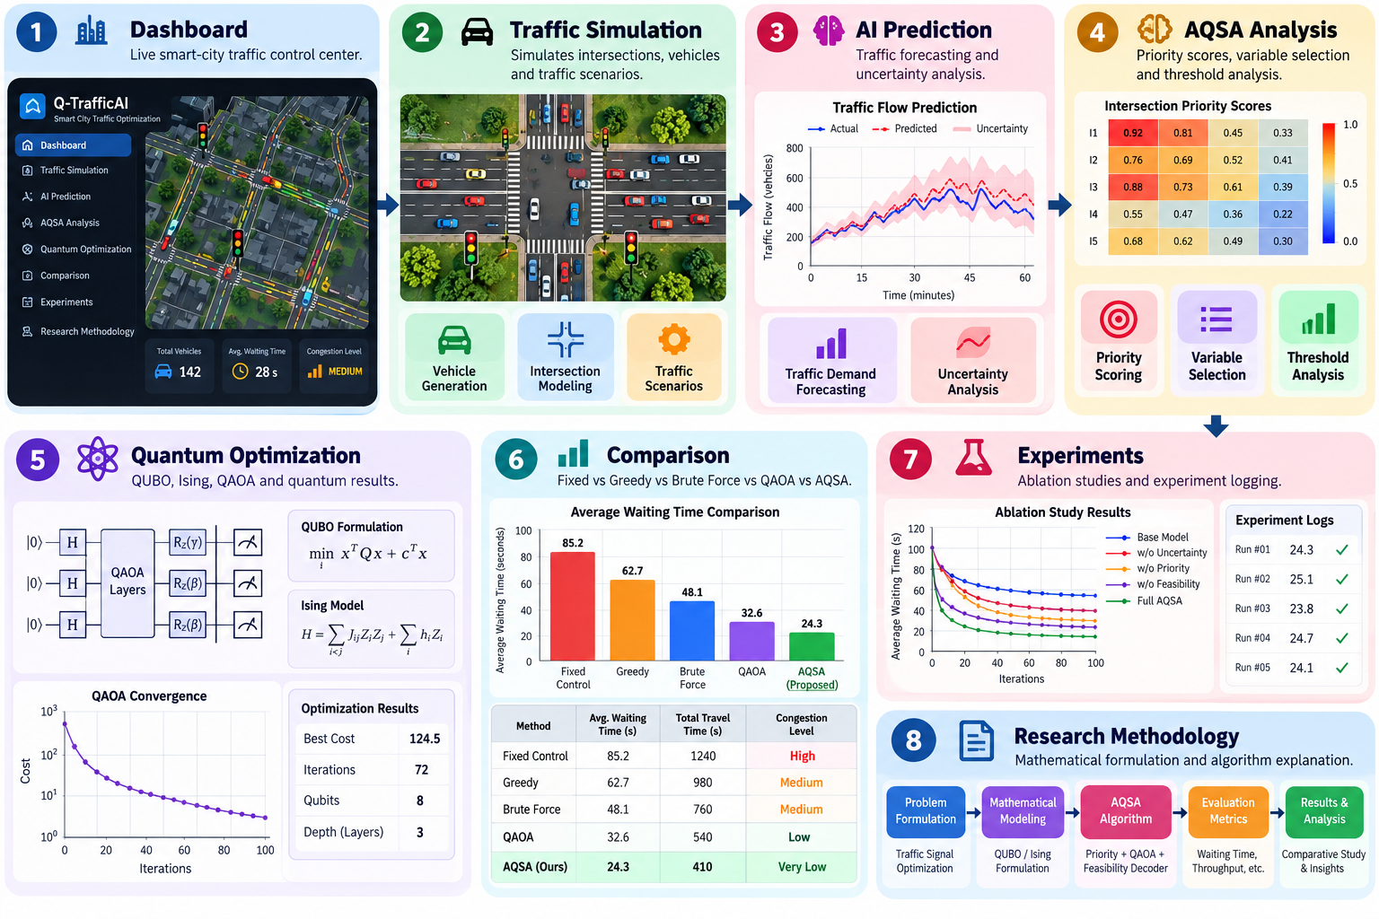
Dashboard & Modules

Slide 22
Results & Performance
Method | Avg Wait | Avg Queue | Throughput | Feasibility
Fixed-Time | 44.2 s | 86.4 | 24.5/min | 100%
Greedy | 35.8 s | 69.1 | 28.2/min | 100%
Brute Force | 26.8 s | 51.5 | 33.1/min | 100%
Standard QAOA | 41.2 s | 79.5 | 25.8/min | 48.5%
AQSA + QAOA | 27.2 s | 52.8 | 32.8/min | 100%
Key observation
In this recorded benchmark, AQSA + QAOA substantially improves over fixed-time and standard QAOA, while approaching the exact brute-force result.

Slide 23
Ablation Study
Standard QAOA
↓
AI + QAOA
↓
AI + Dynamic QUBO + QAOA
↓
AI + Variable Selection + QAOA
↓
Complete AQSA + QAOA

Slide 24
Record results
Key Message
The ablation study shows progressively improved recorded performance as the AQSA components are added.
Experiment | Avg Wait | Feasibility
Standard QAOA | 41.2 s | 52.4%
AI + QAOA | 38.1 s | 58.1%
Dynamic QUBO + QAOA | 34.0 s | 74.5%
Variable Selection + QAOA | 30.5 s | 86.2%
Complete AQSA + QAOA | 25.6 s | 100%

Slide 25
Advantages
Adaptive
Traffic conditions continuously influence optimization.
AI-Driven
Traffic prediction guides optimization decisions.
Quantum-Assisted
QAOA is used to solve the dynamically generated optimization problem.
Resource-Aware
Only important intersections are mapped to available qubits.
Closed-Loop
Traffic simulation feeds new states back into the optimization pipeline.
Explainable
The dashboard exposes priority scores, QUBO matrices, quantum results and performance metrics.
Research-Oriented
Includes benchmarks, ablation studies and threshold experiments.

Slide 26
Limitations
Current quantum experiments are performed on simulators.
Experiments are limited to small qubit counts.
Traffic data is primarily simulated/sample data.
Real-world traffic deployment requires additional validation.
Quantum simulation becomes computationally expensive as qubit count increases.
QAOA performance depends on circuit depth and parameter optimization.
The recorded benchmark does not establish quantum advantage.

Slide 27
Future Scope
Real-Time Traffic Integration
Integrate live traffic feeds and IoT sensors.
Larger Urban Networks
Scale from small simulated networks toward larger road networks.
Real Quantum Hardware
Evaluate AQSA on available quantum hardware.
Advanced AI
Explore:
LSTM
Transformers
Graph Neural Networks
Reinforcement Learning

Slide 28
Multi-Agent Traffic Optimization
Coordinate multiple intersections and traffic corridors.
Priority Vehicles
Support:
Ambulances
Fire vehicles
Public transport
Sustainability
Optimize traffic with consideration for fuel consumption and emissions.

Slide 29
Conclusion
Q-TrafficAI presents a hybrid approach combining:
Artificial Intelligence
for traffic prediction
↓
AQSA
for adaptive signal prioritization
↓
Dynamic QUBO
for traffic-specific optimization modeling
↓
QAOA
for quantum-assisted optimization
↓
Traffic Simulation
for evaluating optimized signal plans

Slide 30
Final Takeaway
Q-TrafficAI does not send the entire traffic network blindly into quantum optimization. It uses AI to identify where optimization matters most, dynamically constructs the problem, and then applies QAOA within a controlled quantum resource budget.

Slide 31


