Slide 1



BeatEye: A Music Genre
Predictor
by Madhusudhan, Deepika, Ashmit

Slide 2



Project Outcomes
1
Accurate Genre Classification
Application should be able to precisely identify the genre of the audio file given based on various aspects.
2
Scalable Genre Classification Model
The application should be able to handle a vast and diverse set of audio files. It should be able to seamlessly handle upcoming and niche genres.
3
Cross Platform Utility
The application should work across all platforms.
3
Feature Extraction From Audio Tracks
The application should be able to extract meaningful features related to the audio file like the timbre, macabre, pitch, rhythm, etc.

Slide 3




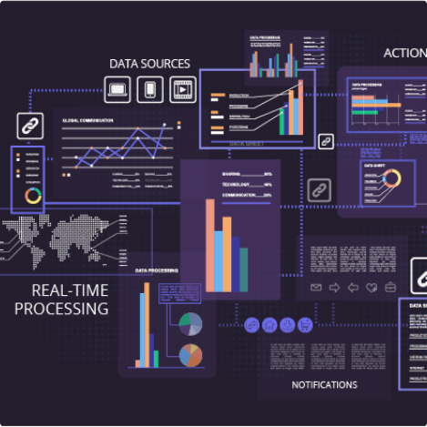
Project Feasibility Analysis
Technical
Feasibility
Economic
Feasibility
The application will leverage
Existing ML algorithms and python libraries to bring about
Innovative solutions.
Example: Librosa, TensorFlow
K Means Clustering
Services like cloud, APIs and web-frameworks will be fairly
Easy to attain at a low cost.
Time
Feasibility
Around 3 Months as the project primarily focuses on information extraction from audio files.

Slide 4
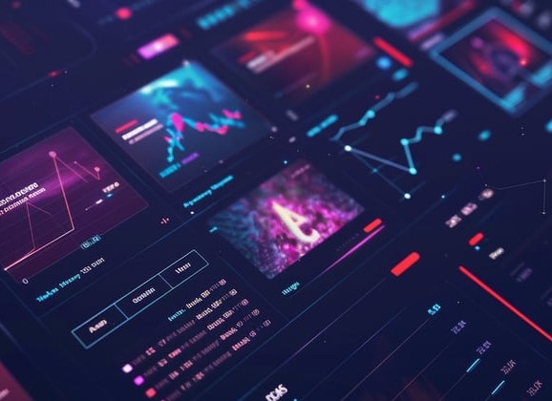
Orientation With Societal Needs
Personalized Music Recommendations
Enhanced recommendation engines for universal applications to improve customer satisfaction and engagement.
Educations
Music Theory can leverage this tool to enhance programs related to pursuit of music/music industry.
Novelty Of Project Title
Breakdown of Title
Reflection of Core Functionality
Appeals To a Versatitle Group of Users

Slide 5

Orientation With Societal Needs
Support For Music Industry
Artists can identify market dynamics and genre popularity.
Optimized Logistics
Personalized Music Recommendations
IIoT enables real-time tracking, predictive maintenance, and inventory optimization, ensuring efficient supply chain management.
Enhanced recommendation engines for universal applications to improve customer satisfaction and engagement.
Novelty Of Project Title
Breakdown of Title
Reflection of Core Functionality
Appeals To a Versatitle Group of Users

Slide 6
Orientation With Societal Needs
Optimized Logistics
Personalized Music Recommendations
Support For Music Industry
IIoT enables real-time tracking, predictive maintenance, and inventory optimization, ensuring efficient supply chain management.
Artists can identify market dynamics and genre popularity.
Enhanced recommendation engines for universal applications to improve customer satisfaction and engagement.
Novelty Of Project Title
Breakdown of Title
Reflection of Core Functionality
Appeals To a Versatitle Group of Users

Slide 7
Use Cases and Real-world Examples of IIoT in Industries
Novelty Of Project Title
Industry
Use Case
Breakdown of Title
Manufacturing
Real-time production monitoring and predictive maintenance.
Beat Represents rhythm and eye represents the project’s ability to “see” different genres.
Transportation
Connected vehicles for fleet management and route optimization.
Reflection of Core Functionality
Focuses primarily on understanding and analyzing the auditory elements of music
Energy
Smart grids for efficient energy distribution and consumption.
Appeals To a Versatitle Group of Users
Retail
Inventory tracking and supply chain optimization for seamless operations.
Resonates with every genre including contemporary, hip-pop and various sub genres.

